Slide 1


Braille for College Level STEM Courses
Christa Miller, christa.miller@vt.edu
Chelsea Cook, cook2010@vt.edu
Notes:
Christa:
Welcome everyone. If you are here to talk about how to obtain Braille for College Level STEM courses, you are in the right place. If you would like to have a copy of today’s presentation and the accompanying handout(s) you can download them from the ATIA website or directly through the mobile app on your device.
Before we being, let me get a quick idea of who is in the room.
If you are high-school student give a shout
If you are a parent give a shout
If you work in the office of disability services at your institution give a shout
If you are a transcriber give a shout
Anybody else?

Slide 2
Learning Objectives
List 10 actions that promote a positive working relationship when requesting or providing a Braille accommodation.
List 3 key questions parents and students should be prepared to ask prospective colleges about Braille accommodations.
Identify 3 publicly available resources for students to access college level Braille materials.
Notes:
Christa:
Our plan for today, is to make this session as much a conversation as possible. The learning objectives:
To identify what promotes positive working relations when requesting Braille
To list key questions students and parents should ask a prospective college
And to identify resources for obtaining Braille

Slide 3
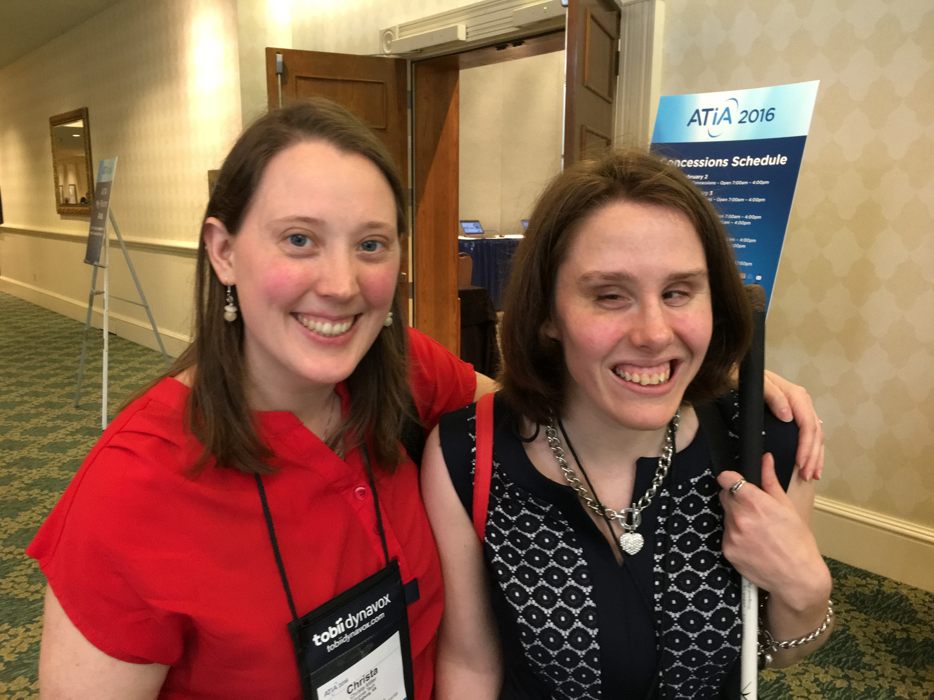
Today’s Speakers
Christa Miller christa.miller@vt.edu
  Manager of Inclusive Learning Media Services at Virginia Tech
Chelsea Cook cook2010@vt.edu
  Alumnae, Virginia Tech
Notes:
Christa:
Now I’d like to introduce today’s speakers.
On the phone we have Kelly Woodward. Kelly is on the Virginia Tech Services for Students with Disabilities staff and was the primary coordinator for all the textbook requests. As we share our experiences with all of you today, Kelly will speak to many of the questions and concerns Disability Support Staff have when trying to anticipate or create a Braille Accommodation.
Next I’d like to introduce Chelsea Cook who was the student who received the Braille. She is a wealth of knowledge regarding not only access to Braille in college, but also the many technologies that facilitate the communication and independence that is necessary to succeed in college.
Lastly, I am Christa Miller and I work for the Educational Technologies group at Virginia Tech. I had the privilege of being the Lead Braille Transcriber while Chelsea was an undergraduate, and I worked extensively with Kelly planning which textbooks would be purchased and which would be produced in-house.

Slide 4
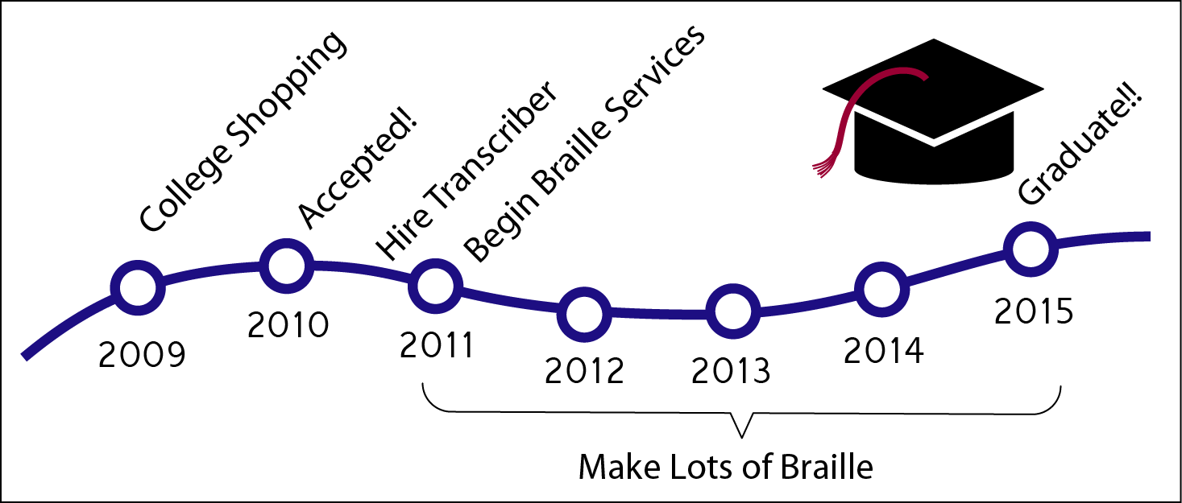
Story Background
From 2010 to 2015, the Braille team transcribed ~23 textbooks, thousands of tactile graphics, and thousands of pages of Braille
Notes:
Christa:
Although the story really starts with how Chelsea fell in love with astronomy, we only have time today to time travel to 2009 when Chelsea was a senior in high school. During questions and answers at the end we’ll be happy to talk about further experiences.
College shopping 2009
Accepted February 2010
Hire Christa August 2010
Make lots of Braille
Graduate May 2015
So in 2009 While Chelsea was busy interviewing colleges and trying to figure out who might be able to provide Braille as well as an awesome undergraduate experience, Christa was busy with her first year of graduate studies in Industrial and Systems engineering and Kelly was working through her first year with the Services for Students with Disabilities Office. Little did we know that our worlds were about to collide with one another and take us on a grand adventure.
During the five years of Chelsea’s undergraduate career we laughed a lot, cried occasionally, ranted when necessary, and cheered until our throats were soar at her graduation. We transcribed about half of her textbooks, thousands of graphics and boxes upon boxes of Braille. We’ve tried organize the lessons we learned in this presentation into a story of what the experience might look like if you could see it through all three of our perspectives from start to finish.

Slide 5

I’m a High School Senior, yay! Now what?
Shopping for Colleges
  Ask all the questions any student would ask
  Identify key questions and concerns before contacting Disability Support Staff.
    Has the school ever supported a Braille reader before?
    Does the school have any Braille equipment already?
    What monetary resources does the school have and would they be willing to commit some resources to providing Braille?
Notes:
Chelsea:
Tell us a little bit about how you found Virginia Tech and what questions were most important to you when you first approached SSD and who did you meet with.
Talk about the questions you had for the physics department. How did you set up a meeting, who was it with? Did they give you a tour of the facilities? Etc..
Additional questions/advice:
-Searching for programs of interests, Investigate the financial standing of the Institution, Be ready to interview the school
-Is the department willing to be flexible about scheduling courses and instructors to avoid scheduling the student for courses with new faculty or first time courses?
-Is the department/school flexible about 4 year graduation expectations?
-Does the institution offer a summer academy program to adjust to the campus and college lifestyle?

Slide 6
Inquiry for Braille Accommodation, now what?! (1 of 2)
Step 1: BREATHE and DON’T PANIC
Step 2: If the student has applied, but not yet received an acceptance letter…
Disability Services
Assistive Technologies
Student
Notes:
Kelly:
Disability, AT and Student.
Get a list together
What does the student have?
What do we have?

Slide 7

Inquiry for Braille Accommodation, now what?! (2 of 2)
Step 3: If you want to be prepared for a Braille student and don’t have one enrolled
  Who provides professional development on accessibility?
  Who keeps up with emerging (assistive) technologies and accessibility tools?
Notes:
Christa:
If you do not have any Braille accommodations currently, but you want to be prepared in case there are two things I would recommend. Figure out who on your campus provides resources and support for faculty to improve the accessibility of their materials. When we started this process at Tech, the fact that there was very little pre-existing support for faculty regarding accessibility training became apparent and we’ve worked hard in the interim to provide better and more readily available support and training.
Secondly, know who keeps up with emerging assistive technologies and accessibility tools. This might be someone in assistive technologies, disability support, information technologies, or a faculty member who does research on the topic. It might be someone who is not even at your institution. It’s just important to find someone who can be a resource for A significant portion of a workflow for providing Braille involves how to transfer information from print to digital formats to Braille and then reversing that process.

Slide 8

The Acceptance Letter Arrives!
Once the student has been accepted and reserved his/her spot everyone -- student, administration, support -- can switch into high gear.
Notes:
Christa:

Slide 9
What can students do before the semester to prepare?
Start assembling your village
Technology upgrades; get additional training if necessary
Make sure your individual subscription services are up-to-date
Get oriented to campus and community
Request BRF copy of textbooks
Notes:
Chelsea:
Start assembling your village
i.e., Readers, notetakers, teaching assistants
Purchase technology upgrades; get additional training if necessary
Make sure your individual subscription services are up-to-date
Get oriented to campus and location
i.e., public transportation, dining options, shopping
Request BRF copy of textbooks

Slide 10

What should the institution do to prepare for the semester?
ALL HANDS on DECK!
Start notifying members of the campus community who will have a direct influence on the student’s experience
  Provost and Office for Equality and Inclusion
  Dining Services and Residence Life
  Campus Facilities for Braille signage
  Department Heads
  IT support (if necessary)
  Campus Safety
  Hire a transcriber (if desired)
Notes:
Kelly

Slide 11
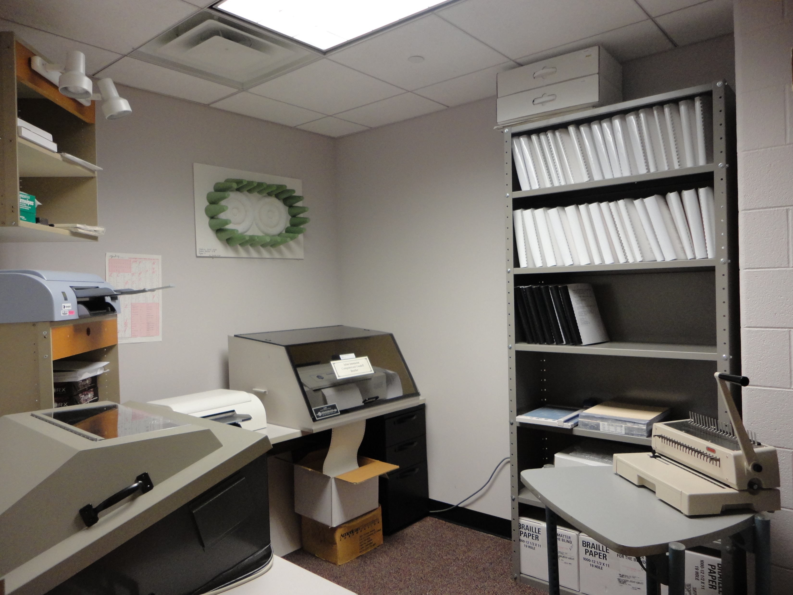
BE FLEXIBLE
In the midst of all the preparations, it is more important to prepare to be flexible
People + technology + Braille =
ANYTHING is possible
Notes:
Christa:
This may be what helped our team continue to meet deadlines better than any other tips and tricks we tried. It (was and) is impossible to anticipate all the challenges that arise when trying to get so many pieces of software, technology and people to work seamlessly.
Do what you can to prepare for what you know will happen and then prepare to be flexible for when the unexpected happens.
Embossers break, people get sick, technology glitches, wireless networks go down.

Slide 12
Alternative Text Options
The Braille textbook does not have to be the same as the in-class textbook, if the professor and department are willing. Examples:
  Cross-reference equivalent texts
  Use previous edition
  Choose an alternative book in a format that is easier to transcribe
  Purchase either text or graphics and produce the remainder in-house
Note: For STEM, Braille is preferable to audio
Notes:
Christa:
Math Department Example
Might end up with a better book for everyone

Slide 13
How much does this cost?
Available in Braille
Around $10,000 for one book
Not available in Braille
$25,000 to $50,000
Notes:
Image: One image of a bag of money alone. One image of three bags of money grouped together.
How much does it cost to purchase a Braille book? If the book is already available from ATPC or AMAC then the price for a book usually starts at $10,000 and goes up. We are paying for the time and resources needed for the vendor to use the BRF (electronic Braille format) file they have in inventory and print the many volumes needed for the book.
If we use a book not already available in Braille, then the cost is estimated to start at $25,000. We are paying for the vendor to transcribe the textbook from scratch, create the tactile graphics, emboss the components and bind the volumes. For example one book we needed that was not already available in a Braille format was quoted at $34,000.
The amount of money needed to purchase a book not already available in Braille requires Disability Services to include the provost’s office in the process. The instructor and department will be asked to confirm and explain why this purchase is necessary.

Slide 14


Locating Textbooks
Plan 1 yr. to 6 mo. ahead
Start with the Access Text Network and campus library to find a copy of the book
Check to see if the book already exists in Braille
  Listservs
  (i.e., ATHENS, AHEAD, etc.)
  Louis Database from APH
Look for a digital copy
  Bookshare.org
  (.BRF, DAISY)
  LearningAlly (audio)
Notes:
Christa:
A year ahead sounds like a lot, but when it comes down to having someone transcribe a whole book even half a book a year can just fly by.
Don’t reinvent the wheel if you don’t have to

Slide 15
Additional Resources
Know who the external resources are:
  Bookshare (Bookshare Home)
  Louis Database (Louis Database Home)
  AMAC Accessibility and Research Center (AMAC Home)
  ATPC Alternative Text Production Center (ATPC Home)
  tBase Communications (tBase Home)
  National Braille Press (NBP Catalog)
Any transcribers who have previously worked with the student (National Braille Assoc.)
Notes:
Christa
Louis has things that are more reading heavy

Slide 16



The Daily Grind: for the institution
Faculty training and orientation
Textbook purchasing and production decisions
Instructional materials requests and production
Receive feedback and adapt
Notes:
Provide LaTeX source code
Use email over LMS notifications
Text messages
Christa:
Once classes are chosen and textbooks are in production it’s time to make some decision about day to day communications
In our case, I took the lead on this activity. I did either group or individual trainings on the lead times, file formats and coding conventions necessary for transcribing ah-hoc materials. For most classes we transcribed a set of lecture notes, homework problems, homework solutions, exams and exam solutions. Occasionally, there were some quizzes thrown in as well. So a lot of material times 4 to 5 classes with weekly deadlines made for a very busy Braille team.
I need to state, and I think Chelsea and Kelly would agree, that even though it would be nice for a Braille reader to receive everything in Braille it is not practical and sometimes not necessary. For example, pre-class quizzes that are concept based rather than computational could be sent and submitted via email. So if the institution decides to produce some Braille or a lot of Braille in-house that does not mean the school will be producing every single document a student uses in Braille. Just thinking about the amount of supplemental reading material and video watching professors assign is enough to show the impracticality of producing everything in Braille.
In addition to training faculty on how and when to make Braille requests there are two other important issues to communicate.
From the Student, should come information about in-classroom needs like people keeping backpacks off the floor, not leaving hand written notes for room changes, etc. Chelsea would you like to comment on how you communicated this kind of information to faculty?
And from the Disability Support Office (in our case SSD) should come the official accommodation letter and answers to any questions about legal obligations
Lastly we all asked the faculty to avoid asking the student questions about Braille, not surprisingly our faculty were very curious about the Braille volumes, how they were made, that they were double sided, that it was possible to create tactile graphics, etc. And although these are great questions and they help faculty relate to the student considering how much more time it takes a Braille student to get material in Braille, do lab reports/homework/take home tests/etc., it is better not to spend the student’s time asking questions, when the student is the one who needs answers.

Slide 17

The Daily Grind: for the student
It’s up to the student to plan ahead and stay organized
  Get class notes ahead of time
  Add a 3 credit hours to your course load
  for managing the village
  Try not to worry too much about how many years it takes to graduate
  Have fun and be silly
Notes:
Chelsea:

Slide 18

The Daily Grind: for disability services
Reassess accommodations as needed
Focus on equivalent experience versus equal
  i.e., focus on specific learning objectives
Maintain open lines of communication with student, faculty and transcribers
Notes:
Christa:
There is no once and done about a Braille accommodation. Each semester brings a new set of challenges and often technology requirements. Specific accommodations relating to time, alternative access and communication methods should be reassess on an ongoing basis.
To determine appropriate changes, work with the instructor to focus on specific learning objectives. This will allow the entire village to develop a collaborative solution where in-accessible technology does not become a road block.

Slide 19
Basic Steps Summary
Choose what books can be purchased ahead and from whom
Orient faculty to the communication adjustments necessary for accommodating a Braille reader (every semester)
Set-up a workflow for internal Braille transcription, if desired
Notes:
Christa? Kelly

Slide 20
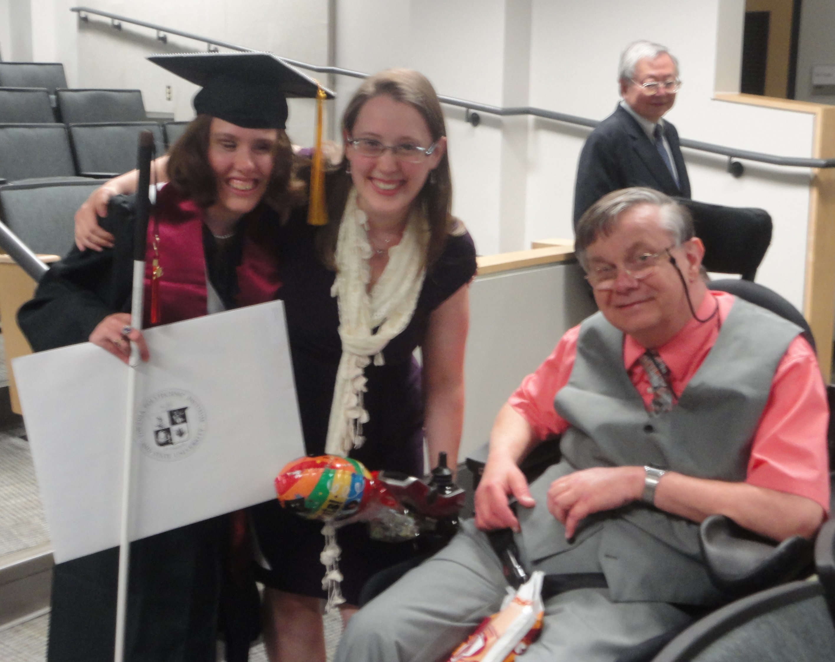
The Road to Graduation
Along the way keep your goal in mind i.e.,
  Graduation
  Job Success
  Life long dreams
Notes:
Christa/Chelsea
The road to graduation is filled with easy days and hard days for all students. So no matter what happens and what challenges you may face along the way keep your dreams and your goals in mind.

Slide 21
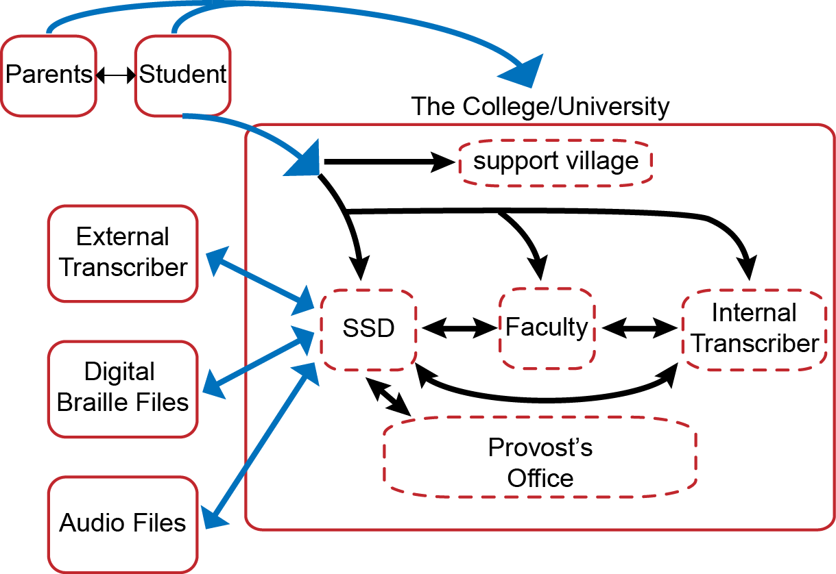
The Support Network (AKA Village)
Student
Disability Support
Assistive Tech.
Transcriber(s)
Professors
Teaching Assistants
Readers
Reverse transcribers
University Community
Notes:
Christa:
So now we’ve given all of you an outline of how organized ourselves. Here is a generalized graphical representation.
The parent(s) and the student contact schools, interview departments, send out applications, etc.
Once the student is accepted and enrolls, the parent involvement drops out to a great extent. The disability laws for adults are different than for minors and once a student turns 18 a school cannot divulge any information to a parent without the written authorization of the student
Within the institution someone on campus, probably the provost’s office, will provide financial resources.
The disability office will handle the official accommodation letter and supporting documentation
And then depending on if the school decides to produce any Braille in house
The student, the disability office, the faculty and the transcriber(s) will work together to organize textbook requests, Brailled materials, and troubleshoot issues
In conjunction to that, it is up to the student to manage whatever other support is needed/desired: readers, reverse transcribers, attending office hours, scheduling additional time with teaching assistants, etc.

Slide 22

Troubleshooting: Freshman Year
Notes:
Christa: Now, lest you all think that we at Virginia Tech found the perfect solution we are going to transition into some Question and Answer time first on specific topics and then on any remaining questions.
To start us off, Chelsea can you tell us one or two stories about what life on campus was like and perhaps one challenge that you had to wrangle.
*Dr. Baker and Understanding Space
*Dorm room router
Chelsea:
Christa: Are there additional questions for Chelsea regarding Campus Life?

Slide 23

Troubleshooting: Textbooks
Notes:
Christa: Next Kelly can you tell us one or two stories about what challenges you faced with textbooks either with publishers or Braille houses and the solutions you came up with.
Kelly:
Christa: Are there additional questions for Kelly regarding textbooks?

Slide 24

Troubleshooting: Ad-hoc Braille
Notes:
Christa: Lastly about Braille, two challenges I faced with providing Braille and how I overcame them
-balancing my skills
-training faculty and creating mutual respect
Are there additional questions regarding transcription?

Slide 25

Final Questions
Christa Miller christa.miller@vt.edu
Chelsea Cook cook2010@vt.edu
Notes:
Last call for questions

