Slide 1
Section 508 Refresh
Bill Curtis-Davidson
Senior Director, Strategic Consulting Services
Accessing Higher Ground
November 17, 2017

Slide 2
Topics
Section 508 Refresh
508 Refresh Background & Themes
Overview of Standards
Hardware & Software Standards
Application of WCAG 2.0
Functional Performance Criteria
Documentation & Support Services Standards
VPAT 2.0 and FAR Updates
Questions & Answers

Slide 3
508 Refresh Background & Themes

Slide 4
Topics (cont’d)
508 Refresh Background & Themes
Requires Information & Communication Technology (ICT) developed, purchased, used, and maintained by the Federal government to be accessible to people with disabilities
The United States Access Board issues the standards
Standards Adopted as a best practice for procurement by many US public sector organizations (states)
Standards sometimes applied to programs using Federal funds (Section 504) HHS/CMS, Education, etc.

Slide 5
Section 508 Covered Technology
508 Refresh Background & Themes
Includes I/T and any equipment or interconnected system or subsystem of equipment, that is used in the creation, conversion, or duplication of data or information.
Examples:
Telecommunications products – e.g. phones
Information kiosks and transaction machines
Websites, web applications and software
Electronic documents
Multimedia
Office equipment such as copiers and fax machines

Slide 6
Harmonization – 508 and 255
508 Refresh Background & Themes
The ICT Standards and Guidelines rule updates and harmonizes Section 508 standards and Section 255 Telecommunication Accessibility Guidelines.

Slide 7
Harmonization – Global Alignment
508 Refresh Background & Themes
Focus on voluntary international consensus standards for core technical requirements
Idea #1: One global accessibility standard
Idea #2: Bigger accessibility market = better, more accessible solutions
Harmonize with other web and electronic content standards (Australia, New Zealand, Canada, Japan, Germany, France)
Harmonize with international standards such as the European Union’s EN 301-549 standard for public procurement of ICT
Ten referenced standards

Slide 8
508 Refresh General Themes
508 Refresh Background & Themes
Use consensus based standards when possible
Normalize to WCAG 2.0 as base standard for web, electronic content, software
Harmonize with other international standards and regulations
Generally bring the standard up-to-date with the modern era
Focus on functional use profile v. product type
Functional Performance Criteria updated:
New cognitive Functional Performance Criteria added
Clarified scope of functional performance criteria
New requirements and coverage definitions for:
Electronic content, AT interoperability, Authoring tools, Hardware closed product functionality and front-facing access

Slide 9
508 Refresh Timeline
508 Refresh Background & Themes
Final rule approved by Access Board and Office of Management and Budget (OMB)
Published in the Federal Register on Jan 18, 2017
Revised standards in effective as of Mar 21, 2017
Compliance w/ Section 255 Guidelines not required until/if adopted by FCC
Compliance w/ Section 508 standards is Jan 18, 2018
Federal Acquisition Regulations (FAR) to be updated
Proposal out Oct 2017 with 60 day comment period
Will set date for procurement requirements by Federal agencies’
GSA to provide guidance on GPAT 2.0 and other questions
JANUARY 18

Slide 10
Overview of 508 Refresh Standards

Slide 11
508 Refresh Structure
Overview of the 508 Refresh Standards
Structure
Scoping Requirements (Reference Electronic Content, Documents, and Software)
Functional Performance Criteria
Hardware (general, closed functionality, 2-way voice, etc.)
Software (includes Web Applications)
Support Documentation and Services
Referenced Standards
Requirements of all relevant technology apply
Example: Mobile phone contains HW, SW, content all in one product
Overlap of product requirements point of confusion in current standards
Validate a system based on all relevant technical requirements
Clarify the set of standards that will apply to a system

Slide 12
What is Not Included in 508 Refresh
Overview of the 508 Refresh Standards
Real-time text (RTT) requirement reserved for later
FCC has adopted RTT allowance for wireless providers using VOIP
FCC has requested information on loosening need for TTY compatibility as RTT is more widely adopted
TTY support is not in Section 508 refresh
In transition with RTT
TTY compatibility covered by Section 255 guidelines
Under 255 TTY compatibility is still required w/ support for emergency call
Reference to PDF/UA-1 as a way to meet revised standards for PDF is not included in final rule
PDF/UA may still be useful in assessing WCAG 2.0 conformance & may be required for authoring tools

Slide 13
508 Refresh Qualifying Exceptions
Overview of the 508 Refresh Standards
Legacy ICT – Any component or portion of existing ICT that complies with original Section 508 standards and has not been altered on or after January 18, 2018
National Security Systems – ICT operated by an agency that is part of a national security system
Federal Contracts – ICT acquired by contractor incidental to a contract
ICT Functions Located in Maintenance or Monitoring Spaces – status indicators or operable parts for ICT functions located in spaces frequented only by service personnel for repair, maintenance or occasional monitoring of equipment
Undue Burden or Fundamental Alteration – conformance is only required to the degree that it does not impose an undue burden, or result in a fundamental alteration in the nature of the ICT

Slide 14
508 Refresh Equivalent Facilitation
Overview of the 508 Refresh Standards
E101.2 Equivalent Facilitation. The use of an alternative design or technology that results in substantially equivalent or greater accessibility and usability by individuals with disabilities than would be provided by conformance to one or more of the requirements in Chapters 4 and 5 of the Revised 508 Standards is permitted.
The functional performance criteria in Chapter 3 shall be used to determine whether substantially equivalent or greater accessibility and usability is provided to individuals with disabilities.

Slide 15
Recent Access Board Guidance
Overview of the 508 Refresh Standards
Used, maintained, or procured unaltered & compliant before January 18, 2018 falls under the safe harbor for Section 508
Safe harbor applies on a component/element basis
Altered includes change of UI, data, or interoperability
Security patch for web site that doesn’t change UI/data = not altered
Previously non-compliant ICT not covered under Safe Harbor
ICT under development but not yet used by January 18, 2018 does not fall under Safe harbor
Individual agencies still have flexibility in implementing and regulating revised Section 508 standard under Rehab Act
Current Section 508 standards still relevant – even after January 18, 2018 for evaluating existing non-updated ICT

Slide 16
Hardware Standards
Overview of the 508 Refresh Standards
Closed Products standards updated
Requirements now refer to “closed functionality” instead of “closed products”
Requires speech output for ICT containing a display screen
Requires Braille instructions for activating speech output
Provides font, height and contrast requirements for characters on display screens and variable message signs
Requires equitable levels of privacy for all individuals
New contrast, key layout, ticket, fare card and keycard orientation, and forward and side reach requirements for operable parts
New wideband speech (HD voice) two-way communication requirement for IP-based networks
Captioning and audio description requirements have been updated for digital media and tuners

Slide 17
Software Standards
Overview of the 508 Refresh Standards
All software must follow WCAG 2.0 A and AA success criteria and conformance requirements
Chapter 5 of the rules contain additional requirements for software:
Non-Web Software (applications that have access to platform-level services)
Software Platforms and Operating Systems
Authoring Tools (software used in the creation of content or software)

Slide 18
Software Standards - Interoperability
Overview of the 508 Refresh Standards
ICT must be interoperable or compatible with documented features of assistive technology and accessibility features
Applies to software, tools, and platforms
Not applicable to web apps – WCAG 2.0 safe harbor
Would apply to mobile apps
Would apply to mobile hybrid apps
General focus: use operating system APIs and standard system accessibility functions when

Slide 19
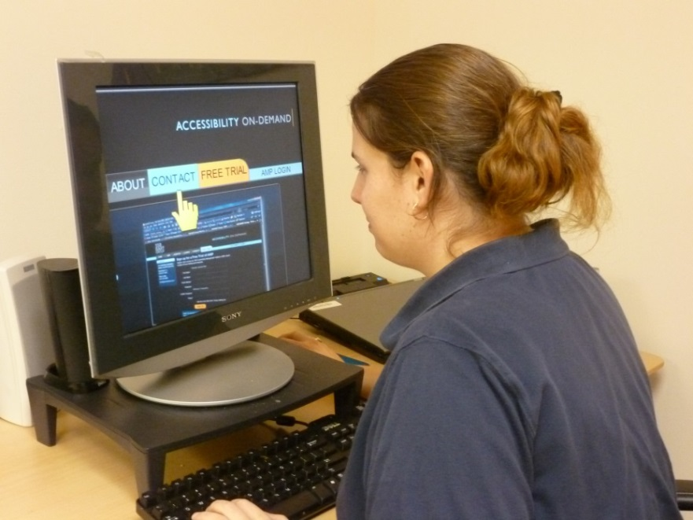
Electronic Docs: Public-Facing
Overview of the 508 Refresh Standards
Arguably covered under the current standards but interpretations vary
All public facing content covered
Internal “official agency business” covered
Content broadly defined – includes agency websites, blog posts, social media sites, e-mails and the like
Official content posted on non-agency URL seems to be covered
Alternative can be provided for inaccessible third party content

Slide 20
Electronic Docs: Not Public-Facing
Overview of the 508 Refresh Standards
“Agency Official Communication” includes the following:
An emergency notification;
An initial or final decision adjudicating an admin claim or proceeding;
An internal or external program or policy announcement;
A notice of benefits, program eligibility, employment opportunity, or personnel action;
A formal acknowledgement or receipt;
A survey questionnaire;
A template or form; or
Educational or training materials.
Intranet web content designed
Narrow archival exception – can’t be publicly available

Slide 21
Electronic Docs: Not Public-Facing (Cont’d)
Overview of the 508 Refresh Standards
WCAG 2.0 A and AA
Authoring tools also covered
If PDF export has option for PDF 1.7 -- PDF/UA must be supported.
A system that can generate covered content needs to support the generation of accessible content

Slide 22
Application of WCAG 2.0
Overview of the 508 Refresh Standards
Key take-away for electronic content, web, software, documents: Use WCAG 2.0 Level A and AA
Also includes WCAG Conformance Requirements
Compliance-Level, Full-Page, Complete process, Accessibility Supported, and Non-Interference (guidance on alternatives)
Applies to non-web docs & software (desktop or mobile) through lens of Guidance for applying WCAG to non-web ICT document
4 primary exceptions (multiple ways, bypass blocks, consistent ID, & consistent navigation), some differences e.g set of documents rather than set of pages
Keyboard interface support is required even for mobile
Don’t actually have to make a formal WCAG conformance claim
Examine sufficient techniques and documented failure

Slide 23
Variances: Legacy 508 Web / WCAG
Overview of the 508 Refresh Standards
Section 508 1194.22 Web | WCAG 2.0 Level A / AA | Comments
Twice per second flashing limit – no exception for size. Allows for flashing in the range from 56-59 times per seconds. | WCAG’s is 3 times per second and also allows for small areas to contain flashing content. | Practically equivalent
Require that documents are readable without associated style sheets | Only requires that content is in a meaningful sequence | More flexibility
Requires that embedded and linked non-HTML media provide a link to an accessible plug-in | Indicates that the technology relied upon for conformance are accessibility supported. | Most agencies will likely still be providing links to plug-ins, if not on every page, on some general page.

Slide 24
Variances: Legacy 508 Web / WCAG (Cont’d)
Overview of the 508 Refresh Standards
Section 508 1194.22 Web | WCAG 2.0 Level A / AA | Comments
Requires that alternative pages are not used unless they can be made accessible | WCAG allows for alternative pages to be used, but has no bar to determine when they are not allowed | Unclear how strictly this was followed previously. Could be addressed by agency requirements.
In our experience, most US Federal Agencies require that link text is meaningful when taken out of context, even though it’s not explicitly required in Section 508. | WCAG Level AA allows for link text to be understand in context. Out of context is a WCAG Level AAA requirement. | Some agencies will likely want to address this in their checklists.

Slide 25
Functional Perf Criteria: Applicability
Overview of the 508 Refresh Standards
Functional performance requirements only apply in one of the following situations:
A technology standard/guideline does not exist to address the situation
As an equivalent manner to meet the standards when a technical standard cannot be met
Theoretically a safe harbor for products that are technically compliant but not usable by people with disabilities
Practically unlikely to be the case
Remaining functional performance criteria tweaked for clarity
Example: With Limited Vision. Where a visual mode of operation is provided, ICT shall provide at least one mode of operation that enables users to make use of limited vision.

Slide 26
New Functional Perf Criteria in Refresh
Overview of the 508 Refresh Standards
Without Perception of Color. Where a visual mode of operation is provided, ICT shall provide at least one visual mode of operation that does not require user perception of color.
With Limited Manipulation. Where a manual mode of operation is provided, ICT shall provide at least one mode of operation that does not require fine motor control or simultaneous manual operations.
With Limited Reach and Strength. Where a manual mode of operation is provided, ICT shall provide at least one mode of operation that is operable with limited reach and limited strength.
With Limited Language, Cognitive, and Learning Abilities. ICT shall provide features making its use by individuals with limited cognitive, language, and learning abilities simpler and easier

Slide 27
Documentation & Support Services
Overview of the 508 Refresh Standards
Product supporting documentation - notably product documentation - must now clearly conform to WCAG 2.0 A & AA requirements
Exceptions for 4 WCAG SC – bypass blocks, multiple ways, consistent identification and consistent navigation
Includes web based service and support
Provide alternative formats for individuals that are blind or low vision on request
Only applies when non-electronic documentation is provided.
Provide overview of accessibility and compatibility features
Support services support the communication needs of people with disabilities

Slide 28
VPAT & FAR Updates

Slide 29
VPAT® 2.0
VPAT & FAR Updates
Final VPAT® 2.0 was published by ITIC in October 2017
Includes 508 Refresh, WCAG 2.0, EN301-549
Includes references between shared standards
Provides updated guidance on completing document
Other non-federal public sector people seeking open VPAT® type document as well
GSA publishes GPATs (General Product Accessibility Templates) that:
Clarify which 508 standards are applicable for different product functions based on product type; Uses VPAT format.
Will likely be updated later this year; focus just on 508 Refresh Standards.

Slide 30
Likely Federal Agencies’ Approach
VPAT & FAR Updates
Update checklists (document, web, software)
Most agencies have own checklist breaking down what Standards mean:
Examples: VA, DHS, HHS, SSA
Many checklists already incorporated some WCAG 2.0 SC
Some agencies apply current software standards to web, others do not
Federal baseline includes 1194.21(a), (c), (h)
Simplifies approach; Same standards applied across docs, web, software
Checklist may be used in procurement process
For most non-hardware, non-authoring tool content, the focus will be support for WCAG 2.0 A/AA and conformance requirements

Slide 31
Questions & Answers

Slide 32
Thank You and Contact
Section 508 Refresh
Contact Us
Bill Curtis-Davidson
Senior Director, Strategic Consulting Services
www.levelaccess.com info@levelaccess.com
(800) 889-9659
bill.curtis-davidson@levelaccess.com
Follow Us
@LevelAccessA11y
Level-Access
Level Access
Level Access Blog

