Slide 1
INTRO TO AUDIO DESCRIPTION
Lily Bond
3Play Media
lily@3playmedia.com
www.3playmedia.com
@3playmedia
ACCESSING HIGHER GROUND 2017

Slide 2
What will we cover?
WHAT is audio description?
HOW do you create audio description?
WHERE do you publish audio description?
WHY should you describe?
WHO is 3Play Media?
Q&A

Slide 3
WHAT IS AUDIO DESCRIPTION?
Notes:
Secondary audio track that narrates the relevant visual information contained in a video
Usually represented by an AD icon

Slide 4
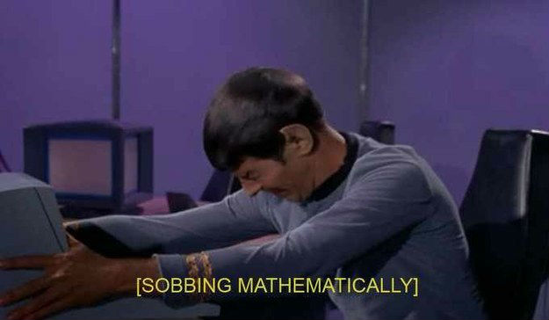
“Spock shakes the computer.”
NARRATES RELEVANT VISUAL INFORMATION
Notes:
Audio description would vocalize the visual; captions would textualize the audio.
Similar to captions, which people are much more familiar with, which transcribes the relevant auditory information. Captions assume a viewer can’t hear; audio description assumes a viewer can’t see.
Difficult because in many cases, there is very little space to describe, so it is important to prioritize key visual information.
For those who have never heard description before, it’s often described as similar to the sports announcer in a baseball game, narrating the plays over the radio.

Slide 5
UNDESCRIBED VS. DESCRIBED
Notes:
EXAMPLE – without audio description, then with audio description.
WITHOUT DESCRIPTION: https://www.youtube.com/watch?v=-WdC4DaYIeQ
WITH DESCRIPTION: https://www.youtube.com/watch?v=O7j4_aP8dWA
Close your eyes and see how much you can understand w/o description.

Slide 6
EXTENDED AD
Notes:
What is extended AD?
Example: http://www.3playmedia.com/how-it-works/how-to-guides/audio-description/audio-description-examples/

Slide 7
HOW
DO YOU
CREATE DESCRIPTION?

Slide 8
A FEW WAYS …
Narrate visuals at the time of recording
Create a text description or WebVTT file
Record voiced description & merge with source audio
Outsource for professional description
Notes:
DIY methods – time consuming and expensive. For lecture or educational content, you can sometimes:
Have professors or narrators narrate the visual information on their slides or in the background as they’re happening. Easiest way to cut costs.
Create a text-only description; note that this will lose much of the cinematic detail for the viewer
Create a text-only description that *fits into the spaces.* If using able player, set timings and add as a webvtt track
Once you’ve created a text description, if you have good recording equipment and video editing software, you can record voice acted descriptions and merge it with your source audio, then output a second video with description.
Outsource. Note that traditional vendors charge between $15-$75 per minute.

Slide 9
QUALITY STANDARDS
Notes:
Important to follow best practices for description quality. What is most important to describe? How do you describe credits, or text on screen?
What to describe
When to describe
How to describe (things like text on screen, credits)
DCMP description key is great.

Slide 10
WHERE DO YOU PUBLISH DESCRIPTION?
Notes:
Unlike captions, description is not supported by most video players

Slide 11
Mobile/Tablet
Online Video
TV, Movie Theater, Airplane, Live Theater …
Notes:
Has been around since the late 1970s, but with more broad adoption in the 90s. 1998 (508 Rehabilitation Act for federal programs) and 1999 (Notice of Proposed Rule Making from the FCC) saw audio description becoming more of a requirement for broadcast and online video.
Now being applied to dozens of devices – if supported. Making description more widely available for online video is slightly dependent on video player & browser support.
Description is being used on all devices, and more and more for online video. Also used for live theater, at movie theaters, on in-filght entertainment, and for broadcast TV.

Slide 12
The short list (of players that natively support AD)
Able Player
OzPlayer
Brightcove

Slide 13
Ways to publish description:
Second video with description
Secondary audio track
WebVTT track
Text-only merged transcript
Audio description plugin
Notes:
Most players don’t support description, so often the only way to publish is to link to a second version of your video with description (like the Frozen trailer)
A few players support a secondary audio track, where users can select an AD audio for the same video source. Some support this by swapping in a new source video with description.
HTML5 natively supports a WebVTT description track (just like with captions); however, browser support and player support are lacking. Must be read by a screen reader. Right now, Able player is the only one that reliably supports this.
Text-only merged transcript & description; good for deaf/blind viewers, but not time synchronized. Would be like providing a transcript only for a video.
We’ve developed a keyboard & screen-reader accessible audio description plugin, which allows your description to play with a video player without having to republish the video.

Slide 14
WHY SHOULD YOU DESCRIBE?
Notes:
Many reasons outside of accessibility

Slide 15
BENEFITS OF AUDIO DESCRIPTION
Accessibility
> Estimated 23.7 million Americans (10%) have trouble seeing.
Autism
> Helps to better understand emotional and social cues
Flexibility
> View videos in eyes-free environments
Language Development
> Listening is a key step in learning language.
Auditory Learners
> 20-30% of students retain information best through sound.
Inattentional Blindness
> Phenomena where you fail to recognize visuals “in plain sight.”
Legal Requirements
> May be required by law
Notes:
1) Accessibility: 2015 National Health Interview Survey found that 23.7 million Americans (10%) have trouble seeing.
2) Autism: individuals on the autistic spectrum find that audio description helps better understand emotional and social cues only demonstrated through actions or facial expressions. Answers questions like “what does that smile mean?”
3) Flexibility: view videos in eyes-free environments (cooking, in the car, etc.)
4) Language development: listening is a key step in learning language and associating it with appropriate actions and behaviors.
5) Auditory learners: research into how the brain processes information reveals that there are two channels: auditory and visual. 20-30% of students say they retain information best through sound.
6) Inattentional blindness is the phenomena where you fail to recognize visual information in plain sight. We often have instances where we missed a key visual element in a video or image until it was pointed out to us. Audio description can help point those key visuals out to all viewers.
7) May be required by law.

Slide 16
Rehabilitation Act of 1973
Section 504: Broad anti-discrimination law
Section 508: Electronic & information technology
Section 508 Refresh: WCAG 2.0 requirements
Notes:
1973
Section 504: anti-discrimination law that requires equal access for individuals with disabilities. Applies to federal & federally funded programs.
Section 508: introduced in 1998 to require federal communications and information technology to be accessible. Apples to federal programs, but often applied to federally funded programs through state & organization laws.
Audio description is a requirement of Section 508, which was just refreshed to include language from the WCAG 2.0 Level AA guidelines.

Slide 17
WCAG 2.0 Level AA
Requires audio description for all pre-recorded, synchronized media
Success criteria
Notes:
WCAG 2.0 is the international standard for web accessibility, which, until the 508 refresh, was not written into any US federal accessibility laws.
AD requirements: required for all pre-recorded, synchronized media
Provides success criteria for how to meet these requirements. Allows for no description if all visual information is articulated in the audio of the source video.

Slide 18
Americans with Disabilities Act (1990)
Title II: Public Entities
Title III: Places of Public Accommodation
ADA Title III Lawsuits
Notes:
1990
5 sections
Title II: public entities; Title III: public accommodations (extends to private sector)
"Places of public accommodation" – what constitutes this?
Tested against online businesses
Refresh coming?

Slide 19
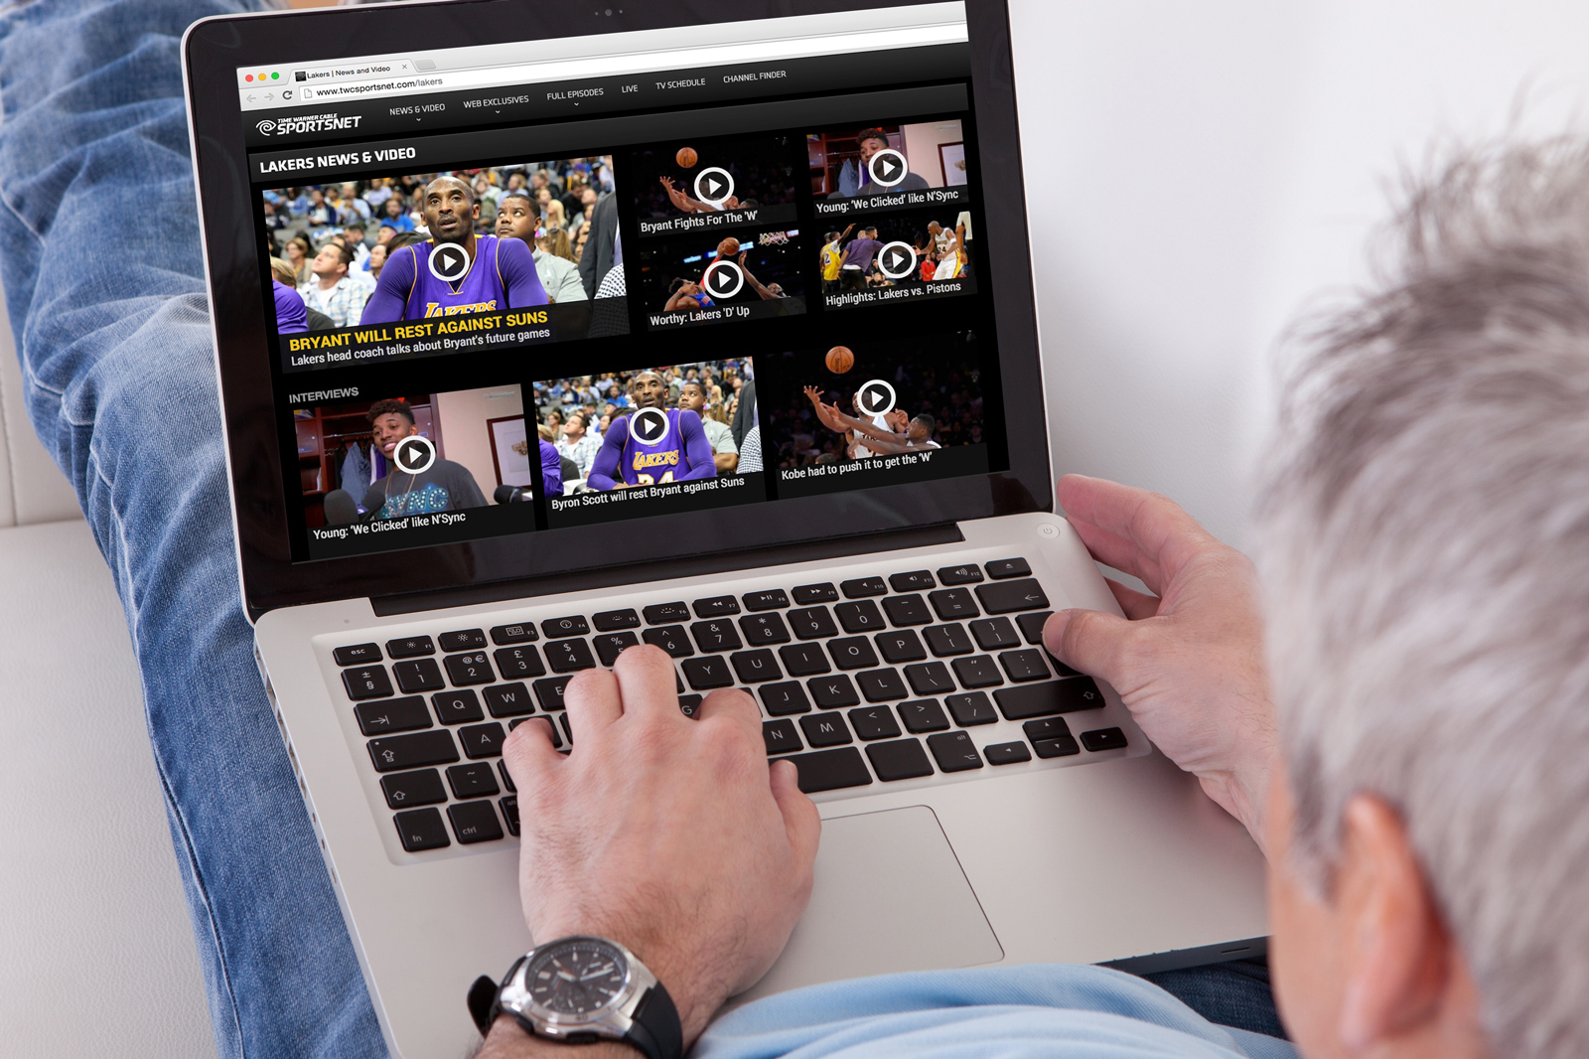
21st CENTURY COMMUNICATIONS & VIDEO ACCESSIBILITY ACT
AD requirements for prime-time viewing & children’s programming
Goal: 100% AD on TV by 2020
Notes:
Phases in between 2010 and 2020
Currently: Top 60 TV markets required to describe 50 hours per quarter. Next phase in is July 1, 2018:
Multi channel video distributers must provide 87.5 hours per quarter

Slide 20
DESCRIPTION LAWSUITS & SETTLEMENTS
ACB vs. Netflix
> Settlement: Netflix agreed to provide AD for many streaming titles by EOY 2016
Hamilton
> Sued for violating Title III of the ADA by failing to provide AD
AMC Theaters
> Failing to provide assistive audio description devices to blind viewers
DOJ vs. UC Berkeley
> DOJ submitted letter to UC Berkeley that their MOOC content was inaccessible
Notes:
American Council of the Blind vs. Netflix:
- Settlement; Netflix agreed to provide AD for many streaming titles by December, 2016. You can view a library of described Netflix videos by going to the footer on their site.
Hamilton:
Sued for “systematic civil rights violations” against the blind community under Title III of the ADA by not providing audio description
Berkeley:
DOJ underwent an investigation and submitted a letter to UC Berkeley last year finding their MOOCs to be inaccessible.
Among violations: lack of audio description and closed captioning on video content
Berkeley has since said they will take down their free MOOC content, citing many reasons in addition to the cost of making it accessible
AMC:
Claims they provide assistive listening devices for audio description; plaintiff claims they are often not available, broken, or drained of battery
Cites violation of the ADA & seeks recourse for discrimination

Slide 21
“Excluding businesses that sell services through the Internet from the ADA would run afoul of the purposes of the ADA.”
- Judge Ponsor, NAD vs. Netflix
Notes:
Because the laws were written before the proliferation of online video, we must turn to the courts to see what they believe about how the ADA and Section 504 should apply to the online sector:
Case of National Association of the Deaf vs. Netflix:
“Excluding businesses that sell services through the Internet from the ADA would run afoul of the purposes of the ADA”

Slide 22
INNOVATING AUDIO DESCRIPTION
Notes:
Traditional audio description can be insurmountable for institutions, but technology is helping to innovate the process of audio description.

Slide 23
SYNTHESIZED SPEECH - PROS
PROS
Processing Speed
> Utilizing technology to make processing automated & eliminating the need for human retakes.
Cost
> Synthesized speech drives down costs by using machines instead of voice talent.
Description Speed
> Easy to have pre-set choices to manipulate speed of voiced description w/o distortion.
Flexibility
> Allows for more creative publishing tools, like allowing users to edit descriptions.
Familiarity
> Blind users are used to screen reader voices (faster & mechanized).
Notes:
Why Synthesized Speech?
PROS:
Processing speed
Cost
Ability to manipulate speed of voiced description w/o distortion
Because of all the above: make description editable & have flexible output
Blind users are used to screen reader voices (more mechanized)

Slide 24
SYNTHESIZED SPEECH - CONS
CONS
Vocalization
> Sounds like a machine (because it is a machine).
Tone
> Limited ability to alter tone, although there are ways to address this.
Pronunciation
> Some issues with pronunciation due to the use of synthesized speech. Can be partially addressed.
Notes:
Why Synthesized Speech?
PROS:
Processing speed
Cost
Ability to manipulate speed of voiced description w/o distortion
Because of all the above: make description editable & have flexible output
Blind users are used to screen reader voices (more mechanized)
CONS:
Sounds like a machine (but not that bad!)
Limited ability to alter tone (‘say as’ concerned, happy, angry, etc.)
Pronunciation issues – today; something we’re looking at, can be addressed.

Slide 25
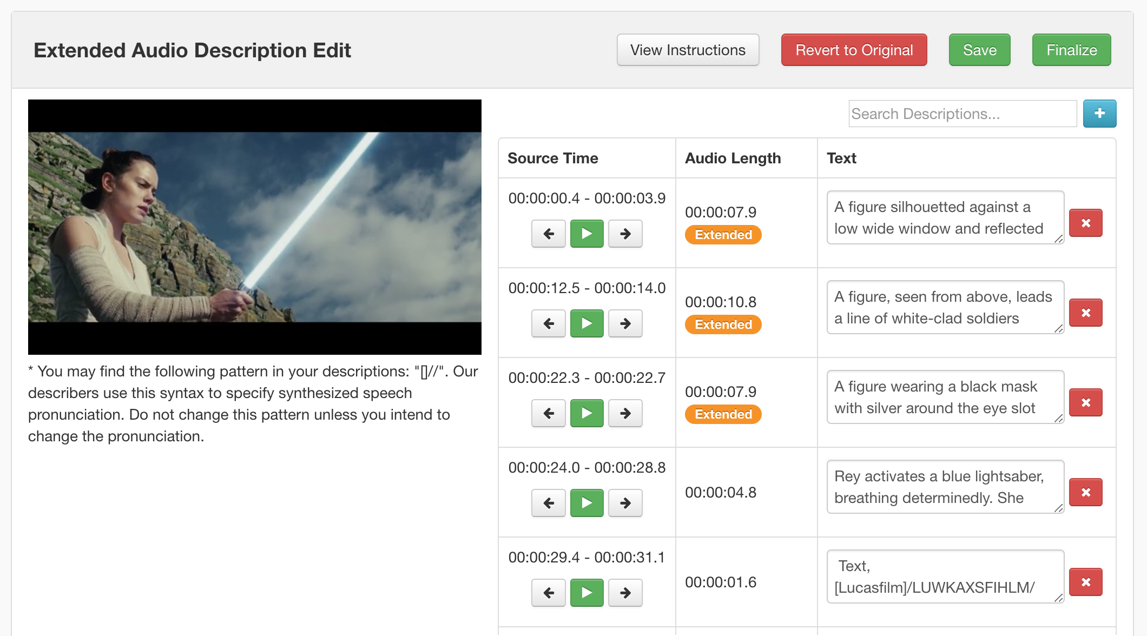
EDITING AD
Notes:
Traditional description vendors don’t allow the end user to edit their descriptions.
Our workflow allows you to edit description frames after your files have been processed. If you have specific words you’d like changed, or the name of a speaker that your describer wasn’t sure about, you can edit those after the fact. When you finalize, your edits will propagate to all outputs. You can easily revert to the original description if you’re not happy with your edits.

Slide 26
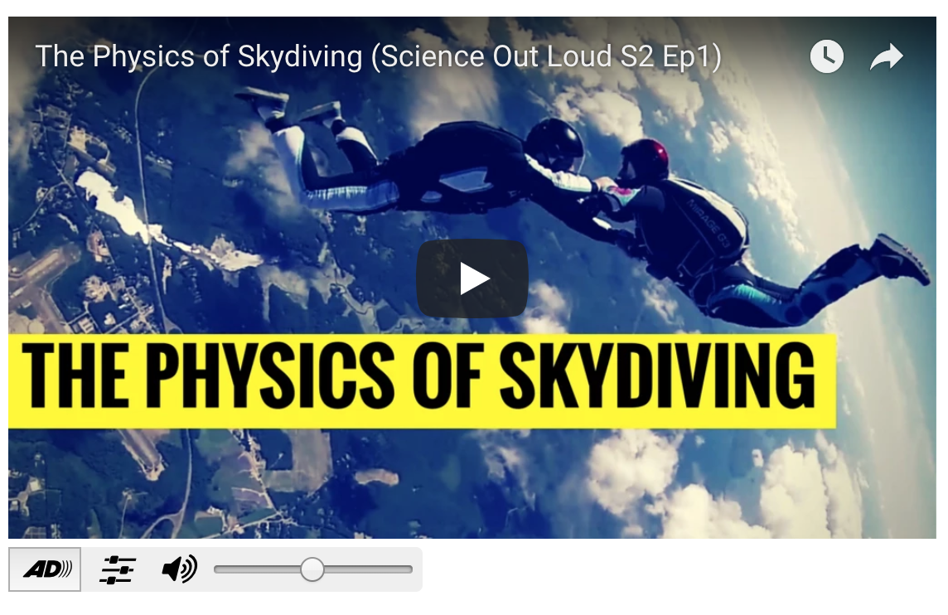
PUBLISHING:
AUDIO DESCRIPTION
PLUGIN
Notes:
Demo how simple the audio description plugin is.
http://www.3playmedia.com/how-it-works/how-to-guides/audio-description/audio-description-examples/

Slide 27
Q&A
Lily Bond
3Play Media
lily@3playmedia.com
www.3playmedia.com
@3playmedia

