Slide 1
The W3C Accessible Online Learning Community Group What have we done and what should we do next?
Mary Ziegler, MIT
David Sloan, The Paciello Group

Slide 2
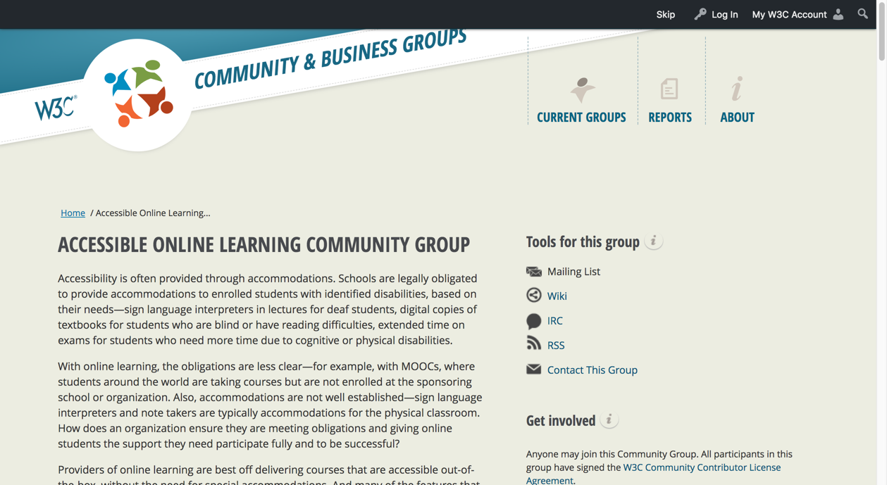
A brief history

Slide 3
AccessLearn, the essential facts
Established as a W3C Community Group in April 2015
Now has 98 members, though a smaller set of regular participants
Web site: https://www.w3.org/community/accesslearn/

Slide 4
W3C Community Groups
A way to contribute to the W3C standards activity, without the constraints of W3C membership and processes.
Allows for volunteer work to happen in areas that could potentially enrich the standards development process.
Can’t publish formal standards
But they can produce deliverables that could be shared with working groups for consideration and action

Slide 5
The Web Accessibility Initiative
Standards work: WCAG, ATAG, UAAG, ARIA,…
Task Forces: Cognitive Accessibility, Low Vision, Silver,
Supporting resource development, led by the Education and Outreach Working Group (EOWG)
https://www.w3.org/WAI/

Slide 6
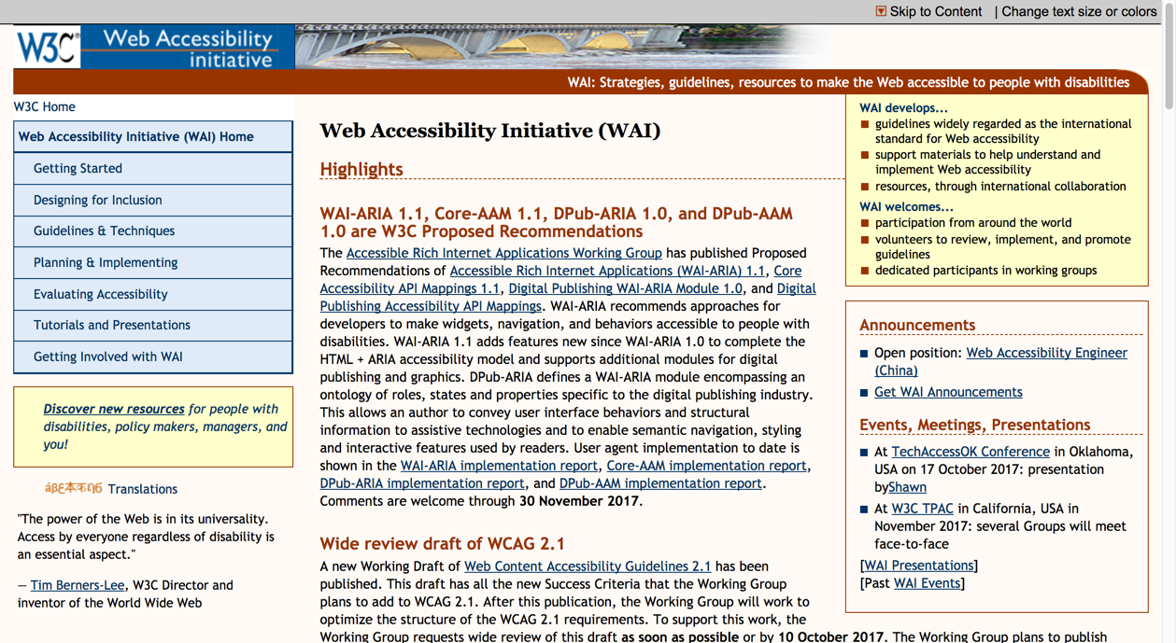
What use do you make of the WAI web site?

Slide 7
Establishing AccessLearn
Helping W3C and WAI meet the information needs of people working in online learning accessibility by:
Identifying where WAI resources could be enhanced to better support the needs of different stakeholders
Informative (supporting resources)
Normative (standards)

Slide 8
AccessLearn’s work so far

Slide 9
Initial survey (2015): gathering opinion
Online survey, asking group members about:
usefulness of W3C accessibility standards
Challenges to providing accessible online learning experience
Challenges and opportunities in emerging technology
Results summary: https://lists.w3.org/Archives/Public/public-accesslearn/2015Jul/thread.html

Slide 10
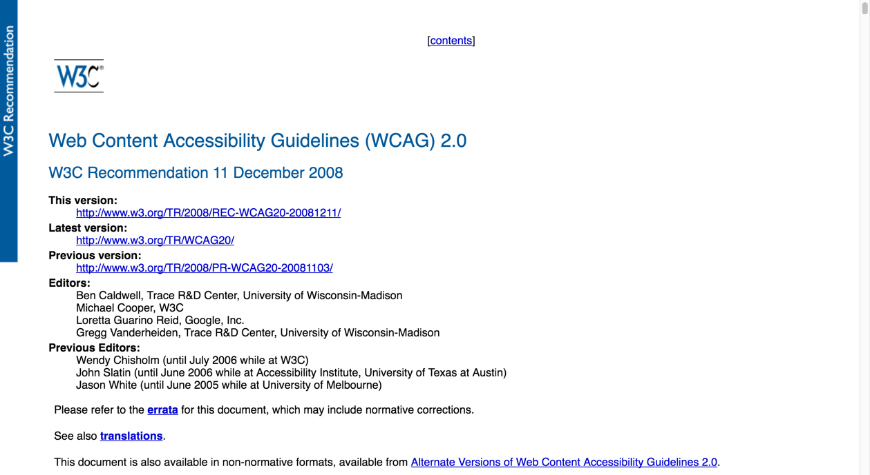
How well do you think W3C accessibility guidelines support accessible online learning?
Notes:
For the following guidelines, how many people think they do a great job, okay job, terrible job of supporting online learning accessibility?
WCAG
ATAG
UAAG

Slide 11
How well do current W3C Accessibility standards support creation and evaluation of accessible online learning?

Slide 12
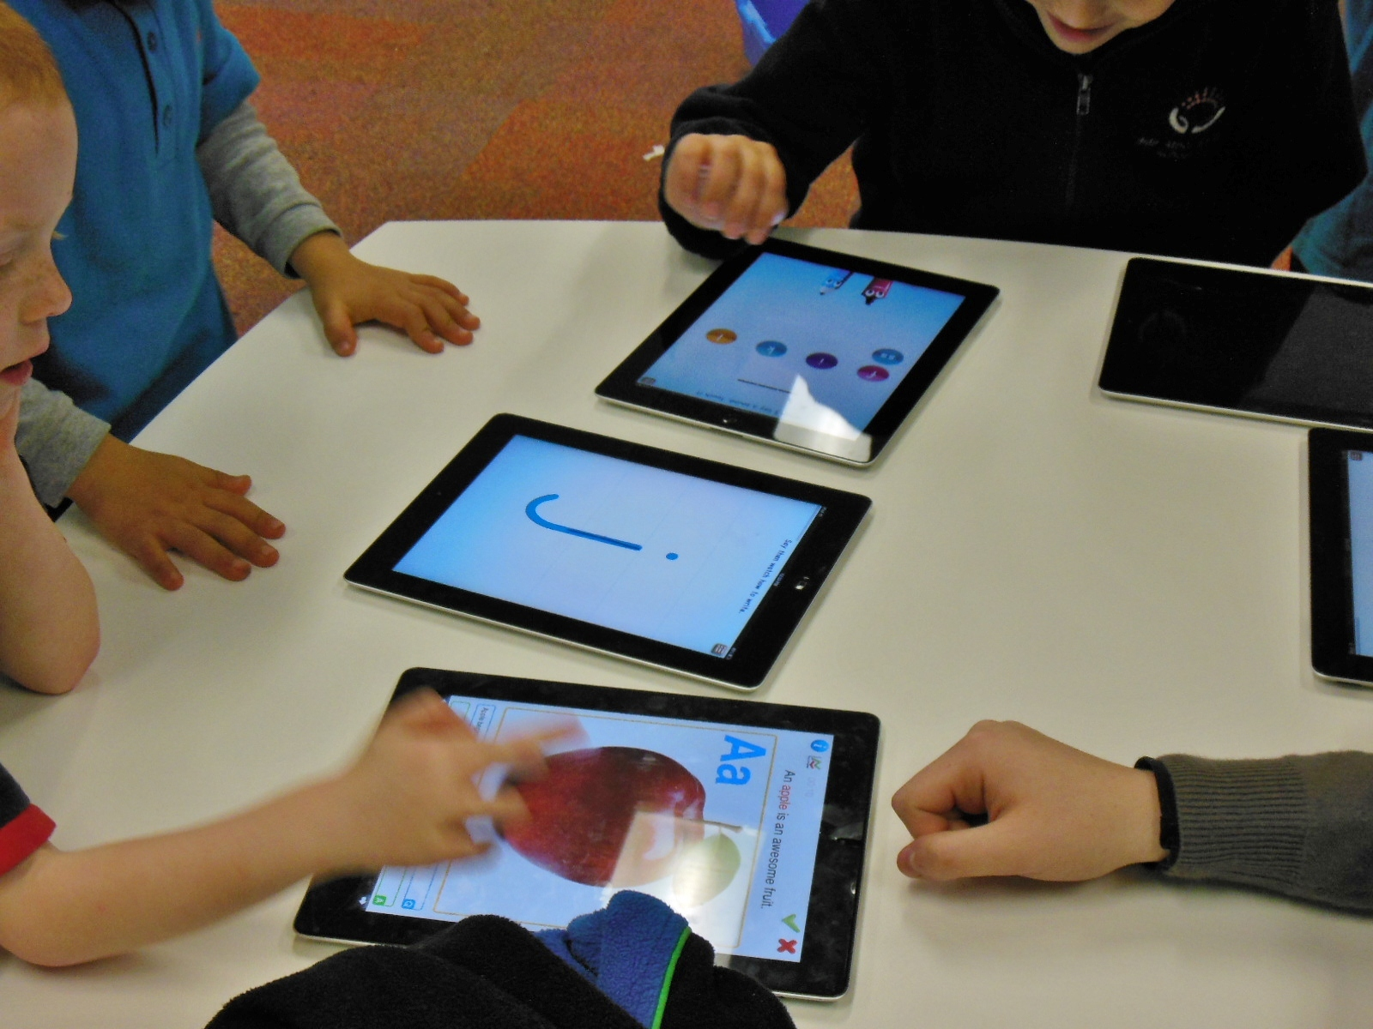
What are the key challenges to providing accessible online learning experiences?

Slide 13
Key challenges to providing accessible online learning experiences
Lack of accessibility knowledge and skills amongst course creators
Limitations of accessibility support by learning platforms
Ineffectual or incomplete institutional accessibility strategy
Limitations of accessibility of digital learning resources
Lack of standards focusing on accessible online learning
Lack of clarity in legal requirements
(n=58)

Slide 14
Next steps: Defining gaps in knowledge and gaps in content
What are the most significant knowledge gaps that exist amongst people who have a stake in accessible online learning?
What knowledge does W3C currently offer that could fill those gaps?
If this knowledge exists, how can we make it easier to find and use?
What content gaps exist that need filled?
The group set to work identifying and mapping these knowledge and content gaps…
…and developing a prioritized set of recommendations for addressing these gaps

Slide 15
Process to identify knowledge gaps and recommendations pertaining to them
25 knowledge gaps identified
54 WAI resources identified with relation to online learning
Consider if information pertaining to each gap was:
Present on the WAI website
Present but hard to find
Present but hard to apply to online learning
Hard to find and hard to apply
Rate priority of gaps (high, medium, low)

Slide 16
Key gaps
Online learning ecosystem and accessibility: Lack of understanding of full scope and dependencies of the digital ecosystem required for accessible online learning (responsibilities, roles, supports for content creators and learners, technical infrastructure of LMS, etc.)
Accessible communication for learning: Lack of guidance and standards on asynchronous and synchronous accessible communication for digital media in online learning, specifically where users require different inputs and outputs to communicate with each other.

Slide 17
Key gaps
Assessments: Lack of standards directly applicable to accessible, pedagogically effective, and fair online assessments.
Content vs LMS accessibility: Lack of understanding of the distinction between a course LMS/platform and the content placed within it, and resulting implications for accessibility.
Learner characteristics: Lack of understanding of the characteristics of learners with disabilities, what assistive technologies they use, that they do not all use an assistive technology, and what knowledge, training, and practice the learners require to access content or demonstrate knowledge.

Slide 18
Current high-priority recommendations for new content
Online learning ecosystem: Description of key components and their relationship to, and role in, delivering accessibility.
Authoring tool accessibility: Definition of the role that authoring tool accessibility plays in a model of online learning accessibility
Best practices for web-based communication: Explanation of the ways communication (e.g. learner-instructor, peer-to-peer, real time) is important in online learning, and key requirements for accessible real-time communication

Slide 19
Current high-priority recommendations for new content
Assessments: Coverage of accessibility of academic assessments provided online, the importance of incorporating POUR principles into their design, an explanation of how to describe visuals giving key visual data without interpretation, and an outline of possible exceptions and need for accommodations.
Personas and user stories: Enhancing existing WAI personas and user stories to include more focus on learning.
https://docs.google.com/spreadsheets/d/1LHynDV-umVHF3NcKkCIuSL12lzZCj-2qS4gjmLtsXto/edit#gid=1155254872
Notes:
https://docs.google.com/spreadsheets/d/1LHynDV-umVHF3NcKkCIuSL12lzZCj-2qS4gjmLtsXto/edit#gid=1155254872

Slide 20
Next steps

Slide 21
Actions
Refine recommendations
Work with Education and Outreach Working Group (EOWG) to create an action plan to implement recommendations
Write, review content
Identify other opportunities to enhance WAI’s support for online learning accessibility

Slide 22
We’d love your help!
How to get involved:
Go to: https://www.w3.org/community/accesslearn/
Sign up for a W3C account (you don’t need to work for a member of W3C)
Join AccessLearn

Slide 23
More details
Contact the group chairs if you’d like to know more about what we do:
David Sloan: dsloan@paciellogroup.com
Mary Ziegler: maryz@mit.edu

