Slide 1
Results & Takeaways from a National Study on Closed Captioning in Higher Education
Accessing Higher Ground – November 17th, 2016
Lily Bond, 3Play Media
lily@3playmedia.com
@lilybbond, @3playmedia

Slide 2
Agenda
Study Overview
Student study
Institutional study
Takeaways
Further questions & future research
Q&A

Slide 3
Study Overview
Collaboration between OSU eCampus Research Unit & 3Play Media
Head researcher: Dr. Katie Linder
Kathryn.linder@oregonstate.edu
ecampus.oregonstate.edu/research/
Two national studies:
Student uses and perceptions of closed captions & transcripts
How colleges nationwide are handling captioning & transcription

Slide 4
STUDENT STUDY

Slide 5
Student Research: Questions
To what extent are students aware of the availability of closed captions and transcripts in their courses?
To what extent do various student populations use video closed captions and transcripts?
Why do students use video closed captions and transcripts?
How do students use video closed captions and transcripts to support their learning?
To what extent do various student populations perceive the use of video closed captions as potentially valuable to their learning?

Slide 6
Recruitment & Participation
Reached out by email to 3,742 institutional representatives
Students asked to complete a 46-question online survey
Fifty $25 Amazon gift cards given away in a raffle
15 institutions agreed to help distribute
2,839 students responded
2,124 of those responses were included after data cleaning
One problem: many institutions & representatives think about captions solely in relation to accommodation.

Slide 7
Who Responded?
School | Respondents | Institutional Profile
A | 1 | Private 4-year, nonprofit, Northeast
B | 8 | Public 2-year, nonprofit, Midwest
C | 32 | Public 4-year, nonprofit, Southeast
D | 4 | Public 4-year, nonprofit, Southeast
E | 32 | Public 2-year, nonprofit, Southwest
F | 7 | Public 4-year, nonprofit, Midwest
G | 64 | Public 2-year, nonprofit, Midwest
H | 24 | Private 4-year, nonprofit, Southwest
I | 60 | Public 4-year, nonprofit, Midwest
J | 4 | Public 4-year, nonprofit, Midwest
K | 1130 | Public 4-year, nonprofit, West
L | 300 | Public 4-year, nonprofit, West
M | 100 | Private 4-year, nonprofit, Northeast
N | 123 | Public 4-year, nonprofit, West
O | 235 | Public 4-year, nonprofit, West

Slide 8
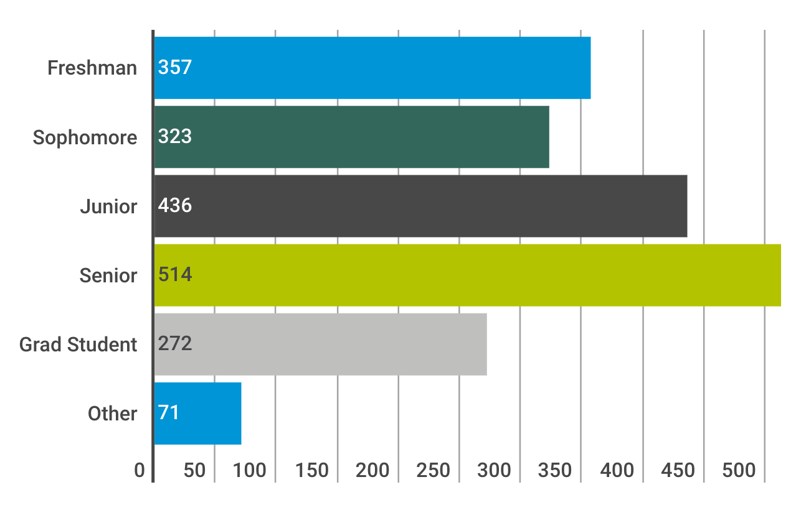
Who responded (2)?
Notes:
Almost half of respondents are juniors or seniors
Almost 83% were undergrads

Slide 9
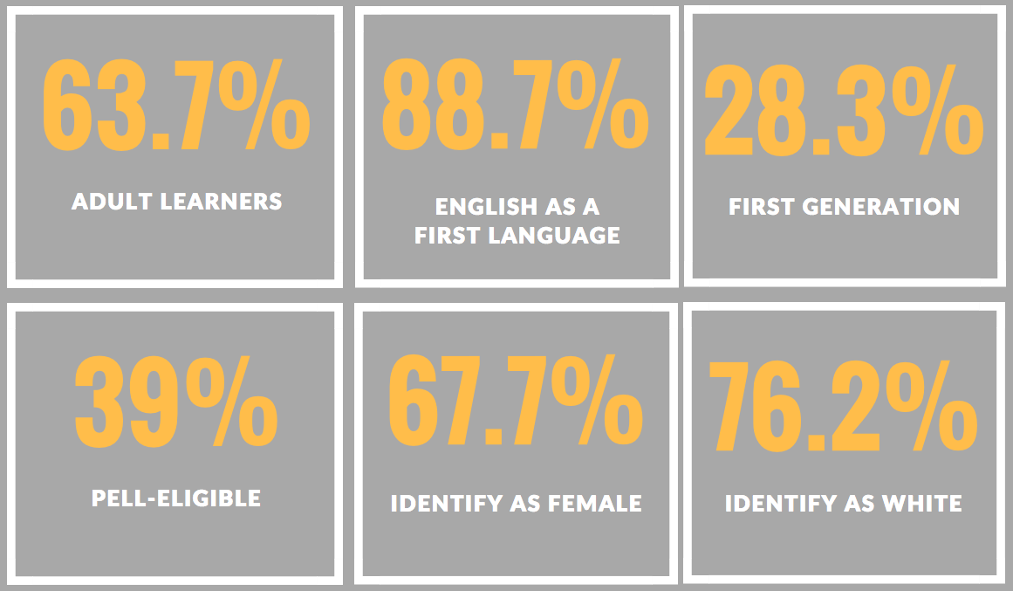
Who Responded (3)?
Notes:
Adult learners: over 24
Large number of online learners: may account for some of the adult learners
Number of first generation may be higher: many were unsure

Slide 10
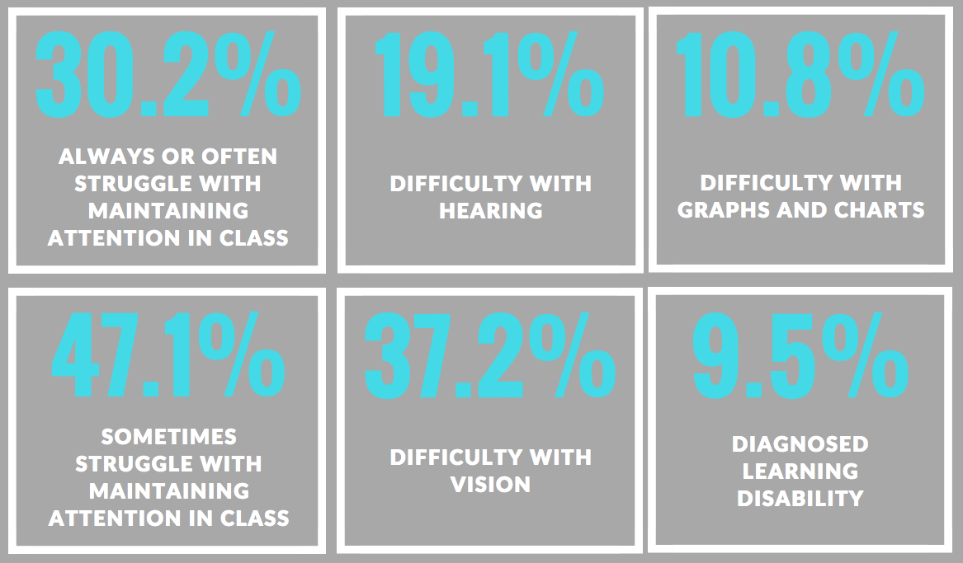
Who Responded (4)?
Notes:
disabilities:
Over 75% said they struggle with maintaining attention
19% difficulty hearing may be inflated due to poor distribution techniques

Slide 11
Who Responded (5)?

Slide 12
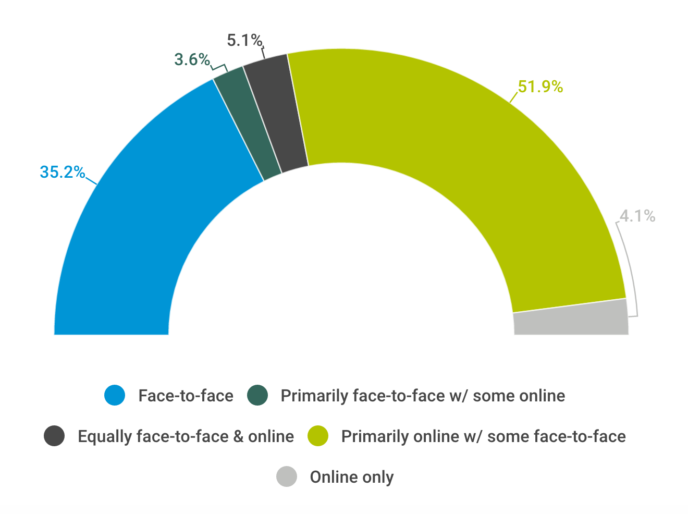
Who responded (6)?
99.7%
have courses that include videos
What kind of course modality?
Notes:
Nice balance of face to face and online
- Significance of video in class

Slide 13
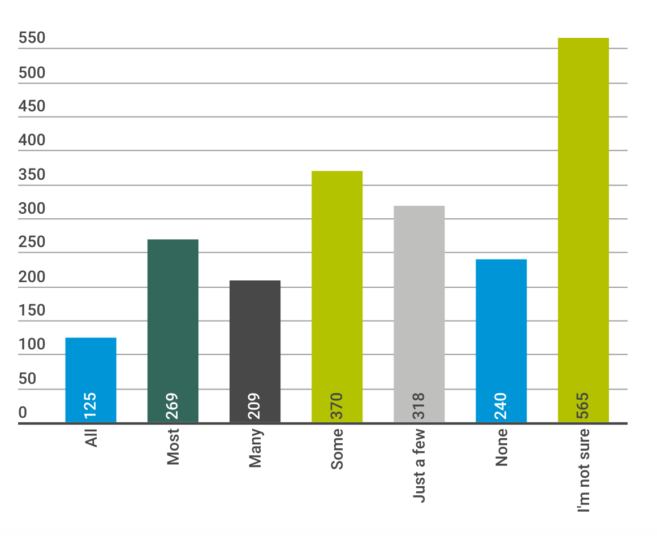
How many videos in your courses had closed captioning?
Notes:
About 29% said all/most/many: less than 1/3
27% not sure – we’ll look at that in a second

Slide 14
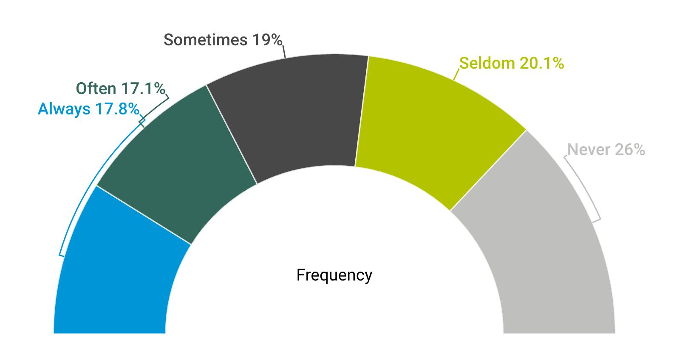
74% of students use captions at least some of the time

Slide 15
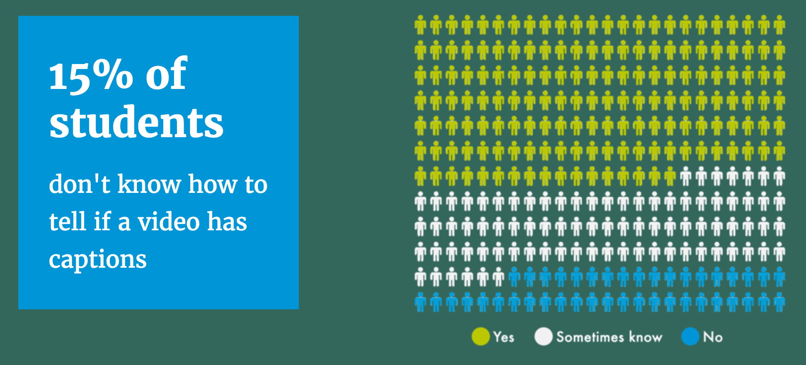
Use & perceptions of captions
Notes:
Only 56% of students always know for sure how to tell if a video has captions; about 30% not sure
Only 60% of students always know how to turn on captions; 25% not sure; 15% no

Slide 16
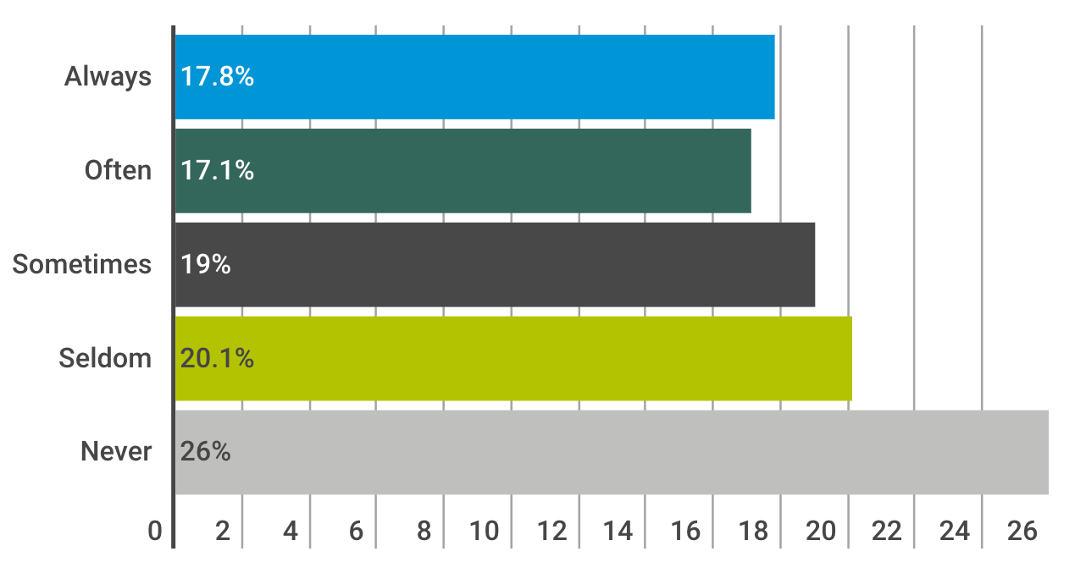
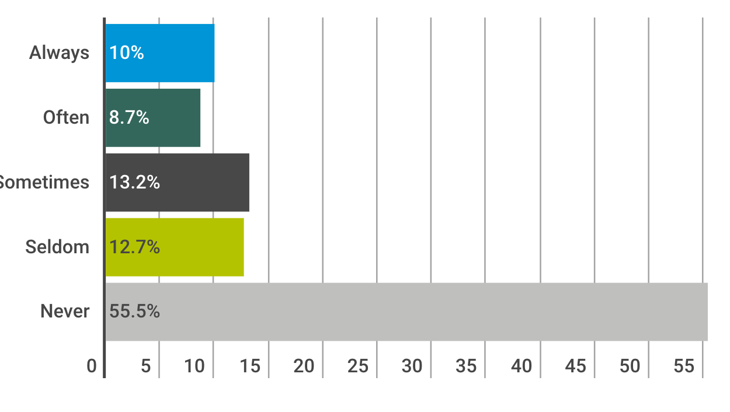
Students are more likely to use captions than transcripts:
How often did you use captions when available?
How often did you use transcripts when available?
Notes:
Much larger number using captions always/often/sometimes: 54%; compared to transcripts: 32%
56% never use transcripts; 26% never use captions

Slide 17
How helpful are captions vs. transcripts?

Slide 18
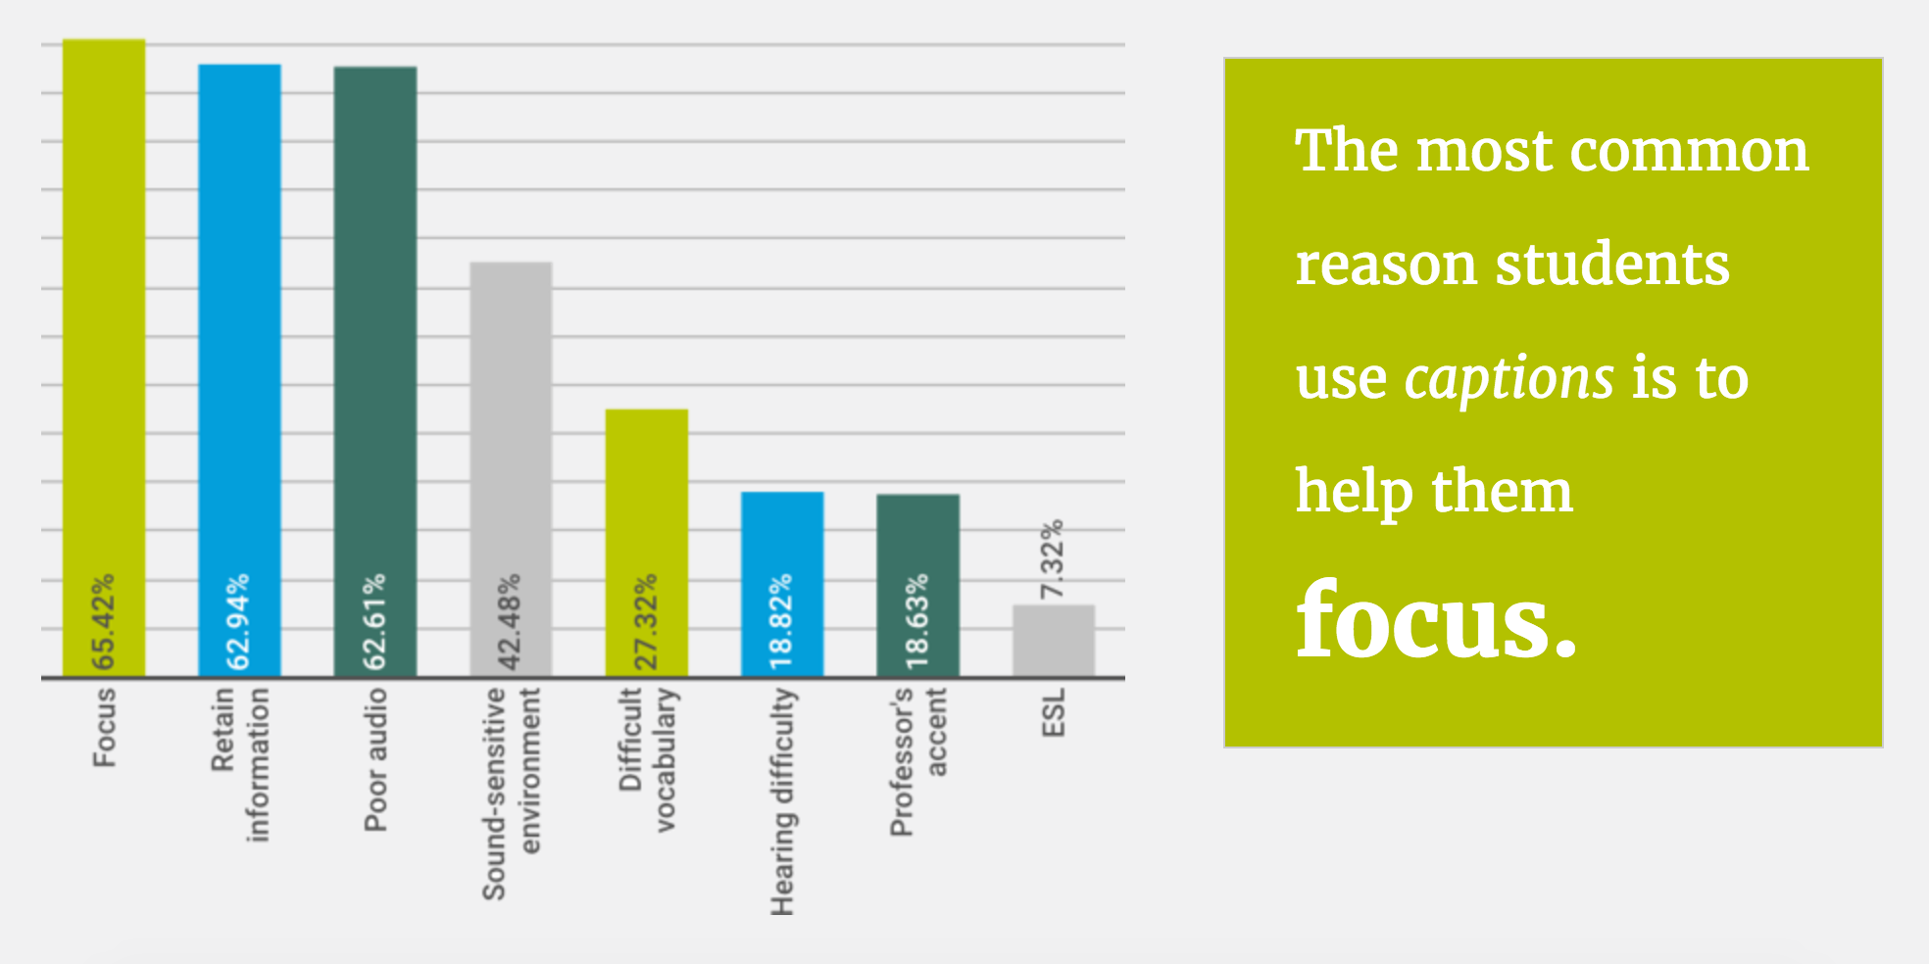
Why do students use captions?
Notes:
When looking at why students use captions:
65% say it helps them focus, 63% that it helps them retain information; 63% help with poor audio
We’ll look at qualitative data in a minute

Slide 19
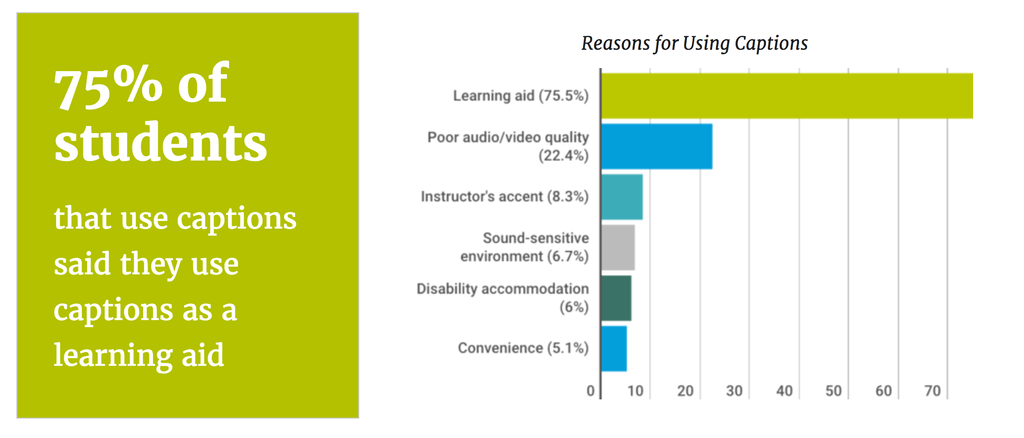
Main benefits of captioning
Notes:
Quotes:
Environmental: “I don’t like playing videos with sound when I’m in an environment where doing so would be disruptive.”
Video/audio quality: “Helps when a video has poor sound quality.”
Instructor difficult to understand: “My professor has a slight accent that makes her words fast and jumbled.”
Convenience: “I find it easier to read along with the videos rather than just sit there and listen to the professor talk.”
Accommodation: “I’m dyslexic so it helps me to know that the notes I’m writing down are both spelled correctly and in the right syntax.”

Slide 20
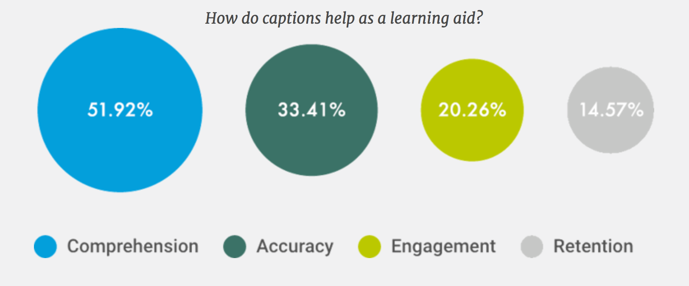
52% of students that use captions
said captions help as a learning aid by improving comprehension
Notes:
Accuracy: “If I need to write down notes, I know exactly how to quote a video.”
Comprehension: “It can help me deeply understand the lecture.”
Retention: “By simultaneously reading and listening to the content, I am able to retain the information better.”
Engagement: “They help me to focus on the video instead of just tuning out the noise.”

Slide 21
What are the hindrances of captions?
400 qualitative comments included in analysis
41.5% (166) said that closed captions were distracting or required too much cognitive load
34.8% (139) said that closed captions included incorrect information such as typos or were incorrectly synced with the video
32% (128) said that closed captions blocked important information
1.1%
of students thought captions were “extremely” or “very” much a hindrance

Slide 22
Why do students use transcripts?

Slide 23
What are the hindrances of transcripts?
153 qualitative comments included in analysis
43.79% (67) said that transcripts were distracting from the video or visual cues or required too much attention or cognitive load
20.26% (31) said that transcripts included incorrect information such as typos, were not well-written, or were not formatted well
14.38% (22) said that transcripts were too long, were too much to read, or required too much time
2.2%
of students said transcripts were “extremely” or “very” much of a hindrance
Notes:
Environmental: “They helped me understand what was being said if I was in a noisy environment, or when I was in a quiet environment. I found it easier to follow along as well.”
Video/audio quality: “They allow you to read what is said without having to understand the speaker clearly.”
Instructor difficult to understand: “It is not always easy to understand professors who have a foreign dialect or who speak too quickly.”
Convenience: “It’s much easier to locate the key ideas and terms.”
Accommodation: “It helps with my learning disability, being able to read the information while watching the video.”
Accuracy: “If I missed anything, I could have it right in front of me.”
Comprehension: “It is harder to take notes from a video. Transcripts allow easier identification of key points.”
Retention: “I am a visual learner so being able to read the material at my own pace and take notes helped me retain the information better.”
Engagement: “It helps me not have to take notes, which allows me to focus on the video.”

Slide 24
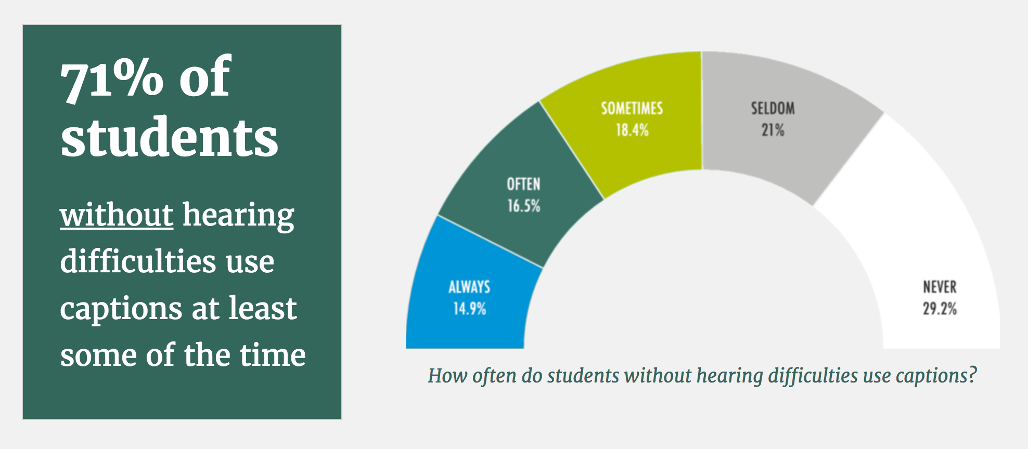
What about students who are not deaf/hard of hearing?

Slide 25
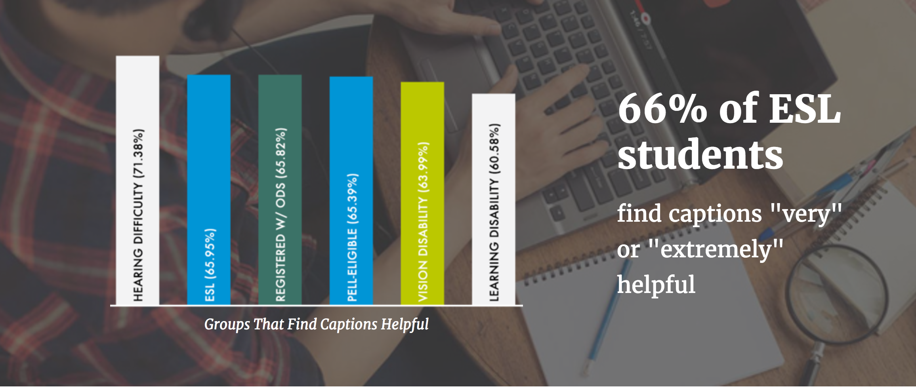
How do captions help ESL students?

Slide 26
Takeaways
Almost all classes include some video
Students tend to prefer captions to transcripts
Captions are not being provided for all videos, or students aren’t aware of them
Students find that captions help aid learning in a range of ways
Many common hindrances are related to the captioning process

Slide 27
INSTITUTIONAL STUDY

Slide 28
Institutional Research: Questions
What solutions are being used to implement captioning across an institution?
Are institutions implementing captioning as a campus-wide initiative?
Are captioning solutions centralized or decentralized?
Are institutions implementing captioning proactively or reactively?
What are the motivations for implementing captioning?
Who are the stakeholders involved in implementing captioning initiatives?
What are the current budgets for captioning?
Who is held responsible for ensuring effective captioning?

Slide 29
Institutional Research: Questions (2)
What barriers prevent effective implementation of captioning?
Are any institutions implementing captioning particularly well?
What does an effective and efficient implementation of captioning across courses and programs look like?
Do institutions rely on data or research documenting the benefits of captioning & transcription to secure funding?

Slide 30
Recruitment & Participation
Reached out by email to 3,742 institutional representatives
Representatives asked to complete a 61-question online survey
Five 10-hour captioning credits from 3Play Media as raffle
54 representatives responded (47 were included in analysis)
One problem: representatives were told to pass the study on to a person capable of answering questions about captioning; you’ll see that the survey did not always get into the right hands.

Slide 31
Who Responded?
Institution Type:
Enrollment:
 | Frequency
University, PhD/MD/JD/EdD | 21
University, Bachelors and Masters | 11
Community College | 8
Bachelors but not graduate degrees | 2
Two year college | 1
Professional school | 1
Technical/trade/vocational | 0
Other (please describe) | 0
 | Frequency | Percentage
1,000 or less | 1 | 2.3%
1,001 – 5,000 | 8 | 18.2%
5,001 – 10,000 | 4 | 9.1%
10,001 – 20,000 | 12 | 27.3%
20,001 – 30,000 | 7 | 15.9%
30,001 – 40,000 | 7 | 15.9%
40,001 – 50,000 | 4 | 9.1%
50,000+ | 1 | 2.3%
total | 44 | 100%

Slide 32
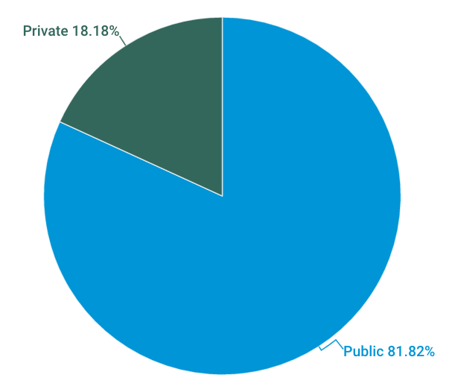
Who Responded (2)?
Online Courses:
 | Frequency | Percentage
None | 1 | 2.3%
1-50 | 3 | 6.8%
51-100 | 8 | 18.2%
101 or more | 17 | 38.6%
I don’t know | 14 | 31.8%
Other | 1 | 2.3%
Public vs. Private:
MOOCs:
 | Frequency | Percentage
No | 28 | 63.6%
Yes | 11 | 25%
I don’t know | 5 | 11.4%

Slide 33
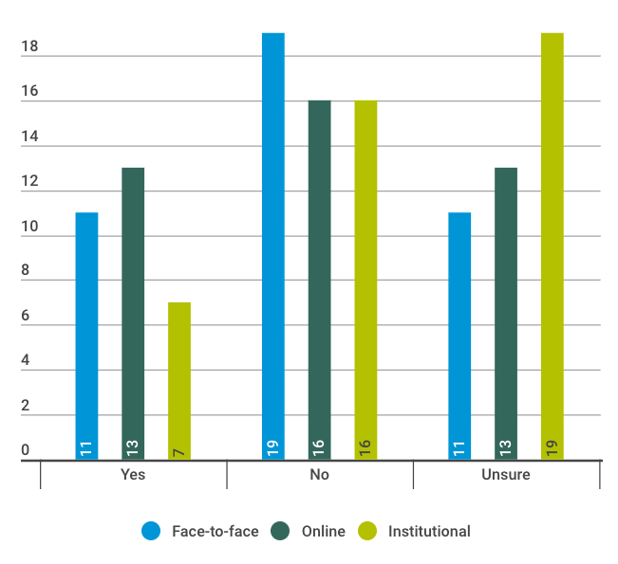
Video Inventory
Does your institution track or inventory the videos that are created at your institution?
25%
are sure they inventory videos

Slide 34
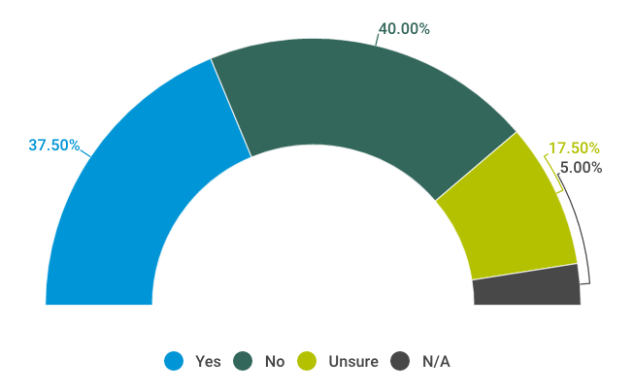
Face-to-face vs. online vs. institutional:
Is the approach to captioning these videos the same in all of these scenarios?

Slide 35
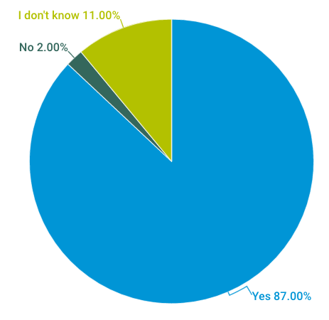
How much captioning is being done?
Is captioning ever done for any videos?
For how many videos is captioning created?

Slide 36
For how many videos are transcripts created?

Slide 37
Let’s get legal …
How confident are you that you understand what it means to be in compliance w/ accessibility laws?
 | Frequency | Percentage
Very unconfident | 1 | 2.1%
Unconfident | 3 | 6.4%
Neither unconfident not confident | 5 | 10.6%
Confident | 18 | 38.3%
Very confident | 20 | 42.6%
80%
are confident they understand

Slide 38
Let’s get legal …
What is your understanding of what it means to be in compliance with federal and state accessibility laws regarding closed captioning?
 | Frequency | Percentage
We are required to proactively caption all of our videos | 24 | 51.1%
We are required to proactively caption most of our videos | 9 | 19.1%
We are required to provide cc’s only in the case of a deaf student or an accommodation request | 9 | 19.1%
We’re required to proactively caption some of our videos | 4 | 8.5%
I don’t know | 1 | 2.1%
We’re not legally required to provide any cc’s | 0 | 0%
Notes:
Remember that 80% were confident they understand, but the answers are all over the board.
Also note that 50% said their understanding is that they’re required to caption all videos
Only 8% are captioning all videos > slide 35

Slide 39
Let’s get legal …
To what extent do you believe your institution is meeting legal requirements?
17%
believe they are meeting or exceeding requirements
Notes:
Remember that 80% were confident they understand, but only 17% believe they are meeting those requirements
Equally concerning that some people believe they’re not at all meeting requirements

Slide 40
Why are institutions captioning?
 | Frequency | Percentage
To be in compliance with the law | 37 | 78.72%
To avoid potential litigation | 35 | 74.47%
In response to accommodation requests | 33 | 70.21%
To support the needs of all learners | 29 | 61.70%
To create a learning environment that is aligned with the mission of the institution | 20 | 42.55%
To be in compliance with institutional policies | 14 | 29.79%
Because research supports a connection between caption use and positive learning outcomes | 13 | 27.66%
To address a significant need at our institution | 11 | 23.40%
In response to faculty demand | 11 | 23.40%
In response to student demand that is not accommodation-related | 4 | 8.51%
I don't know | 1 | 2.13%
Other | 0 | 0.00%
Institutions are equally worried about compliance & litigation

Slide 41
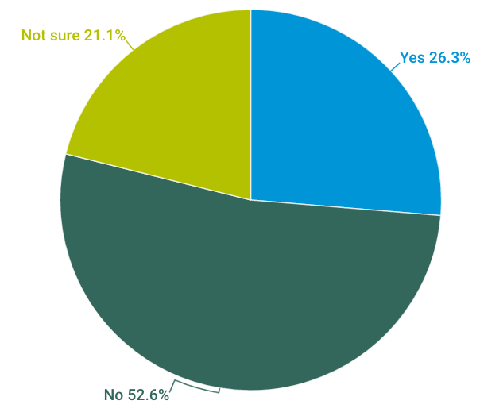
Are you monitoring caption compliance?
Notes:
Note that 75% and 78% are worried about litigation and compliance, respectively, yet only 26% monitor compliance.
Fascinating to me based on the deep concern about litigation. 75% caption to avoid litigation; yet only 50% are monitoring compliance.

Slide 42
Why are institutions not captioning?
 | Frequency | Percentage
Lack of general awareness | 26 | 55.32%
A budget doesn't exist | 23 | 48.94%
Staffing is inadequate | 22 | 46.81%
Unclear whose responsibility it is | 22 | 46.81%
Don’t have buy-in of administration to caption videos | 20 | 42.55%
It’s too time consuming | 19 | 40.43%
It’s too expensive | 18 | 38.30%
Faculty won’t do it | 18 | 38.30%
Currently not an institutional priority | 15 | 31.91%
We weren’t aware it was something that should be done | 8 | 17.02%
We don’t know how to do it | 7 | 14.89%
Lack technical capability | 6 | 12.77%
Concerned about copyright infringement | 6 | 12.77%
Other | 3 | 6.38%
I don't know | 1 | 2.13%
This is not a genuine need at our institution | 0 | 0.00%

Slide 43
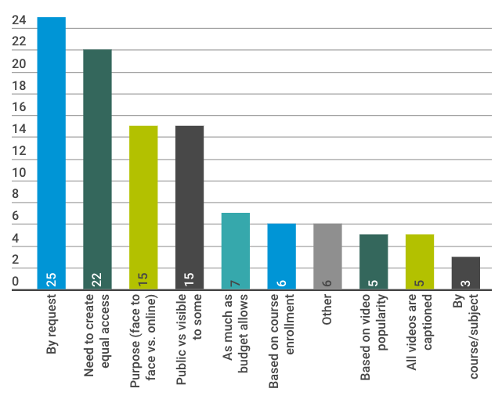
How are videos prioritized for captioning?
5
said all videos are captioned
Notes:
38 said they are very confident or confident they understand requirements to caption
24 correctly identified the legal requirement to caption all videos
7 said they are meeting requirements
5 said that all videos are captioned

Slide 44
Do formal guidelines exist to inform captioning of videos created at your institution?

Slide 45
Are captioning guidelines systematically communicated to video creators?

Slide 46
Who actually creates the captions?

Slide 47
Who decides whether to create captions?
Notes:
Disability Services
IT
Provost
Vice President or VP of Student Affairs
Chief Information Officer
Chief Disability Officer
Deans
Faculty
Students
I don’t know
Other

Slide 48
Who decides what captioning solution to use?

Slide 49
Who is designated to ensure caption quality?
 | Frequency | Percentage
Office of Disability Services | 22 | 46.81%
The creator of the video | 21 | 44.68%
Staff who are dedicated to closed captioning | 18 | 38.30%
A third party outside of this institution | 18 | 38.30%
Office of Information Technology | 8 | 17.02%
No one is designated to do this | 7 | 14.89%
I don't know | 5 | 10.64%
Other | 5 | 10.64%
Automated software | 3 | 6.38%

Slide 50
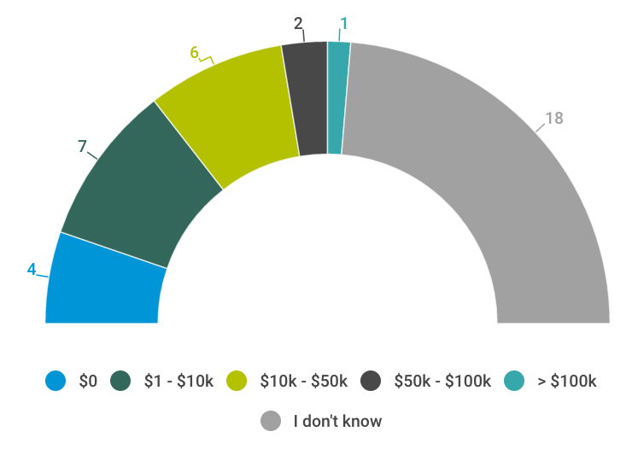
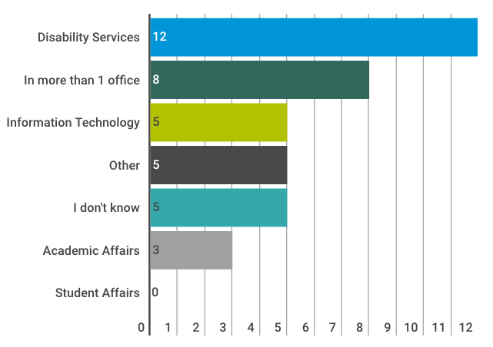
Budgeting for Captioning
Where is the budget for captioning housed?
What is your institution’s budget?

Slide 51
What factors inform the budget?
 | Frequency | Percentage
The number of students who request accommodation that requires captioning | 18 | 38.30%
Our accessibility budget as a whole | 12 | 25.53%
The amount of video content | 8 | 17.02%
Other | 6 | 12.77%
I don't know | 5 | 10.64%
Legal considerations | 5 | 10.64%
Enrollment | 2 | 4.26%
Other data from within this institution | 2 | 4.26%
Data from outside of this institution | 0 | 0.00%
Notes:
Several people wrote in responses who answered “other”:
We were given a set amount of funds and eventually backed by central funds to cover any cost overruns
Demand
We do not have a budget - it is a ground up effort across campus
there is no budget directly, it is training budget
based on a rolling accommodations budget
We do not have a budget for this.

Slide 52
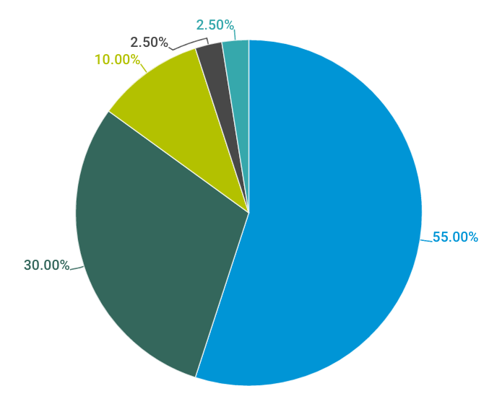
Are caption efforts centralized?
To what extent are captioning efforts systematic across your entire institution?
55%
said captioning is not systematic
Notes:
55% here say it’s not systematic at all; another 30% say it’s only somewhat systematic.
Only 12.5% said it’s systematic or very systematic.

Slide 53
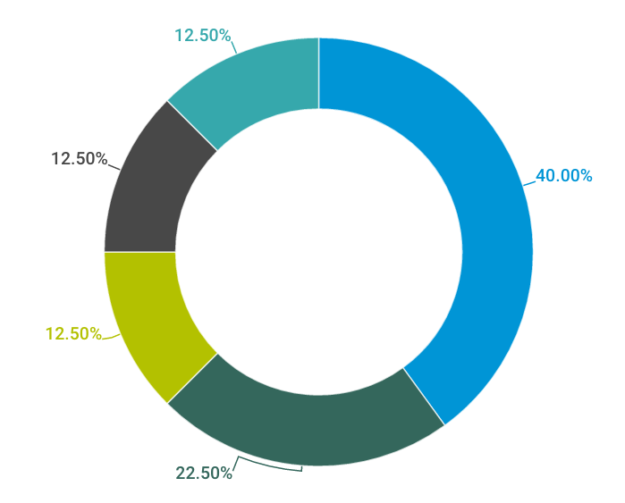
Are caption efforts proactive or reactive?
62.5%
said captioning is reactive

Slide 54
Takeaways
Still confusion about the legal requirements for captioning in higher education
Despite stating compliance & litigation as the top reason many institutions are captioning, many institutions do not measure compliance
Different processes, staffing, and criteria are used for captioning in face-to-face, online, and institutional videos
The majority of institutions report that captioning is not systematic or centralized
Many schools have a reactive approach

Slide 55
More questions & lessons learned
To what extent were the captions used automatic?
Did the length of the video have any effect on how many videos were captioned?
Getting the study in the right hands. There were a lot of “I don’t know” responses in the institutional study, and a high percentage of students receiving accommodations in the student study.
What video players were being used? Did students have trouble finding/using captions in certain players/LMS systems?
Notes:
From student study: issues with quality > were those automatic?

Slide 56
More questions & lessons learned
Trends between public vs private, large vs small, etc. likely coming soon.
Was there a correlation between poor quality and the solution being implemented?
Include definition/standards for what constitutes “effective” captioning
Differentiate between live captioning and captioning for recorded videos
Of those schools that are captioning all videos, what is their process?

Slide 57
Q&A
Accessing Higher Ground – November 17th, 2016
Download the student study:
http://www.3playmedia.com/resources/research-studies/student-uses-of-closed-captions-and-transcripts/
Contact:
Lily: lily@3playmedia.com
www.3playmedia.com
Katie: kathryn.linder@oregonstate.edu

