Slide 1
A Little Means a Lot
Simple Ways to Improve Online Course Accessibility

Slide 2
A Little about Me

Slide 3
A Little about Me

Slide 4
A Little about Me

Slide 5
A Little about Me

Slide 6
My Professional Background
12/2012–current: Instructional Designer, Eastern Kentucky University Design and develop online courses and learning objects in collaboration with faculty subject matter experts Ensure that course designs meet Quality Matters standards Advise/train faculty on best pedagogical practices for online courses Copy course content and establish groups and project-related teams inside course sites each term Troubleshoot Blackboard and other technology problems for instructors 2/2009–12/2011: Technology Analyst, Emergency Management Assistance Compact Designed/developed first-ever online training course for NEMA/EMAC, using Flash and Moodle Coordinated, facilitated, and recorded training Webinars Developed training materials for both on-ground and online trainings Collaborated with subject matter experts to develop training materials and conduct Webinars

Slide 7
My Professional Background
12/2012–current: Instructional Designer, Eastern Kentucky University
Design and develop online courses and learning objects in collaboration with faculty subject matter experts
Ensure that course designs meet Quality Matters standards
Advise/train faculty on best pedagogical practices for online courses
Copy course content and establish groups and project-related teams inside course sites each term
Troubleshoot Blackboard and other technology problems for instructors
2/2009–12/2011: Technology Analyst, Emergency Management Assistance Compact
Designed/developed first-ever online training course for NEMA/EMAC, using Flash and Moodle
Coordinated, facilitated, and recorded training Webinars
Developed training materials for both on-ground and online trainings
Collaborated with subject matter experts to develop training materials and conduct Webinars

Slide 8
Check Your Spelling

Slide 9
Check Your Spelling (with Embedded Screen Reader Audio)
ENG 101 Is Now Open
English 101 is not open for your viewing. Take time before beginning assigments to revew the site, and ask qustions to the course manger on the forum.

Slide 10
Provide Correct Semantic Structure

Slide 11
Provide Correct Semantic Structure
“As with the original intention of the web, screen readers and other assistive technologies largely ignore visual styling and focus primarily on semantics and structure.”
WebAIM Semantic Structure webpage

Slide 12
Provide Correct Semantic Structure
Student Learning Outcomes
The goal of this course is to effectively research elements of literacy development.
Module 1 Objectives
Students completing this module will be able to
1. List and explain the eight components of literacy development.
2. Analyze current research and best practices in the field.
3. Identify and illustrate the processes and instructional strategies in the following areas:
--Word recognition
--Vocabulary
--Comprehension

Slide 13
Provide Correct Semantic Structure
Student Learning Outcomes
The goal of this course is to effectively research elements of literacy development.
Module 1 Objectives
Students completing this module will be able to
List and explain the eight components of literacy development
Analyze current research and best practices in the field
Identify and illustrate the processes and instructional strategies in the following areas:
Word recognition
Vocabulary
Comprehension

Slide 14
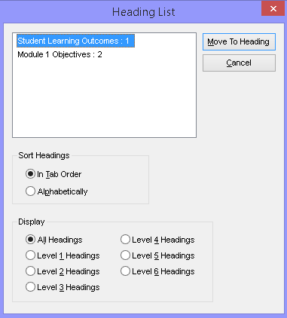
Provide Correct Semantic Structure
Student Learning Outcomes
The goal of this course is to effectively research elements of literacy development.
Module 1 Objectives
Students completing this module will be able to
List and explain the eight components of literacy development
Analyze current research and best practices in the field
Identify and illustrate the processes and instructional strategies in the following areas:
Word recognition
Vocabulary
Comprehension

Slide 15
Resources for Learning about Semantic Structure
WebAIM’s Semantic Structure webpage
Using Styles in Microsoft Word (2013)

Slide 16
Resources for Creating Good HTML from Microsoft Word (When Styled Properly)
HTML-Cleaner
WORDHTML

Slide 17
Question Your Need for Tables

Slide 18
Question Your Need for Tables (with Embedded Screen Reader Audio)

Slide 19
Question Your Need for Tables
Module Activities and Points
Module 1
Activity 1 (20 points)
Activity 2 (30 points)
Activity 3 (40 points)
Module 2
Activity 1 (25 points)
Activity 2 (20 points)
Activity 3 (30 points)
Module 3
Activity 1 (50 points)
Activity 2 (100 points)

Slide 20
Write Descriptive Link Text

Slide 21
Write Descriptive Link Text
Click here to read the instructions, and click here to view the video.
Are you a middle school teacher who wants an elementary certification? Read more: http://readingapprenticeship.org/wp-content/2014/01/certifications

Slide 22
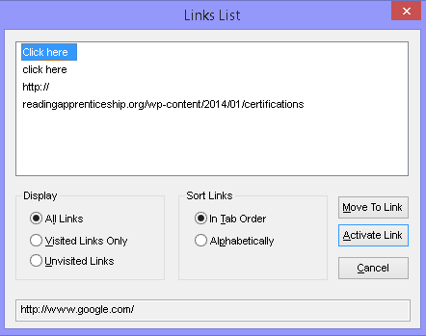
Write Descriptive Link Text (with Embedded Screen Reader Audio)
Click here to read the instructions, and click here to view the video.
Are you a middle school teacher who wants an elementary certification? Read more: http://readingapprenticeship.org/wp-content/2014/01/certifications

Slide 23
Write Descriptive Link Text (with Embedded Screen Reader Audio)
Read the instructions, and then view the video.
Are you a middle school teacher who wants an elementary certification? Read about the add-on certifications available in your state.

Slide 24
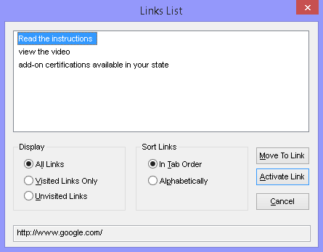
Write Descriptive Link Text
Read the instructions, and then view the video.
Are you a middle school teacher who wants an elementary certification? Read about the add-on certifications available in your state.

Slide 25
Add Alt Text with a Purpose to Images

Slide 26
A Little about Me

Slide 27
A Little about Me

Slide 28
A Little about Me

Slide 29
A Little about Me

Slide 30
Add Alt Text with a Purpose to Images
“A good rule of thumb to consider is to include what you might relay over the phone.”
Penn State Accessibility webpage

Slide 31
Add Alt Text with a Purpose to Images

Slide 32
Add Alt Text with a Purpose to Images
<img src=“https://www.eku.edu/dinosaur.png”
alt=“Dinosaur Turning toward Viewer with Mouth Open” … >

Slide 33
Resources for Learning about Alt Text
WebAIM’s Alternative Text webpage
Penn State’s Accessibility Image ALT Text webpage
Microsoft webpage on creating accessible Word documents

Slide 34
Present Text Using Text, Not an Image of Text

Slide 35
Present Text Using Text, Not an Image of Text

Slide 36
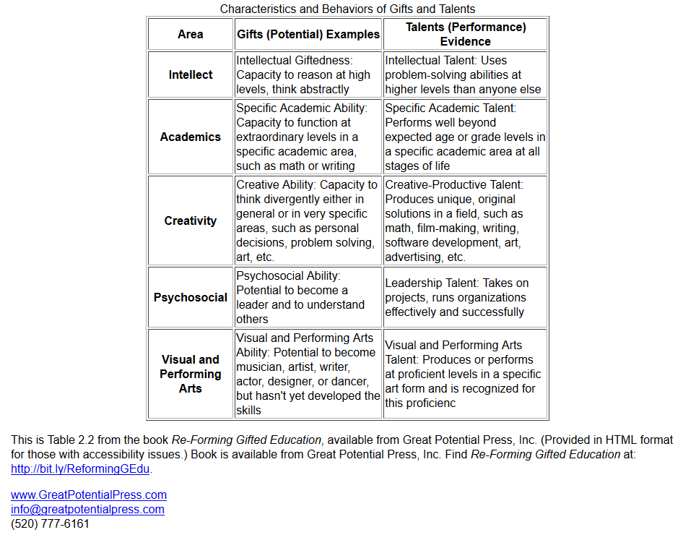
Present Text Using Text, Not an Image of Text

Slide 37
Resources for Extracting Text from Images
Virtual View from Window Eyes
Microsoft OneNote
Free OCR
Online OCR

Slide 38
Rely on Elements Other than Color, Shape, Size to Convey Information

Slide 39
Rely on Elements Other than Color, Shape, and Size to Convey Information

Slide 40
Rely on Elements Other than Color, Shape, and Size to Convey Information

Slide 41
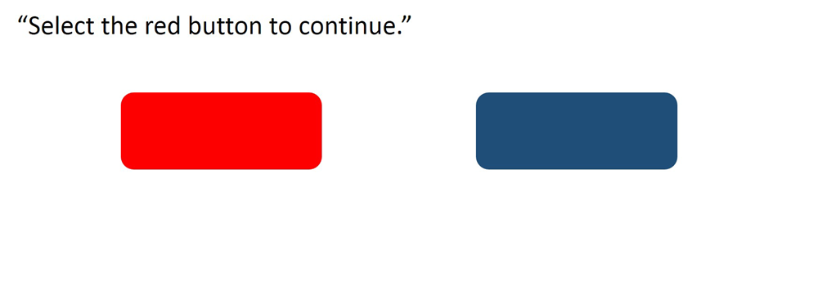
Rely on Elements Other than Color, Shape, and Size to Convey Information

Slide 42
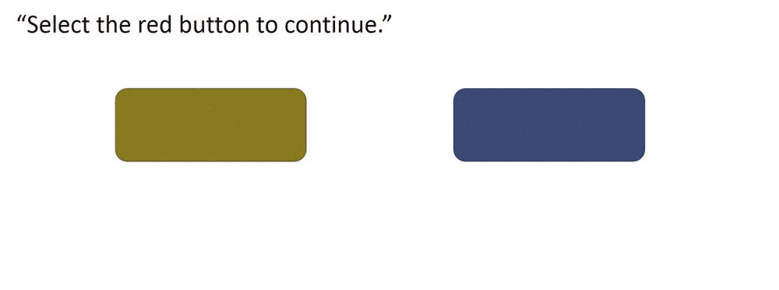
Rely on Elements Other than Color, Shape, and Size to Convey Information

Slide 43
Add Emphasis Using Techniques That a Screen Reader Can Translate
Be sure that you enroll in the course no later than June 30!!!
If you do not do this, you will not be able to take the course again until the following year!
AGAIN, JUNE 30 IS THE FINAL DAY TO ENROLL.

Slide 44
Add Emphasis Using Techniques That a Screen Reader Can Translate
Be sure that you enroll in the course no later than June 30! If you do not do this, you will not be able to take the course again until the following year.

Slide 45
Add Emphasis Using Techniques That a Screen Reader Can Translate
Important: Enroll in the course no later than June 30! If you do not do this, you will not be able to take the course again until the following year.

Slide 46
Resources for Learning about Colorblindness Effects
Etre’s Colour Blind Simulator
Colorblind Web Page Filter
Coblis: Color Blindness Simulator

Slide 47
Provide Captions and Transcriptions

Slide 48
Closed Captions Help …
Focus
Retain information
Overcome poor audio quality
In sound-sensitive environments
With difficult vocabulary
With hearing difficulties
If professor has difficult accent
Those for whom English is a second language
From 3PlayMedia/Oregon State University Webinar
“National Research Results: How and Why Do Students Use Closed Captioning?”

Slide 49
Captioning Tips
If you write a script before recording, you might
upload your video to YouTube, and use the YouTube captioning options
create captions for a video inserted directly into a PowerPoint file with the STAMP plug-in for PowerPoint
create captions using Camtasia Studio’s captioning tool

Slide 50
Captioning Tips
If you do not create a script before recording, you might
upload your video file to YouTube, and allow YouTube to create automatic captions; then edit those captions for accuracy
contact your institution’s disabilities services office to see if transcription services are offered

Slide 51
Use Microsoft Office’s Built-in Accessibility Tools

Slide 52
Use Microsoft Office’s Built-in Accessibility Checker and Tools

Slide 53
Use Microsoft Office’s Built-in Accessibility Checker and Tools

Slide 54
Use Microsoft Office’s Built-in Accessibility Checker and Tools

Slide 55
Hone Your Accessibility Skills through Personal Development

Slide 56
Books
Read books specifically about universal design and accessibility, such as Sarah Horton and Whitney Quesenbery’s A Web for Everyone.

Slide 57
Websites
WebAIM: probably the best website for learning the basics of web accessibility for free
SSB BART Group: an information technology accessibility consultant that offers free webinars and short videos on web accessibility.
The Paciello Group: an accessibility consultant that provides a good Colour Contrast Analyser.
Utah State University’s SALSA: a tool that creates “Styled and Accessible Learning Service Agreements” (SALSAs) in an accessible, properly styled HTML format
University of Minnesota’s Accessible U, University of Washington’s Accessible Technology, and Penn State’s Accessibility: university sites that provide excellent short tutorials on accessibility

Slide 58
Training
WebAIM: provides in-person trainings (at a cost) at its Logan, Utah, location at various times throughout the year.
Deque University: a training site from website accessibility consultant Deque Systems that offers 12 different courses in web accessibility (at a cost). If you have a disability, the courses are free.
Lynda.com: a training site that offers such courses (at a cost) as “Foundations of UX: Accessibility” and “Creating Accessible PDFs with Adobe DC”
Massive Open Online Courses (MOOCs): Information and Communication Technology (ICT) Accessibility is offered through edX and developed by Georgia Institute of Technology’s AMAC Accessibility Solutions and Research Center.

Slide 59
Professional Learning Communities
Leverage a tool like Twitter to follow accessibility experts and keep in touch with the latest on the #a11y front.

Slide 60
Conclusion
“Disability resides in the society, not in the person.”
United Nations Enable website

Slide 61
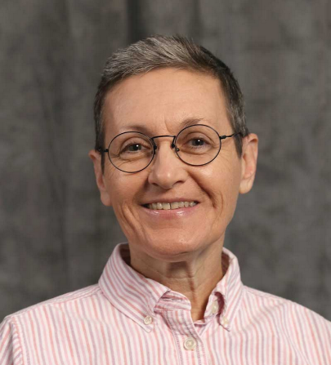
My Contact Information
jennifer.perkins@eku.edu
Twitter: @jenperkins

