Slide 1
Big Ten Academic Alliance Accessibility Collaboration
A Model for multi-institution collaboration

Slide 2
Big Ten Academic Alliance Member Institutions

Slide 3
Presenters/Panelists
Kirk Corey – Director of Policy and User Services
Joe Humbert – Accessibility Specialist
Todd Weissenberger – IT Accessibility Coordinator
Bill Welsh – Associate Vice President for Access

Slide 4
Big Ten Academic Alliance: Origins
Originally “Committee on Institutional Cooperation”
Established to address common institutional challenges
Envisioned by “Council of Ten” (Big Ten Presidents), 1956
Seed funding allocated by Carnegie Corporation, 1958

Slide 5
Strategic Themes and Supporting Goals
PROVIDE NATIONAL LEADERSHIP & INFLUENCE
Enable members’ executive leaders to showcase the impact of member institutions.
Emphasize and promote topics having interest and import to research universities.
Increase visibility of high-impact programs.
PROMOTE A SUSTAINABLE CULTURE OF COLLABORATION
Build academic and public partnerships.
Intentionally connect programs and activities across functional areas of the consortium and the member universities to accelerate adoption of best practice.
Align Big Ten Academic Alliance headquarters operations and resources to support large-scale initiatives and signature programs.
Model collaboration through a proactive and adaptive culture.
INCREASE COST SAVINGS & EFFICIENCIES
Leverage strong peer groups to identify opportunities to maximize efficiencies.
Expand opportunities for cost savings through shared technology and library infrastructure.
Utilize joint procurement processes to gain efficiencies and reduce costs.
Develop model strategies for effectively sharing and promoting exemplary practices that enhance member universities’ academic and administrative programs and activities
http://www.btaa.org/docs/default-source/default-document-library/big-ten-academic-alliance-strategic-directions-2016-2018.pdf

Slide 6
Executive Leadership
Governed by Big Ten Provosts, a “Board of the Whole”
Supporting leadership from
Chief Information Officers
Graduate Deans
Liberal Arts and Sciences Deans
Library Directors
Senior International Officers
IT Accessibility Group chartered, sponsored, overseen by Big Ten CIOs

Slide 7
Information Technology Accessibility Group (ITAG)
Initially an informal affinity group (Accessibility and Usability, ca. 2008)
Chartered by Big Ten CIOs, 2011
Dedicated to building strategies to address common challenges
Comprises staff from a wide range of institutional roles
Notes:
Initially an informal affinity group (Accessibility and Usability, 2008)
Chartered by Big Ten CIOs
Dedicated to building strategies to address common challenges
Comprises staff from a wide range of institutional roles
Information Technology
Disability Services
Instructional Design
Student Affairs
Multimedia
Counsel

Slide 8
ITAG Organizational Chart
Chief Information Officers (CIO's)
Provide support & collective funding
2 CIO's are ITAG members
Information Technology Accessibility Group (ITAG)
Information Technology, Disability Services, Library, Assistive Technology, Procurement, Instructional Designers
ITAG Subgroups (Practice groups)

Slide 9
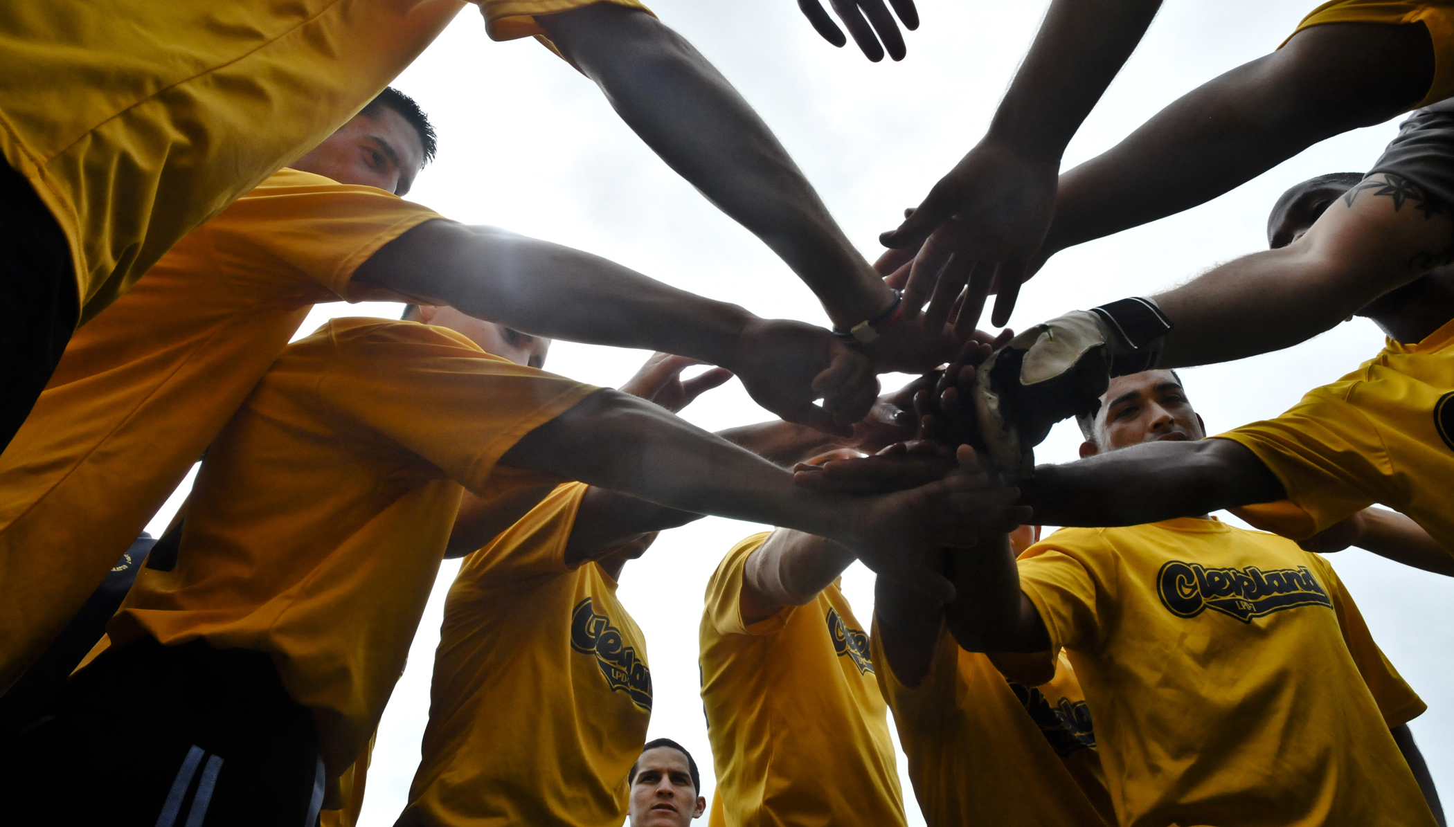
Collaboration
Academic Resources and Exchange
Research Partnerships
Library Initiatives
Purchasing and Licensing Consortia
Leadership and Staff Development
Global and Public Health
Voluntary, Non-binding, Non-coercive

Slide 10
How We Collaborate
Monthly meetings
Set agenda
Success Stories
Annual Face-2-face Meeting
Subgroups/Practice groups
Listserv
Breaking news
Continued discussion

Slide 11
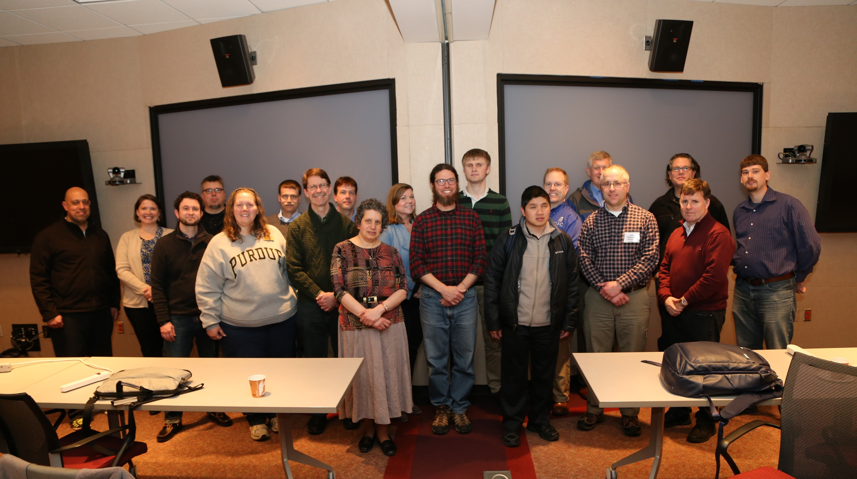
Annual Face-2-Face
Hosted by member institution
Low or no registration cost (only travel)
Explicit time for collaboration
1-day agenda over a 24-hour period
Critical topics
Subgroup meetings

Slide 12
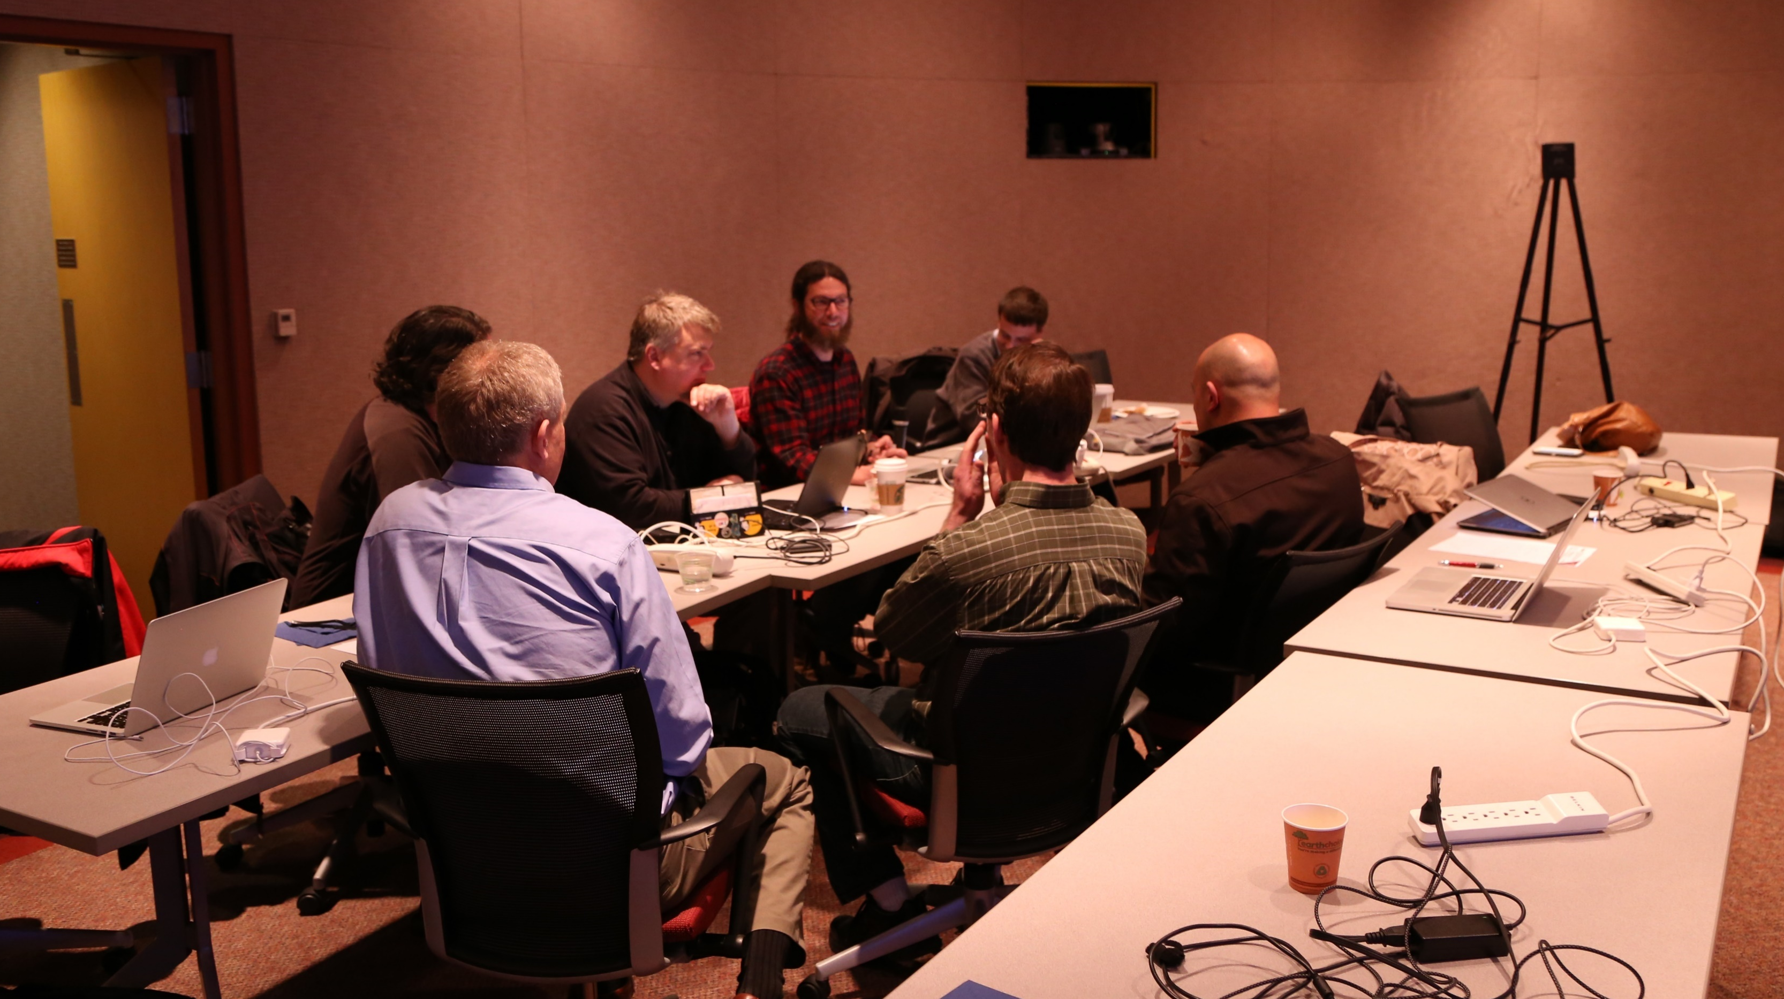
Subgroups/Practice Groups
Cover an explicit topic
Spread work load
Allow for wider participation

Slide 13
Initial Projects
Evaluation of the accessibility of a single product
Web-based accessible media player comparison
Captioning survey and media captioning methods
Vendor Guide to Web Accessibility (a.k.a. the Vendor Cookbook)

Slide 14
Current and Ongoing Projects
Accessibility 101: training and badging
Accessibility assessment of products
E-Book accessibility and assistive technology
Purchasing language and contract models
Accessibility Evaluation Tools & Methodology
Collaboration with other BTAA groups

Slide 15
Benefits of Collaboration
Close working relationship with peers
Sharing of resources
Confidential information
Funding
Feedback on individual projects

Slide 16
Sharing of Information
All members explicitly acknowledge partnership & rules of conduct
Shared to aid in development
Group consensus, but individual institution adaptation

Slide 17
Practice Group
a group of people who share an interest ...in a particular domain or area. It is through the process of sharing information and experiences with the group that the members learn from each other, and have an opportunity to develop themselves personally and professionally. - Lave & Wenger 1991 (http://en.wikipedia.org/wiki/Community_of_practice)
The ITAG is a great example of a Practice Group in action.
This model can be replicated in other higher ed. consortiums.

Slide 18
Other Big Ten Examples
Combining leveraging and expanding resources of member universities is a central strategic focus
The Big Ten Academic Alliance has saved more than $19 million through the purchasing consortium
Software Licensing Principles
Reciprocal Library Borrowing

Slide 19
Other Examples of Consortiums or Practice Groups Outside of BTAA
Cal State’s Accessible Technology Initiative (http://www.csun.edu/universaldesigncenter/shared-responsibility)
Montana Accessibility Interest Group (http://www.umt.edu/accessibility_group/default.php)
Tennessee Board of Regents’ Accessibility Initiative (https://www.tbr.edu/academics/accessibility-initiative)

Slide 20
How Could this Model Be Replicated?
Start small with one or two projects to develop group practices
Go for the low hanging fruits where efforts might already exist
Start with assessment within the alliance
Questions to ask:
Can similar models work within your academic alliances?
What are the some of the alliances to which audience members belong?
How to obtain buy-in?
Do CIO's get it?

Slide 21
Session Q & A
WWW.BTAA.ORG/GROUPS

