Slide 1
Student Access to JAWS, MAGic, and Portable Video Magnifiers through APH creating a compliant campus Michael Wood Strategic Account Manager – Education mwood@vfo-group.com

Slide 2
About VFO
Freedom Scientific – (JAWS – MAGIC – WYNN - RUBY)
Optelec – (Clearview with Speech – Traveller)
Ai-Squared – (ZoomText – Sitecues)

Slide 3
About VFO
VFO develops products – both hardware and software – in cooperation with end-users. Innovation is important to us and we always strive for the best solution.
Our team has extensive knowledge and years of experience in the field of assistive technology. With our solutions, we enable users to gain an education, obtain employment, succeed in professional careers, and live independently throughout their lives.
Our products are represented in more than 70 countries

Slide 4
Objective of APH Student Edition
Students should always have the latest release versions
Immediate access to newest features such as Convenient OCR and MathML (Speech and Braille)
Offer JAWS Tandem for remote help by either the Vision Teachers or Tech Support
Provide FS Reader Software DAISY player and all existing Training Material

Slide 5
Objective of APH Student Edition
Offer a solution via APH Quota Funds
Give Students the choice to use JAWS, MAGic, or even both if necessary
Provide access to software 24/7, including on home computers
Works on all Windows 7, 8.1, and 10, including the Professional versions

Slide 6
APH Student Edition
JAWS Screen Reader
MAGic Screen Magnification including Speech Option

Slide 7
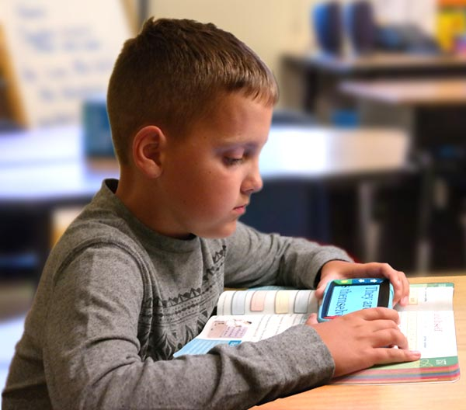
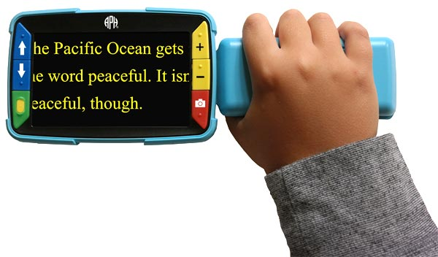
APH Video Mag HD
A robust, kid-friendly handheld video magnifier available on Quota!

Slide 8
How It Works
Federal Quota Funds used to purchase from APH
Annual subscription, provides both JAWS and MAGic for the student
The 12 months begins from the date of the first authorization
License includes 3 authorizations (more by request)
Includes Freedom Scientific Phone Support

Slide 9
Full License Issued after 4 Years
Registered license in the Student’s Name each year
After 4 subscriptions have been registered
Full Home Edition License issued for Student to own
No cost to the school, parent, or APH
Upgrades and Technical Support throughout K-12 Education
After completion of K-12
Student can enter the SMA Program for their license
The cost of SMA today for that is $120 for 2 years

Slide 10
Ordering information from APH
JAWS and MAGic Student Edition, One-Year Subscription: $300.00
Video Mag HD: $499.00
Ex Officio Trustees can submit a signed Quota order to APH by fax or mail. The order can be for one or more JAWS/MAGic Student Edition one-year subscriptions

Slide 11
What’s New in JAWS 18 you ask….
What's New

Slide 12
Dancing Dots
Reading Music
Accessible Music Technology from Dancing Dots
for the Visually Impaired Musician Powered by JAWS, MAGic and ZoomText
CREATE, READ, PRACTICE, and PERFORM your music.
Learn the score using your preferred mix of magnified print, braille, speech and verbal cues.

Slide 13
Dancing Dots
Writing music
Talking braille score combines verbal cues from JAWS with music braille shown on paperless braille display
Low vision users read and write music at zoom level up to 10X.
Type notes into your score using PC keyboard or play on attached musical keyboard.
Quote from Sarah Outwater, blind composer:
“It was the best feeling in the world to hear my teacher take a piece of music I had written, and sight-read it at the piano. There wasn't a choir singing, but I got shivers down my spine anyway, just knowing that now my music isn't just mine, I have the capability of sharing it with the whole world.”

Slide 14
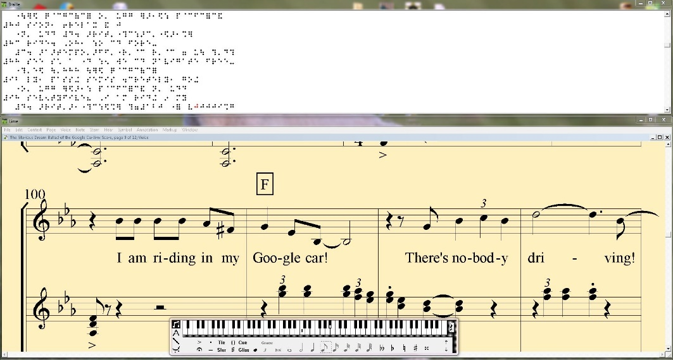
Dancing Dots
A light-hearted but (I hope) thought-provoking song about a blind guy who dreams of the first time he drives his "Google Car", that is, a self-driving car. It is performed by a chorus formed of my students from my 2016 Summer Music Academy in Napa, California in a live performance we gave at the San Francisco Lighthouse last August 9.

Slide 15
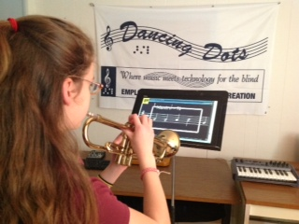
Dancing Dots

Slide 16
TypeAbility Training for Teachers
Videos for Teachers to assist students
TypeAbility Tutorial Part 1
TypeAbility Tutorial Part 2
TypeAbility Tutorial Part 3

Slide 17
TypeAbility Offer
Leading typing tutor designed for users of JAWS and MAGic
Typing skills, JAWS Keyboarding commands, and even Windows commands
Details on this product from http://yesaccessible.com/
Only $79 to add TypeAbility on your Annual Subscription

Slide 18
Free Training Material
DAISY Books for use with built in FS Reader or on your portable DAISY Book reader
Free Titles include:
Windows 10 Basics with JAWS and MAGic
Google Docs with JAWS and MAGic
Facebook with JAWS and MAGic
Access everything on the Training Pages on the Freedom Scientific web site today

Slide 19
Resources on JAWS
www.freedomscientific.com/JAWS
What to consider when upgrading to Windows 10
Authorization issues, key resets, and version info
J-Say and Leasey third party add-ons
Reading MathML with speech and Braille
Tandem for assisting users from a distance
“Surf”s Up” helps learning techniques accessing the web

Slide 20
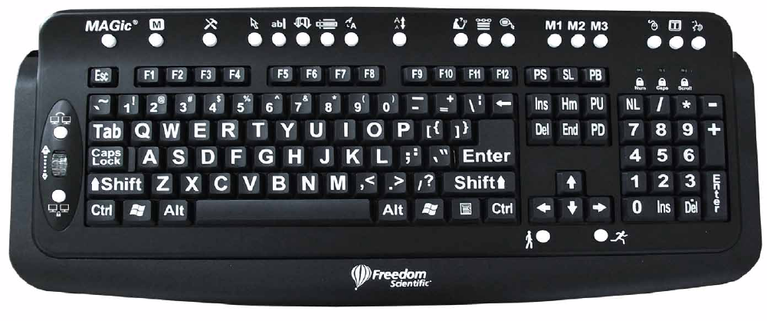
Optional Large Print Keyboard
Works with JAWS and MAGic for only $79
22 specialized keys provides single-key control of most used features

Slide 21
Questions

