Slide 1
Assistive Technology Outcomes in Post-Secondary Students with Disabilities: the Influence of Diagnosis, Gender, and Class-Level
Accessing Higher Ground 2016
Westminster, Colorado
November, 2016
Marla C. Roll, MS, OTR/L
Matt P. Malcolm, PhD, OTR/L

Slide 2
About Us
College of Health & Human Sciences
Department of Occupational Therapy
Colorado State University
Marla C. Roll, MS, OTR /L
Director – Assistive Technology Resource Center
Assistant Professor, Department of Occupational Therapy
Matt P Malcolm, Ph.D., OTR/L
Associate Professor
Department of Occupational Therapy

Slide 3
Agenda
CSU and ATRC overview
What our research has told us thus far
Need and rationale for continued research
Assistive Technology Outcomes in Post-Secondary Students with Disabilities: the Influence of Diagnosis, Gender, and Class-Level
Translation to practice and future research
Discussion

Slide 4
Desired Learning Outcomes
Participants will learn how diagnosis, gender, class-level (e.g., Freshman), and other variables impacted AT outcomes.
Discuss other relevant variables to consider in AT service provision and assessment
Engage in discussion regarding future research directions related to AT service provision
Notes:
We are hoping to consider the 4th learning outcome in a large group discussion at the end.
Shorten or bold
Please ask questions throughout

Slide 5
Institutional Profile
Land grant institution
Carnegie Research University
Comprised of 8 colleges
32,000 students
1,700 faculty
4,500 employees
Located in northern Colorado in Fort Collins, CO (Population: 150,000)
Notes:
Need to update with years stats

Slide 6
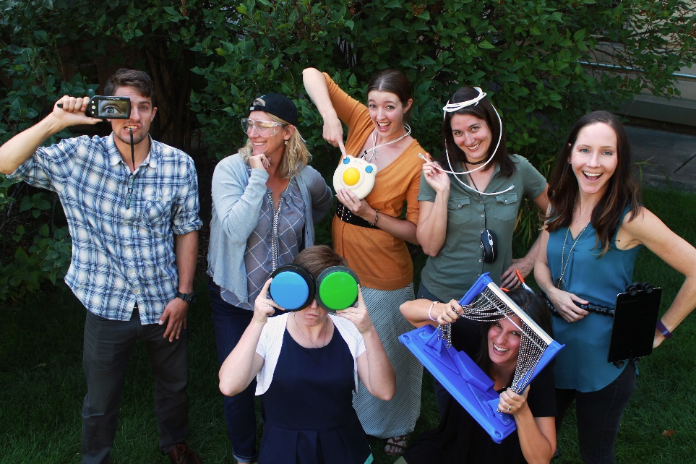
ATRC Mission:
The ATRC ensures equal access to technology
and electronic information for CSU students
and employees with disabilities.
Service Overview:
Services include assistive technology assessments, accommodations and training, as well as consultation and education regarding accessibility and universal design of mainstream and instructional technologies.
OT graduate education regarding assistive technology.
Notes:
ATRC’s is funded by the VP for IT office to ensure ADA and 504 compliance. Three primary functions: provide AT supports to employees and students, consult with the campus on digital accessibility ( how to make web sites and course materials accessible for users of assistive technologies. Today’s presentation is focusing the aspects related to AT supports for students.
Our model is a bit unique. We serve the entire campus but are affiliated with the OT graduate program which allows us to tap into OT faculty and grad students for staffing, research, etc. Win win – we hire OT grad students to assist with our service delivery to campus.

Slide 7
Who comes to the ATRC?
The ATRC serves all majors and undergraduate, masters and PhD level students.
Referrals for students come through the campus DS office and the health center
A separate accommodation process related to technology access occurs.

Slide 8
The ATRC process/service:
Intake/ interview
Gather baseline data (COPM)
Assessment – determination of best tech match
Acquisition of AT supports
Contextual training
Monitor/ follow through
Data collection
( post COPM & ATRC survey)
Notes:
As mentioned, referrals come from primarily the DS office ( some temp dis from PT dept).
We conduct an involved interview/ intake - part of that includes the COPM admin – it serves as a pre baseline measure but also guides our intervention – what we offer – e.g. if they said that reading was the most important task, then we would prioritize reading as the place to start with tech supports.
We use a structured trial and error with the students using the AT to complete school work.
AT is acquired although, we are increasingly using campus site license so the tech is readily available.
We provide training in the location where they plan to use it…. E.g. library, their personal laptop, etc.
We can provide as many sessions as they need – focus is on the application of AT/ tech to academic tasks
Follow through happens throughout the semester
Once the OT feels the AT supports have had time to provide an effect, we administer the COPM again and our ATRC survey.

Slide 9
Our findings to date
Students with any dis.
Reading
Note-taking
Studying
Test-taking
Writing
Notes:
Using the Canadian Occupational Performance Measure (COPM), we previously examined students’ Performance and satisfaction ratings for academic tasks of reading, writing, note-taking, studying, and test-taking.

Slide 10
Performance & Satisfaction ratings significantly increase with AT service delivery
Students with any dis.
Reading
Note-taking
Studying
Test-taking
Writing
(p<.001)
Malcolm MP, Roll MC. (2016). The impact of assistive technology services in post-secondary education for students with disabilities: Intervention outcomes, use-profiles, and user-experiences. Assistive Technology. DOI: 10.1080/10400435.2016.1214932
Notes:
And we found that performance and satisfaction ratings for academic tasks of reading, writing, note-taking, studying, and test-taking all significantly increase following their participation with AT services.
(Malcolm MP, Roll MC. (2016). The impact of assistive technology services in post-secondary education for students with disabilities: Intervention outcomes, use-profiles, and user-experiences. Assistive Technology. DOI: 10.1080/10400435.2016.1214932)

Slide 11
User experiences
Were AT needs identified and in a timely manner?
90% strongly agreed or agreed
What is the best training approach for you?
Demonstration (38%), independent practice (22%), supported practice (22%)
Where do you use AT?
Library (46%), home/dorm (25%), student support services (20%)
On what academic tasks did you use AT?
Studying and reading

Slide 12
User experiences (cont’d)
Did AT positively impact your grades?
Yes (84%)
Did AT help you remain in your classes?
Yes (89%)
Were you able to independently use your AT?
Yes (88%)
If you stopped using AT, why?
Cost
Overall AT availability
AT did not work properly
Will you continue using AT post-graduation?
Yes, very likely (50%)

Slide 13
Previous finding + new questions
What we know
What we do not know
Performance & satisfaction is improved w/AT services
Timely, complete, student-centered, and contextually-appropriate service delivery is important
Use of AT improved the academic experiences of students
Are there differences in AT outcomes across student attributes of diagnosis, gender, and class-level (e.g., Freshman)?
Do these different attribute groups experience and use AT differently?
Notes:
What we know
Performance & satisfaction is improved w/AT services
Timely, complete, student-centered, and contextually-appropriate service delivery is important
Use of AT improved the academic experiences of students
What we do not know
Are there differences in AT outcomes across diagnostic groups, gender, and class-levels (e.g., Freshman)?
Do these different demographic groups experience and use AT differently?

Slide 14
Our new research questions:
1. What is the makeup of the population of students seeking AT services considering attributes of diagnosis/impairment, gender, and class-level?
2. How might these attributes impact AT outcomes related to student perceptions of their performance and satisfaction in completing common academic tasks?
3. Are student perceptions of AT service provision, use, and impact influenced by these same attribute variables?

Slide 15
rationale
The type of diagnosis may influence AT needs, outcomes, and experiences
Women and men in higher ed. have different needs and experiences. Is this true when AT services are involved?
Because the first years of college are the most challenging, might “higher ed. experience” (class-level) be relevant?
For this new investigation
Notes:
What is the rationale for this new investigation?
The type of diagnosis may influence AT needs, outcomes, and experiences
Women and men in higher ed. have different needs and experiences. Is this true when AT services are involved?
Because the first years of college are the most challenging, might “higher ed. experience” (class level) be relevant?

Slide 16
How research might allow us to enhance service delivery
ATRC would be better able to anticipate who might benefit from services
ATRC might be able to target certain populations through outreach efforts – getting them in the door
Information about what diagnoses are benefitting could shape both what we buy and how we train – cater our services to their needs.

Slide 17
Disabilities in Higher Education
Nationally, 11.3% of undergraduates report some type of disability ( National Center for Education Statistics, 2008; U.S. Government Accountability Office, 2009).
At Colorado State University (Schelly, Davies, & Spooner, 2013).
8%–11% report a disability
Non-apparent disabilities are the largest proportion and growing
Notes:
Additionally, national statistics speak to an increased number of students with disabilities attending higher education. Statistics at CSU have mirrored the nat’l stats as well.

Slide 18
Methodology

Slide 19
Methodology
Participants: college students seen as clients in the CSU ATRC between 2011-2015
n=455
All client identifiers were removed from the data at point of analysis
Methods approved by CSU IRB
Investigation: Exploratory and retrospective
Measurement:
Intake questionnaire: attributes
End-of-semester ATRC survey: service provision, AT use, AT impact
Pre- and post-AT intervention (semester) mCOPM: performance, satisfaction

Slide 20
ATRC use of mCOPM
Student
Reading
Note-taking
Studying
Test-taking
Writing
Focuses areas of occupation on academic skills in postsecondary education
How do you rate your performance?
How satisfied are you with this task?
Notes:
mCOPM has allowed us to tailor measures to our population. Also, the focus is on academic success versus use of the technology….
Term occupation is OT speak but translates to meaningful tasks of a college student

Slide 21
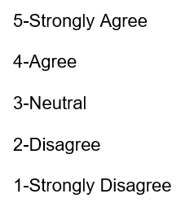
Use of the ATRC survey
Five variables were assessed from the ATRC survey:
“The ATRC staff accurately identified and met my needs during the evaluation, assessment and training sessions” (identification of need).
“The assistive technology accommodation was provided by the ATRC in a reasonable time-frame” (timely accommodation).
“I am currently independently able to use the recommended assistive technology to meet my needs” (independent AT use).
“I feel comfortable requesting course materials from instructors that work best for my learning style and assistive technology needs” (comfort advocating).
“Using Assistive Technology positively impacted my ability to remain in my course(s)” (remain in courses).

Slide 22
RESULTS

Slide 23
What is the makeup of the population of students seeking AT services considering attributes of diagnosis/impairment, gender, and class-level?
Research question 1

Slide 24
Distributions of students served by diagnosis or impairment
Non-apparent (~73%)
Notes:
CNS would include non-apparent like cog impairments secondary to TBI
Approximately 73% of students fit into the category of non-apparent. This number is likely larger given the number of students in the “unspecified” category

Slide 25
Types of Disabilities
Mobility Impairments
Visual Impairments / Blindness
25%
Apparent
75%
Learning Disability
Mental/behavioral disorder (e.g., ADHD, ASD)
CNS damage (e.g., TBI)
Mood disorder (e.g., depression, PTS)
Non-apparent
Notes:
Who is using assistive technology in higher education is changing as is the types of AT they are using. In the early days of the ATRC, the larger population served was students with apparent disabilities. No longer true – thankfully, the types of AT solutions for non apparent have increased as well. However, students with non-apparent disabilities are less likely to self-identify and to receive necessary accommodations.

Slide 26
How might attributes impact AT outcomes related to student perceptions of their performance and satisfaction in completing common academic tasks?
Research question 2

Slide 27
COPM Performance
Notes:
When comparing COPM Performance scores diagnostic groups, we found main effects of time (F_{5,184}=147.72, p<.001, $η_{p}^{2}$ = .45) and group (F_{5,184}=2.85, p=.017, $η_{p}^{2}$ = .072), and a significant group-by-time interaction (F=_{5,184}=2.61, p=.027, $η_{p}^{2}$=.066) for COPM Performance scores. Post-hoc comparisons revealed that the increase in pre- to post change of the Performance score was significantly greater for students with a mental-emotional impairment (a*) compared to those with learning disability (LD; a₁*), those with visual deficit (a₂*), and those with attention deficit disorder/ attention deficit hyperactivity disorder/autism spectrum disorder (ADD/ADHD/ASD; a₃*).

Slide 28
COPM Performance
Notes:
When comparing COPM Performance scores diagnostic groups, we found main effects of time (F_{5,184}=147.72, p<.001, $η_{p}^{2}$ = .45) and group (F_{5,184}=2.85, p=.017, $η_{p}^{2}$ = .072), and a significant group-by-time interaction (F=_{5,184}=2.61, p=.027, $η_{p}^{2}$=.066) for COPM Performance scores. Post-hoc comparisons revealed that the increase in pre- to post change of the Performance score was significantly greater for students with a mental-emotional impairment (a*) compared to those with learning disability (LD; a₁*), those with visual deficit (a₂*), and those with attention deficit disorder/ attention deficit hyperactivity disorder/autism spectrum disorder (ADD/ADHD/ASD; a₃*).

Slide 29
COPM Satisfaction
Notes:
When comparing COPM Satisfaction scores across diagnostic groups, we found main effects of time (F_{1,183}=145.88, p<.001, $η_{p}^{2}$ = .44) and group (F_{5,183}=4.18, p=.001, $η_{p}^{2}$ = .103), and a significant group-by-time interaction (F=_{5,183}=2.65, p=.025, $η_{p}^{2}$=.067). Post-hoc comparisons revealed that the increase in pre- to post change of the Satisfaction score was significantly greater for students with a mental-emotional impairment (a*) compared to those with learning disability (LD; a₁*), those with visual deficit (a₂*), and those with attention deficit disorder/ attention deficit hyperactivity disorder/autism spectrum disorder (ADD/ADHD/ASD; a₃*).

Slide 30
COPM Satisfaction
Notes:
When comparing COPM Satisfaction scores across diagnostic groups, we found main effects of time (F_{1,183}=145.88, p<.001, $η_{p}^{2}$ = .44) and group (F_{5,183}=4.18, p=.001, $η_{p}^{2}$ = .103), and a significant group-by-time interaction (F=_{5,183}=2.65, p=.025, $η_{p}^{2}$=.067). Post-hoc comparisons revealed that the increase in pre- to post change of the Satisfaction score was significantly greater for students with a mental-emotional impairment (a*) compared to those with learning disability (LD; a₁*), those with visual deficit (a₂*), and those with attention deficit disorder/ attention deficit hyperactivity disorder/autism spectrum disorder (ADD/ADHD/ASD; a₃*).

Slide 31
Significantly different changes in performance and satisfaction ratings between groups (p<.02) Greatest change seen for those with mood disorders (p<.05) Gender & class-level did not influence performance and satisfaction ratings
Research question 2: How might attributes impact AT outcomes related to student perceptions of their performance and satisfaction in completing common academic tasks?
Notes:
For research question 2, there were significant differences in the positive change scores when diagnosis was entered as a factor. This greatest changes were seen for those with a mood disorder. Gender & class-level did not influence performance and satisfaction ratings.

Slide 32
Are student perceptions of AT service provision, use, and impact influenced by these same attribute variables?
Research question 3
Notes:
Research question 3: Are student perceptions of AT service provision, use, and impact influenced by these same attribute variables?

Slide 33
Timeliness of accommodation by diagnosis/impairment
Notes:
Diagnostic groups significantly differed on their ratings of “timeliness of accommodation” (F_{6,75}=2.66, p=.021). Post-hoc pairwise comparisons revealed that individuals with mobility deficits or chronic pain (a*) rated “timeliness of accommodation” significantly lower than individuals in the learning disabled (a₁*), ADD/ADHD/ASD/other cognitive perceptual (a₂*), or “other” (a₃*) diagnostic groups.

Slide 34
Timeliness of accommodation by diagnosis/impairment
Notes:
Diagnostic groups significantly differed on their ratings of “timeliness of accommodation” (F_{6,75}=2.66, p=.021). Post-hoc pairwise comparisons revealed that individuals with mobility deficits or chronic pain (a*) rated “timeliness of accommodation” significantly lower than individuals in the learning disabled (a₁*), ADD/ADHD/ASD/other cognitive perceptual (a₂*), or “other” (a₃*) diagnostic groups.

Slide 35
Independence of AT use by diagnosis/impairment

Slide 36
Independence of AT use by diagnosis/impairment
Notes:
Diagnostic groups significantly differed on their ratings of “independence of AT use” (F_{6,75}=2.24, p=.049). Post-hoc pairwise comparisons revealed “independence of AT use” was also rated significantly higher by individuals with a learning disability compared to those with CNS damage.

Slide 37
What was NOT significantly different
Across diagnosis/impairment groups, ratings for these items were similar:
ATRC’s “Identification of AT need” ($\overline{x}$=4.4/5)
Student’s “comfort in self-advocating” for AT needs ($\overline{x}$=3.8/5)
Student’s ability to “remain in courses” ($\overline{x}$=4.2/5)
ATRC Survey results did not differ by gender
ATRC Survey results did not differ by class-level

Slide 38
Across some diagnoses, feelings about the timeliness of AT services and independence of AT use differed Especially note the lower ratings for those with mobility deficit (timeliness) and CNS damage (independence) AT identification, advocacy, and course success ratings were similar across diagnostic groups Gender and class-level did not influence student ratings
Research question 3: Are student perceptions of AT service provision, use, and impact influenced by these same attribute variables?

Slide 39
Take Home Points from the Data
1/3 have diagnosis of LD
Freshman comprise the largest represented class
Performance and satisfaction ratings for all tasks significantly increased
AT outcomes of performance and satisfaction were significantly influenced by diagnosis (for some diagnoses)
AT user experiences were somewhat influenced by diagnosis (for some diagnoses)
Gender and class-level did not influence AT outcomes or user experiences

Slide 40
How may our results be translated to practice?
Although we are not diagnosis-focused, we must consider how person-factors related to diagnosis might influence the student’s AT service outcomes and her/his experiences with AT
Enhance accommodations for students who have a learning disability, visual deficit, mental/behavioral disorder, or CNS damage
Consider “therapeutic use of self” as an intervention principle overlying AT service provision
Explore processes that allow for improved planning for mobility impairments
Must have adequate supports for note-taking

Slide 41
What is next?
Link AT services to objective academic outcomes (retention, GPA, graduation, etc.)
Develop appropriate outcome measures specifically tailored to assess progress in college students who use AT.
Explore co-curricular or co- academic activities - how AT impacts
Focused research on students with non-apparent disabilities

Slide 42
Group Discussion:
Other variables to consider? ( demographics,etc.)
What other research questions should we be asking?
What research questions are you asking on your campus?
Notes:
What else???

Slide 43
Thank You!
Questions:
Contact Info:
Marla.Roll@colostate.edu
Matt.Malcolm@colostate.edu
Slide show available on the ATRC Website
(http://atrc.colostate.edu/presentations.aspx)

Slide 44
AT Accommodation Categories | Description
AT for note-taking | Smartpens that syncrhonize audio lecture recordings to written notes, digital recorders, software or mobile applications for note-taking
Audio readings | Provides audio-only format of a book or class reading, i.e., in MP3 format
Modified display | Changes to color, font, and masking through variety of software and applications; color overlays, open dyslexic font
Text & Audio readings | Reading format that combines text and audio, e.g., text-to-speech
AT for writing | Software and mobile applications that addresses spelling, grammar, language production, mind-mapping, proof-reading
Text recognition | Software and hardware that provides optical character recognition to convert certain non-text file formats (e.g., PDF) into a text format
Alternative inputs | Hardware and software that replace the typical standard keyboard and mouse, e.g., alternate keyboards and pointing devices, voice recognition software
Screen reader | Software that audiblizes all computer events
Magnification | Software or hardware used to magnifiy content, e.g., screen magnification software, hand-held and mounted magnifiers
Ergonomic equipment | Ergonomic keyboards, pointing devices, positioning devices (wrist rests, arm supports, document holders, etc.)
Single word display | Software and mobile applications that display single words during reading
Tactile support | Hardware and software to create tactile graphics for non-text information (images, diagrams, graphs, maps, etc.)

