Slide 1
Accessibility and the California Community Colleges Online Eduction Initiative – Lessons Learned
Jayme Johnson
Director of Accessibility and User Experience
CCC Online Education Initiative

Slide 2
Agenda
What is the Online Education Initiative (OEI)?
Accessibility lessons we’ve learned
Policy & Procurement
Scarcity is the enemy of accessibility
Good pedagogy means it is accessible…
Institutional responsibility (online accessibility is more than course design)

Slide 3
California Community Colleges Online Education Initiative Title Slide. Three images of people using computers, and logos for the Online Education Initiative and California Community Colleges Chancellor's Office.

Slide 4
What is the OEI Trying to Do?
The Online Education Initiative (OEI) is a collaborative effort among California Community Colleges to help significantly more students complete their educational goals by increasing both access to and success in high-quality online courses.

Slide 5
What About Accessibility?
Accessibility is an absolute requirement for all OEI activities and services.
The OEI aims to increase the success of traditionally under-represented students in online education, such as students with disabilities.
WCAG 2.0 AA is the specified standard for ALL OEI resources.

Slide 6
CCC System
With 113 different campuses, the California Community College System is the largest post-secondary educational system in the world.

Slide 7
A Little Background
Notes:
Funding for the California Community Colleges was cut $1.5 billion between the 2007-08 and 2011-12 academic years
Course offerings statewide were cut by roughly 25 percent due to the five consecutive years of deep budget cuts.
The cuts forced community colleges to ration course offerings and as a direct result, nearly 500,000 students were shut out of the system.

Slide 8
Where We Are Now
2010-2013 Turning away students
2015-16 Trying to get them back!

Slide 9
Distance Education in CCC
The average time it takes a student to graduate from a CCC:
7 years
The average time it takes for a student to transfer from a CCC to a four-year institution:
4 years
Source: CCC Research and Planning Group (February 2015) based on data from the CCC Chancellor’s Office MIS Data Warehouse.
Notes:
Facts: Impact of Budget Cuts on the California Community Colleges System During the Recession:
Funding for the California Community Colleges was cut $1.5 billion between the 2007-08 and 2011-12 academic years (PPIC report).
Course offerings statewide were cut by roughly 25 percent due to the five consecutive years of deep budget cuts.
The cuts forced community colleges to ration course offerings and as a direct result, nearly 500,000 students were shut out of the system.

Slide 10
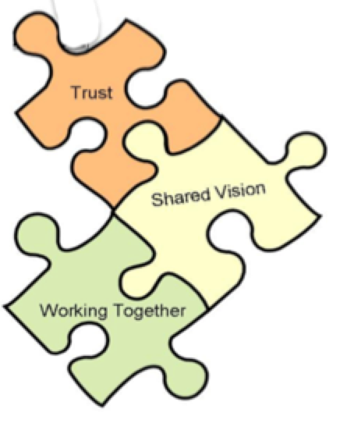
Develop a cross-system collaborative culture focused on what works for students.
.
.
.
.
.
.
.
.
.
.
.
.
.
.

Slide 11
Accessibility Connects the Dots
Initial efforts surround developing an accessible digital ecosystem for online education, centered around student need.
Developing accessible curriculum and identifying critical faculty supports.
Identifying equity issues and closing the gap for students with disabilities.
Developing truly adaptive and responsive technologies for education.

Slide 12
Some OEI Projects
Student Services
Counseling
Readiness Modules
Student/Course Exchange
Technology
CCMS
SIS Adaptor
Single Sign-on
Ally
Course Design
OEI Rubric
Review Process
Discipline-Specific Repositories
Work w/3rd party publishers
Academic
Proctoring
Anti-plagiarism
Tutoring

Slide 13
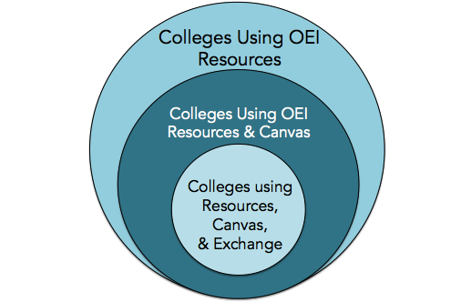
Three levels of opportunity for CCC participation in the OEI.
Notes:
More about Canvas later….. Myth busting: add that courses don’t have to be reviewed to go to canvas only for the exchange.

Slide 14
Accessibility Lessons Learned (so far…)
Procurement processes
Support: system-wide, student, staff, faculty.
Course design
Institutional access issues beyond course design
The value of an independent 3rd party to verify and help with heavy-lifting

Slide 15
Policy & Processes
Who to contact, and how…
Expected wait time for a response
Prominently displayed
Consider master document that describes processes for procurement and other aspects of the business.

Slide 16
Procurement Processes
RFP & Contract language
Sandboxes, demos, usability testing
NDA logistics & testing
Iterative accessibility & commercial non-availability
Goals, milestones, penalties, accommodations charge-back

Slide 17
Scarcity is the Enemy
If the enemy of accessibility is scarcity, then ignorance, laziness, and fear are its toady henchmen…
Scarcity of $$$, skills, understanding, awareness, and leadership leads to a lack of accountability (and access).
Providing effective support for access is an investment in the institution.
Be prepared to address Accommodations vs. Accessibility.

Slide 18
Readiness for Online Learning
“Quest for Success”
First accessibility “issue” for OEI
Able Player
Disabled Student modules coming…
Readiness Modules - Creative Commons http://apps.3cmediasolutions.org/oei/

Slide 19
OEI Student/Course Exchange
Consortium of participating colleges
Home colleges and teaching colleges
Canvas CMS
OEI Course Design Rubric
Ally

Slide 20
Online Course Exchange
Simply put: Enhanced access for students who can’t get the courses they need at their local college to get the courses from another college in the consortium, and without a lot of hassle.

Slide 21
CCMS: Canvas
Great support for accessibility
ATHEN Canvas Accessibility Workgroup

Slide 22
OEI Purchase of Canvas
98/113 colleges have declared intent to migrate;
Over 78 have formally initialized the process
Some important items to note
OEI is currently paying 100% cost until 2018-19 when it will either continue at 100% or drop to OEI paying 2/3 of the cost via ongoing grant funding.
If OEI pays, colleges may choose to have more than one CMS only if they pay the OEI contracted price for Canvas, otherwise colleges have some migration time but must use Canvas as sole CMS.
24/7 Help desk for Canvas is included
Migration resources are available.
Faculty Resources are available, too.
Notes:
Do we need a list of the 47? The implementation guide is linked at the CMS type.

Slide 23
SIS Adaptor
The magic glue
Automation of processes
Elimination of redundancy
Coordinates student information and centralizes data for disability verification and accommodation prescriptions

Slide 24
Single Sign-On
Establish a cohesive digital infrastructure/ecosystem
Student profile becomes a passport for learning
Creates potential for truly adaptive computing technology that responds to user preferences, accommodations, and academic progress, which creates a responsive and intelligent user experience.

Slide 25
Ally
Automated accessibility solution
Integrates directly into Canvas
Assesses all materials
Creates accessible alternate formats

Slide 26
Ally Alt Formats
Enhance original document
HTML – high quality semantic version
Multiple alternate formats: electronic braille, EPUB, audio, etc.

Slide 28
OEI Course Design Rubric
4 Primary Components:
A. Course Design
B. Interaction and Collaboration
C. Assessment
D. Learner Support

Slide 29
Create Accessible Materials
Use heading styles.
Describe images and non-textual content.
Provide captions and transcripts where appropriate.
Use meaningful link text.
Tables for Data.
Use color, but use it carefully.

Slide 30
Select Accessible Resources
Look for content that:
Uses heading styles.
Describes images and non-textual content.
Provides captions and transcripts where appropriate.
Uses meaningful link text.
Uses tables for data.
Uses color, but uses it carefully.

Slide 31
Discipline-Specific Learning Objects
The concept: identify disciplines with endemic accessibility issues, create accessible learning objects and activities for open repository.
Instructional Designers and Access Specialists work with faculty subject matter experts.
Determine targeted alternate formats for optimal usage within certain usability contexts.
Creative Commons licensing for widespread sharing.

Slide 32
Third-Party Content & Publishers
The CCC Chancellor's Office has hired a publisher liaison.
Work in progress with major publishers.
Encouraging transfer of inaccessible website content into Canvas as accessible content.
Identifying high-value content and working with authors to enhance accessibility.

Slide 33
Enhance the Accessibility of your Teaching
Include a statement in your syllabus inviting students to talk with you and the DSPS office about any disability issues.
Point out campus resources like study skills labs, tutoring centers, computer labs, etc.
When teaching, state objectives, review previous lessons, and summarize every so often.

Slide 34
Beyond Course Design
Campus risks to online accessibility
DSPS in the online context
Online Accommodations Model
Policy, procedures, accountability
Professional Development
Union issues

Slide 36
Questions?

Slide 37
Resources
OEI Accessibility Resources for Online Education: https://ccconlineed.instructure.com/courses/98
CCC Accessibility Center Guidelines: http://cccaccessibility.org/techniques/accessible-document-creation
OEI Project Website: www.ccconlineed.org
Project updates: http://ccconlineed.org/category/pats-blog/

Slide 38
Thank You!
Jayme Johnson
Director of Accessibility and User Experience
California Community Colleges Online Education Initiative
jjohnson@ccconlineed.org

