Slide 1
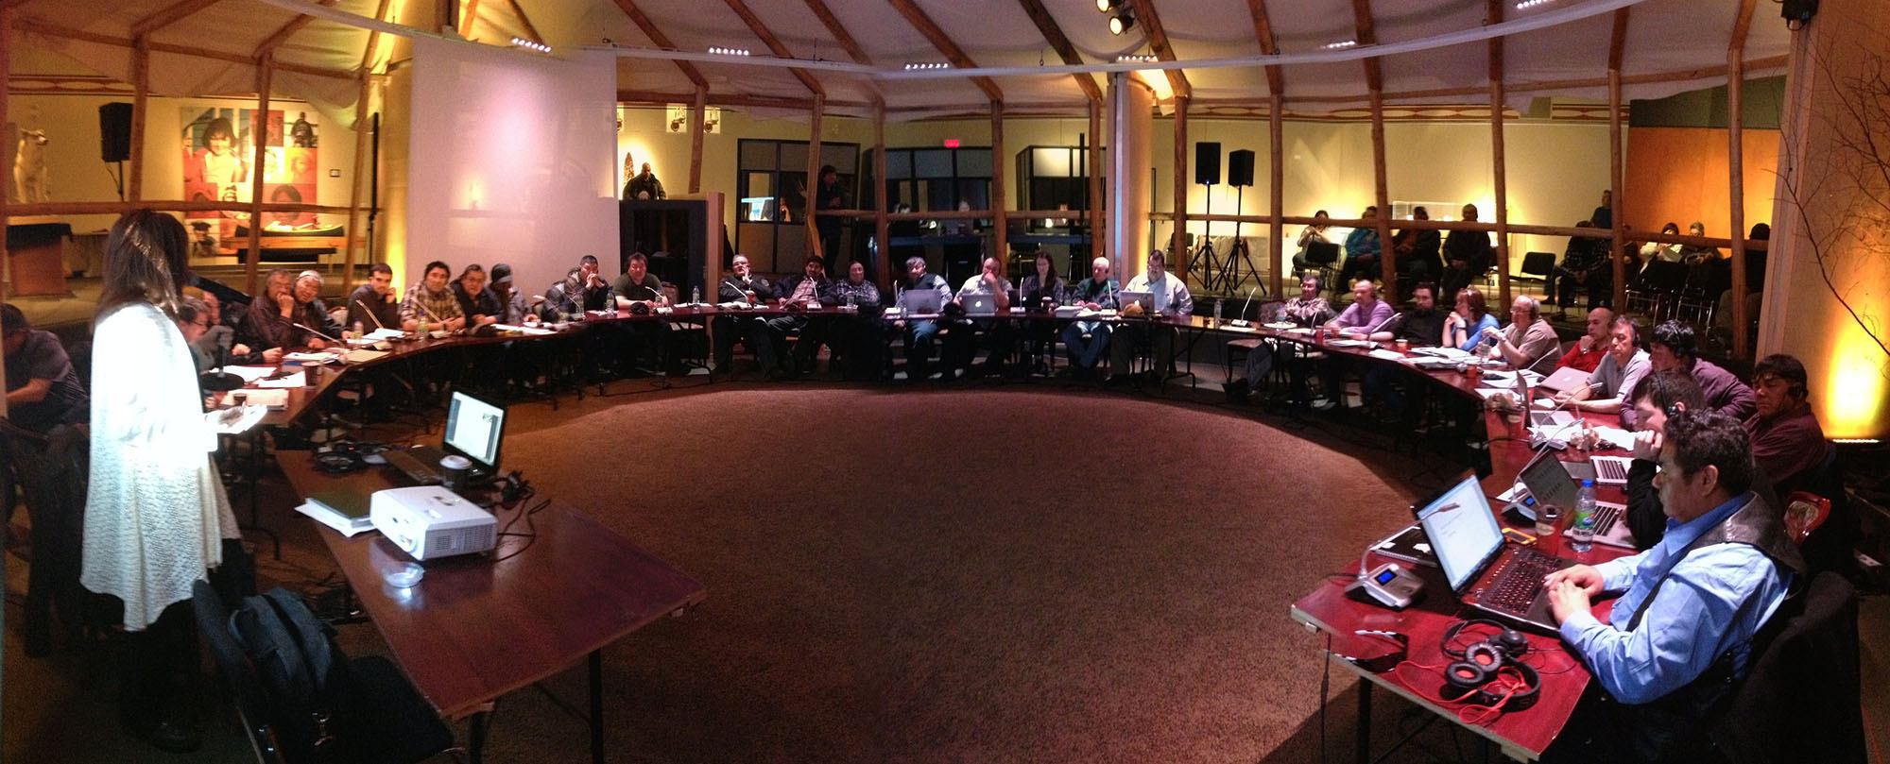
LinkedIn
YouTube
Google+
Facebook
Twitter
Social media
Information in the public interest
Immediate threats
Accessibility standards & policies
Access to information
User generated content

Slide 2
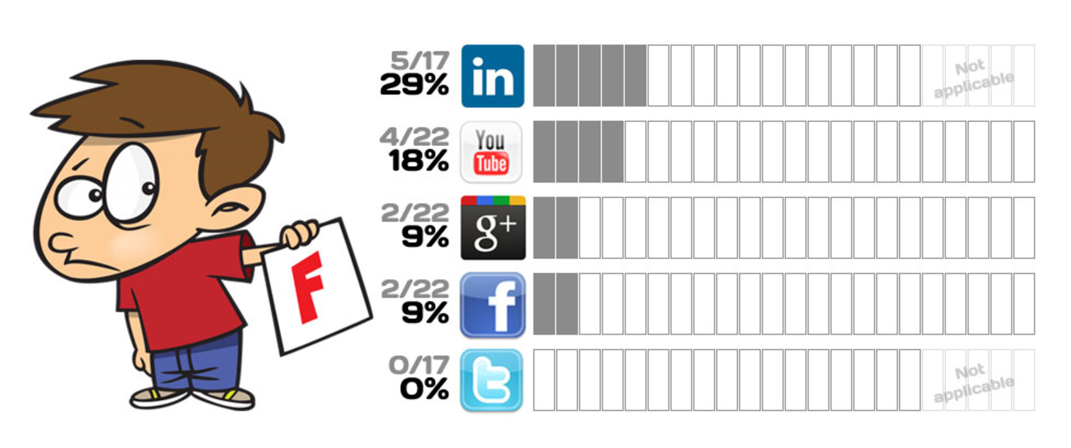
Some 5 years ago…

Slide 3
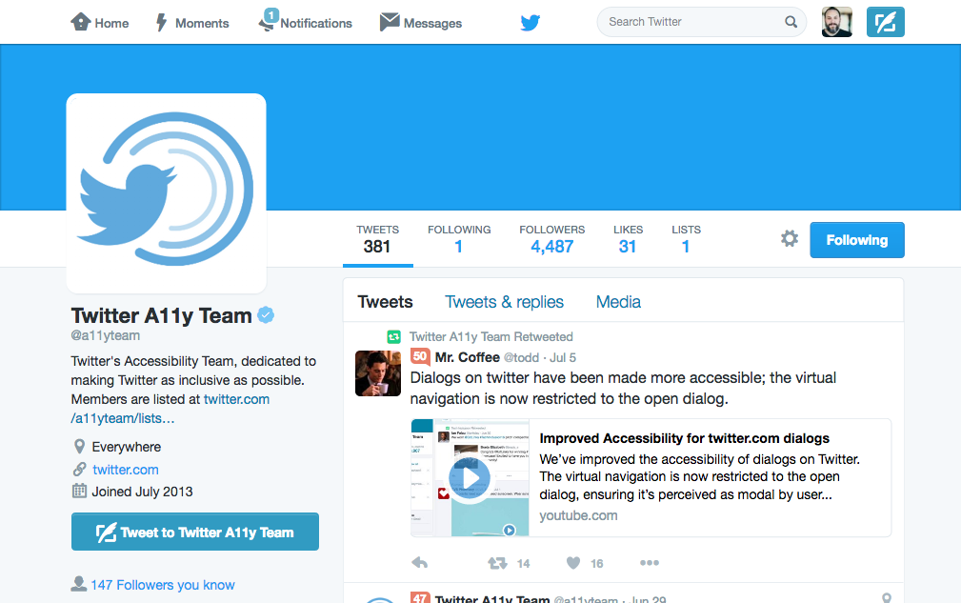
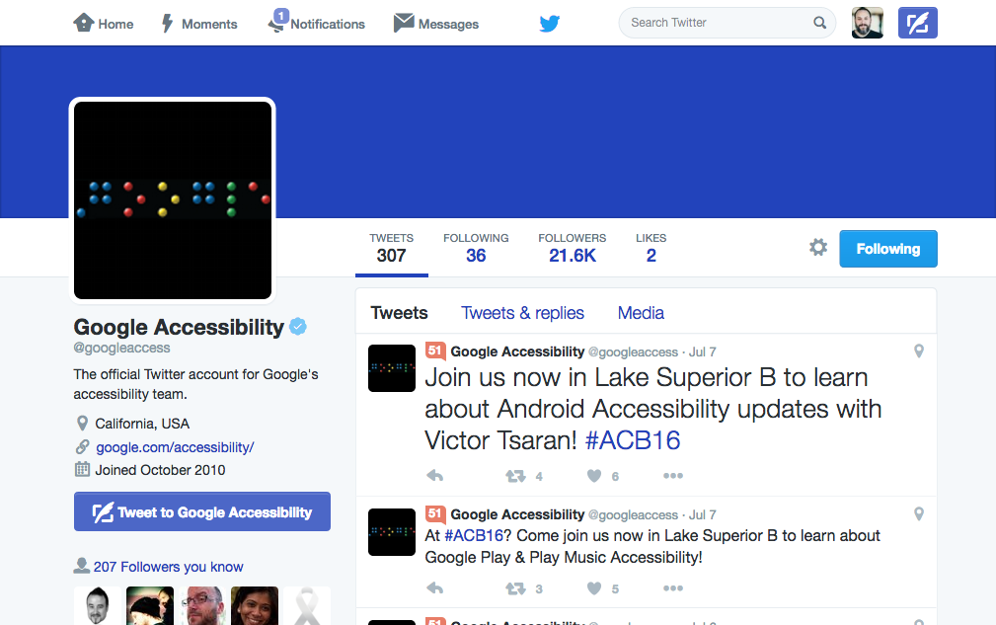
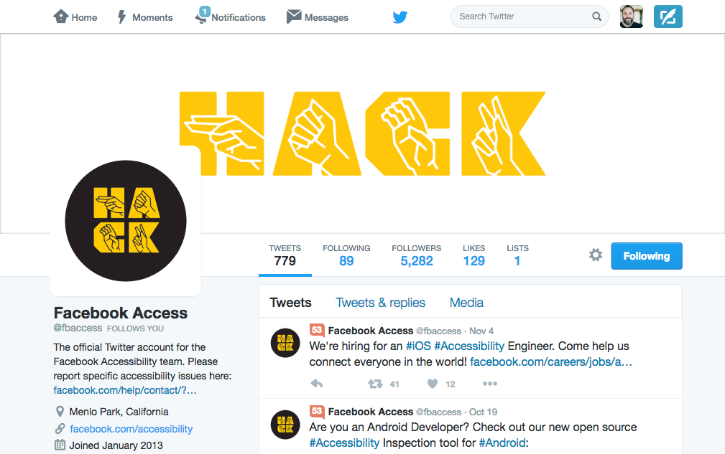
Lots has happened since then!

Slide 4
Social Media, Accessibility, and You
November 16, 2016
John Foliot (john.foliot@deque.com) Denis Boudreau (denis.boudreau@deque.com)

Slide 5
Social media channels
384 issues reported
20 automated rules (heavily depends on content)

Slide 6
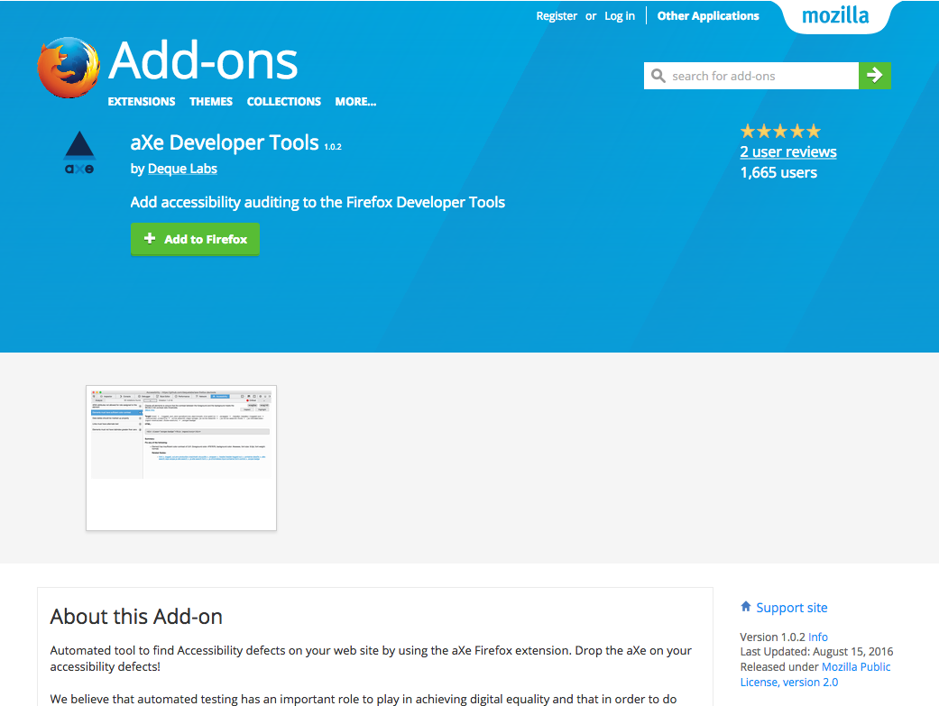
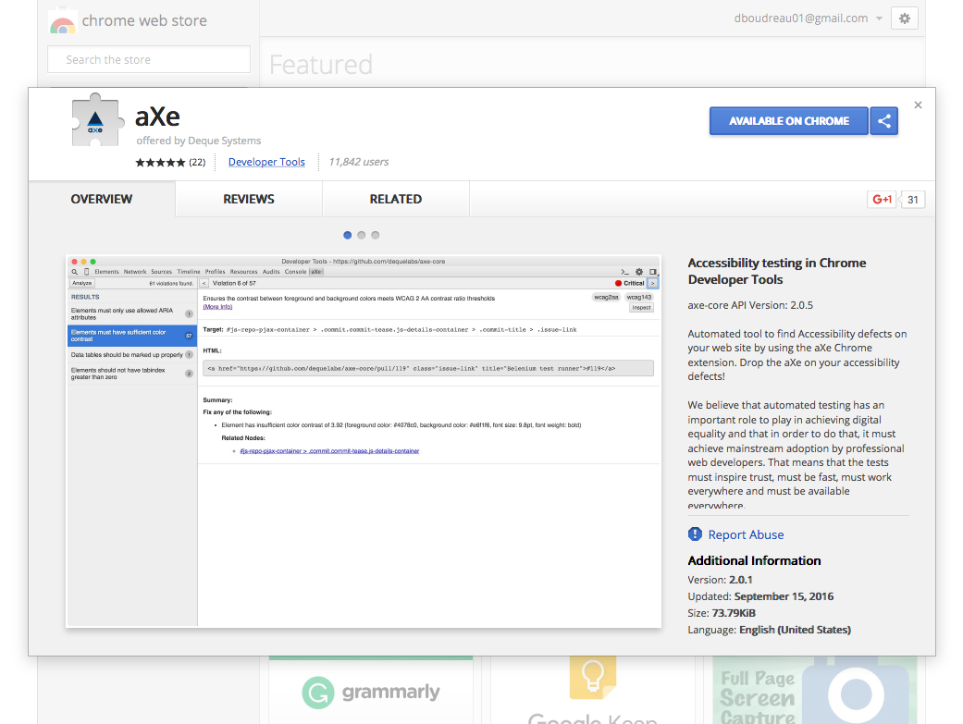
Axe Developer tools
https://addons.mozilla.org/en-us/firefox/addon/axe-devtools/
https://chrome.google.com/webstore/detail/axe/lhdoppojpmngadmnindnejefpokejbdd

Slide 7
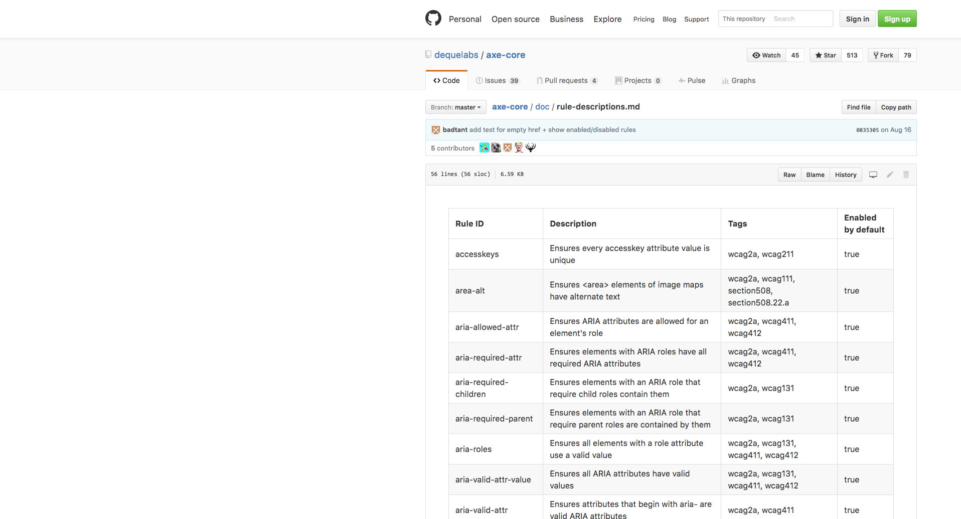
Axe Core rules
Resource https://github.com/dequelabs/axe-core/ blob/master/doc/rule-descriptions.md
Notes:
Provide an overview of the rules used in Axe – discussion about automated rules.

Slide 8
Twitter
Incorrect use of ARIA attributes
Buttons with indiscernible text
Insufficient color contrast ratios
Duplicate ID attribute values
Frames without unique title attributes
Lang attribute not defined
Lang attributes with invalid values

Slide 9
Facebook
Buttons with indiscernible text
Insufficient color contrast ratios
ARIA roles missing expected children
ARIA attributes with invalid values
Missing form labels
Links with indiscernible text
ARIA roles with invalid values
Radio inputs not part of a grouping

Slide 10
LinkedIn
Buttons with indiscernible text
Insufficient color contrast ratios
Duplicate ID attribute values
Frames without unique title attributes
Lang attribute not defined
Missing required ARIA attributes
ARIA roles missing expected children
ARIA roles missing expected parents
ARIA attributes with invalid values
Empty <title> element
Missing form labels
Links with indiscernible text

Slide 11
Pinterest
Buttons with indiscernible text
Insufficient color contrast ratios
Links with indiscernible text
Images without alt text
Zooming and scaling is disabled

Slide 12
YouTube
Incorrect use of ARIA attributes
Frames without unique title attributes
Tabindex attributes with positive values
<video> elements without captions
<video> elements without audio descriptions

Slide 13
Instagram
Buttons with indiscernible text
Insufficient color contrast ratios
Missing form labels
Links with indiscernible text
<video> elements without captions
<video> elements without audio descriptions
Images without alt text
Zooming and scaling is disabled

Slide 14
Social media and accessibility
Incorrect use of ARIA attributes | X |  |  |  | X
Buttons with indiscernible text | X | X | X | X |  | X
Insufficient color contrast ratios | X | X | X | X |  | X
Duplicate ID attribute values | X |  | X
Frames without unique title attributes | X |  | X |  | X
Lang attribute not defined | X |  | X
Tabindex attributes with positive values | X |  |  |  | X
Missing required ARIA attributes |  |  | X
ARIA roles missing expected children |  | X | X
ARIA roles missing expected parents |  |  | X
ARIA attributes with invalid values |  | X | X
Empty <title> element |  |  | X
Missing form labels |  | X | X |  |  | X
Links with indiscernible text |  |  | X | X |  | X
ARIA roles with invalid values |  | X
Radio inputs not part of a grouping |  | X
<video> elements without captions |  |  |  |  | X | X
<video> elements without audio descriptions |  |  |  |  | X | X
Images without alt text |  |  |  | X |  | X
Zooming and scaling is disabled |  |  |  | X |  | X

Slide 15
The more diverse the content on social media platforms is, the more rules are likely to be failed by automated tools…
“
”

Slide 16
Taking a closer look…
Low hanging fruits (+/- 30% of existing issues)
Everything else

Slide 17
Axe core manifesto
Automated accessibility testing rules must…
have a zero false positive rate
be lightweight and fast
work in all modern browsers
themselves, be tested automatically
Join the Axe-Core community and get involved! https://github.com/dequelabs/axe-core

Slide 18
While some social media channels have been working really hard to make their platforms accessible, much remains to be done.
“
”

Slide 19
Polices and Standards

Slide 20
WCAG 2.0
Does the W3C WCAG 2.0 accessibility standard apply, and if so, how?

Slide 21
WCAG 2.0
Web Content Accessibility Guidelines
Social Media = Publishing
Sub-set of WCAG 2.0 likely applies
Currently no legal precedent
Who wants to be first?

Slide 22
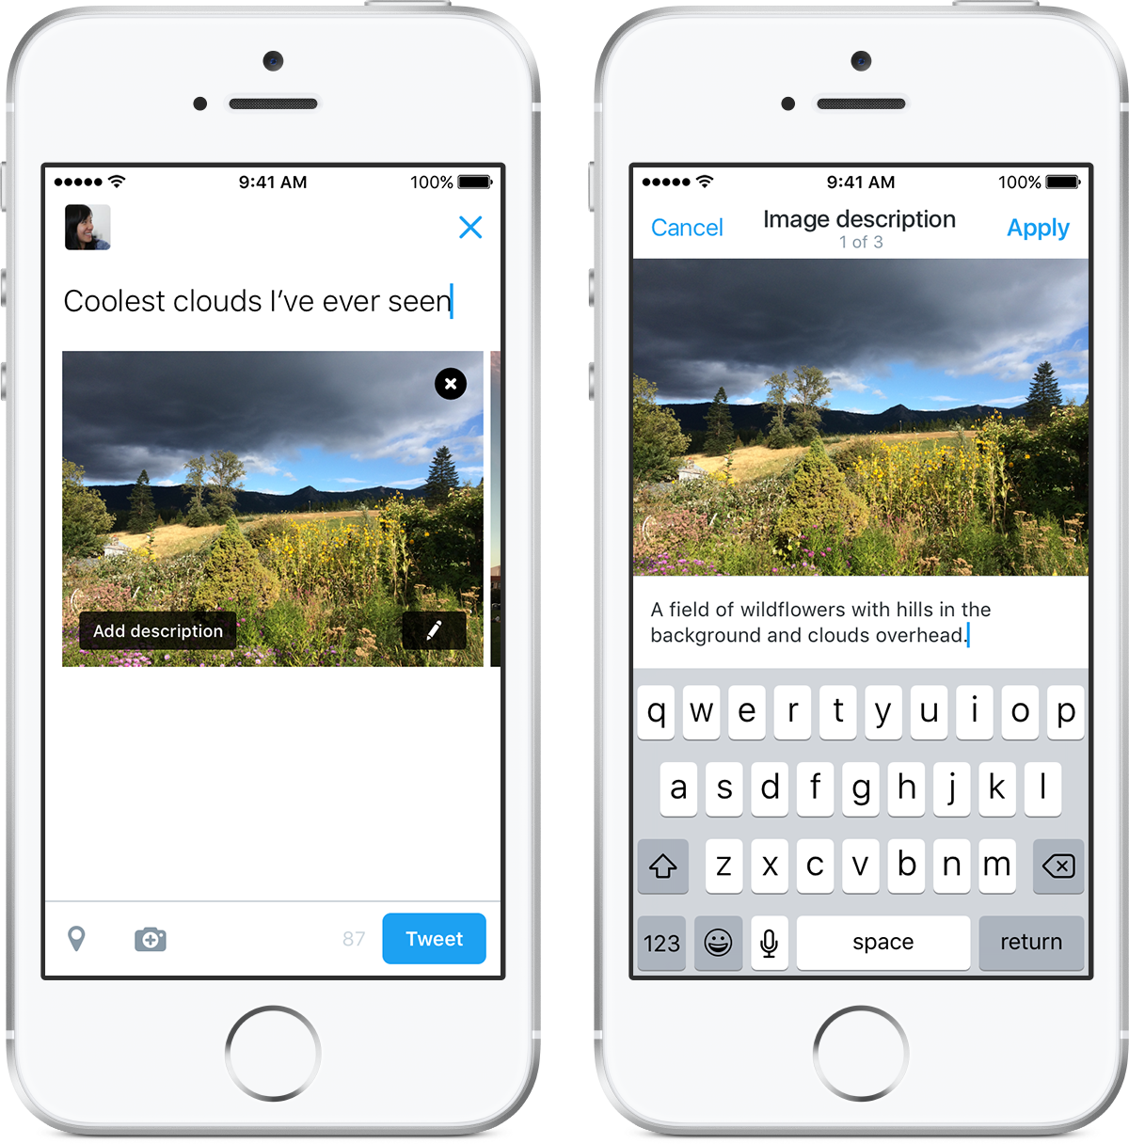
WCAG 2.0 Success Criteria: Perceivable
SC 1.1.1 Non-text Content: All non-text content that is presented to the user has a text alternative that serves the equivalent purpose.

Slide 23
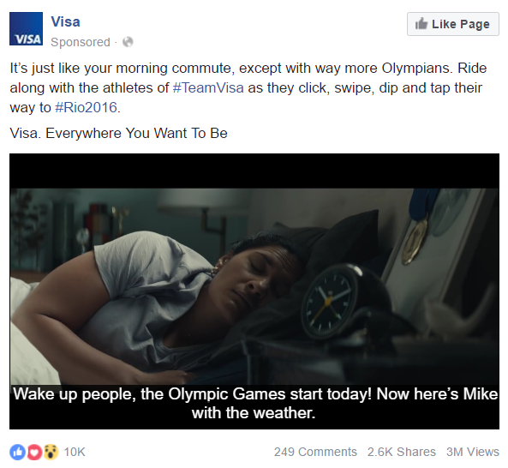
WCAG 2.0 Success Criteria: Perceivable
SC 1.2.1 Audio-only and Video-only (Prerecorded): For prerecorded audio-only and prerecorded video-only media, the following are true, except when the audio or video is a media alternative for text and is clearly labeled as such:
Prerecorded Audio-only: An alternative for time-based media is provided that presents equivalent information for prerecorded audio-only content.
Prerecorded Video-only: Either an alternative for time-based media or an audio track is provided that presents equivalent information for prerecorded video-only content.
SC 1.2.2 Captions (Prerecorded): Captions are provided for all prerecorded audio content in synchronized media, except when the media is a media alternative for text and is clearly labeled as such.
SC 1.2.3 Audio Description or Media Alternative (Prerecorded): An alternative for time-based media or audio description of the prerecorded video content is provided for synchronized media, except when the media is a media alternative for text and is clearly labeled as such.
SC 1.2.5 Audio Description (Prerecorded): Audio description is provided for all prerecorded video content in synchronized media.

Slide 24
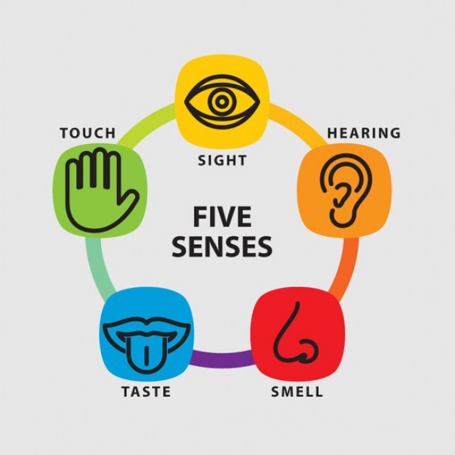
WCAG 2.0 Success Criteria: Perceivable
SC 1.3.3 Sensory Characteristics: Instructions provided for understanding and operating content do not rely solely on sensory characteristics of components such as shape, size, visual location, orientation, or sound.

Slide 25
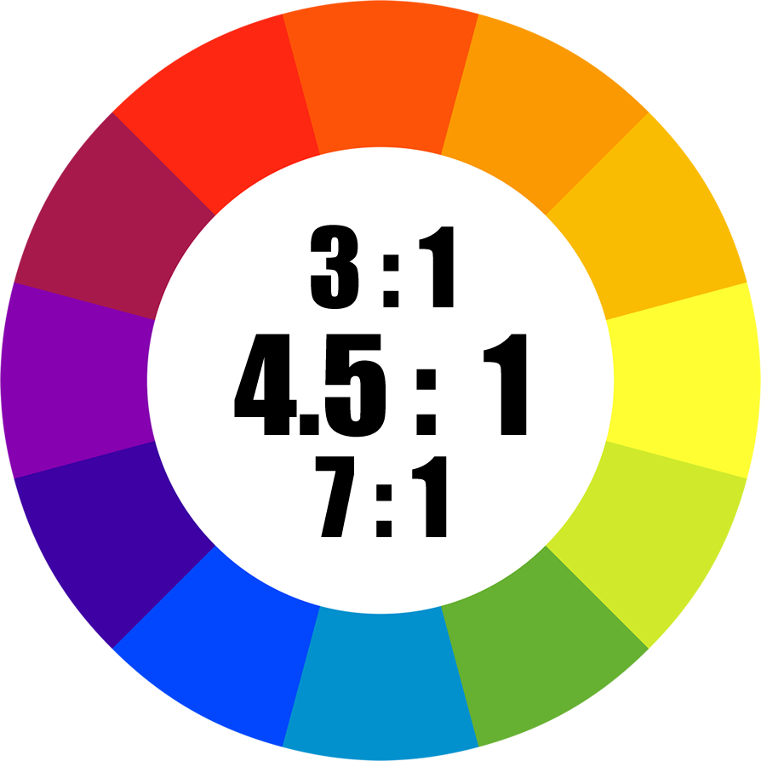
WCAG 2.0 Success Criteria: Perceivable
SC 1.4.1 Use of Color: Color is not used as the only visual means of conveying information, indicating an action, prompting a response, or distinguishing a visual element.
SC 1.4.3 Contrast (Minimum): The visual presentation of text and images of text has a contrast ratio of at least 4.5:1…

Slide 26
WCAG 2.0 Success Criteria: Operable
SC 2.3.1 Three Flashes or Below Threshold: Web pages do not contain anything that flashes more than three times in any one second period, or the flash is below the general flash and red flash thresholds.

Slide 27
WCAG 2.0 Success Criteria: Operable
2.4.4 Link Purpose (In Context): The purpose of each link can be determined from the link text alone or from the link text together with its programmatically determined link context, except where the purpose of the link would be ambiguous to users in general.

Slide 28
Section 508
What about Section 508?
§ 1194.22 Web-based intranet and internet information and applications.
(a) A text equivalent for every non-text element shall be provided (e.g., via “alt”, “longdesc”, or in element content).
(b) Equivalent alternatives for any multimedia presentation shall be synchronized with the presentation.
(j) Pages shall be designed to avoid causing the screen to flicker with a frequency greater than 2 Hz and lower than 55 Hz.
(k) A text-only page, with equivalent information or functionality, shall be provided to make a web site comply with the provisions of this part, when compliance cannot be accomplished in any other way. The content of the text-only page shall be updated whenever the primary page changes.

Slide 29
What (if any) is your legal liability exposure?
Opinion:
The lack of a Social Media Accessibility Policy at your institution today means you are unprepared.

Slide 30
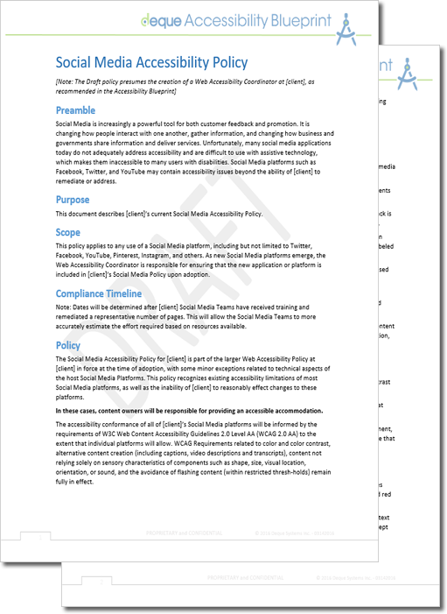
Strategy and Draft Policy
Preamble
Unfortunately, many social media applications today do not adequately address accessibility and are difficult to use with assistive technology, which makes them inaccessible to many users with disabilities. Social Media platforms such as Facebook, Twitter, and YouTube may contain accessibility issues beyond the ability of [institution] to remediate or address.
Purpose
This document describes [institution]’s current Social Media Accessibility Policy.
Scope
This policy applies to any use of a Social Media platform, including but not limited to Twitter, Facebook, YouTube, Pinterest, Instagram, and others. As new Social Media platforms emerge, the Web Accessibility Coordinator is responsible for ensuring that the new application or platform is included in [Institution]’s Social Media Policy upon adoption.
Compliance Timeline
[?????]
Download a copy: https://www.dropbox.com/sh/mgofto9ly7innuz/AADwwTGvfIID9NDbbuhMzRywa?dl=0

Slide 31
Strategy and Draft Policy
Policy
The Social Media Accessibility Policy for [institution] is part of the larger Web Accessibility Policy at [institution] in force at the time of adoption, with some minor exceptions related to technical aspects of the host Social Media Platforms. This policy recognizes existing accessibility limitations of most Social Media platforms, as well as the inability of [institution] to reasonably effect changes to these platforms.
In these cases, content owners will be responsible for providing an accessible accommodation.
The accessibility conformance of all of [institution]’s Social Media platforms will be informed by the requirements of W3C Web Content Accessibility Guidelines 2.0 Level AA (WCAG 2.0 AA) to the extent that individual platforms will allow. WCAG Requirements related to color and color contrast, alternative content creation (including captions, video descriptions and transcripts), content not relying solely on sensory characteristics of components such as shape, size, visual location, orientation, or sound, and the avoidance of flashing content (within restricted thresh-holds) remain fully in effect.

Slide 32
Best Practices

Slide 33
Facebook – Best Practices
General Account Information
Ensure your website address is listed in the “About” section of your Timeline/Page in order to provide an easy point of entry to more information.
Include other ways to contact your organization, such as your department number with an extension, linking to an online “Contact Us” form, or general contact email address for more information.
http://www.queensu.ca/accessibility/how-info/social-media-accessibility

Slide 34
Facebook – Best Practices
Photos, Video, and Audio
Provide a caption for any photo you post. On your Facebook page:
When creating a new album, add captions to your photos by going to the edit input field associated with a photo. Enter caption text. Repeat this step for all photos in the album.
When uploading a single photo, type a caption in the text field that will be used as a caption for the photo.
If the photo/video/audio is on your website you can provide a link back to the webpage that hosts a copy of the photo, video, or audio with full longer description, and/or caption/transcript.
After posting a video, or audio, immediately post a comment that directs users to the full caption or the full transcript.
http://www.queensu.ca/accessibility/how-info/social-media-accessibility

Slide 35
Facebook – Best Practices
Photos, Video, and Audio
If you have a YouTube channel, upload your video to your channel and make sure you enable closed-captions (you’ll want to upload your own transcript to make sure the captions are accurate). Then post a link to your YouTube video as your status update, rather than uploading the video into Facebook. This will ensure that visitors will be taken to your accessible version on YouTube.
Alternately, provide captions as Open Captions. Be creative, many Facebook videos today are ‘artistically’ captioned, and connect with users in the even with audio silenced (initial state).
http://www.queensu.ca/accessibility/how-info/social-media-accessibility

Slide 36
Twitter – Best Practices
General Account Information
In the “Bio” section of your profile, include other ways to contact your organization, such as your department number with an extension, an online “Contact Us” form, or general contact email address for more information.
Ensure you have good color contrast between the background, avatar, and bio information.
Place any hashtags or @mentions at the end of the tweet. This allows a screen reader to voice the main content of the tweet more clearly in the beginning, and saving the service-specific speak for the end (the parts that sound confusing).
Avoid using unfamiliar acronyms or “text-speak” that would sound strange if read by a screen reader. If space allows, try to spell out the acronyms or use full words to better convey the information.
Use "CamelCase" for multiple words for hashtags; that is, capitalize the first letters of compound words
http://www.queensu.ca/accessibility/how-info/social-media-accessibility

Slide 37
Twitter – Best Practices
Photos, Video, and Audio
Put the following prefixes before tweets that have photos, videos, or audio. This allows people using screen readers to know what to expect before it’s read out loud. The uppercase formats are for further clarity to sighted users.
Photos: [PIC]
Videos: [VIDEO]
Audio: [AUDIO]
If your website has a full closed captioned video or transcript posted online, include a link back to the page.
Make your tweet serve as a descriptive caption so it has context for the item and then link back to your website if necessary.
http://www.queensu.ca/accessibility/how-info/social-media-accessibility

Slide 38
Social media accessibility myths
People with disabilities don’t use social media
Social media is accessible and can be used without limitation
Organizations using social media are reaching everyone they need and want to reach
It’s expensive and time-consuming to make social media content accessible
Compliance with Section 508 of the Rehabilitation Act of 1973 guarantees social media accessibility

Slide 39
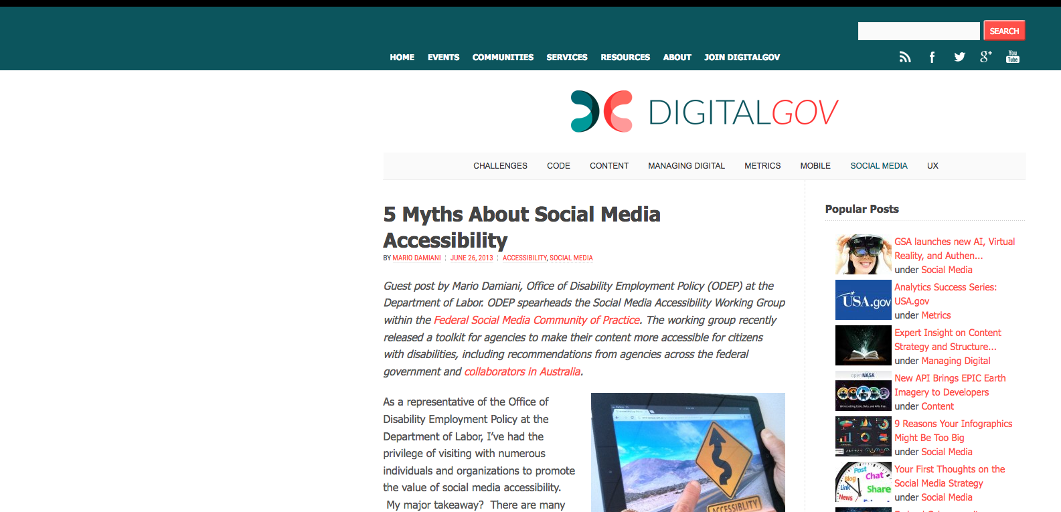
Myths, debunked
Resource https://www.digitalgov.gov/2013/06/26/5-myths-about-social-media-accessibility-2/
Notes:
Provide an overview of the rules used in Axe – discussion about automated rules.

Slide 40
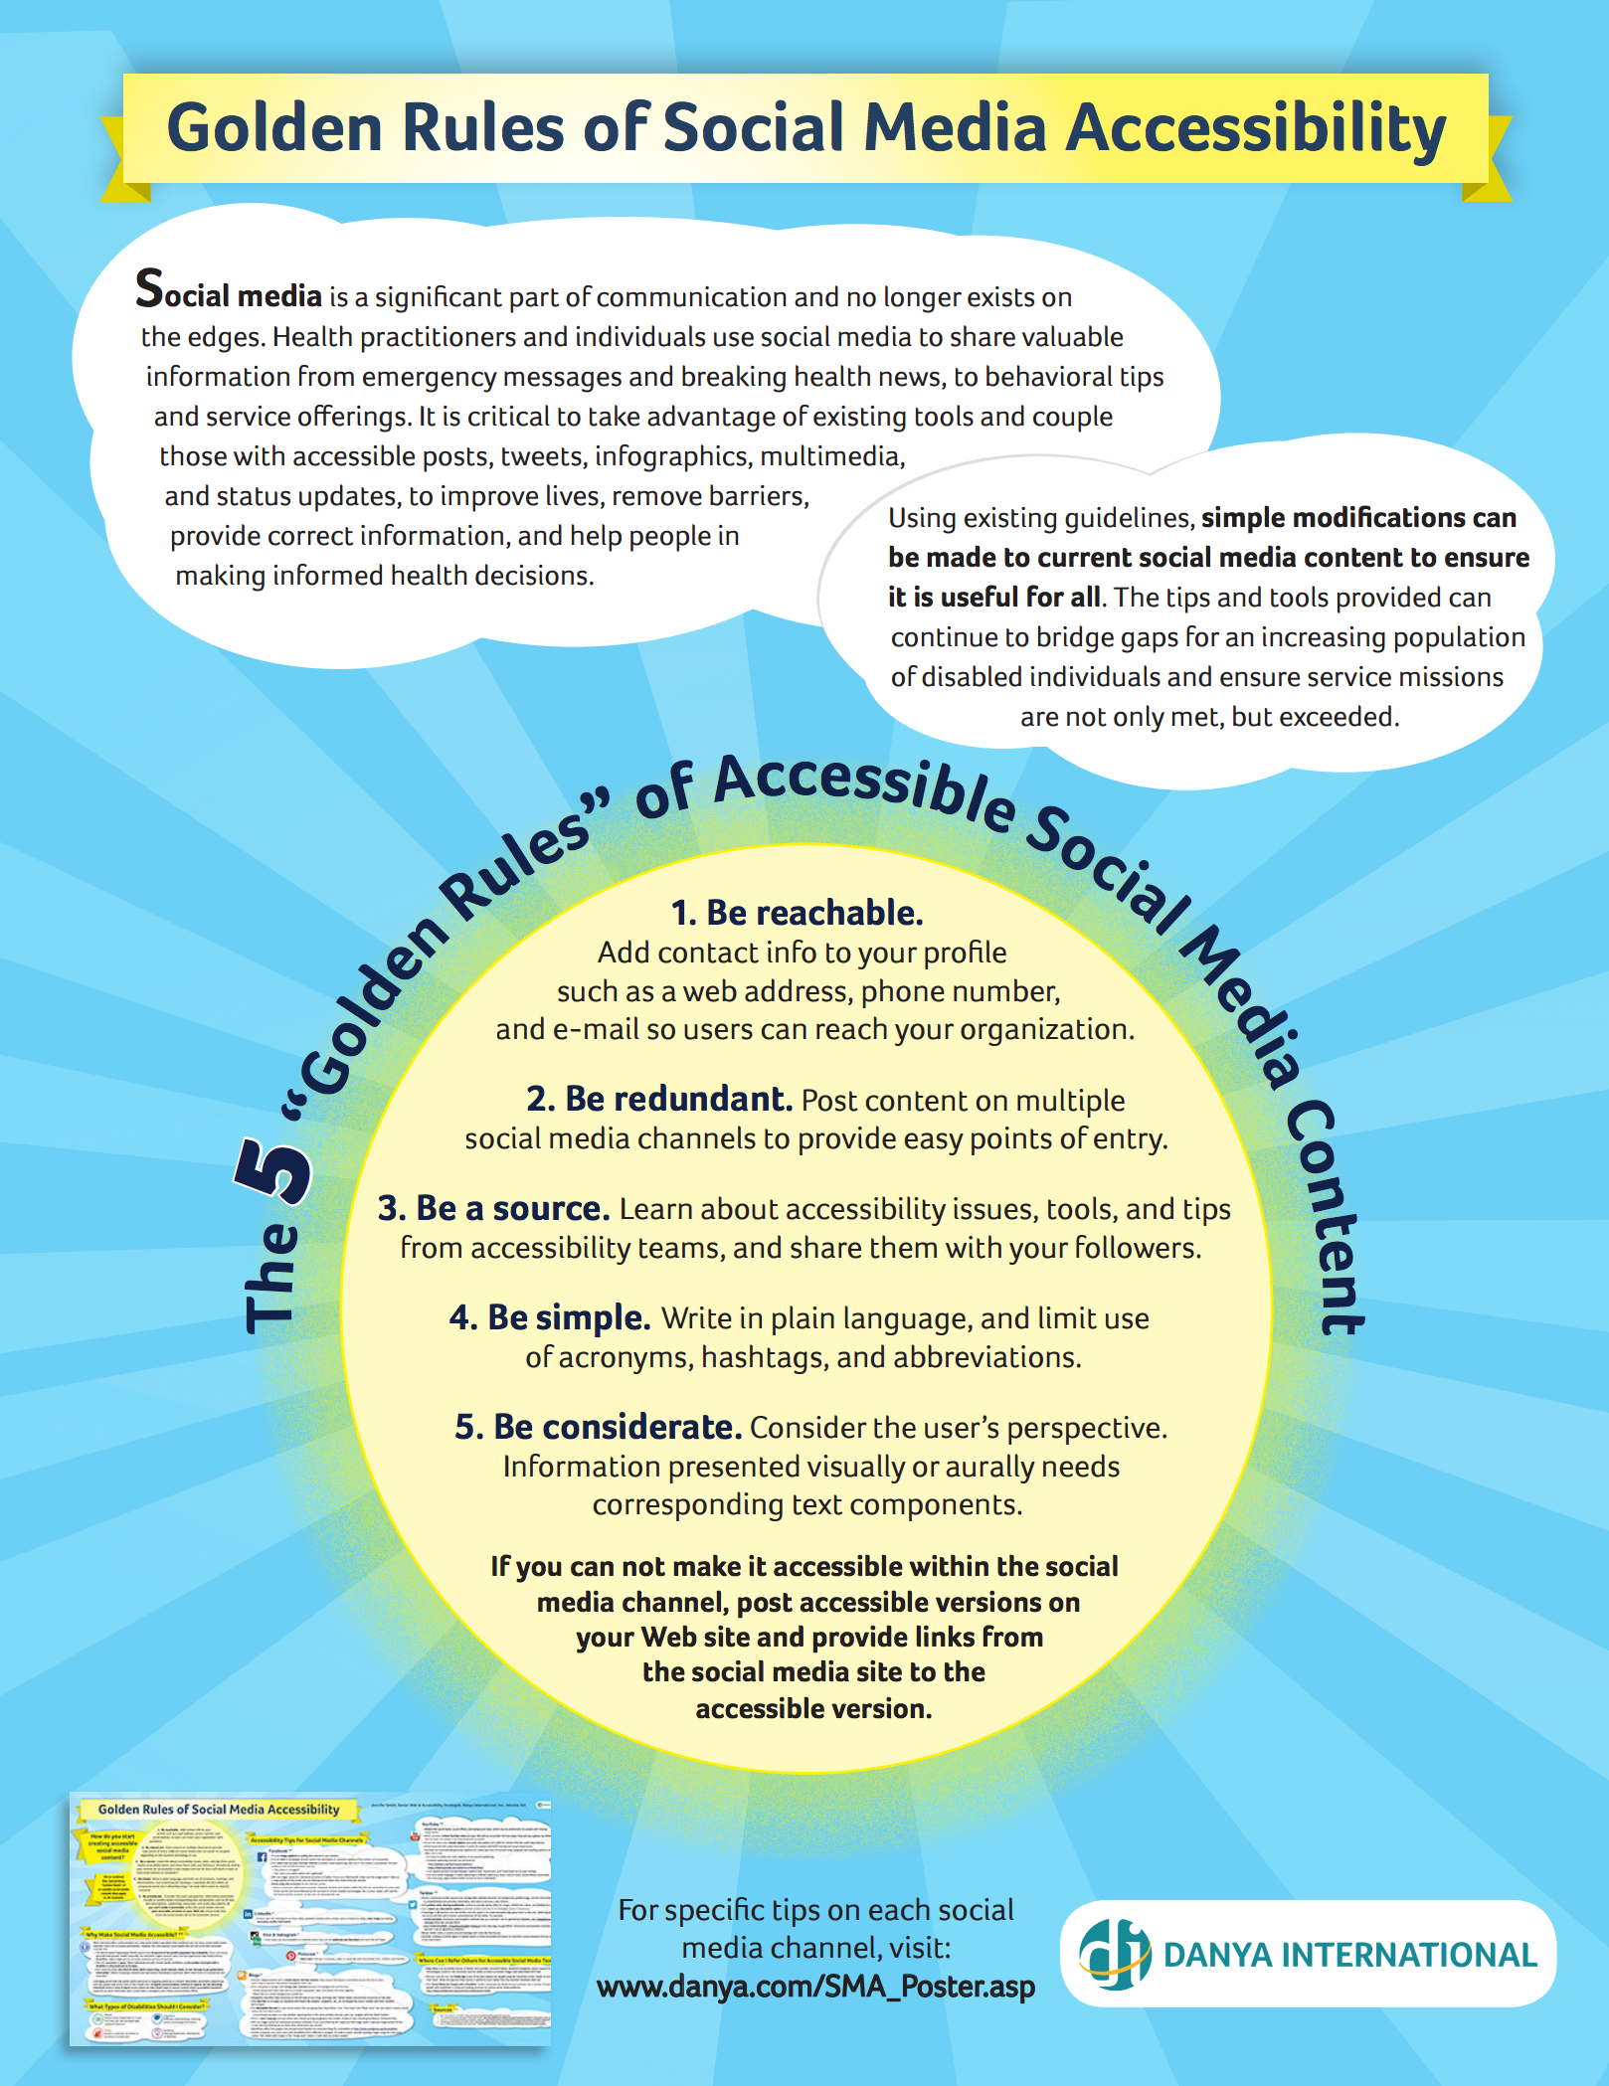
Golden rules of social media accessibility
Be reachable.
Be redundant.
Be a source.
Be simple.
Be considerate.
Reference http://www.danya.com/files/sma_poster.pdf

Slide 41
Accessible social media
Golden rules
Be reachable. Add contact info to your profile such as a web address, phone number, and e-mail so users can reach your organization.
Be redundant. Post content on multiple social media channels to provide easy points of entry.
Be a source. Learn about accessibility issues, tools, and tips from accessibility teams, and share them with your followers.
Be simple. Write in plain language, and limit use of acronyms, hashtags, and abbreviations.
Be considerate. Consider the user’s perspective. Information presented visually or aurally needs corresponding text components.

Slide 42
If you can’t make it accessible within the social media channel, post accessible versions on your Web site and provide links from the social media site to the accessible version
“
”

Slide 43
Questions & wrap up
Thank you!

Slide 44
Contact Us
John Foliot Principal Accessibility Strategist
Email: john.foliot@deque.com
Twitter: @johnfoliot
Denis Boudreau Principal Accessibility Expert
Email: denis.boudreau@deque.com
Twitter: @dboudreau

