Slide 1
PDFs and Professors: What is Reasonable to Ask of Instructors
Powerpoint available at
AHG website
accessiblek.com
Amanda Isbell, Accessible Text Assistant, aisbell@uw.edu
Krista Greear, Assistant Director, greeark@uw.edu
Disability Resources for Students
Notes:
Krista – introduce title and why I chose it. Emphasize that I don’t have all the answers and I certainly don’t have all the answers for institutions where I don’t work

Slide 2
Who We Are & Why We Are Here
Krista Greear
Amanda Isbell
Talk about something that affects us all
Notes:
Krista

Slide 3
What We’re Going to Talk About
Identifying the scope (at UW)
Pinpoint some issues
Brainstorm solutions
Play devil’s advocate for our brilliant solutions
Share with UW has done
End with encouragement
Notes:
Krista

Slide 4
Identifying Scope
Notes:
Krista introduce: Amanda who will be sharing data that communicates the scope of what UW is dealing with

Slide 5
How Many PDFs Are We Dealing With?
# quarters | # different classes | # pages (all of them) | # files | # PDFs | % of files that are PDFs
9 | 228 | 145,259 | 8,956 | 6,356 | 70.9%
# pages of PDFs | UW time to convert accessible versions | Hours to convert pages | Weeks of full-time work
118,447 | 100 pages / hour | 1,184 | 29.6
Notes:
Amanda – this is a table showing how many PDFs we are dealing with. (Share each column with the numbers).

Slide 6
State of the Syllabi – Part 1
Campus | Had Canvas Course | Had Syllabus | % Courses that had Syllabus | Had Syllabus Statement | % Syllabi that had Syllabus statement
Seattle | 2177 | 1174 | 54% | 783 | 67%
Bothell | 384 | 264 | 69% | 247 | 94%
Tacoma | 59 | 37 | 63% | 35 | 95%
Total | 2620 | 1473 | Avg. 62% | 1065 | Avg. 85%
Notes:
Amanda – introduce syllabus project. Had the happy task to look over 5k courses. These courses were selected because there was an accommodation request for this class at some point during the 2015-2016 academic year. I had to find the class, find the syllabus and determine if there was a syllabus statement about accommodations, where to find Disability Resources, where to find their contact information. UW has 3 campuses, Seattle, Bothell, Tacoma. (Share the percentage for each campus for the 2 columns with percents. ) Considering the fact that there were less classes evaluated between Tacoma and Bothell, it makes it more likely that there will be a syllabus statement for those classes and explains their higher percentage.

Slide 7
State of the Syllabi - Part 2
Campus | Had Syllabus Statement with Accurate DRS Info | % Syllabi that had Syllabus statement with Accurate DRS info
Seattle | 362 | 46%
Bothell | 193 | 78%
Tacoma | 33 | 94%
Total | 588 | Avg. 73%
Notes:
Amanda – this slide highlights the percentage of how many syllabus statements had accurate DRS contact info.

Slide 8
What Does This Tell Us?
The syllabus is the starting place for accessibility
If there is no information, it is reasonable to suppose that disability or accessibility is not on the instructor’s radar
Notes:
(Amanda – read slide). What does this tell us? (I was also curious about this after two months of going through canvas.)
**
But now we can use the data to approach departments and start conversations..

Slide 9
Texts Used in Spring 2016
See file available at http://accessinghigherground.org/pdfs-professors-reasonable-ask-instructors/
Notes:
Krista -

Slide 10
Immediate Take Aways
Stop doing it alone!
Stop working in silos!
Stop pretending you don’t need (fill-in-blank here)!
Notes:
Krista – There is too much work to be done to attempt to do it all yourself. I’m all about being ambitious but there’s only so much PDF remediation one can take before realizing that there could be a better way.

Slide 11
Specific Issues When Professors Use PDFs
Notes:
Krista -

Slide 12
Issue – Instructors are not trained about accessible PDFs
Often, there are no required trainings
It’s hard to mandate trainings without administrator buy-in
Instructors are trained in a specific discipline(s) and may have minimal formal teaching foundations
Instructors may not be aware about the number of students with disabilities
Notes:
Krista -

Slide 13
Issue – Tend to re-use PDFs from term to term
They find something they like and keep it forever
It’s a lot of work to put together or create content
It’s easy to copy and paste a file or online course
Notes:
Krista

Slide 14
Issue – Instructors don’t know what to look for when acquiring PDFs through databases
Variety of databases = variety in quality
Terminology may not be same across
Text-based PDF
Full-text
Text Selectable PDF
PDF
Searchable PDF
Notes:
Krista – at what point in their teaching background would they have been taught these differences?

Slide 15
Issue – Instructors scan their own materials (sometimes poorly)
Not all instructors have access to quality scanners
Not all instructors are trained in what a quality scan looks like
Instructors may have TAs or other clerical staff scan materials
They may not do post-scan edits (like rotating, cutting off black gutters, etc.)
Notes:
Amanda -

Slide 16
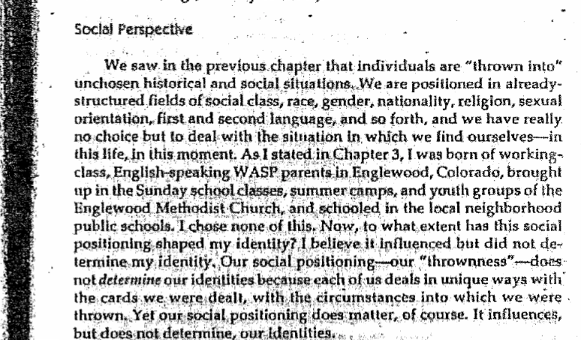
Example – Instructors scan their own materials (sometimes poorly)
Notes:
Amanda -

Slide 17
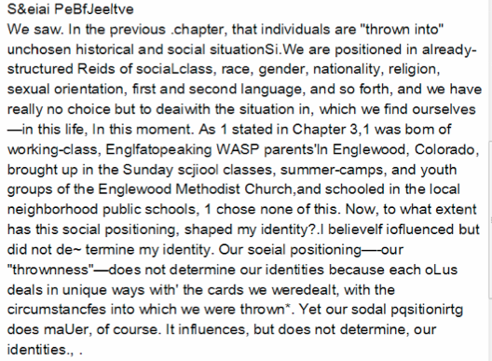
Example – Instructors scan their own materials (sometimes poorly)
Notes:
Amanda – read part of script aloud

Slide 18
Issue - PDFs are not well named or consistently named
Team B Survey Data
Week 6 persuasive writing
Au-PowerIdentityThirdRail
beduc391_freire_chapter_2_pedagogy_of_freedom
beduc391_milner_afterword_culture_curriculum_and_identity
beduc391_steele_chapter_2_whistling_vivaldi
beduc452bringle
beduc452cone
beduc480cooper-1
beduc553_cummins_ch3_negotiating
Notes:
Amanda – list of bad names like (read a couple aloud). Me, as a sighted person, has no idea what these files contain.

Slide 19
Addressing the Issues

Slide 20
Typical Ways to Teach Instructors
Have one-on-one meetings
Send emails
Create workshops
Create a training course
Share videos
Use built-in tools
Talk to their deans and department chairs
Notes:
Amanda -

Slide 21
Challenges with Typical Ways to Teach Instructors
Have one-on-one meetings
Time consuming
Send emails
Trashed
Create workshops
Instructors don’t or can’t come
Create a training course
So much work for something not required
Talk to their deans and department chairs
Feels more like tattling than goodwill-building
Notes:
Amanda -

Slide 22
Principles for Friend-Making (from Like Switch)
Proximity
Be in same vicinity in non-threatening environment (meetings, coffee stops, bathroom breaks, campus events)
Frequency
# of contacts you have over time (monthly meeting, ride the same public transportation, buy lunch at same place)
Duration
Length of time spent with other person (offer to buy hot beverage, lingering a bit longer over small chat each time)
Intensity
How strongly can satisfy other person’s needs through vernal and nonverbal behavior (get job done)
Notes:
Krista - This is more of a long-term approach but can be adapted in short-turn around times for accommodation purposes.
Identify the folks with the most influence to implement the kind of change you are seeking, make a goal to be friends with them

Slide 23
Golden Rule of Friendship
If you want people to like you, make them feel good about themselves.
Jack Schafer, former FBI Agent, The Like Switch
Notes:
Krista - This is more of a long-term approach but can be adapted in short-turn around times for accommodation purposes.
Identify the folks with the most influence to implement the kind of change you are seeking, make a goal to be friends with them.
I’m not entirely sure we do this regularly with instructors.

Slide 24
What UW Has Done In Past Year
Simplified what we ask of instructors (Ongoing)
Collected data. Lots of data (Ongoing)
Asked about built-in OCR capability of scanning service through libraries (Jan 2016)
Meeting with Assistant VP of Student Life (April 2016)
Meeting with VP of Student Life (June 2016)
Volunteered to help Student Life publication accessible (Oct 2016)
Invited to Provost office to teach how to make PDFs accessible (Nov 2016)
Notes:
Krista - Now DS at UW is housed in Student Life, away from instructors. We get to do the trickle up, trickle across and trickle down effect. Start where you are.

Slide 25
Other Ideas – Part 1
Write 1 sentence what you think is realistic for non-accessibility experts to do. Post in visual spot.
Identify how much of material is FOUND vs CREATED
Become friends with those that support instructors
instructional designers, tech support, Centers for Teaching and Learning, librarians
Share videos or live demos of end-user experiences with the content instructor has provided

Slide 26
Other Ideas – Part 2
4 things that all content creators should be able to do (YouTube video playlist)
Use built-in tools in the software they are using
Adobe Acrobat Pro
MS Office 2013+
UDOIT
A11y
GrackleDocs

Slide 27
Summarizing
Identify what instructors need to know/do
Determine most realistic method to share that info or change that behavior
Collect and use data to tell your story
Instructors are, and should be, your friends
Start with the smallest realistic goal to help instructors. Goal has to be slam-dunk-able
Notes:
Krista and Amanda summarize

Slide 28
Thank you!
Amanda Isbell, Accessible Text Assistant, aisbell@uw.edu
Krista Greear, Assistant Director, greeark@uw.edu
Disability Resources for Students

