Slide 1





New Universal Design Approaches
For Web Accessibility
How To Extend Reach And Impact
Marc Zablatsky
www.sitecues.com
(802) 367-6149
mzablatsky@aisquared.com
@mzablat

Slide 2





















World leader in vision accessibility and accommodation for 40 years
World’s best-selling computer screen reader and screen magnifier (JAWS and Zoom Text)
Provider of magnifiers and braille displays
Distributed in over 70 countries worldwide
Most Fortune 1000 companies use our products

Slide 3
Overview and Learning Objectives
  Today’s goal is to arm educational institutions with practical steps they can take to increase accessibility across their institutions
  A general discussion, with specific examples focused on web accessibility and low vision populations
  Learning Objectives
  1
  What is the potential for universal and inclusive design?
  2
  What are the most commonly observed barriers?
  3
  What specific steps can educational institutions take?

Slide 4



Accessibility in your organization
Tools
Individual accommodations, compliant website, accessibility features within applications & content
Supported Users
Students, employees, alumni, families, student applicants, job applicants, library patrons, community members
Management
Procurement, implementation capabilities, testing, measurement

Slide 5



Accessibility should be universal
Support a wide range of abilities
Be easy to deploy and to scale
Achieve high levels of end user adoption
In education, be delivered across institutional functions: learning, library, admissions, hiring, alumni relations, community engagement

Slide 6
Accessibility isn’t just the right thing to do…
Legal and Regulatory Drivers
Numerous lawsuits since 2003 has driven focus on accessibility of the technology (websites, LMS, course materials, etc.)
Higher Ed are frequent targets for lawsuits, along with local / state government and retail
Risk concerns drive increased scrutiny by institutions
Most settlements require WCAG compliance + accessibility statements/policies + ongoing accessibility testing + training
Legal requirements give strong incentives for accessibility investment

Slide 7
Accessibility Litigation In Higher Ed
Timing
Plaintiff
Defendant
Settlement
2011
NFB, US Department of Education
Penn State
Course management systems, web sites, classroom technology, library resources, banking services, and more
2014
US Department Of Education
University of Cincinnati, Youngstown State University
Website for students, prospective students, employees and visitors
2015
US Department of Justice
Miami University-Ohio
Website, LMS & course materials
US Department Of Education
University of Phoenix
Online learning
Legal settlements cover all institutional activities, not just teaching

Slide 8
Why isn’t accessibility more universal?

Slide 9
Universal design is not enough
Universal Design
Designed for everyone
Deployed across all operations
Adopted by all who could benefit
Universal Deployment
Universal Adoption
Solutions for accessibility and AT need to be scalable and measurable

Slide 10
Traditional AT not reaching its potential
  Assistive Technology use among visually impaired
Assistive technology users
95% of users who could benefit from zoom & speech don’t own an assistive technology
– David Wu, Ai Squared
No assistive technology users
More focus needs to be placed on reaching “the other 95%”

Slide 11
Market research finds that most adults could benefit from AT
  Adults who could benefit from
  Assistive Technology
Very likely to benefit
Unlikely to benefit
Likely to benefit
  Source: Microsoft & Forrester, “The Wide Range of Abilities and Its Impact on Computer Technology” (2003)

Slide 12


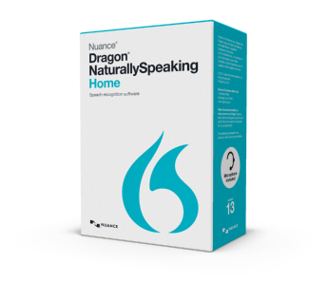


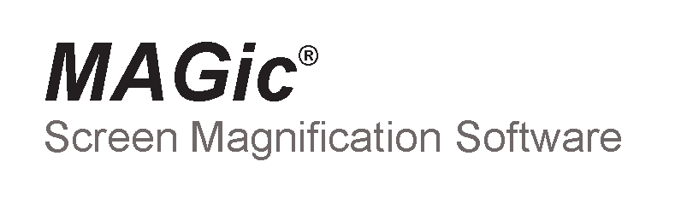
Commercial ATs are great at helping those who use them
  ZoomText
  Window-Eyes
  Dragon
  Jaws
  Magic
  NVDA
Individual accommodations are only part of the solution

Slide 13
Many barriers to Assistive Technology adoption
AT Feature Bloat
BARRIERS TO ADOPTION
Need For Training
Web Performance
Varying Needs
Cost
Lack of Awareness
Lack of
Tech Skills
Many With Minor Need
Self-Identification

Slide 14





Delivering accessibility is challenging due to the variety of need
Populations with Online Challenges
Online Needs
LOW
VISION
Includes blind and non-correctable low vision
Enlarged text, enlarged mouse, easy panning
9%
Includes dyslexia, ADHD, autism
Focus enhancement, dimming of background content
LEARNING
DISABILITES
15%
Individuals reading below 5th grade level
Page reading, clear navigation cues
LOW
LITERACY
21%
English-as-a-second language (ESL)
Ability to read text with speech overlay, native language support
NON NATIVE
SPEAKERS
5%
Includes the 50% of seniors with one or more diagnosed disability
All of the above, made easy to learn and use
SENIORS &
BOOMERS
39%
All percentages based on US population
Source: US Census, American Community Survey, National Institute of Health, National Adult Literacy Survey, National Health Interview Survey
It is critical to understand how needs vary

Slide 15
Needs vary greatly, even among those with low vision
H
  High frequency
M
  Medium frequency
L
  Low frequency
 | Impact on Vision
Cause of Vision Loss | Visual acuity | Field of vision | Contrast sensitivity | Color vision | Glare sensitivity | US Population, Age 40+
Age-related Macular Degeneration |  |  |  |  |  | 2.1M
Cataracts |  |  |  |  |  | 24.4 M
Diabetic Retinopathy |  |  |  |  |  | 7.7 M
Glaucoma |  |  |  |  |  | 2.7 M
Retinitis Pigmentosa |  |  |  |  |  | <1 M
Cone Dystrophy |  |  |  |  |  | <1 M
Achromatopsia |  |  |  |  |  | <1 M
Albinism |  |  |  |  |  | <1 M
H
M
L
H
H
H
H
H
H
M
H
H
H
H
H
H
H
H
H
There is no one-size-fits-all accommodation for low vision
All figures based on US population age 40+
  Source: PreventingBlindness.org

Slide 16
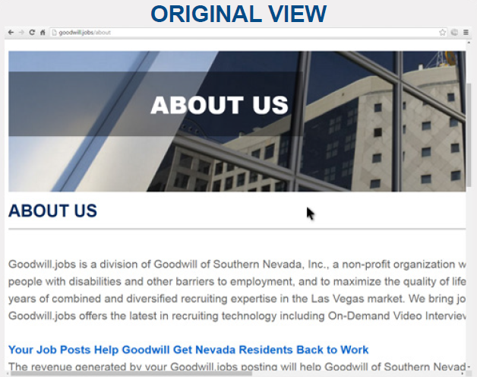
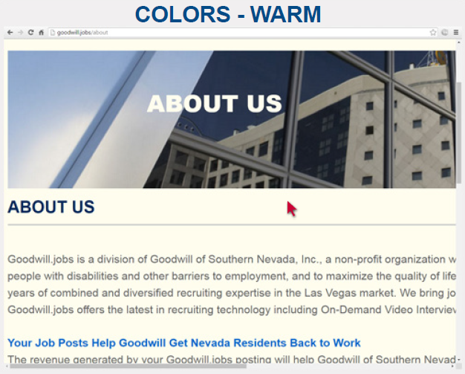
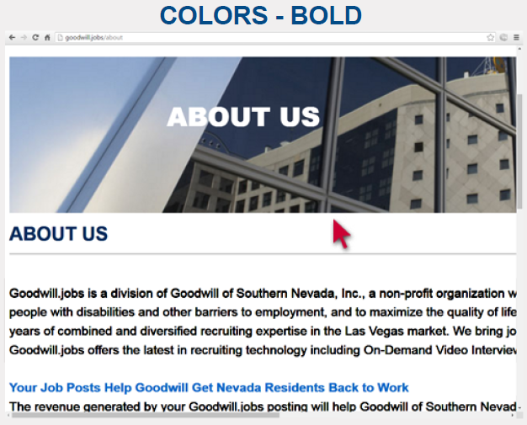
There is No One-Size-Fits-All Design
Original View
Best contrast for dyslexia
Best contrast for low vision
Individual users must be able to customize their view

Slide 17
Built-in accessibility tools are generally known, but seldom used
Use of Built-in Accessibility Tools
Comments
  Built-in accessibility tools include all functionality built into the operating system or browser to make content and applications more accessible
    Zoom / magnifier
    Font size
    Mouse size & color
    Line thickness
    Colors & contrast
  Use of pinch zoom in mobile has greatly increased awareness of built-in accessibility tools
Question: Have you ever used the built-in accessibility tools (e.g., Browser Zoom, Large Fonts) included in your computer’s operating system or web browser?
Source: Ai Squared web user research (2015)
To be effective, accessibility tools must be widely adopted

Slide 18
Built-in accessibility tools are underused because of poor discoverability, poor usability, and the need for training
Reasons for Not Using Built-in Accessibility Tools
Comments
  These responses apply only to those who don’t use built-in accessibility tools
  Older web users need education and help in order to take advantage of the current generation of built-in accessibility tools
  Over ¼ state that built-in tools are not what they need
Question: How useful are the built-in accessibility features (e.g., Browser Zoom, Large Fonts) in your computer’s operating system or browser?
Source: Ai Squared web user research (2015)
Web users need better accessibility tools

Slide 19
Self-identification is a major issue
Region | Disclosure percentages
North America | 3%
Latin America and Caribbean | 5%
Europe | 4%
Africa | 9%
Middle East | 3%
Indian sub-continent | 2%
Eastern and Southeastern Asia | 4%
Pacific | 4%
Although 15%-20% of the population has a disability, far fewer disclose or self-identify
  Source: Globaldisabilityinclusion.com; http://image-store.slidesharecdn.com/8b54c2fa-397d-45c8-9356-0d5f18f0935c-large.png
Investing tools that are for everyone is a great way to drive adoption

Slide 20
Addressing organizational barriers is also important
“Why do organizations struggle to make their websites accessible?”
Organizational Challenges
1) Awareness
2) Compliance vs. usability mind set
3) Technology, logistics, and cost
4) Complexity
5) Customization
6) Inadequate testing
7) Concern over impact on design & functionality
  Source: WebAIM 2014 Web Accessibility Practitioners Survey; PEAT 2015 report: eRecruiting & Accessibility: Is HR Technology Hurting Your Bottom Line
The right technology can help overcome many barriers

Slide 21




How do we assess accessibility vs. usability?
Accessibility
Usability
… evaluated based on adherence to guidelines and standards
… measured based on user impact and feedback
Speed to complete task
Task error rate
Information retention
Section 508
Accessibility projects can benefit from usability measurement

Slide 22
Solutions to improve accessibility in higher ed

Slide 23









Tools for website access & usability
Font resizer
Alternative View
Speech
Multifunction
www.readspeaker.com
www.sitecues.com
www.readability.com
www.reciteme.com
www.usablenet.com
www.captivoice.com
www.texthelp.com
www.essentialaccessiblity.com
www.audioeye.com
USER1st
Inclusite
FACILiti
There are many ways to make websites more accessible and usable

Slide 24
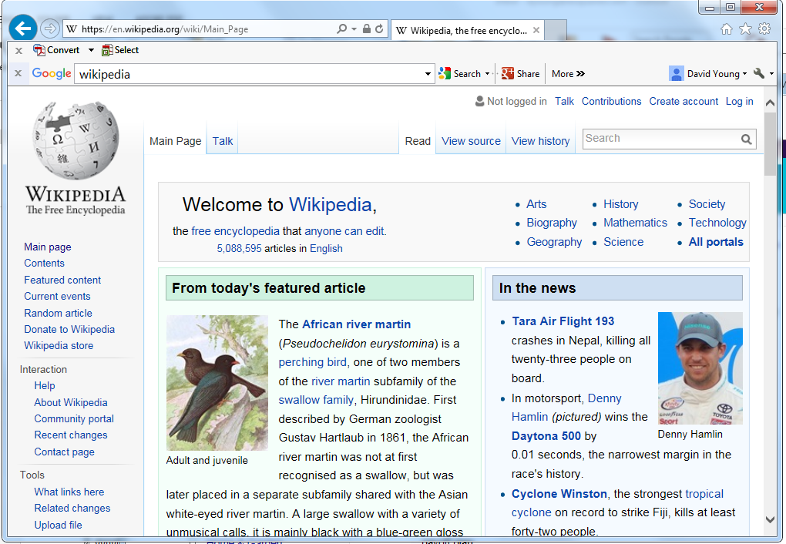


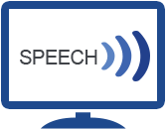

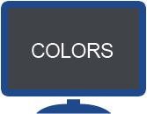

Offer additional functionality to allow users to customize
6 ways to make any online content more usable

Slide 25


Sitecues is taking a novel approach to AT and accessibility
Universally designed
Simple and intuitive
Free to end user
Seamless - just a site feature
Putting the user in control
Customizable UX / Functionality
Turnkey solution – easy setup
Globally available
Measurable impact
Delivering ROI
Geared toward usability, rather than compliance

Slide 26

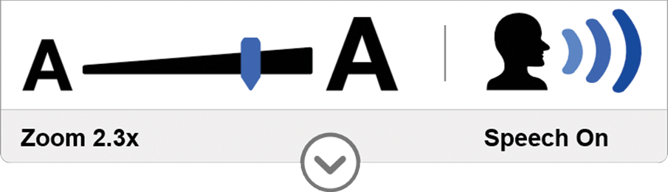
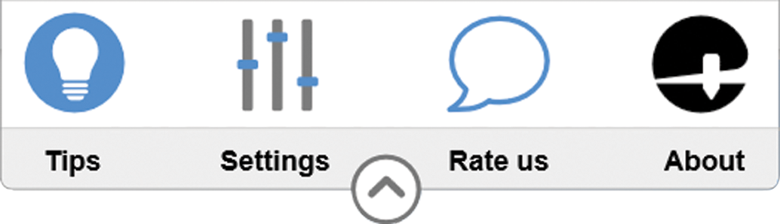
What is Sitecues?
Sitecues is Software-as-a-Service technology for website owners
Sitecues makes websites
more accessible and usable
  Build zoom, speech, color themes and other reading enhancements into any website
  Website visitors can customize their user experience based on personal needs without impacting others
  Seamlessly integrates into any existing website with minimal effort and without a redesign
  For anyone with print challenges
  Or with situational needs
SENIORS AND
BOOMERS
LOW
VISION
SITUATIONAL
NEEDS
LOW
LITERACY
LEARNING
DISABILITIES
Over 100M in US*
  Source: US Census, American Community Survey, National Institute of Health, National Adult Literacy Survey, National Health Interview Survey

Slide 27
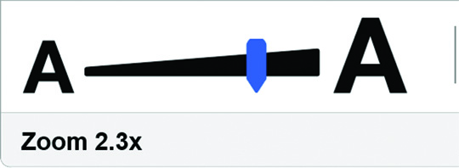
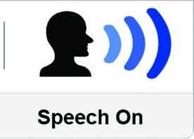
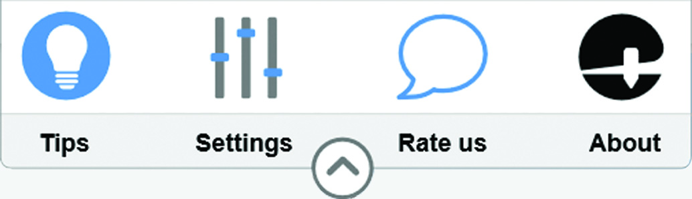
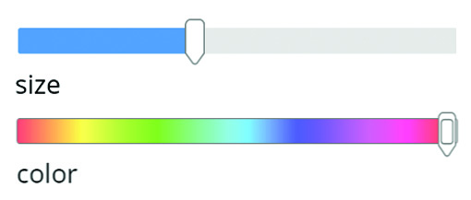
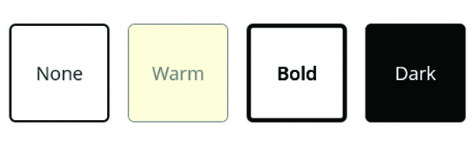
Powerful functionality, yet easy-to-use
Zoom
See it bigger
Adjust magnification using the main panel
Speech
Read it aloud
With speech on select an area and press <enter>
Additional features:
Mouse and keyboard control
Section 508 compliant
User tips and instructions
Multi-browser support
23+ languages
Mouse
Change the pointer
Activate through the settings menu
Colors
Select a color theme
Activate through the settings menu
Highlights
Create a highlight box
No activation required once zoom or speech are on
Lens
Create reading box
Activate by pressing <spacebar>

Slide 28
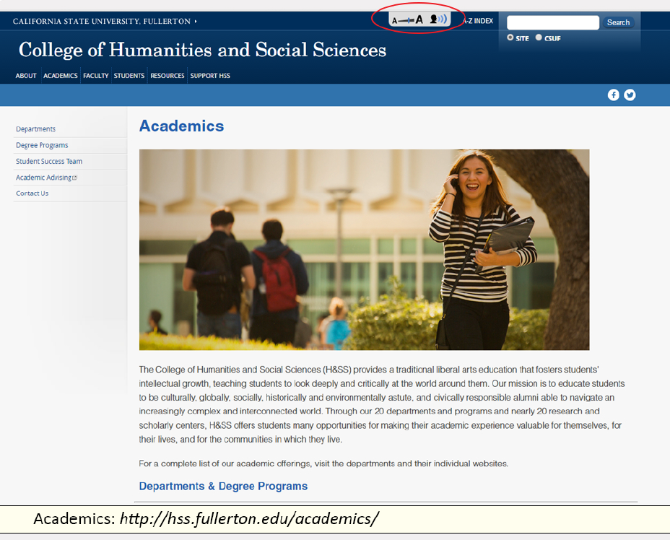
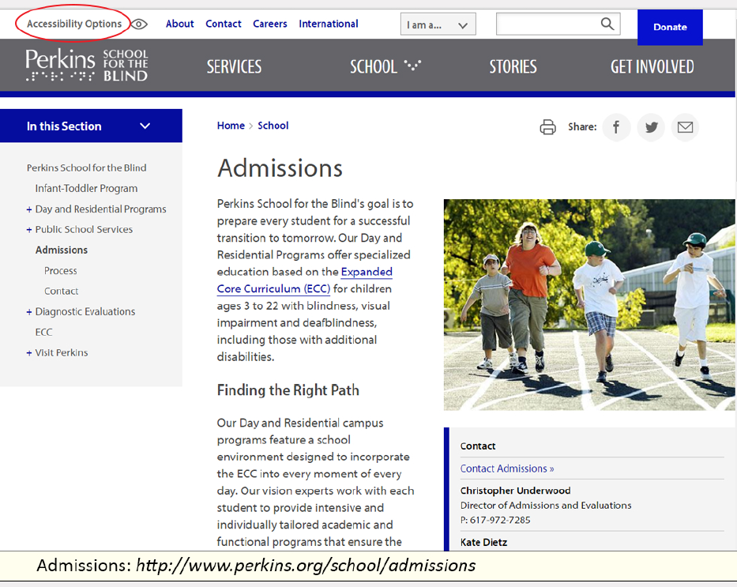
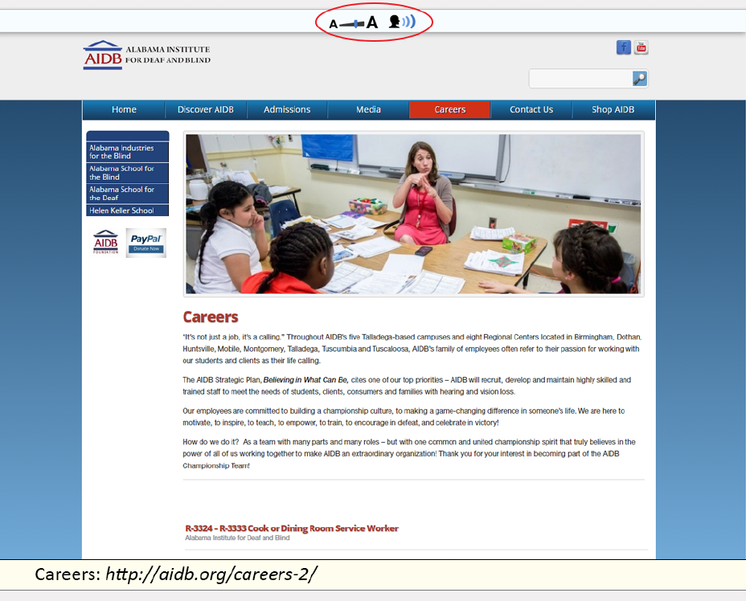
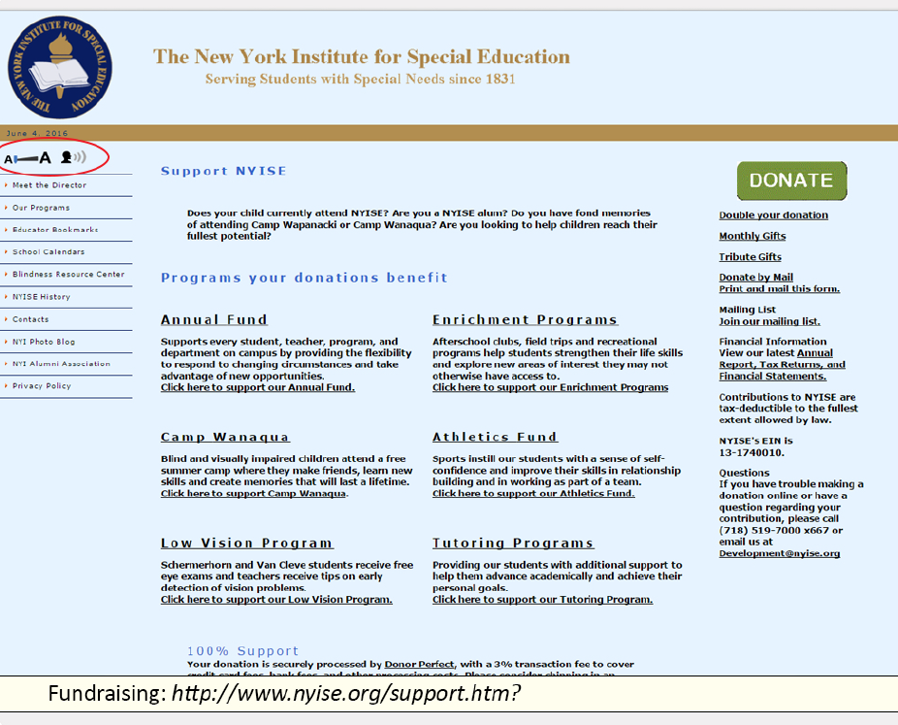
For educational institutions, Sitecues enhances accessibility across all areas of operation
Academics: http://hss.fullerton.edu/
academics
Admission: http://www.perkins.org/
school/admissions
Careers: http://aidb.org/careers-2
Fundraising: http://www.nyise.org
support.htm?

Slide 29
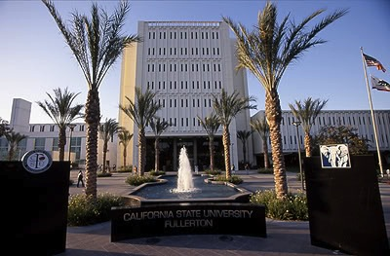

CSU Fullerton Case Study
Located in Fullerton, California
36,937 students / 4,071 faculty + staff
Part of California State University system

Slide 30

CSU ATI for Student Success
Supporting Projects
Do you know your audience?
Business Practices with documentation and training
Tools for automated web compliance evaluation
Manual evaluation for accessibility compliance
Tools to support students, staff, faculty and the public to access web pages
Identified Disabilities
  Many types and combinations
Disabilities that are not known
Temporary Disabilities
Unknown visitors to the site that may join your university

Slide 31
How many individuals with needs go unidentified?
Challenges in
  Reading
  Visual attentive focus
  Vision
  Problems navigating a web page
Piloting sitecues to explore how a universal design approach may assist visitors to webpages

Slide 32
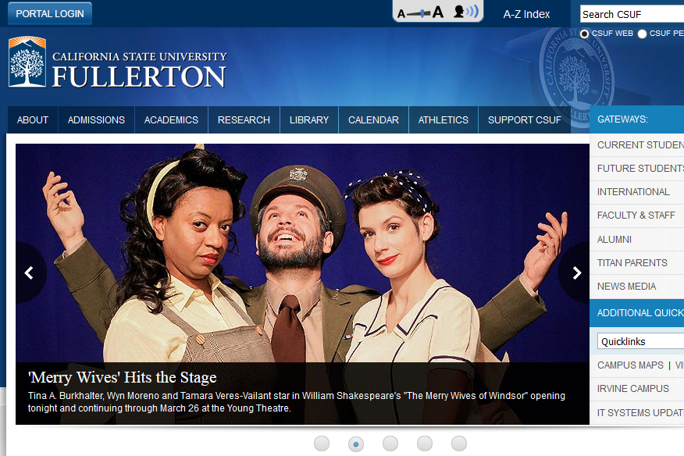
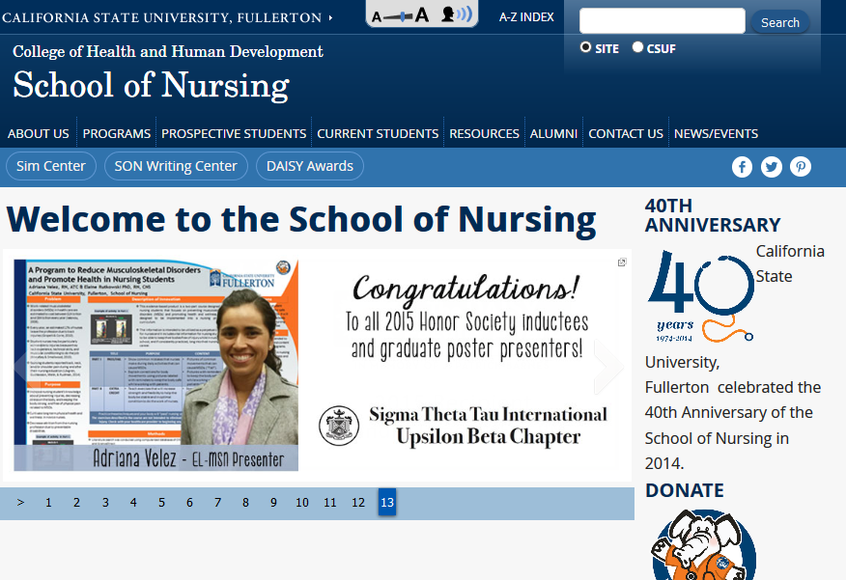
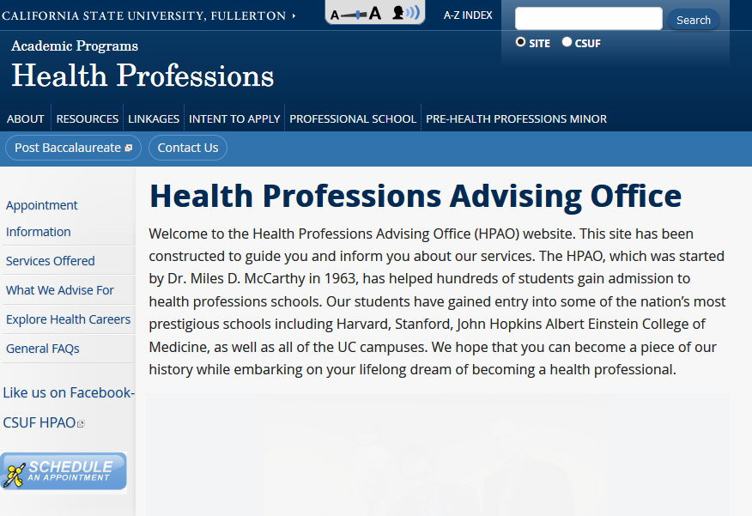
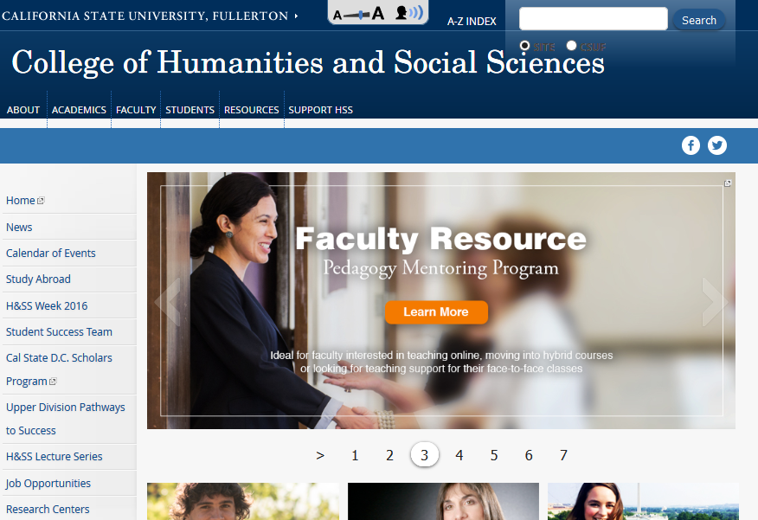
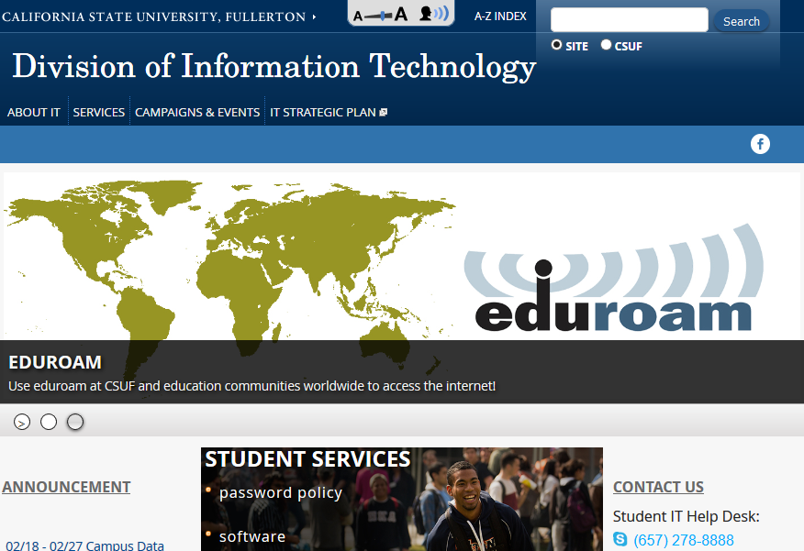
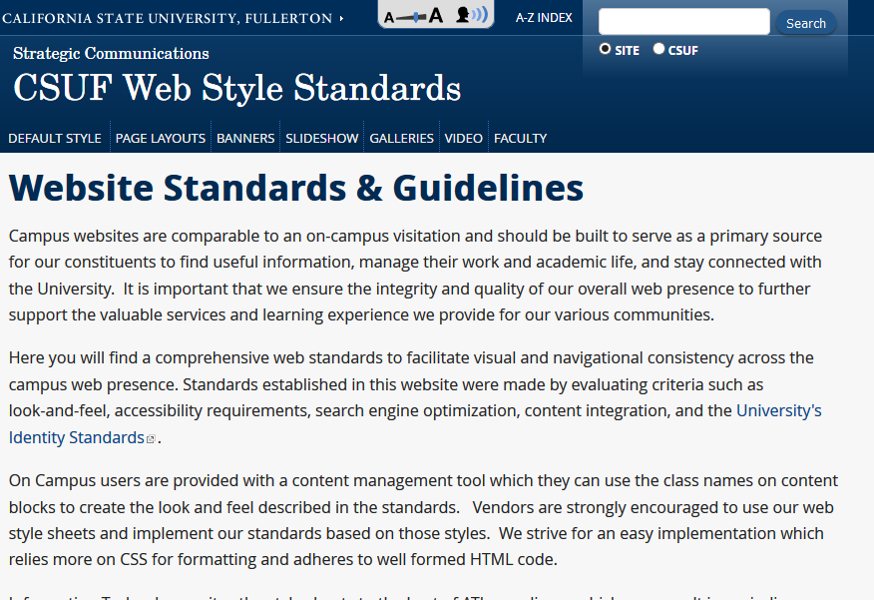
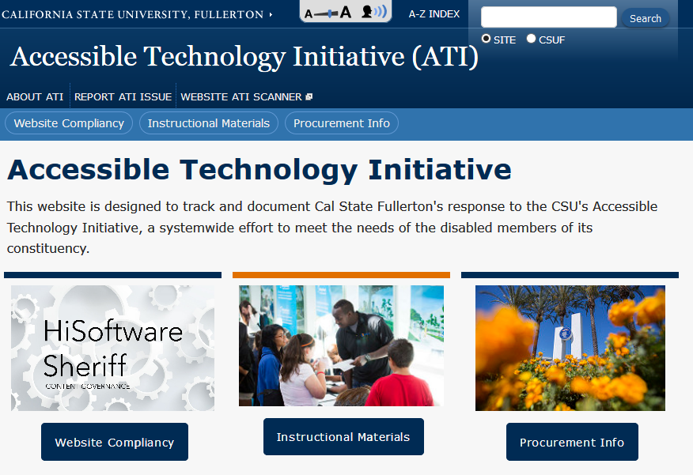
CSU Fullerton Case Study, continued
Currently installed on:
Sitecues originally went live on website in August 2015
Launched via new templates
CSU-Fullerton homepage
CSU-Fullerton School of Nursing
CSU-Fullerton Health Professions
CSU-Fullerton College of Humanities & Social Sciences
CSU-Fullerton Division of Information Technology
CSU-Fullerton Web Standards
CSU-Fullerton Accessible Technology Initiative (ATI)

Slide 33
CSU Fullerton – Benefits of sitecues
Why implement sitecues?
To increase support to students with disabilities
Zoom and speech function offers significant help
Website team strives to take a leadership position towards disability services
Adds value to many not previously served
Significantly better than browser zoom & OS accessibility
Brings greater value to website services

Slide 34
CSU Fullerton - Implementation
Ease of implementation
1
Easy to add Sitecues code – instructions provided were clear and simple to follow
Minimal time required from IT staff
2
Added Sitecues to Web Content Management System template
Created tab to place Sitecues badge in
No coding for over 100 website owners to implement
3
Received support as needed
Support from Ai Squared has been excellent

Slide 35
CSU Fullerton Metrics
For February 2016 on www.fullerton.edu
42k discovered Sitecues
6,272 Sitecues users
Sitecues Users
4x more repeat visits
8% more page views per session
3.9 zoom uses per zoom user
4.2 speech uses per speech user
3.7 lens uses per lens user

Slide 36

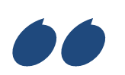
Case Study: Shared Computers in Libraries
Sitecues was distributed by the New Jersey State Library’s Talking Book and Braille Library to key communities of need
Installed on 30 shared computers within public library branches
A specific terminal is designated within each library
Minimal requirement for technical support or user training
Talking Book & Braille Library
Adam Sczepapiniak and Mary-Kearns Kaplan
New Jersey State Library
  “We chose a solution that makes it easy for libraries in New Jersey to serve their print disabled population... “
  “We are able to help people read by basically, listening.”
  “We see enormous applications for Sitecues in statistics and projections on vision loss…”

Slide 37
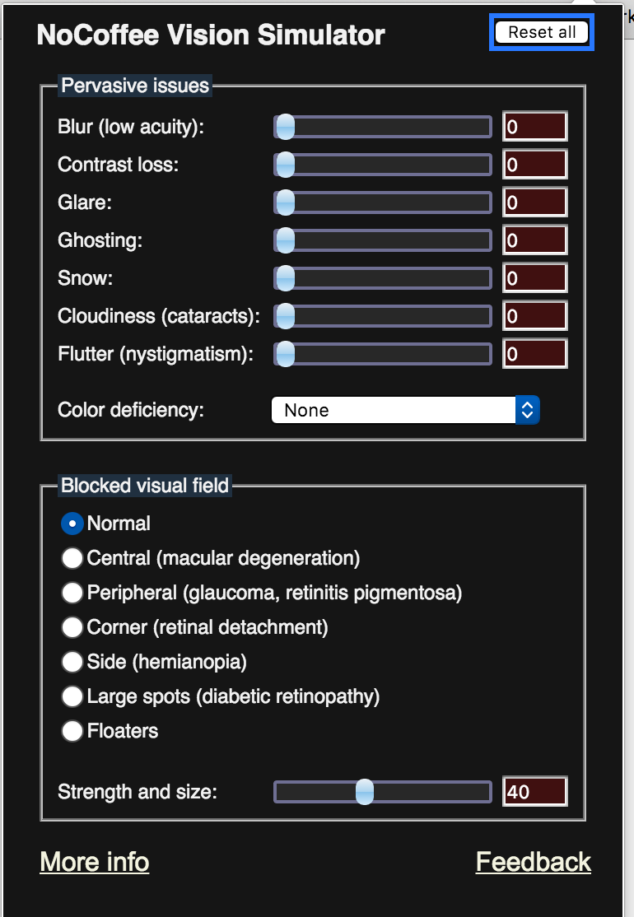
Understanding the user’s perspective with a vision simulator
No Coffee
Free Chrome extension
bit.do/coffee0
3500+ users –
used at Amazon
Made during a
snowstorm
Caveats:
  Not medically
  accurate
  Mouse not affected
Encourage accessible design by building empathy among developers

Slide 38
Recommendations - Tools
Tools
Individual accommodations, compliant website, accessibility features within applications / content
Take an “all of the above” approach to delivering accessibility
Given users more options – more types of tools and more ways to customize
Don’t assume that users can teach themselves
Don’t compromise on usability

Slide 39
Recommendations – Supported Users
Supported Users
Students, employees, alumni, families, student applicants, career applicants, library patrons, community members
Consider audiences beyond students
Strive to support users who do not self-identify as having a disability
Support users with minor needs
Support non-AT (Assistive Technology) users

Slide 40
Recommendations - Management
Management
Implementation capabilities, vendor selection, testing, measurement
Don’t stop at universal design – strive for universal delivery and adoption for those who could benefit
Augment compliance testing with usability testing
Don’t forget about adoption
Find ways to measure (availability, adoption, feedback, etc.)
Insist on open & web-based platforms and applications
Prioritize solutions and projects that scale
Engage with stakeholders across the institution
Don’t wait!

Slide 41
For More Information
Marc Zablatsky
VP and General Manager
sitecues by Ai Squared
+1 617-875-0248
mzablatsky@aisquared.com
@mzablat
www.sitecues.com
@sitecues
sales@sitecues.com
857-259-5272
If you give us your business card, we will get you this presentation

