Slide 1
goo.gl/j46v1M
Notes:
link to slides: goo.gl/j46v1M

Slide 2
Creating a Culture of Accessible Procurement at Michigan State University: Library and College/Department Perspectives
Arlene Weismantel, Senior Associate Director, MSU Libraries
Heidi Schroeder, Libraries’ Accessibility Coordinator, MSU Libraries
Nate Evans, Manager, MSU IT, Digital Content & Accessibility
James Jackson, MSU IT, EIT Accessibility Coordinator
Notes:
Michigan State University is committed to purchasing accessible Electronic Information Technology (EIT). MSU has developed guidelines and processes for accessible EIT purchasing. These guidelines, which have been developed by Information Technology, the Office of General Counsel, and the ADA Coordinator, are being applied to EIT purchases being procured through central Purchasing. The MSU Libraries have also developed accessibility purchasing procedures for library EIT. While several aspects of the Libraries’ procedures align with MSU’s central purchasing guidelines, the unique issues surrounding library e-resources/EIT have resulted in some distinct differences. This session will describe the accessibility purchasing guidelines and strategies for centrally purchased MSU EIT and the MSU Libraries’ e-resources. Presenters will discuss the similarities and differences of these procedures and will describe experiences and lessons learned from managing these many vendor relationships.

Slide 3
Objectives
Michigan State University’s accessibility policy and Electronic Information Technology (EIT) Purchasing Process.
EIT purchasing process
Library EIT purchasing procedures

Slide 4
Culture
Notes:
With digital accessibility, Culture is the biggest challenge, not technology.
I think that recycling is a great metaphor for us to consider as we think about accessibility on our campuses. Do you remember recycling back in the early 1990’s? Pop tabs were the only part of a typical pop can that could be recycled. It was frustrating trying to gather those pop tabs, keep track of them, and get them recycled, but we did it! Even though the process was not super friendly, we did it because we wanted to recycle, and it was the right thing to do.

Slide 5
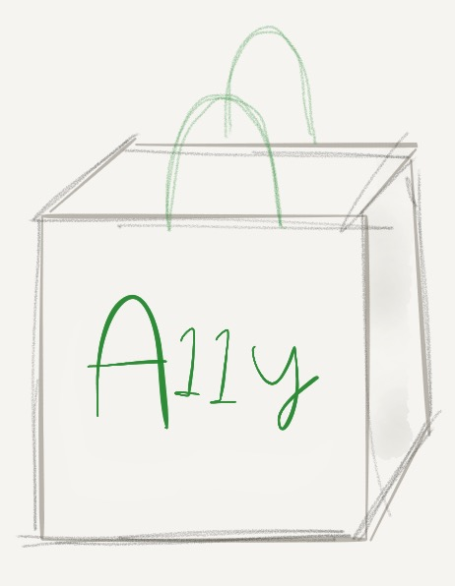
Where is your accessibility culture?
Beginning
Established

Slide 6
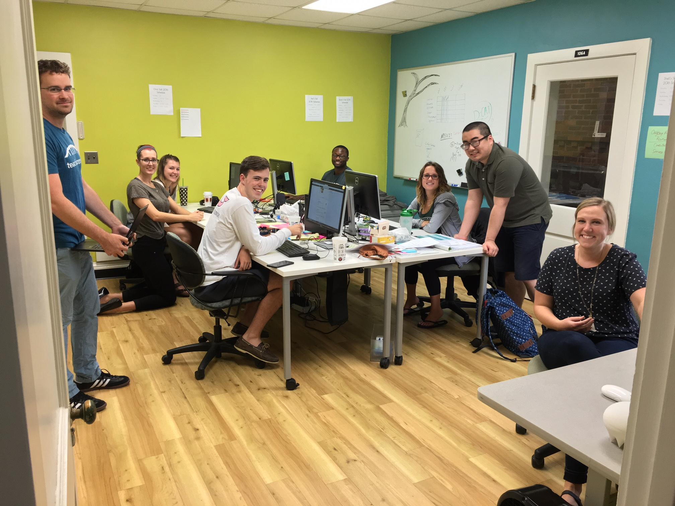
“Yeah, it is a super cool app, but it’s inaccessible. I can’t recommend it...”
Notes:
I think that recycling is a great metaphor for us to consider as we think about accessibility on our campuses. Do you remember recycling back in the early 1990’s? Pop tabs were the only part of a typical pop can that could be recycled. It was frustrating trying to gather those pop tabs, keep track of them, and get them recycled, but we did it! Even though the process was not super friendly, we did it because we wanted to recycle, and it was the right thing to do.

Slide 7
Accessibility at MSU
2008: Web Accessibility Policy Established
2014: Technical standards updated to WCAG 2.0
2015-2016: Implementation Project
Five-year accessibility plans
Web Accessibility Policy Liaisons Group
Guidelines & process for EIT purchasing at MSU
Notes:
Developing an EIT purchasing process at MSU required partnership with Purchasing, General Counsel, and the ADA Coordinator.
Link to our EIT purchasing process.

Slide 8
Notes:
Developing an EIT purchasing process at MSU required partnership with Purchasing, General Counsel, and the ADA Coordinator.
Link to our EIT purchasing process.

Slide 9
Engage Accessibility at Multiple Points of the Procurement Process
Procurement Terms
Requires WCAG 2.0
Creates awareness with the vendor
Initial Screening
Collect information and documentation
Prioritize by Risk
Accessibility Evaluation
Evaluate vendor claims
Collect additional information
Get changes made
Alternative Access
Equally Effective Alternative Access Plan (EEAAP)
Accessibility Statements
Documentation
Accountability Structures
EIT Accessibility Acknowledgement Form
Channels for responding to problems

Slide 10
Purchasing and Accessibility History
In 2015, two campus initiatives:
Development of Electronic Information Technology (EIT) Accessibility purchasing procedures.
All units submitted a 5-year EIT Accessibility Plan to the Digital Content and Accessibility team, the ADA Coordinator and the EIT Accessibility Coordinator. The plan requires consideration of accessibility when making EIT purchases and we have incorporated our unique purchasing procedures into that plan.
Notes:
In early 2015, staff who were on MSU accessibility committees told library administrators that EIT accessibility purchasing procedures were being developed with the university’s central purchasing department. The Libraries immediately realized that we were not like most departments on campus who purchase virtually all materials through central Purchasing. We are a purchasing agent in our own right and the vast majority of what we purchase falls into the EIT category. We made contact with people who were on the committee developing the procedures so that we could align our procedures if possible. When library representatives including me, Heidi and our Associate Director for Collections attended these meetings, the procedures were already close to completion and, because of our unique situation, it was clear we needed to develop some procedures specific to the Libraries.
We were also asked to submit a 5-year accessibility plan along with all other major academic units on campus. That plan required units to address the procurement process, so we made sure we had our procedures written and reviewed by the General Counsel’s office prior to the deadline for submitting our 5-year plan.

Slide 11
Purchasing Library Collections
Budget for purchasing library collections:
We are slightly above average in terms of investment out of the approximately 125 libraries that are a part of the Association of Research Libraries (2014-15).
Currently, we are spending more than 75% of our collections budget on electronic resources. Most of these resources are web-based collections of journals and books that we “lease” from publishers.
Notes:
Today I’m going to talk about the Libraries’ accessibility purchasing procedures and will briefly mention some other ways that we try to ensure that our collections are available to persons with disabilities. Before launching into the presentation, I want to thank Heidi Schroeder, the Libraries’ Accessibility Coordinator. She has done the lion’s share of the work writing our purchasing procedures and our 5-year EIT accessibility plan and making sure that the procedures are followed. In addition, Heidi is continually contacting vendors and pushing them toward making the content that we purchase more accessible. In addition, she supervises the student employees that remediate our content.
Basic information about the MSU Libraries: We are a member of the Association for Research Libraries (ARL), essentially the 125 largest research libraries in the U.S. and Canada. We are slightly above the average ARL member in terms of spending.
We are spending more than 75% of our budget on electronic resources, not paper materials. Most of these resources are web-based collections of journals and books. We also purchase a number of databases, which are essentially search engines that facilitate the finding of books and journals and, in many cases, link to the full-text which may be owned by another company. It’s a complex environment.

Slide 12
Importance of Accessibility in the MSUL
Aligns with library values:
“All information resources that are provided directly or indirectly by the library, regardless of technology, format, or methods of delivery, should be readily, equally, and equitably accessible to all library users.”
Inaccessible resources cost us time and money.
Libraries’ remediation service
Risk of lawsuits and complaints.
Notes:
Libraries have always been concerned with social justice. The American Library Association includes access as one of its core values: “All information resources that are provided directly or indirectly by the library, regardless of technology, format, or methods of delivery, should be readily, equally, and equitably accessible to all library users.” (From: http://www.ala.org/advocacy/intfreedom/statementspols/corevalues.)
The MSU Libraries have always been concerned about accessibility and have had a liaison to our Resource Center for Persons with Disabilities and an Assistive Technology Center, with staff to maintain it, for as long as I have worked there. Our Web Services department has been applying MSU’s web accessibility policy to our website since it was approved in 2009. For quite a few years, we have conducted some accessibility testing of web pages and e-resources primarily by testing with screen-reader users.
Of course, there are also some less noble interests at work. Inaccessible resources cost us time and money. The Libraries have a remediation service to make our resources accessible if they are not. Heidi has spent many hours hiring, training and supervising students to remediate resources that should be accessible when we purchase them. The large publishers who produce these resources have a lot more money than we do and they should be providing the resources to us in an accessible format. MSU’s Resource Center for Persons with Disabilities also spends time remediating library content.
We also don’t want to put the University at legal risk. Libraries have been specifically mentioned in a number of complaints. OCR resolution agreements make it clear that libraries are responsible for inaccessible content that we purchase from external vendors.
The large academic content providers have profit margins of approximately 35%, more than Apple or Facebook. One of our critical scientific publishers had revenue of 25.2 billion in 2015 with a 37% profit margin.

Slide 13
Library Purchasing Environment
The Libraries’ acquisitions department is the purchasing agent for library materials and these orders do not go through MSU’s central purchasing office.
Integrated Library Systems – which include the searchable catalogs that you are all familiar with when using the library – include purchasing modules, so the moment an order is placed, people using the library catalog will know that the item is on order.
Notes:
We have an internal Acquisitions Department that serves as the purchasing agent for library collections. These purchases do not go through MSU’s central purchasing office because this operation is made more efficient by our integrated library system and the expertise of librarians. Librarians ensure that licensing terms are favorable to promoting scholarship and research. For example, in our negotiations we fight for the right to lend materials through interlibrary loan programs, because no library can afford to purchase everything and researchers will always need materials not available in their home libraries. We also negotiate the right for walk-in clients to use our electronic resources on-site. This service was obvious in the print environment and we feel it’s important for the public to continue to have access to high quality research. Public access to our databases from off-site is strictly prohibited by all licensing agreements from all publishers and vendors. Only current faculty, students and staff have off-site access.
The price of electronic resources is generally determined by the number of full-time students, faculty and staff. In the fall of 2015, MSU had just over 50,000 students and over 12,000 faculty and staff, making some e-resources astonishingly expensive. (One example is a major scientific journal package which costs our library in excess of 2,000,000/year.) Librarians responsible for collections ensure that libraries are part of larger consortia to increase our purchasing power. The MSU Libraries are part of several consortia, some within our state and some nationally, and we meet at national conferences to discuss our collective interests.
Another unique characteristic which makes central purchasing for libraries unrealistic is the integrated library system (ILS/LMS). All but the smallest libraries have these systems comprised of software modules to facilitate ordering and payment which are seamlessly integrated into the public interface that allows library users to find what they need and either link to it or check it out. When a library submits an order to a vendor, the system automatically creates a record in the library’s online catalog so people who use the library will know that the item is on order. These systems are highly complex and dramatically different from a general purchasing system, tracking different editions and individual journal issues. These systems also allow for the tracking of licensing agreements and provide link resolvers which accept and parse URL data and use that data to direct our people to the information that we have paid for.

Slide 14
Challenges to Purchasing Accessible Materials (1)
Most materials that the library purchases are sole-source. There is no other publisher that offers the same content, so there is often no (or very little) competition.
An aggregator will purchase content from many publishers and sell it to libraries.
Publishers and aggregators both have content and interfaces and both can have unique accessibility problems.
Notes:
Most materials that the library purchases are sole-source. There is no other publisher that offers the same content, so there is often very little or no competition between publishers.
For example, Cambridge University Press publishes the journal Behavioral and Brain Sciences, a journal that neuroscientists, psychologists and physicians at the university need to do their work. This journal, and the articles in it, are unique. Cambridge is the only publisher of that journal.
Journal content in general may or may not be accessible, for example, PDFs as images with no OCR. And the accessibility of the search interface that allows the user to find the articles is a separate accessibility issue.
Sometimes publishers like Cambridge will sell their content to an aggregator like ProQuest or EBSCO. These companies purchase content from many different publishers and sell it to libraries in large, often very expensive, packages.
Often, publishers do not supply content to aggregators in an accessible format. An aggregator may receive articles from a publisher as inaccessible PDFs. Aggregators need to have accessibility in mind when they negotiate with publishers, just as libraries do. As far as I can tell, most aggregators have thought some about the accessibility of their search interface, but have given almost no thought to the accessibility of the content they purchase.

Slide 15
Challenges to Purchasing Accessible Materials (2)
It’s almost impossible for libraries to place pressure on publishers and aggregators through the threat of cancellation.
Notes:
It’s almost impossible for libraries to place pressure on publishers and aggregators through the threat of cancellation. The top-tier journals in a field are held by all university libraries who have active faculty in that field. If a university has neuroscience, psychology or medical programs, it’s unthinkable for the library not to carry journals like Behavioral and Brain Sciences. If a library does not have a journal that a faculty member perceives as needed to do their research, get grants or get tenure, the faculty member will go to great lengths to ensure that it does.
Cancelling an aggregator package has consequences as well. If we cancel a package with 200 journals in it, that could potentially mean that we would have to order journals individually, an incredible burden on our acquisitions department. We may lose volume discounts as well.

Slide 16
Library EIT Purchasing Procedures (1)
Applies to all new e-resources, renewals and existing platforms/content.
Give priority to high-risk, high-impact e-resources.
Existing e-resources are prioritized into 5 tiers by platform.
The 5 tiers correspond with the 5 years of our plan.
Tier 1 contains the highest impact vendors.
Notes:
The library’s accessibility purchasing procedures closely align with the university’s; however, one difference is that our priority is to start with high-risk resources as we can’t address everything immediately.
High-risk resources are the most used based on our statistics. We also prioritize resources that we know are required reading for classes, again prioritized on the size of the class. Unfortunately, we aren’t always aware of which resources are required readings for classes.
For the purposes of the 5-year plan, we divided our over 300 vendor platforms into 5 tiers. We are currently in year one and are tackling our 9 largest vendors and are trying to address the renewals as they occur. The 9 tier-one vendors are Alexander Street Press, EBSCO, Elsevier, Gale/Cengage, JSTOR, ProQuest, SAGE, Springer and Wiley.

Slide 17
Library EIT Purchasing Procedures (2)
Ask for accessibility contact information
Request accessibility documentation
Adjust license language/include addendum
Accessibility testing/evaluation
Document internally & provide feedback to publishers/vendors
Notes:
1. We ask vendors for accessibility staff/teams at their companies. We do this for two main reasons. First, we want to know who the best person is to contact if we have questions or want to provide feedback. This question also gives us insight into how dedicated and knowledgeable a vendor is with respect to accessibility. If they have accessibility staff, they are probably better informed and may already be addressing problems.
In most cases, we have started by asking our sales reps for this information, as it hasn’t been easy to find accessibility information on vendor websites. Most vendors have referred us to general technical support personnel and a few have referred us to user experience teams. Some UX teams are more knowledgeable and proactive than others. Only a few vendors, so far, have referred us to accessibility staff. Some vendors have taken a surprisingly long time to get us this information.
2. We’re also asking for accessibility documentation, specifically, Voluntary Product Accessibility Templates (VPATs) or WCAG 2.0 documentation, since MSU is striving for WCAG 2.0 AA compliance. We are also looking at and documenting vendors’ public-facing accessibility webpages and FAQs. Vendors who have this information readily available are indicating at least an awareness of accessibility.
So far, it has been our experience that most major vendors (tier 1) have VPATs, fewer tier 1 vendors have had WCAG 2.0 documentation. We wonder if the “smaller” vendors/publishers we will address in later tiers will have any documentation at all – we’re thinking many may not, but we’ll have to wait and see.
We are just starting to evaluate aspects of these VPATs in-house as it’s common knowledge in the accessibility community that VPATs are often filled out incorrectly or inaccurately.
There is a VPAT repository for library e-resources, started by Laura DeLancey and hosted by Libraries for Universal Accessibility (LUA). Some of the VPATs listed are out of date, however.

Slide 18
3. Modify License Language/Include Addendum
“Licensor shall comply with the Americans with Disabilities Act (ADA), by supporting assistive software or devices such as large print interfaces, text-to-speech output, voice-activated input, refreshable braille displays, and alternate keyboard or pointer interfaces, in a manner consistent with the Web Accessibility Initiative Web Content Accessibility Guidelines 2.0 AA (http://www.w3.org/WAI/guid-tech.html).
Licensor shall provide to Licensee a current completed Voluntary Product Accessibility Template (VPAT) to demonstrate compliance with the federal Section 508 standards (http://www.state.gov/m/irm/impact/126343.htm).
If the product does not comply, the Licensor shall adapt the Licensed Materials in a timely manner and at no cost to the Licensee in order to comply with applicable law.”
Notes:
Third, we are attempting to insert this accessibility language into our licenses or as an addendum. We used examples/model language from CRL, ARL, other libraries that have already done this, and also solicited feedback from MSU’s General Counsel. We specifically mention WCAG 2.0 AA and Section 508.
We also attempt to include a sentence that makes the vendor responsible for timely remediation –NOT us. The accessibility addendum MSU is attempting to insert for EIT through central purchasing includes indemnification language – ours currently does not.
So far, we have had 2 vendors accept this language as is (and a 3rd agree to it but just via email – not in our actual license) and 5 accept partial/revised language. The revisions have really varied– one only accepted the sentence about providing VPATs, another differentiated between their platform/content, one struck the VPAT sentence because they’re an international vendor and don’t have a VPAT.
Our language will change slightly in the future as the Big Ten Academic Alliance has recently adopted licensing language that all of our libraries will use. It is similar to what’s here.

Slide 19
4. Accessibility Testing / Evaluation
We are testing, but we may skip this step if a vendor accepts our licensing addendum.
Our options for testing include:
MSU’s Usability/Accessibility Research & Consulting (UARC) – Costs $$$
MSUL internal testing (more informal).
MSU’s Accessibility Review Committee (ARC)
Results vary widely and no resource has been perfect
Issues with the content seem to be more prevalent than issues with the platform.
Notes:
The MSU Libraries are also doing accessibility testing/evaluation of our e-resources, although we may skip this if a vendor accepts our accessibility addendum. We currently have 3 methods of accessibility testing.
MSU has a usability/accessibility research and consulting unit (UARC) that provides “preliminary accessibility reports” against WCAG 2.0 AA – we do have to pay for these reviews though. Right now, the funding for these reports is coming out of the collections budget, but we’re trying to secure some central funding from MSU, since our e-resources can be used by anyone on campus. UARC provides us with actual documents, which we can share with vendors or colleagues.
We have increased the Libraries’ internal testing efforts. Heidi has improved her abilities with accessibility evaluation tools and screen readers, and we have two students who help her with this work.
Finally, MSU has a central Accessibility Review Committee, including James and Nate, which completes accessibility testing of some of our major e-resources. For example, the ARC has already done accessibility testing of a couple centrally purchased library systems: our library catalog and our interlibrary loan system, for example.
We have done 9 UARC or other formal accessibility tests and the results have varied widely – all have had issues, some more than others.
These reports have identified things like: color contrast issues, lack of or improper use of headings , problems with reading order, inaccessible PDFs (PDFs as images), images without alt text, the inability to tab through content, etc.
For the MSU Libraries’ tier 1 resources, the issues with content (documents and files), as opposed to platforms (host pages with search engines), have been more serious (and prevalent) – especially for resources that contain historical content.

Slide 20
Keep Internal Documentation & Provide Vendor Feedback
Internal documentation:
Using institutional Google Drive
Very time consuming
Feedback to vendors:
E-mails, phone-calls, meetings.
Generally positive, productive.
Notes:
We’re keeping all of our internal documentation on our institutional Google Drive. We have fields for our sales rep and accessibility contact info, whether we’ve received VPATs, if a vendor has accepted our addendum, results from accessibility testing, and any other notes. The BTAA plans to consolidate all information into a database once that initiative gets going.
This is very time consuming and a challenge for Heidi to keep up with.
A really important part of this process is providing vendors with feedback, especially when we’ve done accessibility testing and discover issues. This feedback has taken place via email, phone-calls, and in-person meetings.
Most of the conversations with vendors have been quite positive, but not all have gone well and not all vendors have been responsive to our inquiries and feedback. Having specific feedback from UARC reports has been especially useful to pass along to vendors. They are purely factual (comparing the platform and content against WCAG 2.0 AA) and are coming from a “third party” which feels more neutral to vendors.

Slide 21
Procedural Similarities & Differences with Central Purchasing
Differences
The license language does not include indemnification and was modeled after language used by the Center for Research Libraries, the Association of Research Libraries and other libraries.
The Libraries do not require written acknowledgement of inaccessible content.
Our in-house testing isn’t as skilled or robust as that of Digital Content & Accessibility which supports central purchasing.
Notes:
Indemnification language, which would hold MSU harmless for any legal action taken against us because of the vendor’s inaccessible resources, has not been included in the libraries’ language because vendors will not agree to it.
The Libraries also do not require that an administrator sign an acknowledgement of inaccessible content. This would cause repetitive work when we know that none of our resources are perfect with respect to WCAG 2.0 AA.
Also, our in-house testing capabilities aren’t as robust as the Digital Content & Accessibility team, Nate’s group, which supports central purchasing. We have Heidi supervising two student employees who work approximately 10 hours/week. In addition to remediating the e-resources we purchase through vendors, these students are systematically addressing the content that we have created, including historical collections that we have digitized and put on the Web– another huge job! In addition, Heidi and her students don’t have the same depth of remediation knowledge as Nate’s group, but I expect that to change because his group will be supervising our students while Heidi is on leave and perhaps into the future.

Slide 22
Effect of New Purchasing Procedures
Procedures increase vendor awareness of accessibility issues.
Put pressure on the vendor to change.
If a resource is not essential, we may decide not to purchase it if there are accessibility issues.
Notes:
So, what do these procedures mean for the MSU Libraries? Are we still buying e-resources that aren’t accessible? Yes and probably will continue to, especially if they’re important for teaching/research/learning. We may – and actually have – delayed purchasing e-resources to put some pressure on vendors to either improve accessibility or at least tell us how they plan to try to address issues. We are committed to the idea of NOT purchasing some resources with major issues or delaying purchase, especially if vendors indicated they’d be fixing/improving something.
Buying inaccessible products not only puts the university at risk for a lawsuit and can cost us money in testing/remediation/etc., but it results in us deliberately buying resources we know users with certain disabilities can’t use. All libraries have a wish-list that is longer than the list of things we can actually afford purchase/lease – and we’d obviously like to purchase/subscribe to accessible e-resources over inaccessible e-resources.
We are looking for incremental improvements, an accessibility roadmap that details improvements over period of time, or even a commitment to improving if accessibility seems especially new or unfamiliar to a vendor.

Slide 23
One Example: Vendor A
Vendor A is a major library aggregator with many platforms and products.
After some testing of resources for potential purchase, major accessibility issues of some products were identified (PDFs were images)
We declined/delayed purchase at a savings of hundreds of thousands.
Vendor scheduled a meeting with us.
Vendor engaged in company accessibility training and accessibility audits of some of their products. No news on if they are trying to work with their content providers.
Notes:
We’ve worked with Vendor A for many, many years. They are an enormous library vendor, aggregating content from publishers, and providing many services such as a discovery layer and open URL link resolver. There were several databases on our wish list that we wanted to purchase, one of which was a digitized version of a popular magazine that has been published continuously since the 1800s. After accessibility testing, we discovered that the PDFs were images with no alt text or OCR and a screen reader revealed absolutely nothing about the content.
We declined this purchase and the vendor scheduled a meeting with us and representatives from UARC and Digital Content & Accessibility. Our sales rep was able to communicate the importance of this issue to people higher in the organization and many of them were present at this meeting, including the Director of User Experience and Design. We emphasized the importance of accessibility. Vendor A described the challenges including remediation costs, restrictions from the publishers that they are signing agreements with. They were having some of the same issues with publishers that we were, and we suggested negotiating agreements that incorporate accessibility as we are doing, and workflows to address other content.
What was really surprising about this meeting is that their Director of User Experience and Design seemed to have virtually no knowledge of web accessibility, including standards such as WCAG 2.0 AA.
Since that meeting, the company has engaged in accessibility training and has conducted some accessibility audits of their products. We don’t know if they are working with their content providers to provide accessible content.
We have also agreed on some licensing language with Vendor A. They agreed to comply with the Americans with Disabilities Act (ADA), by supporting assistive software or devices such as large print interfaces, text-to-speech output, voice-activated input, refreshable braille displays, and alternate keyboard or pointer interfaces, in a manner consistent with the WCAG 2.0 AA. They also agreed to provide a current completed VPAT.
They did not agree to: “If the product does not comply, the Licensor shall adapt the Licensed Materials in a timely manner and at no cost to the Licensee in order to comply with applicable law.”
Instead they agreed to: “freely and openly cooperate with the Institution to provide a reasonable accommodation to such end users seeking access. Upon request, Licensor shall remediate content available through the Service to provide it in an alternative format compatible with assistive software or devices, subject to publisher licensing restrictions and technical capability. End users, or Licensee staff acting on behalf of end users, shall make such requests to Licensor via email and such requests shall include adequate citations and requestor contact information and shall be limited to no more than 3 articles or other works represented in the Service per request. Licensor shall respond to such requests within 3 days with remediated content or shall advise if additional time is required to respond or if remediation is not possible.”
This is not ideal. We had a graduate student request a more accessible version of an e-book through Vendor A. Vendor A was very quick to reply and tried to work with us, but the publisher refused to provide Vendor A with a DRM-free version of the e-book, so the MSU Libraries remediated it ourselves.
In addition, we had a student request remediated content from one of the newspapers supplied by Vendor A. They returned the articles to us in a format that couldn’t be easily read with a screen reader. Heidi sent them a video of how the screen reader was interpreting the content.

Slide 24
Challenges & the Future
MSUL’s accessibility work very rewarding – but complex & time consuming.
Work requires a lot of staff time/resources. Unsure about resources available in the future.
Still in the beginning stages – lots more to do.
Would love to see more libraries share/collaborate!
Need to strike a balance between commitment to accessible EIT and acquiring materials needed/wanted on campus.
Most vendors seem familiar with accessibility but many don’t seem to putting resources toward improving.
Advice: Doing something is better than doing nothing. Don’t let perfect be the enemy of the good.
Notes:
Accessibility work is rewarding and meaningful. It’s easy to get behind efforts that are about making our library resources more accessible to ALL users. But, libraries need to find champions within the organization to spearhead the efforts, someone who has a genuine interest in the work as it is complex, time consuming, and challenging.
Our accessibility efforts require quite a bit of staff time and resources, and this is a challenge given all of the other library initiatives and responsibilities that those involved in accessibility currently have. Another challenge is the uncertainty of what resources/time this work will require moving forward. Will there be more work each year? Will there be less work as we streamline and improve our processes and gain experience and knowledge? How much help will our student hires be able to provide?
We have a ton of work to do and we would love to see more libraries sharing/collaborating on e-resource accessibility because we’re all buying/subscribing to the same things. Heidi is now heading up talks among BTAA libraries. At the May BTAA Library Dean/Directors meeting, a proposal for collaborative accessibility efforts was presented – and accepted! This proposal has three parts: 1) Encourage BTAA Libraries to adopt accessibility license language (both for individual and consortial purchases). 2) Pool money from BTAA Libraries for accessibility testing of e-resources especially for BTAA consortial purchases. 3) Create a shared repository of accessibility testing/evaluation results and for other accessibility documentation/notes.
We are trying to find a balance between being committed to procuring accessible EIT, which in the future may mean canceling/unsubscribing to or not buying inaccessible platforms/content, and still fulfilling our mission to acquire materials that are needed or even desired to promote scholarship, research and teaching on campus.
We hope vendors/publishers’ accessibility will improve in the near future, making our work a bit easier. For now, MSU’s General Counsel has acknowledged that the Libraries will most likely have to move forward with purchasing/subscribing to some inaccessible platform/content – even if that puts the university at risk.
A related challenge is that while most vendors seem familiar with accessibility, some don’t seem to be putting adequate resources towards accessibility improvements or incorporating accessibility discussions into their acquisition of third-party content. This isn’t meant to imply that vendors/publishers don’t care about accessibility. We also acknowledge that accessibility improvements, especially those to third party content that they’ve acquired, can be complicated, time consuming and costly. But, we have been a bit concerned and surprised by how some vendors appear to really be scrambling in this arena.
Changes/improvements sometimes don’t happen as fast as one would like. But, the impact of this work is great. Even small, incremental improvements can really make a difference.
With accessibility work, it’s really important to remember that doing something is better than doing nothing.
Libraries can start by having staff “attend” accessibility webinars or read accessibility articles related to libraries. They can ensure that the website is accessible or add captions to your libraries’ video tutorials. Libraries can start asking vendors accessibility questions and trying to insert accessibility license language. Efforts can start where there’s the most interest/priority in the library or that will best match existing accessibility knowledge.

