Slide 1
Effectively Accommodating Low-Vision students

Slide 2
What makes accommodating a low-vision student difficult?
Stigma:
Accessible documents
Distance viewing in the classroom
Testing
Visual material

Slide 3
Stigma
Don’t understand the range of visual impairment
“pretending to be blind”
Don’t want to be seen as a burden
“Can’t do things for themselves”

Slide 4
Accessible Materials
More than Braille
Enlarged text and/or print
Magnification technology
Audio/ Text to Speech
Screen readers

Slide 5
Visual Material
Heavily visual classes (art, geography, geology)
Videos and images
Audio descriptions
Tactile images
Vague language (over there, see here)

Slide 6
Technology solutions
Seeing PowerPoints and lecture materials: Magnilink
The low tech solution: human readers
Zoom Text, Jaws, TTS, speech-to-text
How do you provide tech accommodations for a low-tech student?

Slide 7
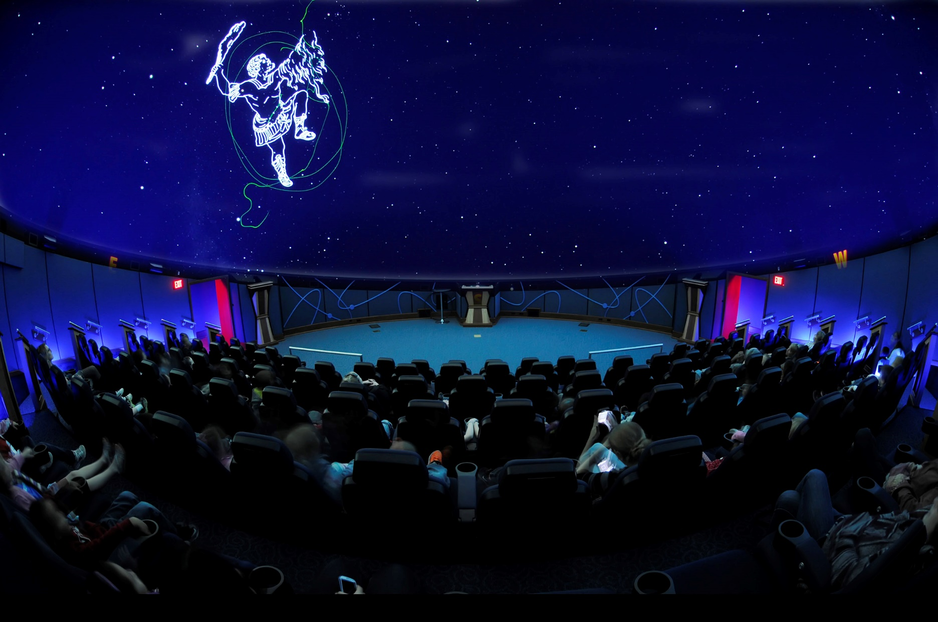

Slide 8
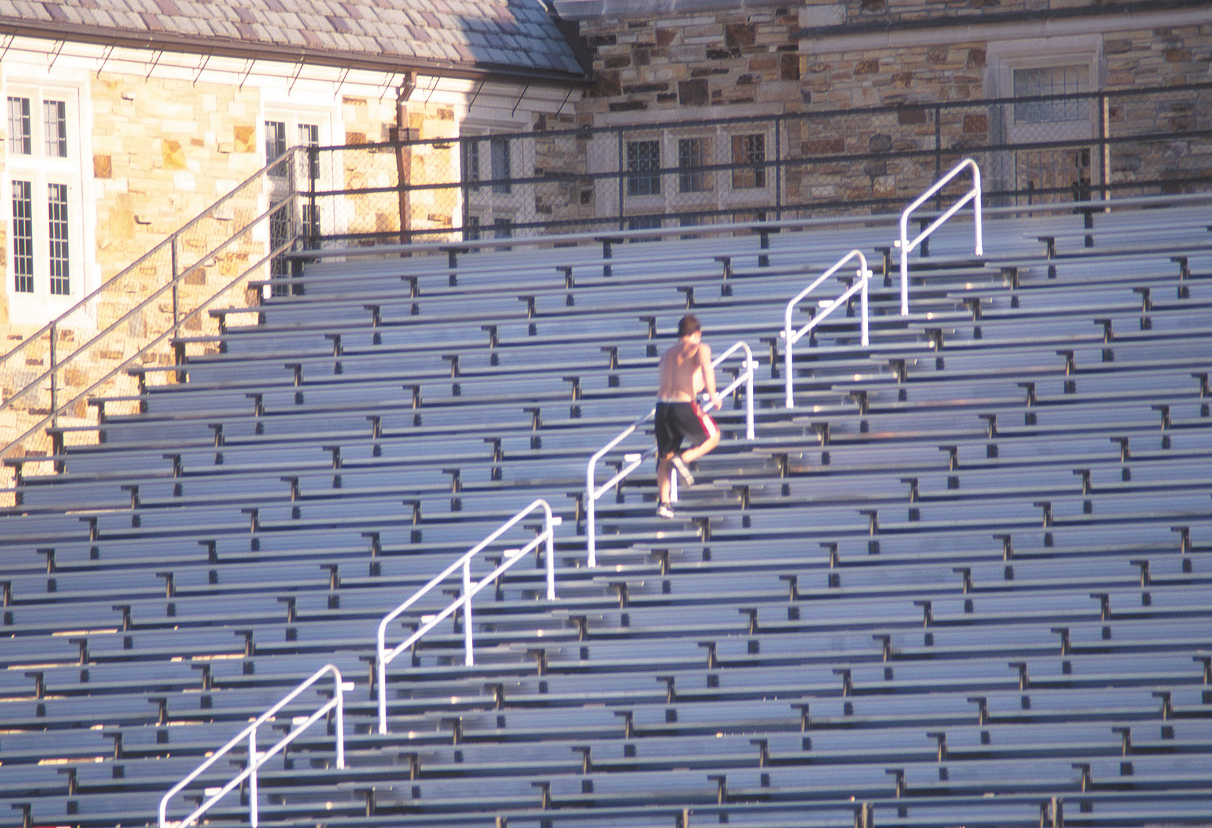

Slide 9
Testing Process
Is the exam in the correct format?
Is the right technology available at the testing site?
Emergency procedure if not?
Preference vs access: why that preference?

Slide 10
Demonstration of vision fields
No Coffee extension

Slide 11
Case Studies
Names changed to protect the guilty.

