Slide 1
Composing Sound:
A Workshop
on Critical & Creative Captioning
Brenda Brueggemann, Ph.D
Univ. of Connecticut

Slide 2
The Menu:
Introduction
A (brief captioned) History
Terms & Terrain
Show & Tell
Trying it Out
>>Quick Queries<<
https://docs.google.com/presentation/d/1xe4i1xtvNc4iEExfN3ApV2ZgsUCkjTiOhh1d4DvSAp4/edit?usp=sharing
https://goo.gl/Su07pt

Slide 3
Quick Query 1:
Who is captioning for??
(“interest convergence”)

Slide 4
THE DISCLAIMER:
This workshop is NOT about:
How to make captions
Technical standards for captioning
Captioning as “accommodation”

Slide 5
A (captioned) introduction
“Why I Mind”
https://www.youtube.com/watch?v=RoNR6EWT7D4

Slide 6
Quick Query 2:
So, um, who invented the internet, anyway???

Slide 7
Quick Query 3:
Chat rooms/programs?
What does that have to do with captioning?

Slide 8
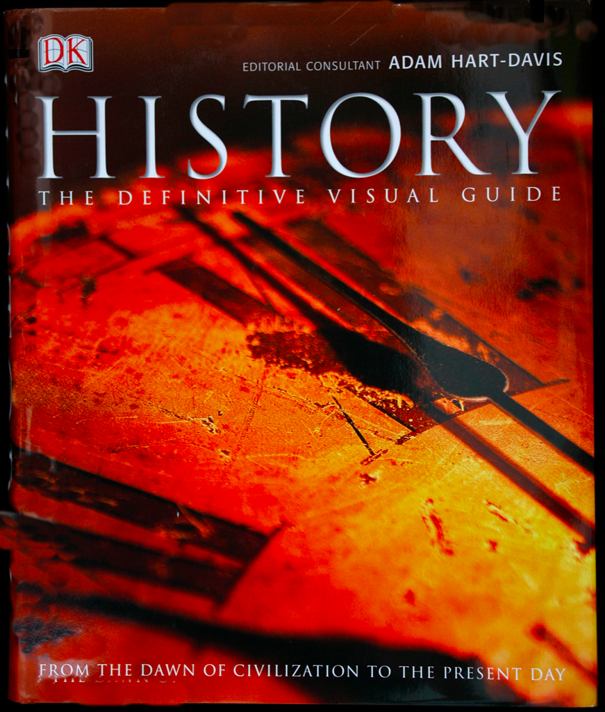
A few (captioned) pages from the history books
1972 first open captioned TV program
The first “decoder” boxes… super heavy and expensive too
In 1982, The National Captioning Institute (NCI) developed a process for real time captioning
Captioning reporters were trained to write more than 200 words per minute
1990--the Television Decoder Circuitry Act was passed by Congress. The bill called for all analog television receivers manufactured after July 1, 1993 to have the ability to display closed captioning.

Slide 9
Quick Query 4:
What was the First open captioned TV program?
Notes:
Julia Child’s The French Chef, 1972

Slide 10
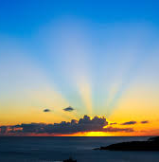
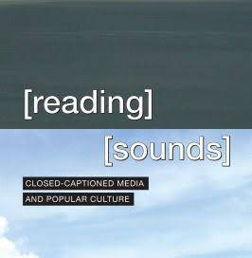
Sean Zdenek
A Whole New Day
Caption Studies:
Terms & Terrains

Slide 11
Captioning as a subjective and interpretive practice
Every sound cannot be (closed/real-time) captioned.
Captioners must decide which sounds are significant.
Captioners must rhetorically invent and negotiate the meaning of the text.
Captions are interpretations.

Slide 12
Quick Query 5:
Why didn’t I caption the *heartbeat* in my “Why I Mind” video?

Slide 13
7 transformations of meaning (interpretation) in captioning
Captions CONTEXTUALIZE
Captions CLARIFY
Captions FORMALIZE
Captions EQUALIZE
Captions LINEARIZE
Captions TIME-SHIFT
Captions DISTILL

Slide 14
Quick Query 6:
When should you use “auto-captions”

Slide 15
Quick Query 7:
Caption interference?
When/how do captions INTERFERE, DISRUPT?

Slide 16
Quick Query 8:
What is caption(ing) (ed)
IRONY?

Slide 17
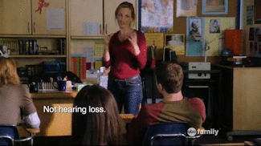
Deaf Gain+
(and captioned irony too)
Marlee Matlin
Switched at Birth

Slide 18
Break Time:
Be back in 10 mins...

Slide 19
Show & Tell Time:
All (or at least some) of the available means of captioning

Slide 20
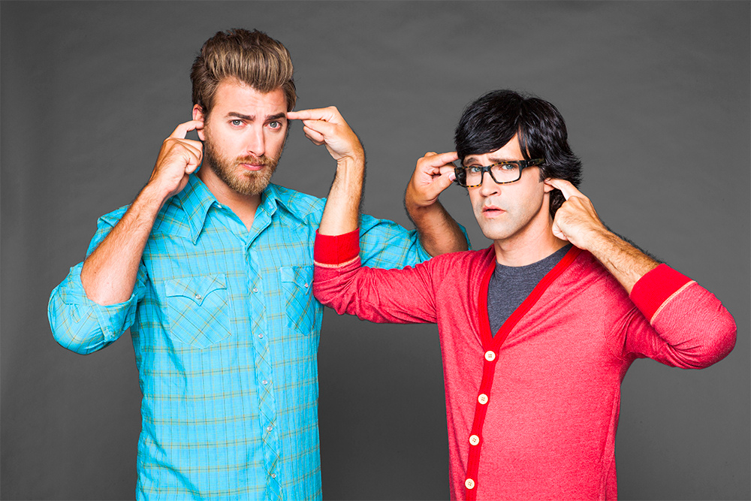
Caption Fail
Rhett & Link, Internetainers
https://www.youtube.com/watch?v=hVNrkXM3TTI&list=PLA220BA20D4D3DE46

Slide 21
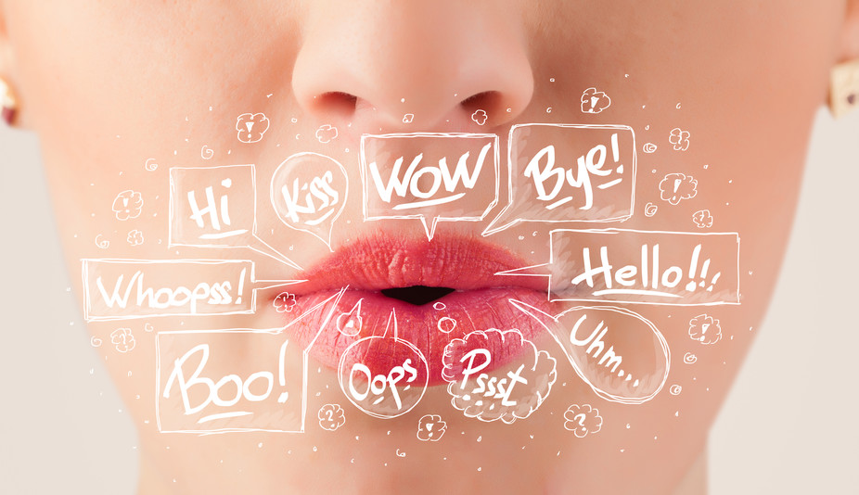
Quick Query 9:
So, why can’t HEARING people lipread?

Slide 22
Badlipreading.com
Presidential Poetry Slam: https://www.youtube.com/watch?v=zC4YpPspnUc
NFL 2016:
https://www.youtube.com/watch?v=W-kGosnzvjU

Slide 23
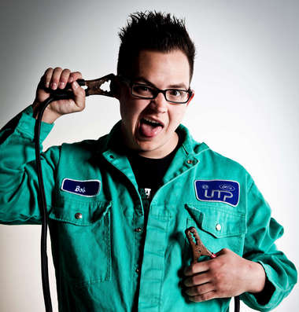
“I’m Deaf” Sean Forbes

Slide 24
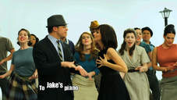
Let’s Mambo!
Notes:
Use to break out of Deaf Jam discussion...

Slide 25
Wayne Betts,
Deaf filmmaker
12:07 & 14:50
https://www.youtube.com/watch?v=ocbyS9-3jjM

Slide 26
Quick Query 10:
Captioning = ACCOMMODATION?
Captioning = ACCESS?
Captioning = AESTHETICS?

Slide 27
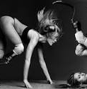
TED Talk
“My 12 Pairs of Legs”
Aimee Mullins
https://www.ted.com/talks/aimee_mullins_prosthetic_aesthetics
42 subtitle languages
Interactive transcript

Slide 28
Let’s Give it a Swim!
https://www.youtube.com/watch?v=pSf-5vbVpAU

