Slide 1
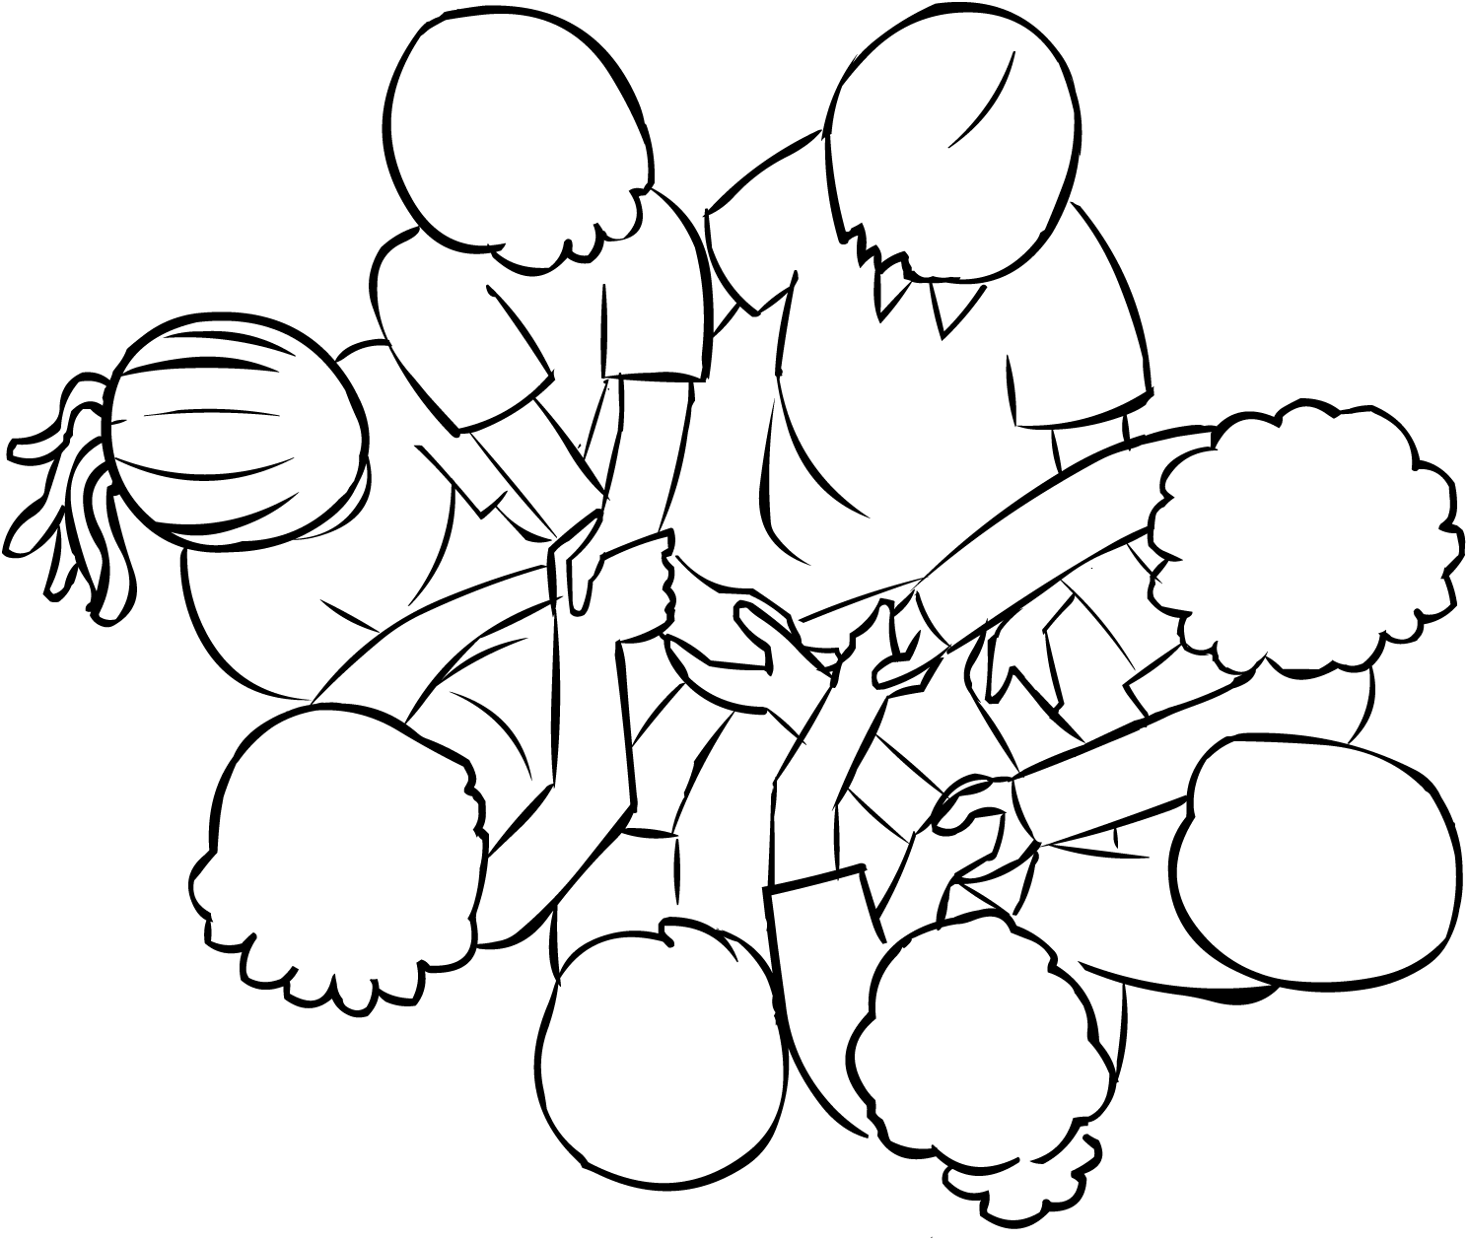
Maintaining Accessibility in the Modern Classroom
Christa Miller, Virginia Tech
TLOS: Assistive Technologies
christa.miller@vt.edu
Notes:
Welcome to this session on Maintaining Accessibility in the Modern Classroom and thank you for attending. My name is Christa Miller and I’m from Virginia Tech, which is tucked into the beautiful Blue Ridge mountains of Southwest Virginia.

Slide 2
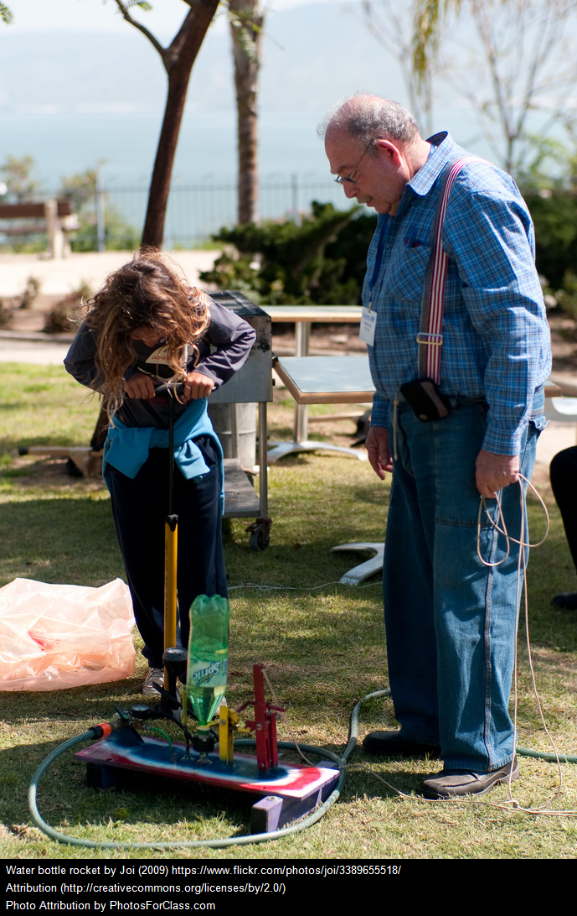
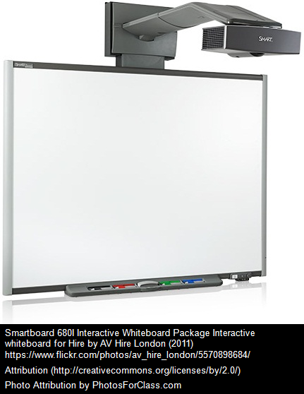
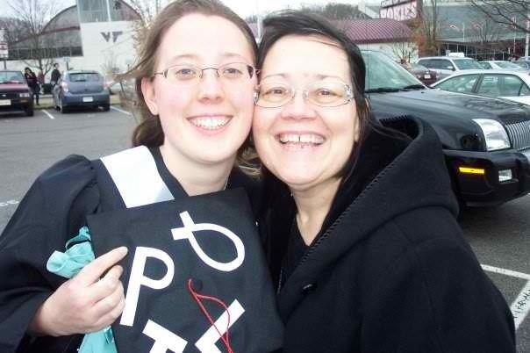

Instruction, People and Technology
Notes:
I want to start us off today with a story.
Imagine a 17-year-old girl sitting in a high school physics class. The teacher is using smart board. She is having students take turns working through parts of an example problem on the board. Then she has the students work out similar problems in small groups. Finally each group shares its results and a lively discussion of formulae and initial conditions ensues. The 17-year-old girl falls in love with physics.
Imagine also that the teacher also has the class design and complete a set of experiments to build a water propelled rocket. The students must build prototypes, perform calculations, analyze data, and build the resulting rocket. That freckled 17-year-old decides to become an engineer.
Think about that learning environment for a moment. What instructional strategies did you hear? What technology must have been employed in this environment? Lastly, consider the long-term impact of the experience on our protagonist.
Instruction, technology, and people. These are the constantly changing, constantly moving parts of our educational environments. Positive and empowering learning experiences like the one I’ve described do not have to be exclusive. Instruction, technology, and people can be nudged in directions that promote and create inclusive learning environments.

Slide 3

Key Points
Current instructional approaches have common activities that create access barriers
Universal Design for Learning (UDL) is one strategy to remove these barriers
When implemented consciously these approaches improve the experience for students with disabilities
Image Credit: EcologyofEducation.net
Notes:
As we begin this morning, I’d like to get a feel for who is in the room.
How many of us are Teaching &/or Research faculty in Higher Ed?
How many of us work in a Disability Support office?
How many of us work specifically in the area of Assistive Technologies?
Throughout the session, I’d like you to keep the following 3 points in mind.
More precise information regarding modern instructional approaches, their commonalities, and where accessibility barriers can be reduced
We will also discuss how Universal Design for Learning can help us and the faculty in our institutions
to implement these instructional methods in a way that supports more inclusive learning environments

Slide 4

Agree or Disagree?
Digital technologies will continue to transform our learning spaces, increase interaction, and improve student outcomes.
Students with disabilities can participate more fully because of digital learning environments.
Current instructional methods
are less accessible than traditional.
The Accessibility Fairy does exist.
Notes:
Alright time for a quick game. Either by raising a hand or calling out do you agree or disagree with the following statements?
To move forward we need to agree, at least for this conversation, that:
Digital technologies support better student outcomes
The internet and our technology make it possible for SWDs to experience more equitable education
Current instructional methods are neither more not less accessible. Implementation is far more essential.
I have yet to find an accessibility fairy but if any of you have seen one at your institution please let me know.

Slide 5

What is an instructional approach?
Active Learning
Blended Learning
Hybrid Learning
Fully Online Learning
Problem-based learning
Project-Based Learning
Team-Based Learning
Writing Tools by peteoshea. http://www.mywritingblog.com/
2014_10_01_archive.html CC BY 2.0
n. A method for delivering content that relies on a set of strategies to achieve a learning objective
Notes:
I feel confident that there are many more approaches we could add to this list. [read aloud].
And what may you ask yourself is an instructional approach exactly?
Given that we are looking at this list with our accessibility glasses on, I think it is fair to state that these different types of learning scenarios have at least 1 thing in common. Each approach is simply one method of delivering content knowledge employing a set of strategies that lead to achieving learning objectives. The approaches listed here may be used together or separately. For example, two instructors implementing the same approach may not use any of the same activities or assessments, while two instructors using different approaches may use many of the same activities and assessments. We are in somewhat grey territory here. This is actually good news for us. It means that rather than trying to become an expert on all the variations of instruction and all of the technologies employed we can focus our attention on the set of strategies they have in common to address barriers.

Slide 6
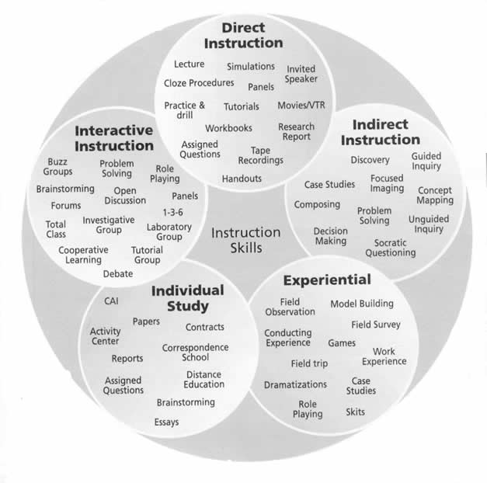
Making an approach accessible:
Requires the integration
of Instruction, People,
& Technology
Instructional Strategies can be sub-grouped as
  Direct Instruction
  Indirect Instruction
  Experiential Learning
  Interactive Instruction
  Independent Study
Notes:
To make any of those approaches accessible we have to consider the people, technology and the ideas that are being integrated. I’ve tried to indicate that rather than tackling the accessibility of a particular approach we can focus on the instructional strategies instead. The figure I’ve included here comes from a school in Saskatchewan Canada. I’ve provided a larger and clearer version in the handouts. From this graphic I want to highlight that the various learning activities, for example direct instruction which includes lectures, simulations, drills and practice these activities in many cases are not themselves “new”. A professor might say, “I’m using Team-based learning. How do I make it accessible?” And the appropriate response to that is, “what kind of strategies are you employing?”
Take a moment and look at the handout I’ve provided. The list of activities is somewhat extensive. Notice that students are still being asked to express their learning through speaking, reading, writing, arithmetic, and creative expression. History and personal experience remind us, however, that empowering students with disabilities to succeed in these tasks corresponds to how the learning environment and learning experience are designed.

Slide 7

Universal Design for Learning v. Instructional Approach
Does UDL conflict with current approaches?
Instructional Approach
Active
Blended
Hybrid
Fully Online
Problem-based
Project-Based
Team-Based
UDL
Representation
Engagement
Action & Expression
Notes:
Enter the importance of Universal Design for Learning. This philosophy, some may prefer to call it a framework, is what enables instructors to design learning environments and experiences that appreciate and anticipate human uniqueness. There are three core principles of UDL, its legs if you will, they are representation, engagement, and action and expression. In my mind almost as important as these principles is that to use UDL is to also continually reflect on its implementation and make changes were ever barriers arise.
The next question then is due any conflicts between current instructional approaches and UDL exist? After reflecting I would argue that current instructional approaches seem to complement the principles of UDL and vice versa. If our instructional approach and UDL are complementary, then we should be able to design barriers out of instruction.

Slide 8
Using UDL to power the instructional method
Informs an instructor’s choice of:
Activities to require
Resources to provide
Technology to utilize
Examples:
  Watching Videos with captions/transcripts
  In-class small group problem-solving
  Using digital study guide with customizable text
  Submitting typed reading summaries through an LMS
Goal:
Structured and Flexible Design
Notes:
The big question then becomes, “how?” As instructors make choices about activities, resources, and technologies, they can use UDL to make sure that activities provide opportunities for students to engage with content in a variety of ways. For example, students may engage through independent reading, through small group problem solving, and through a field trip. When choosing resources to include the instructor can represent content in a variety of ways. For example, students might encounter content through watching a short video, through reading a selected text or research article, and through watching demonstrations. When choosing technologies to incorporate instructors provide multiple means for students to act out and express their knowledge and mastery. For example, students may express knowledge through a short quiz at the beginning of class made available through the Learning Management System (LMS), submitting typewritten reading reflections as homework, and completing group projects.
In no way do I mean for the idealized environment I’ve described to be either a free-for-all or an impossible goal. We must resist the temptation when using UDL to overwhelm students with too many options and we must not assume that accommodations will become irrelevant. The middle ground between these extremes is instruction that is both structured and flexible. What would structured-flexibility look like in a course where one of these instructional approaches is in place?

Slide 9

Activity &
Accessibility
Activities
  Use some Independent, Small Group, Large Group in a predictable pattern that allows students to be both challenged and allowed to excel
  Orient students to accept one another’s strengths
  Allow students to use technology to complete activities
Activities, Resources and Technologies are objects we can make accessible or teach instructors to make accessible.
Notes:
Structured flexibility definitely sounds like an oxymoron. However, when creating activities, resources, and technology, I believe instructors can build flexibility into curriculum in a predictable way.
Over the last several years of working with Faculty, either one-on-one or in workshops, I’ve decided that there are a few pieces of advice we can provide to faculty on the accessibility of Activities, Resources and Technology.
-Use a variety of independent, small group and large group activity. This allows students of all ability levels to highlight strengths.
-Set an expectation level from the beginning about activities and participation.
-Allow technology into the classroom.

Slide 10
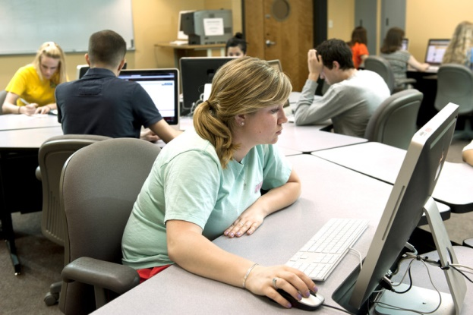
Resources &
Accessibility
Resources
  Use Built-in Assistive Technology to appreciate the need for accessibility
  Use Built-in styles for all document types
  Save To PDF not Print To
  Minimally provide transcripts for Video/Audio resources; provide closed captions if possible
Most common resources:
Talking
Documents
Videos/Animations to watch
Notes:
I’ve combined the results of a survey on instructional tools that faculty use and my experiences transcribing instructional materials into Braille to create this list of the most common resources faculty are using. It will probably not come as a surprise to any of you that they are: digital documents, paper documents, and video/animations.
From working with Faculty, I’ve found that these few things create a better learning experience for everyone.
-appreciating why accessibility features matter by using and experimenting with free built-in AT apps and software
-Built-in styles are available nearly everywhere, and the more our technology relies on the Web the more it ultimately relies on HTML, which means that using those built-in styles is how our AT knows what to say, translate, do, etc.
-PDF was by far the most commonly used external resource. Explaining to faculty that using the print to PDF feature was the equivalent of a digital photocopier helped many of them make an instant connection
-transcripts and captions

Slide 11

Technology &
Accessibility
Technology
  Use Built-in Assistive Technology to test prospective technology
  Avoid making assumptions about how competent students are with technology
  Keep technology incorporation at a level the instructor can truly support
Technology is the area where the most time and consideration should be taken to remove barriers.
Notes:
This is where we need our Accessibility fairy the most. Personally, I think truly accessible technology is a constantly evolving entity. What we consider “accessible” today may not be the same as what we consider accessible tomorrow. This is one more reason to know and use Built-in AT, it allows us to keep up with some of the evolution.
Many times in the last year, it was made apparent to me that faculty assume our digital natives know how to read, write, speak, and be creative using technology. But the truth is that reading, writing, speaking and creativity are actions that are independent of technology. Not all incoming students are as intimately familiar with the functionality of a mouse and those wonderful keyboard shortcuts because they may actually be more familiar with touch-based technology. Those are two different paradigms. This is a lesson not only for our faculty but for those of us in the accessibility arena as well…
Some faculty experience huge amounts of pressure to adopt technologies that are not in their technology toolbox. ….

Slide 12
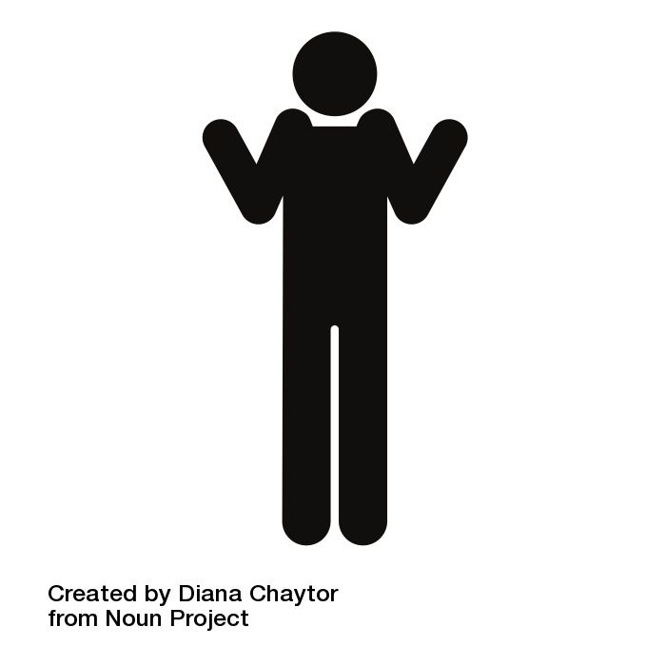
But does it really work?

Slide 13
Statistics for Social Sciences,
Fully Online
Enrollment: 130 per semester
Activities
  10 to 20 minute length videos
  Individual statistical exercises
  Small group discussions
  Weekly quiz assessments
  1 final exam
Resources
  Closed Captioned Videos
  PowerPoint Slides
  Excel Data Tables
  Physical textbook
Technology
  LMS hosted videos
  LMS hosted file repository
  Gmail
  JMP statistical software

Slide 14
Pre-Vet Anatomy, Team-Based
Enrollment: 500 per semester
Activities
  Reading assignments with physical or ebook
  Individual quizzes
  Team quizzes
  Team test & Team final
  Peer review
Resources
  Digital reading guides
  Textbook reading
  Captioned videos
Technology
  Learning Catalytics
  IFAT
  Paper tests

Slide 15
Conclusions
The implementation of an instructional approach is what creates access barriers
UDL lets an instructor create a structured yet flexible learning environment.
Activities, Resources and Technology can be chosen so they support accessibility.
Notes:
Exploring Built-In Accessibility
Accessible Documents by Design
Accessibility in the flipped classroom
Voice Recognition or Video Captioning

Slide 16
Thank You
Many aspects of accessibility
can be designed into the current instructional approaches in a way that improves the learning experience and learning outcomes for all students.
Comments and Questions?
christa.miller@vt.edu

Slide 17
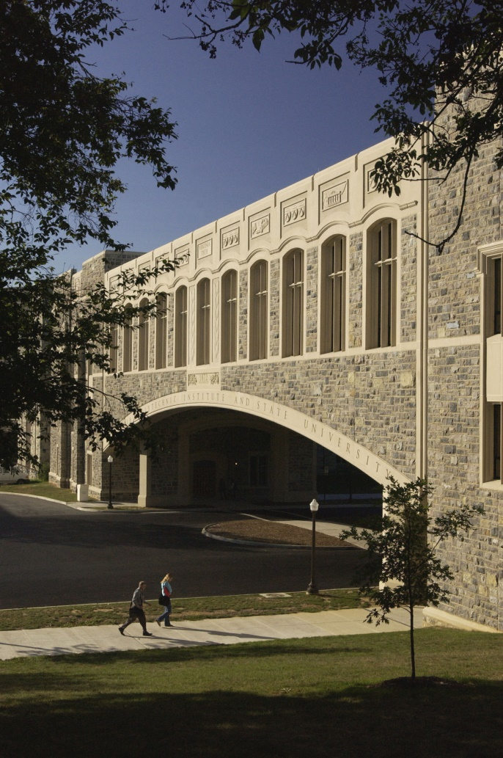
About Us
Support AT accommodations for students and employees
  Text-to-Speech, Voice Recognition, Braille, Captioning, Magnification, etc..
Provide consultations on Web Accessibility and Universal Design for Learning
Training on Assistive Technology
Assistive Technologies Lab
1180 Torgersen Hall
Notes:
I don’t want to go into great detail about Virginia Tech but I think it’s important to know that our Assistive Technologies group is part of the Learning Technologies unit (called TLOS) and this is located within central IT. Being part of central IT rather than tied to the disability support office has historically given us a two-fold mission.
To support AT accommodations….
To wherever possible build accessibility in, whether it’s for a specific course being designed or supporting AT integrations with University wide IT projects like computer labs.

