Slide 1
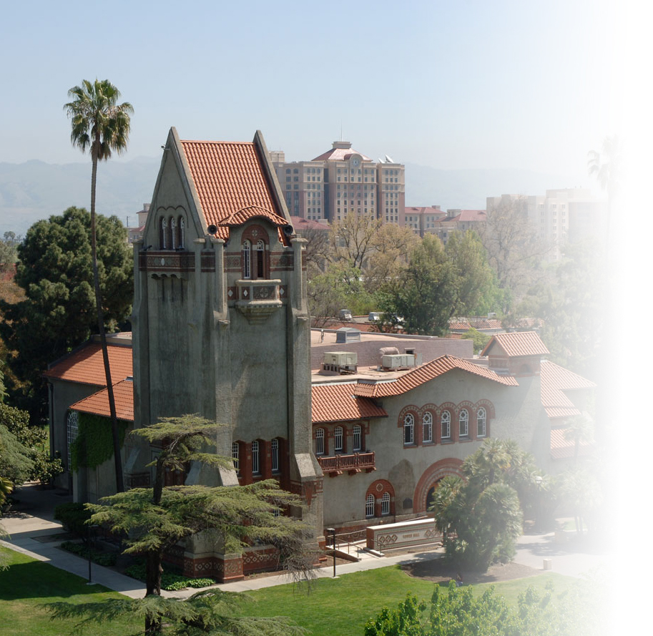
Good for the Goose, Good for the Gander: Enhancing learning opportunities for all students through video captioning
Amy Strage and Elizabeth Tu
San José State University
November 20th, 2015
18th Annual Accessing Higher Ground: Accessible Media, Web and Technology Conference

Slide 2
Agenda
Our Campus & Our Collaborators
Assessing the Needs
Questions about video usage
Questions about captioning needs
Introducing Captioning Services
Case Studies
Usage of captioned videos
Impact of captioned videos on student learning
Wrap-Up: Take Away Messages

Slide 3
SJSU Campus & Collaborators
Students:
Total enrollment: ~ 32,000
Registered w/ Accessible Education Center: ~ 1100 (4%)
Faculty:
Full-time & part-time: ~ 1600-1700
Accessible Technology Initiative Instructional Materials (ATI IM) committee membership:
Academic Senate
Academic Technology
Accessible Education Center
Center for Faculty Development
Library
Information Technology Services
Bookstore
Representatives from faculty & administration

Slide 4
Assessing Faculty & Student Needs
ATI IM administered two faculty surveys:
#1 (December 2012) – To document video usage
#2 (October 2013) – To better understand captioning needs

Slide 5
Status of Captioned Video
55% of respondents said that NONE of the videos viewed In-Class are captioned
62% of respondents said that NONE of the videos they assign for Outside of Class viewing are captioned
 | Not Captioned | < 25% | ~ 50% | > 75% | All | Don’t Know | Other
In-Class | 72 (55%) | 29 (22%) | 2 (2%) | 7 (5%) | 7(5%) | 7 (5%) | 8(6%)
Outside of Class | 82 (62%) | 10 (8%) | 2 (2%) | 2 (2%) | 4 (3%) | 12 (9%) | 20 (15%)
Notes:
Please remind me what the question was. Do we mean that 55% of faculty say that none of their in-class videos are captioned, that 22% of faculty say that less than a quarter of their in-class videos are captioned, etc..?
Yes, the 2 questions are:
What proportion of the video clips you showed IN Class this past semester were captioned or transcribed?
What proportion of the video clips you showed OUTSIDE OF Class were captioned or transcribed?

Slide 6
Source Video Format
This question is important to learn what kind of video files we will be captioning/transcribing.
Note the INCREASE in proportion of ELECTRONIC files received (45% to 89%)
Note the DECREASE in proportion of DVDs received 30% to 11%)
Source Video Format | Spring 2014 | Fall 2014 | Fall 2015
Electronic file (e.g., m4v, Flash, QuickTime, Window Media, Real Player) | 45% | 74.7% | 89%
DVD | 30% | 22.8% | 11%
Other | 14% | 1.3% | 0
VHS tape | 11% | 0 | 0
Blu-Ray | 1% | 0 | 0

Slide 7
Copyright Ownership of Videos
This question is important to determine whether we can add captions or only provide transcripts.
Note the the proportion of faculty asserting they have copyright ownership/permission has DOUBLED.
Copyright Ownership | Spring 2014 | Spring 2014 – present
No – for any of it | 44% | 44%
Yes – for everything I need captioned | 23% | 56%
Yes for some, no for others | 13% | NA
Not sure | 12% | NA
Other | 9% | NA

Slide 8
Introduction of Captioning Services
2012 ~ 2013: Needs Assessment
Spring 2014: Pilot Testing
Fall 2014: Official Roll-out
Needs Assessment 2012 - 2013
Pilot program Spring 2014
Official Roll-out Fall 2014

Slide 9
Captioning Services Infrastructure
Hardware and Software:
Windows and Macs, Dragon Naturally Speaking, MovieCaptioner, AutoSync, YouTube, DVD Studio Pro, etc.
Online Info Hub:
FAQs, request form via Google form, media drop box, media library repository, etc.
Resources:
2 staffs as additional duties; 6 part-time student assistants (50 hours/week)
Automatic Sync Technologies (AST) vendor
Documentation:
Job/workflow & software used, master database log sheet, etc.

Slide 10
Transcription Workflow
Log in digital video file
Manually transcribe video; check accuracy with 1st and 2nd corrections
Sync/time set words with video images, if appropriate
Deliver to faculty for review and approval
Log in video file
Sync words with video images
Deliver for review & approval
Transcribe with 2 checks for accuracy
No copyright
copyright
Closed Captioned Videos
Transcripts

Slide 11
Assessing the Usage and Impact of Video Captioning
Collect information from faculty for whom we provided captioning/ transcribing support
Case #1 – Computer Science 223 Python Language (Fall 2015)
Case #2 – Student feedback from 10 different courses (Fall 2015)
Case #3 – Performance differences in viewing videos with vs. without captions (Fall 2015)

Slide 12
Case #1: CS 223 Python Language
20 upper division students (8 female, 12 male) enrolled; 3-credit computer science course
Students are required to view course videos (30 to 60+ min) prior to face-to-face class
Instructor distributes in-class programming exercises and lectures/discusses key concepts
Students are randomly assigned to groups for peer discussion or debugging
Students are graded based on weekly quizzes, programming exercises, exams, & individual and group projects

Slide 13
Case #1: Usage and Impact of Captioning
The following survey questions were distributed during class:
Are you aware that captioned videos are available?
Did you look at any captioned video?
If answer to [the above] is no, why not?
If answer to [the above] is yes, will you keep look at the captioned videos?

Slide 14
Case #1: Usage of Captioned Videos
Are you aware that captioned videos are available?
7 out of 20 (35%) students are aware the availability of captioned video
Did you look at any captioned video?
2 out of 20 (10%) students viewed captioned video
Questions | Yes | No
Are you aware that captioned videos are available? | 7 (35%) | 3 (15%)
Did you look at any captioned video? | 2 (10%) | 8 (40%)

Slide 15
Case #1: Reasons for Not Watching Captioned Video
I wasn’t aware that they were available. The lectures were easy to hear though
The other videos work just fine
Because they aren’t readily available on canvas… I’m too lazy to seek them out
Not applicable
Was not aware of the captioned videos. But I don’t have trouble understanding your lecture. Plus your videos are a combination of slides + interactive. I can pretty much read and see what you’re saying anyway.
I can clearly understand the words spoken in the video

Slide 16
Case #1: Reasons to Continue Viewing Captioned Videos
I found it helpful to watch the captioned videos to capture complex programming concepts and ideas as I am experiencing programming for the first time. It is really helpful to take important notes on the lecture videos.
The other videos work just fine
I am content with the audio quality of the videos and do not find the captioned videos necessary at this point in time.
I am not sure. I may see those videos in future if I come across something which I am not able to understand.

Slide 17
Case #2: Video Captioning Usage
We contacted 30 faculty members who have used our captioning service and asked them to forward an anonymous survey to their students.
Courses included anthropology, biology, geology, physics, psychology, statistics and engineering technical writing
Students had two weeks to respond. Participation was voluntary.
54 out of a total of 401 students from 10 courses have responded. The return rate is 13.5%

Slide 18
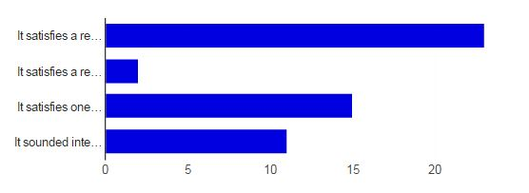
Case #2 - Why Did You Take This Course?
Required for my Major = 22 (60%)
Required for my Minor = 2 (5%)
GE requirement = 15 (41%)
It sounded interesting = 10 (27%)

Slide 19
Case #2: Are you eligible for instructional accommodations?
Yes = 6 (11.1%)
No = 34 (63%)
Not Sure/prefer not to say = 13 (24.1%)

Slide 20
Case #2: Your Experience/Comfort Level with English
English is the only language that I speak = 29 (53.8%)
I speak one or more languages other than English = 23 (42.6%)
I feel very comfortable learning/studying in English = 17(31.5%)
I would feel more comfortable learning/studying in English if my language skills were stronger = 1 (1.9%)
I prefer not to say = 0

Slide 21
Case #2: Use of Captioning
Total respondents = 54
Yes, always/nearly always = 33 (61.1%)
Yes, about half the time = 5 (9.3%)
Yes, but rarely = 8 (14.8%)
No, never, but I knew they were available = 2 (3.7%)
No, never - I didn't know they were there! = 12 (22.2%)

Slide 22
Case #2:Why/When Do you use the Captions?
Captions help me learn (23)
with studying/learning, clarify, affirm understanding, note taking, spelling, pause and replay, etc.
Noisy environment (13)
…when I cannot hear, in a noisy classroom, in a large classroom, etc.
Speaker clarity (11)
Has accent, is hard to understand, not clear, speaks too fast, etc.
Help with hearing impairment (2)
Others (4)
Forget my headphones when listening in a lab or library
Lecture slides help
Captions availability

Slide 23
Case #2: When/Why you do not use captions
Audio is loud/clear enough (7)
No need, irrelevant, freedom to use the sound and rewatch the video, speakers have no accent (7)
Always use it (5)
Distract from the video (3)
Enjoy the facial expression (1)
I listen instead of read (1)
No closed captions (1)

Slide 24
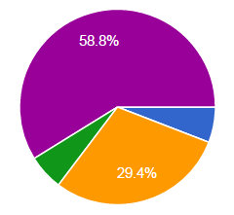
Case #2: Preference for Live Presentation vs. Archived Videos
Strong preference for the live version = 1 (5.9%)
Moderate preference for the live version = 0
No preference = 5 (29.4%)
Moderate preference for the video/archived version = 1 (5.9%)
Strong preference for the video/archived version = 10 (58.8%)
Other = 0

Slide 25
Case #2: Reasons for Preferences
Live Presentation (3)
Easier to hear and focus
Ask questions
Motivate speakers to talk
Archived Videos (9)
Freedom to review, pause, and rewind to learn (5)
Fit into my schedule better
Flexibility for commuter students
Great for note taking to get exact quotes
Speakers are difficult to understand

Slide 26
Case #3: Does Closed Captioning Impact Student Learning?
All Engineering majors are required to take ENGR 100W course and attend the Green Talk guest speaker series.
GreenTalk lectures feature practicing engineers, scientists, and technical experts who deliver up-to-date briefings on how they deal with environmental issues
The live lecture series is held in the Engineering Auditorium; students enrolled in evening sections have to view recorded versions of the talks
Survey distributed to 3 sections of ENGR 100W to assess whether closed captioned videos make any difference in students’ learning. We received 68 out of a total 68 responses. Participation points given to those who provided their names.

Slide 27
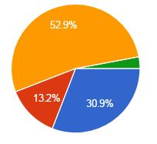
Case # 3: Attendance at Live vs. Video Presentation
Attended the live presentation = 21 (30.9%)
Watched the YouTube video presentation without closed captions = 9 (13.2%)
Watched the YouTube video presentation WITH closed captions = 36 (52.9%)
Other = 2 (2.9%)

Slide 28
Case # 3: Assessing student learning
Survey included 7 multiple choice and 2 open ended questions about the content delivered by the speaker
Students who viewed the videos with captioning answered significantly more questions correctly than those who viewed videos without captions or who attended the live presentation (F = 29.33, p <.000).
 | Attended LIVE presentation | Viewed Video WITHOUT captions | Viewed Video WITH captions
Average number of multiple choice questions answered correctly | 2.77 | 4.22 | 4.89

Slide 29
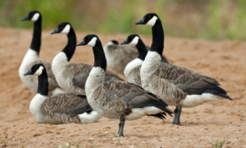
Wrap-up: Take-Away #1
“Good for the goose, good for the gander” with your universally accessible teaching content
29
San Jose State University
Notes:
Summarize points that show how non-AEC students report benefitting from the captions

Slide 30
Wrap-up: Take-Away #2
Plan for appropriate online distribution – make sure all of the geese and all of the gander can benefit from your teaching …
Make sure students realize that closed captioning is available and how to use it. (Case #1)
Closed captioned videos are most effective:
When students encounter new complex concepts or terminologies (Case #1)
When students need to clarify, affirm understanding or spelling (for non-native English speaker), pause and replay, note taking, etc. (Case #2)
When students view different speakers presenting different topics in a big lecture hall (Case #3)
When students are tested of the video content in a shorter time frame (Case #3)
When there is relevancy or connection between video content and student assignments or classroom activities (Case #3)

Slide 31
Wrap-up: Take-Away # 3
Universal Design in Teaching:
Provide multiple ways or strategies in presenting your teaching content or classroom activities
When designing or presenting multimedia course materials, include instructional designers, media producers, IT specialists and librarians as early as possible
Faculty
Learners
IT or Media Producers
Instructional Designers

Slide 32
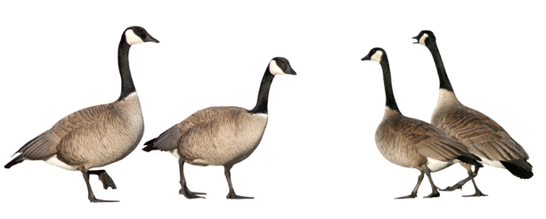
Thank you!!
Questions?

Slide 33
Points of Contact
Amy Strage, Assist. VP for Faculty Development & Director, Center for Faculty Development
San Jose State University
Amy.Strage@sjsu.edu
Phone: 408.924.3715
Elizabeth Tu, Instructional Designer & Instructor
Center for Faculty Development
San Jose State University
Elizabeth.Tu@sjsu.edu
Phone: 408.924.3093

