Slide 1
Accessibility Basics

Slide 3
Hidden in plain sight
Speech-to-text program
Magnifier
Epilepsy
Migraines

Slide 4
It’s not just about vision impairments

Slide 5
Our Services
Audits
Mobile testing
Building web sites
CMS testing
Accessible design
Video accessibility
User testing
OS / browser testing
Consultation
Accessible documents

Slide 6
Our Products
OzPlayer
OzART
OzWiki
BrowseAloud
More information:
www.accessibilityoz.com.au

Slide 7
Overview of accessibility

Slide 8
What is online accessibility?
Online accessibility:
ability for a person with a disability to understand and use a web site, application, intranet, or program
Governed by:
Australian Human Rights Commission: Disability Discrimination Act
Achieved by:
W3C Web Content Accessibility Guidelines (WCAG)

Slide 9
Accessibility is important…
It allows people with disabilities to:
access information like anyone else
interact with others without being categorised as “disabled”
undertake activities which they are not otherwise able to do

Slide 10
People with disabilities

Slide 11
People with disabilities
What types of people with disabilities are assisted by an accessible website?
Disabilities affecting vision
Disabilities affecting how the mind interprets information
Disabilities affecting movement
Disabilities affecting hearing

Slide 12
Vision impairments
Types of vision impairments:
Blindness
Colour blindness
Glaucoma
Cataracts

Slide 13
Vision impairments
Assistive technologies:
Screen readers or braille readers
Braille keyboards or large size keyboards
Magnifiers
User techniques:
Increasing text size
Turning off JavaScript
Increasing colour contrast

Slide 14
Screen reader video
http://www.youtube.com/watch?v=VvWCnFjAGgo

Slide 15
Cognitive impairments
Types of cognitive disabilities:
Epilepsy & migraine
Dyslexia
Aphasia
Problems with memory
Reading disabilities

Slide 16
Dyslexia activity
http://www.pbs.org/wgbh/misunderstoodminds/reading.html

Slide 17
Cognitive impairments
Assistive technologies:
Screen readers
Speech recognition software
Hover highlighting
Dictionary software
User techniques:
Turning off Flash, JavaScript
Decreasing colour contrast

Slide 18
Physical impairments
Types of physical disabilities:
Cerebral palsy
Motor Neuron Disease
Huntington’s
Parkinson’s
Quadriplegia

Slide 19
Physical impairments
Assistive technologies:
Joysticks
Modified or on-screen keyboards
Touchscreens & headwands
Switches
User techniques:
Turning off Flash, JavaScript
Using the keyboard only
Increasing text size

Slide 20
Switch / online keyboard video
http://www.youtube.com/watch?gl=AU&hl=en-GB&v=2BhHwk9qSvI

Slide 21
Hearing impairments
Types of audio disabilities:
Profound deafness
Hard of hearing
Assistive technologies:
Visual alerts for audio alerts
User techniques:
Open or closed captioning (by the author)
Volume control

Slide 22
Accessibility complaints

Slide 23
Legal precedents
June 1999 – August 2000
Bruce Maguire lodged a HREOC complaint about the Sydney Olympics web site
HREOC ruled in Maguire’s favour
September 2000
SOCOG ignored HREOC and fined $20,000
Legal fees greater than $500,000

Slide 24
Previous complaints
Target.com (US)
$6 million class action suit, legal fees in excess of $3.5 million
Government of Canada
Make all of their web sites accessible within 15 months
Netflix
$795,000 in damages and captions within 2 years
Department of Homeland Security
ongoing

Slide 25
Read
Lawsuits in America

Slide 26
Web Content Accessibility Guidelines
Principles, Guidelines, Success criteria, Techniques and Conformance levels

Slide 27
WCAG
Developed by the W3C:
International, vendor-neutral organisation
Written by:
Accessibility specialists
People with disabilities
Software vendors
Version 1 released in 1999
Version 2 released in 2008

Slide 28
WCAG Principles
Perceivable: Information and user interface components must be presentable to users in ways they can perceive. One implication of this principle is that information cannot be presented in a form that is only available through one sense, such as providing only a visual form of a CAPTCHA.

Slide 29
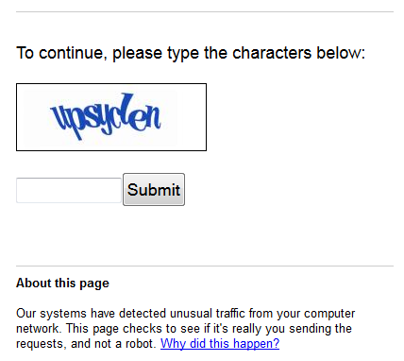
Perceivable
CAPTCHA: Completely Automated Public Turing test to tell Computers and Humans Apart

Slide 30
WCAG Principles
Operable: User interface components and navigation must be operable. In other words, users must be able to operate with the user interface and navigational aspects of a website. One implication of this principle is that interaction with web content should not depend on a user being able to use a physical mouse.

Slide 31
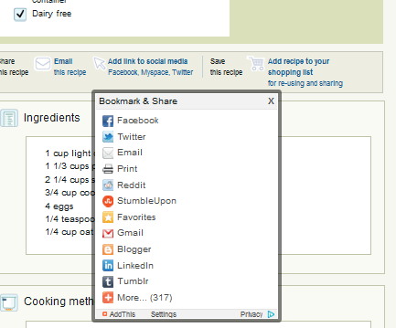
Operable
Tabbing to the AddThis feature makes it appear as a drop-down. When tabbing away from this feature the AddThis remains in a drop-down state.

Slide 32
WCAG Principles
Understandable: Information and the operation of user interface components must be understandable. In other words, users must be able to understand both the information (content) and how to interact with it. One implication of this principle is that changes of content or context must not be triggered unexpectedly (for example, through the use of focus changes).

Slide 33
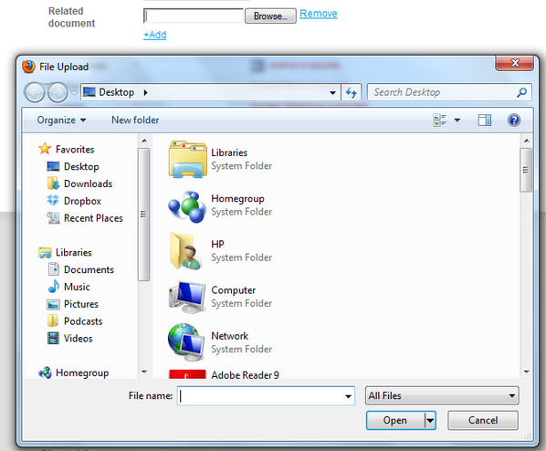
Understandable
Entering a field does not have expected behaviour.

Slide 34
WCAG Principles
Robust: Content must be robust enough that it can be interpreted reliably by a wide variety of user agents, including assistive technologies. One implication of this principle is that a webpage should not require the use of a specific assistive technology (such as a specific screen reader) in order to be accessible.

Slide 35
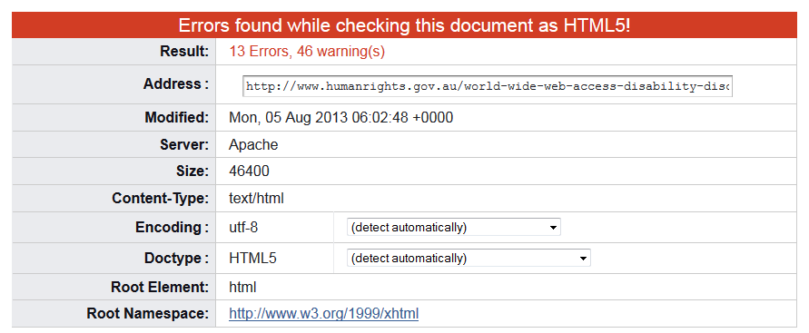
Robust

Slide 36
Guideline example
Each principle has a number of guidelines, for example:
Perceivable
1.1 Provide text alternatives for any non-text content so that it can be changed into other forms people need, such as large print, braille, speech, symbols or simpler language. http://www.w3.org/TR/WCAG20/#perceivable

Slide 37
Success criterion example
Each guideline has a number of success criteria, for example:
Success Criterion 1.1.1
Non-text Content: All non-text content that is presented to the user has a text alternative that serves the equivalent purpose, except for certain situations.
http://www.w3.org/TR/WCAG20/#text-equiv

Slide 38
Technique example
Each success criterion has a number of techniques, for example:
H37: Using alt attributes on img elements
http://www.w3.org/TR/2010/NOTE-WCAG20-TECHS-20101014/H37

Slide 39
Conformance levels
Three conformance levels:
Level A (minimum)
Level AA (medium)
Level AAA (maximum)
Conformance (and conformance level) is for full Web page(s) only, and cannot be achieved if part of a Web page is excluded.

Slide 40
Conformance levels
Complete processes:
When a Web page is one of a series of Web pages presenting a process
Only Accessibility-Supported Ways of Using Technologies: Only accessibility-supported ways of using technologies are relied upon to satisfy the success criteria.

Slide 41
Conformance levels
Non-Interference:
If technologies are used in a way that is not accessibility supported, or if they are used in a non-conforming way, then they do not block the ability of users to access the rest of the page.

Slide 42
Conformance claims
All conformance claims must contain the following:
Date of conformance
WCAG version and URL
Conformance level (A, AA or AAA)
List of pages (URL / domain / process)
Web content technologies relied upon

Slide 43
Who else benefits?

Slide 44
Who else benefits
Elderly
People with temporary disabilities
People with English as a Second Language
People on older software
People on dialup internet access
People using mobile devices
General public

Slide 45
Questions?
Gian Wild
www.accessibilityoz.com.au
gian@accessibilityoz.com.au

