Slide 1
Genesis of the Accessibility and Usability Lab at the University of Colorado Boulder
Presented by:
Amelia Dickerson
Paula J. Vaughan

Slide 2
A Brief History of the AUL
DOJ Inquiry
On behalf of students with blindness or low vision
Led to campus-wide collaboration
Impetus for the Information and Communication Technology Accessibility Initiative
Accessibility & Usability Lab
Born out of the Accessibility Initiative
Just finishing up its first year of existence

Slide 3
What we have learned: Focus
Why Focus on Screen Reader and Magnifier Testing?
Blindness and low vision were the focus of DOJ inquiry.
Campus asked us to target screen reader/magnifier access.
The greatest unmet accessibility need.
Our choice: focus on one area and do it well, versus tackling many areas and doing each less well.
Efforts are focused on accessibility – but usability extends to everyone. Process continually provides usability discoveries.

Slide 4
What we have learned: Principles
Let the process develop organically
Flexibility emphasized over rigid structure
Workflow
Prioritization
Resource scheduling
Start small and build on what works
Small staff, hire new as need and availability arise
Initially basic reports; now including WAVE and WCAG as competence increases
Wait on large investments in equipment, staffing or processes until need is proven

Slide 5
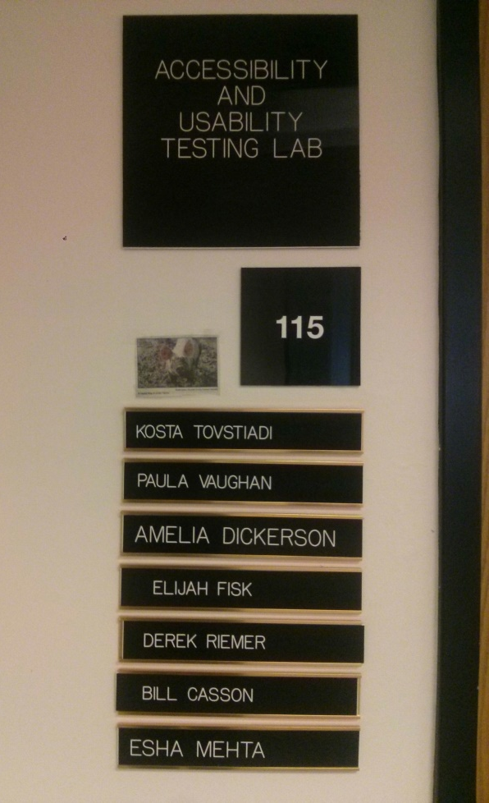
What we have learned: Principles
Formalize the existence of AUL
Reporting structure
Request processing
Training and awareness program initiated
Signage

Slide 6
What We Have Now: Robustness
Formalized processes
The longer we are around,
the more we learn to do
the greater the campus awareness and appreciation of our existence
Client involvement
Clients can be any campus department, instructor, program or facility, as well as systems technology at the central University of Colorado offices.
Introductory meetings
High-level scripting
Collaborative testing with developers
Post-test demos

Slide 7
Robustness on the Horizon
Create a database of encountered accessibility issues
Web accessible
Continual building as testing progresses
Archive of testing summaries
Expand training and awareness program
Help our IT department with their own automated testing in some cases

Slide 8
What We Have Now: Workflow
Client contact:
Acceptance of the request
Discovery of web site/application/features to be tested
Preparation:
Write test scripts
Scheduling (of test queue and of testers)
Testing
WAVE testing
User testing with blind and low vision student testers
Reporting for clients: written & demos

Slide 9
Shortcomings and Responses
Unsteady workflow
Still with peaks, valleys not so deep
Keep roles of everyone working in the lab flexible so we can pick up projects as needed
Concern re. keeping student testers busy
Students have adjusted their expectations and we have been able to give them steadier hours
Opportunities for professional growth are now offered to lab’s student testers
Constraint: One lab
Testing queue may be long, testers may be available, but only one facility is available for testing use

Slide 10
Shortcomings and Responses
Lack of Code knowledge
Deliberate choice to focus on testing and WCAG standards vs. coding.
Cost/benefit analysis of learning code versus enhancing testing/usability expertise led to the decision to forego coding.
The university uses our test results as the basis for requests to vendors to make changes to vendor-controlled code.

Slide 11
Lab Nuts & Bolts
Current staffing
Lab manager reporting to Chief Digital Accessibility Officer
Part-time accessibility consultant
Part-time testing coordinator
Three blind and one low-vision student testers
Three lab dogs
Current lab set up
One PC with NVDA, JAWS, Window-Eyes and magnifier
One Mac with VoiceOver
Two tablets (iOS, Android) and two phones (iOS, Android)

Slide 12
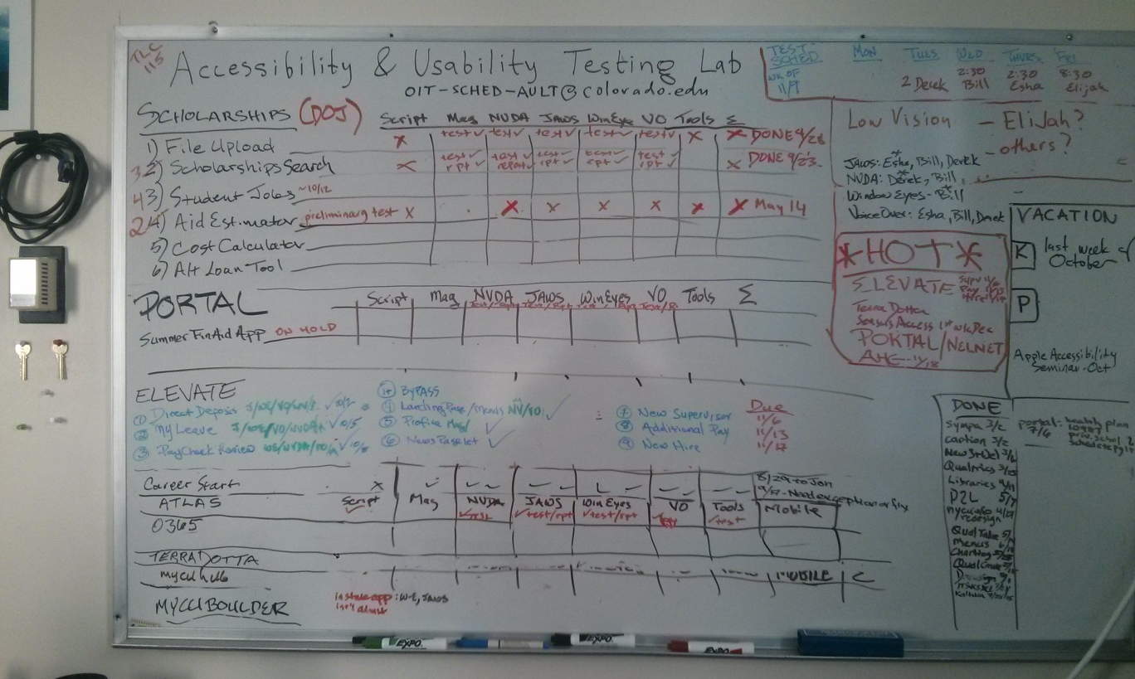
More Nuts & Bolts
A day in the life of the lab – creating order out of chaos!

Slide 13
QUESTIONS?

