Slide 1
Solutions for consuming STEM Content

Slide 2
The problem is…
Knowing that the STEM content is accessible
Ensuring your A.T. can capture the accessible STEM content
Ensuring your A.T. represents the STEM content accurately

Slide 3
Math Audio Guidelines
Mathspeak based on Nemeth
Mathplayer
Mathspeak
Simple Speak
PARCC & Smarter Balanced Consortium Audio Guidelines
Used for online high stake K-12 exams
New students will be familiar with these rules

Slide 4
Screen reader options
NVDA & MathPlayer reads aloud
MathJax in Firefox
Internet Explorer IE8-9 or 11 in compatibility mode
Mathtype equations in office documents when Mathtype installed
Choice of reading rules within MathPlayer & inter-equation navigation
Jaws 16 or later
Reads equations in Internet Explorer of equations rendered with Mathjax or MathPlayer
Inter-equation navigation with equation rendered in separate windows
Notes:
NVDA maths key caps lock + alt + M

Slide 5
Screen Reader options (2)
ChromeVox
Built-in equation support for Mathjax equations.
In math mode can navigate into equations
Window-Eyes, SuperNova, Texthelp Read & Write Gold
Able to read MathML equation render in legacy versions of IE with MathPlayer
In-consistent reading in Word documents
Free TTS reads (e.g. Natural Reader) will not render or read math

Slide 6
Dedicated readers
Central Access Reader (free)
Reading application for Word documents & HTML content
Reads aloud equations created with Mathtype or Word equation editor.
No inter-equation navigation
ReadHear
Read DAISY2, DAISY3, NIMAS< HTML, ePub containing MathML
Powered through internal MathSpeak rules or MathPlayer

Slide 7
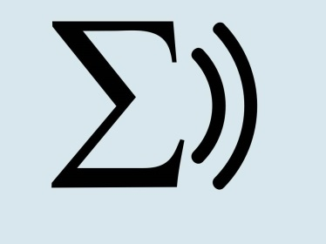
STEMReader project
Develop a usable, sustainable tool for reading aloud maths notation to use alongside their current support strategies.
Goals:
Improve solutions for reading aloud maths notation for students studying from functional skills through to degree level maths and science
Platform independent tool for rendering & speaking MathML with definitions and suitable reading rules
User-centred design throughout user trials throughout development
Due to launch May 2016

Slide 8
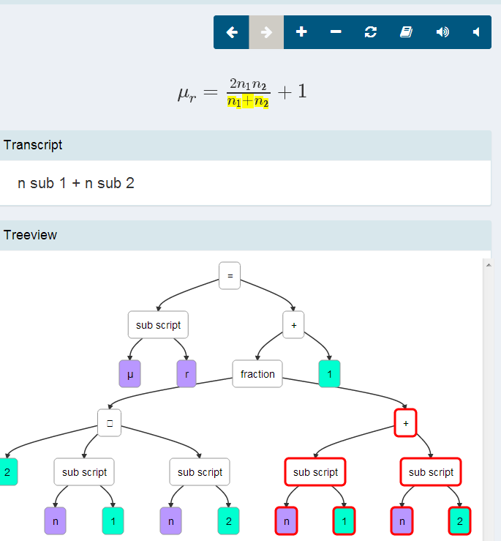
STEMReader www.stemreader.org.uk
Read aloud maths in accurately but without overloading user
Highlight the equation as it is read
Provide users with different options for speaking & exploring equations
Free & premium version will be available

Slide 9
ATbar & STEMReader
Open source TTS toolbar for Windows via clipboard. In development available early 2016
Will launch STEMReader to read equation if MathML on the clipboard
Other developments to support math
Using STEMReader to check MathML / MathJax content on websites through ATbar toolbar
Using protocol handler within web-pages to launch Math AT www.stemreader.org.uk/guidelines

Slide 10
Future developments in STEM accessibility
National STEM accessibility database (UK) in development
Semantic wiki to capture & disseminate knowledge on STEM accessibility
Supported by Learned Societies
WCAG Cog working group looking at Math LD, concentration etc techniques
DIAGRAM project

Slide 11
What’s needed to move STEM Accessibility Forward
Consistent standards for production and testing
Compatible reader and browsers
Assistive technology developed with STEM requirements in mind
NEED User and consumer demand to create required knowledge within support & developer community.

