Slide 1
Solutions for using STEM based curricular materials
Abi James, a.james@soton.ac.uk
Visiting Research Fellow, University of Southampton
Ron Stewart ron@altformatsolutions.com
Managing Consultant, Altformats Solutions
Teresa Haven, Teresa.Haven@nau.edu
Accessibility Analyst, Northern Arizona University

Slide 2
Agenda
Current Campus situation
You and Math
Standards and Guidelines
Coffee!
A.T Solutions for support STEM
Creating Accessible STEM

Slide 3
When they get to college …do students expect math?
Given the sample, calculate:
(i) $n$ (ii) $\sum{x}$ (iii) ${(\sum{x)}}^{2}$ (iv) $\frac{1}{n}\sum{x}$ (v) $\frac{\sum{x}}{n}$
Consider $y_{t}=μ+θy_{t−1}+ε_{t}$.
Determine $y_{1}, y_{2}$ and $y_{3}$
Use the data to obtain Ordinary Least Squares vales of $α and β$in the following regression equation:
$Y_{i}=α+βX_{i}+ε_{i},$ $i=1,2,…,6$
Biology
Business
Economics
Notes:
Biology
Business
Stats and Economics

Slide 4
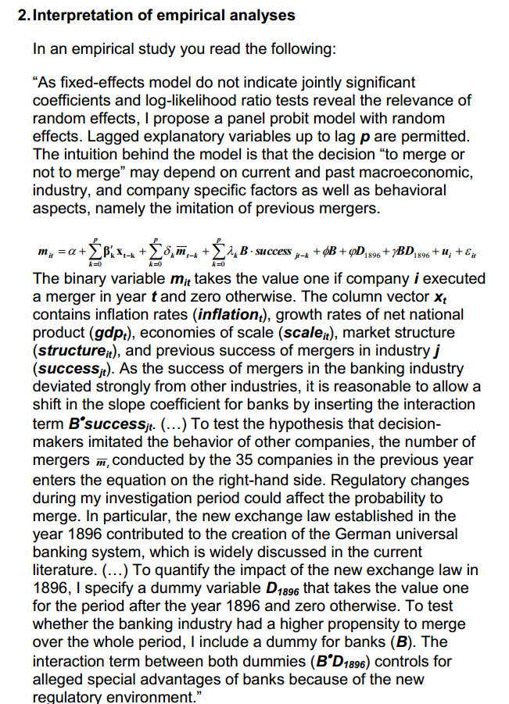
Which subject is this form? Manage-ment
Notes:
Screenshot from a management paper

Slide 5
Textbook screen shot from? Philosophy

Slide 6
Some students might anticipate math content…
Calculate
Which of the following is the Laplace transform of the function $t^{2}e^{2t}$?
(a)$\frac{2}{s^{3}{\left(s+2\right)}^{′}}$ (b) $\frac{2}{{(s−2)}^{3′}}$ (c) $\frac{2}{{(s−2)s}^{3′}}$ (d) $\frac{2}{{\left(s+2\right)}^{2′}}$
(e) none of the above
Chemistry
Engineering
Notes:
Oceanograhpy / Chemisty
Engineering

Slide 7
Students that want to do math….
1. Using the above results and Skokes’ theorem obtain the value of:
$$\iint_{A}{\left\{zj+\left(y−1\right)k\right\}.ⅆS}$$
Where A is the curved surface of the hemisphere $x^{2}+y^{2}+z^{2}=4, z≥0$and $ⅆS$ points outwards from the origin.
2. Mean energy equation can be written as:
Math
Meteorology

Slide 8
Mathematics – the universal language?
“Mathematics: The only true universal language” New Scientist, Feb 2009
“Mathematics is the only language shared by all human beings regardless of culture, religion, or gender.”
But can it be accessible?

Slide 9
Typical Accessibility Requirements
Some users may want to
Zoom / re-size
Change colour, contrast
Search, index
Braille rendering
Use keyboard to navigate to and through content
Read aloud content with or without highlighting

Slide 10
So who needs accessible math? What A.T. do we need to support?

Slide 11
The challenge…. Not just screen reading
“ A student is struggling with dealing with the spreadsheet of numbers as she has narrow vision. So she can see selected bits - but makes it a challenge seeing the big picture and trends”
“When I’m doing maths problems I make careless errors and can’t spot them. So x² becomes 2x when I turn the page. If I cross things out I don’t know if its part of solving the equation or my workings”

Slide 12
The difference between maths & text
Maths is a 2-dimensional notation. Location of a symbol affects its meaning
$f\left(x\right)=a_{0}+\sum_{n=1}^{∞}{\left(a_{n}\cos{\frac{nπx}{L}}+b_{n}\sin{\frac{nπx}{L}}\right)}$
Fourier Series equation
2 dimensional language when reading,
3 dimensional when writing

Slide 13
Talking Maths: difference between math & text
Symbols in maths can mean different things:
[AB]⁻¹
Could be read as:
“left parenthesis, boldface capital a, boldface capital b, right parenthesis, superscript minus one”
OR
“inverse of the matrix product, boldface capital a, boldface capital b”

Slide 14
Math: non-linear representation & ambiguity
Maths when read aloud can mean different things
Example 1: “a plus b over 2”:
$a+\frac{b}{2}$ $\frac{a+b}{2}$
Example 2: “2 plus 4 minus 3”:
$$2+4−3$$
$$2+(4−3)$$

Slide 15
Accurate reading of maths:
Example 1: “a plus b over 2” / “a plus b all over 2”
$a+\frac{b}{2}$ $\frac{a+b}{2}$
Accurate but verbose alternatives
“a plus open fraction b over 2 close fraction”
$$a+\frac{b}{2}$$
“open fraction, open parenthesis, a plus b, close parenthesis, over 2, close fraction”
$$\frac{(a+b)}{2}$$

Slide 16
Mathematical semantics
If possible to drill down into the semantics of an equation then
Audio representation of the notation may be more valuable & put less strain on their working memory capacity
However, mathematical semantics may have consistent notation but not a consistent vocabulary.
Need to consider context and localisation

Slide 17
Context and localisation example
Calculate 300,000 + 56
Calculate 300.000 +56
Calculate $300 000+56$
Calculate 300 000 125 +56
Mathematics is not universally the same!

Slide 18
Then there are symbols
Most STEM materials will contain symbols and numbers within the text.
A.T. voices and tools may not read these or worse get the context wrong
a < 2 “a is less than 2”
$a≤2$ “a is less than or equal to 2”
“M is a subset of N”

Slide 19
STEM Standards & Guidelines: What should we be doing?
WCAG “5.7 Markup and style sheets rather than images”
WCAG-COGA cognitive working group covering maths difficulties
HTML5 & ePub3 using MathML
Guidelines on images e.g Diagram Centre Image Description Guidelines 2015
Guidelines on converting LaTeX to accessible formats University of Bath process

Slide 20
How can we make STEM accessible without…
Standards to test against?
Techniques for accessibility solutions?
Assistive tools to test with?

Slide 21
What is needed for Interoperability?
Content
Standards
Content
Viewer
Assistive
Technology.
Type-set
Encoding
Standards
Technical
Standards

