Slide 1
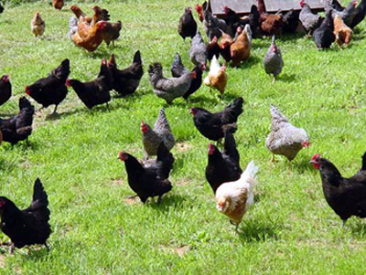
Free, Open Source and other licensing options?
Do we need to go free range?

Slide 2
Many Facets of Assistive Technology
Access
Personalisation and Accessibility
Productivity Tools
Free, Open Source, Mobile, Portable and Online Technologies
Assistive Technologies
Mainstreaming
Notes:
Assistive Technology triangle – from Access Technologies at the top representing the assistive technologies such as screen readers and magnification or specialist text to speech, next personalisation and accessibility where desktop changes are made and built in accessibility tools are used to Productivity which is where built in spell checkers and auto correct may help to the final layer including free, open source, mobile, portable and online technologies
which for some maybe the most important. This is not a hierarchy of tools but rather a complete toolkit approach.

Slide 3
Assistive Technology licence selection!
Open source
Freeware / Shareware
Integrated
Freemium
Subscription
In-app purchase
Commercial
Licence purchase – cost per seat / concurrent user / site…
Support & maintenance, upgrades

Slide 4
But many factors impact on students’ acceptance of Assistive Technology
Technology Acceptance Model (TAM, proposed by Davies,1989)
Wide variation in comments, but all focus on usefulness / ease of use
Notes:
Diagram showing the Technology Acceptance Model. External variables influence Perceived ease of use and Perceived usefulness. This influences attitude and behavioural intentions which leads to actual behaviour. These factors influence whether a user will adopt a new technology. Many recent variation, but all focus on usefulness / ease of use

Slide 5
Barriers and Facilitators to Uptake of Assistive Technologies
PROVIDE TIMELY ACCESS
IMPROVE AWARENESS
ENHANCED OUTCOMES?
IMPROVE FUNCTIONALITY & DESIGN
SMOOTHER TRANSITION BETWEEN PHASES OF LIFE?
INVOLVE USERS IN DEVELEOPMENT & USE
BETTER USE OF RESOURCES?
REDUCE STIGMA
BETTER EXPERIENCE FOR USERS & PROVIDERS?
PROVIDE TECHNICAL SUPPORT
IMPROVE COMPETENCY & CONFIDENCE
Draffan et al (2015) Barriers and Facilitators to Uptake of Assistive Technologies: Summary of a Literature Exploration.
Notes:
Draffan EA¹, James A¹, Cudd P², Bentley C² (2015) Barriers and Facilitators to Uptake of Assistive Technologies: Summary of a Literature Exploration. Pp 350 - 356 Studies in Health Technology and Informatics
Volume 217: Assistive Technology
DOI10.3233/978-1-61499-566-1-350

Slide 6
Customer perceived value
Total Customer Benefit
Total Customer Cost

Slide 7
Advantages..
Free
No cost
Freemium & Integrated
Supported tool
On going development
No / low cost
Easy to try out
Quick to access
Community support
Possibly less stigma attached
Paid licenses
Supported tool
On going development
Sophisticated features
Warranty
Possibly the only solution
Easy to try out
Quick to access
Community support
Less “feature bulk”
Notes:
Advantages.
Free:
- No cost
- Easy to try out
- Quick to access
- Community support
Less “feature bulk”
Freemium & Integrated
- Supported tool
- On going development
- No / low cost
- Easy to try out
- Quick to access
- Community support
- Possibly less stigma attached
Paid licenses
- Supported tool
- On going development
- Sophisticated features
- Warranty
- Possibly the only solution

Slide 8
But…
Free
Little of no support or maintenance
Limited warranties
Liable to disappear
Not always suitable for the workplace
Freemium & Integrated
Features can become premium
Larger user base required to sustain freemium business
Integrated tools, often less training materials
Paid licenses
Cost and upgrades
Feature bloat
Notes:
But…
Free:
- Little of no support or maintenance
- Limited warranties
- Liable to disappear
Not always suitable for the workplace
Freemium & Integrated
- Features can become premium
- Larger user base required to sustain freemium business
- Integrated tools, often less training materials
Paid licenses
- Cost and upgrades
- Feature bloat

Slide 9
Developers’ perspective:
ATbar: open source browser toolbar.
Marketplace allows for customisation & localisation
Maintenance funded through projects
ATbar for Windows: open source desktop tool, providing simple feature set in competitive market
STEMReader: math TTS with freemium model
Free add-in to ATbar, premium version to fund support & future development

Slide 10
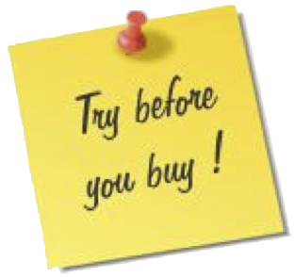
Types of Technology Each example given is one of many! All are different!
Think strategy – find the tools
Text to speech
Spell checking
Graphical mapping
Reminders
Speech Recognition
Scanning and OCR
Dictionaries
Calculators
Note taking
References

Slide 11
Thank You
Abi James & E.A. Draffan
WAIS, Electronics and Computer Science, University of Southampton. E-mail: a.james@soton.ac.uk
ead@ecs.soton.ac.uk
http://access.ecs.soton.ac.uk/

