Slide 1
Lecture Capture

Slide 2
Is Lecture capture an accessibility tool or barrier?
Note-taking is difficult for students with a wide range of disabilities
Lecture capture is purported to support students with disabilities and popular enhancement to student offering
Quality of notes taken in class is related to student outcomes

Slide 3
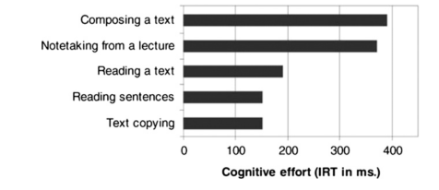
Why is note-taking difficult?
Note-taking in a lecture is approximately 3 times as cognitively demanding as copying text.
Bui & Myerson (2014); adapted from Piolat et al. (2005)
Notes:
Graph Shows the relative cognitive effort of different tasks (IRT in milliseconds):
Composing text ~390
Notetaking from a lecture ~375
Reading a text ~190
Reading sentences ~150
Text copying ~150

Slide 4
Effective note-taking
Requires students to “attend, store, and manipulate information selected from the lecture simultaneously, while also transcribing ideas just presented and processed” (Kiewra & Benton, 1985)
May depend on the type of material and the assessment approach
Factual vs. conceptual learning
Essay vs. multiple choice vs. problem solving assessment

Slide 5
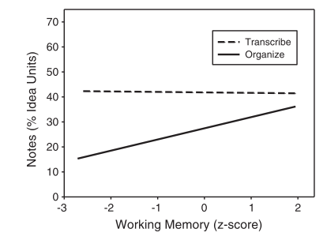
Working memory & note-taking strategy
Bui et al (2013); Bui & Myerson (2014) looked at the impact of working memory on note-taking.
Working memory predicted note-quantity for organised notes but not when attempting to transcribe a lecture
Strategy of transcription was more effective for those with weak working memory
Transcription easier when typing
Notes:
Bui et al (2013) compared students ability to recall notes immediately & in delayed testing, when instructed to transcribe or create organised note by hand or on laptop.
findings suggest not only that transcribing using a
computer can lead to superior immediate recall, but also that
working memory does not have to play a role in this process.
Those with weaker working memory if they used a transcription strategy
captured as many main ideas in their notes, on average, as those with average working memory.
captured significantly more idea units in their notes than high span individuals who took organized notes
low span individuals (i.e., those whose scores on a reading span task were in the bottom
quartile) who used a transcription strategy not only had as many idea
units in their notes, on average, as high span individuals (i.e., those
whose scores were in the top quartile) using the same strategy, they
also had significantly more idea units in their notes than high span individuals who took organized notes (43% vs. 36%).
For those in the “organise” condition, participants were told to paraphrase and organise their notes as much as possible. Those in the “transcribe” condition were told to write down as much of the lecture as possible

Slide 6
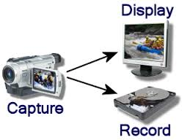
Video Capture
Perceived to improve student experience, widen participation & support note-taking.
Lecture capture is a valuable supplement for students attending lectures, but does not make up for non-attendance (Williams et al, 2012).
Danielson et al (2014) - Students more likely to use video capture in courses that moved quickly.
Students felt lecture capture
helped learning for lecture-oriented courses & improved performance
But no impact on performance in interactive courses.
Notes:
Danielson et al, 2014:
Students more likely to use video capture in courses that moved quickly, relied heavily on lecture, most relevant
Students perceived that lecture capture helped learning for lecture-oriented courses & indications it improved performance. No impact on performance in interactive courses.

Slide 7
Video capture – replay advantages for some?
Test performance improves when notes written during the breaks compared when notes taken while listening to the lecture. (Aiken et al, 1975)
Ruhl & Suritsky (1995) showed that pauses enhanced note-taking by college students with LD.
Students with dyslexia use lecture capture recordings more, listen to them for longer but no significant impact academic performance for any group (Leadbeater et al, 2013)
Revising from lecture recording better than notes for dyslexic students but textbooks were even better (Anderson & Nightingale, ADSHE, 2014)

Slide 8
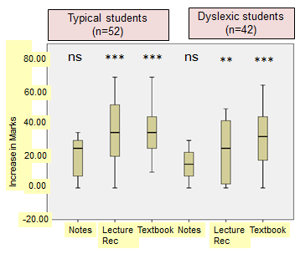
Comparison of revision approaches Vicky Anderson & Karl Nightingale (University of Birmingham)
Non-dyslexic (notes only)
22.50 +/- 13.32
Non-dyslexic (recording )
35.52 +/- 21.56
Non-dyslexic (text books)
35.38 +/- 15.93
Dyslexic (notes only)
15.00 +/-15.00
Dyslexic (recording)
23.33 +/- 19.05
Dyslexic (text book)
31.25 +/- 18.95

Slide 9
Are lecture capture systems accessible?
Thoughts…

Slide 10
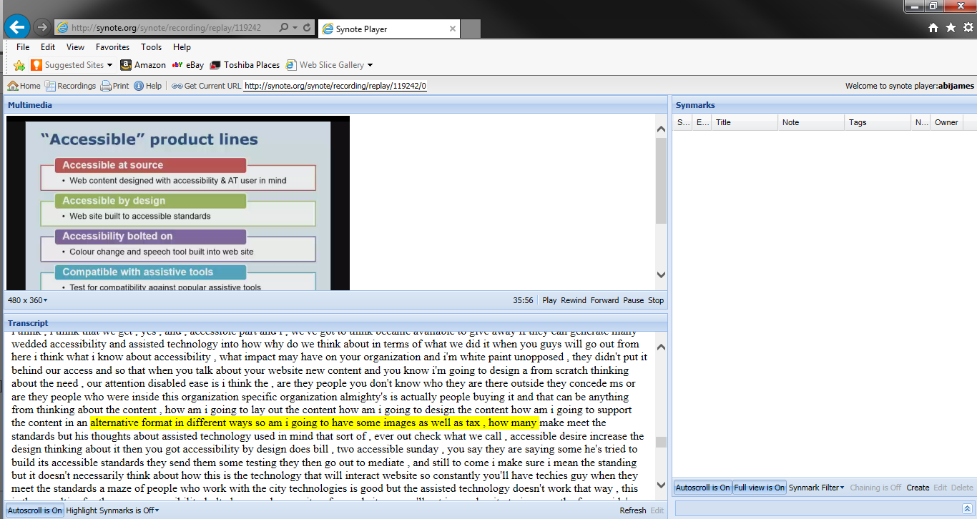
Using Speech recognition to support note-taking (8 year old technology)

Slide 11
Synote @ Southampton
New version is currently being developed for supporting disabled students requiring note-taking support at Southampton
Updating to speaker dependent speech recognition

Slide 12
References
Aiken, E. G., Thomas, G. S., & Shennum, W. A. (1975). Memory for a lecture: Effects of notes, lecture rates, and informational density. Journal of Educational Psychology, 67, 430–444.
Bui, D. C., Myerson, J., & Hale, S. (2013). Note-taking with computers: Exploring alternative strategies for improved recall. Journal of Educational Psychology, 105(2), 299–309.
Bui, D. C., & Myerson, J. (2014). The role of working memory abilities in lecture note-taking. Learning and Individual Differences, 33, 12–22.
Danielson, J., Preast, V., Bender, H., & Hassall, L. (2014). Is the effectiveness of lecture capture related to teaching approach or content type? Computers and Education, 72, 121–131.
Kiewra, K. A., & Benton, S. L. (1985). The effects of higher-order review questions with feedback on achievement among learners who take notes or receive the instructor's notes. Human Learning: Journal of Practical Research & Applications.
Kiewra, K. A., & Benton, S. L. (1988). The relationship between information-processing ability and notetaking. Contemporary Educational Psychology, 13, 33–44. doi:10.1016/0361-476X(88)90004-5
Leadbeater, W., Shuttleworth, T., Couperthwaite, J., & Nightingale, K. P. (2013). Evaluating the use and impact of lecture recording in undergraduates: Evidence for distinct approaches by different groups of students. Computers & Education, 61, 185–192
Ruhl, K. L., & Suritsky, S. (1995). The pause procedure and/or an outline: Effect on immediate free recall and lecture notes taken by college students with learning disabilities. Learning Disability Quarterly, 18,2–11
Williams, A., Birch, E., & Hancock, P. (2012). The impact of online lecture recordings on student performance, 28(2), 199–213.

