Slide 1
STEAM - Why Is Math Accessibility So Hard?

Slide 2
The difference between maths & text
Maths is a 2-dimensional notation. Location of a symbol affects its meaning
$f\left(x\right)=a_{0}+\sum_{n=1}^{∞}{\left(a_{n}\cos{\frac{nπx}{L}}+b_{n}\sin{\frac{nπx}{L}}\right)}$
Fourier Series equation
2 dimensional language when reading,
3 dimensional when writing

Slide 3
Talking Maths: The difference between maths & text
Symbols in maths can mean different things:
[AB]⁻¹
Could be read as:
“left parenthesis, boldface capital a, boldface capital b, right parenthesis, superscript minus one”
OR
“inverse of the matrix product, boldface capital a, boldface capital b”

Slide 4
The difference between maths & text: non-linear representation and ambiguity
Maths when read aloud can mean different things
Example 1: “a plus b over 2”:
$a+\frac{b}{2}$ $\frac{a+b}{2}$
Example 2: “2 plus 4 minus 3”:
$$2+4−3$$
$$2+(4−3)$$

Slide 5
Accurate reading of maths:
Example 1: “a plus b over 2” / “a plus b all over 2”
$a+\frac{b}{2}$ $\frac{a+b}{2}$
Accurate but verbose alternatives
“a plus open fraction b over 2 close fraction”
$$a+\frac{b}{2}$$
“open fraction open parenthesis a plus b close parenthesis over 2 close fraction”
$$\frac{(a+b)}{2}$$

Slide 6
Order of operations Activity: ${(3+\left(2−4\right))}^{2}$
Using the numbers provided work out as many ways as possible to replicate in symbols:
Three plus two minus four squared
Hint: there are at least 3 answers to this sum
PEMDAS – Please excuse my dear Aunt Sally.
Parentheses, Exponents, Multiplication and Division, and Addition and Subtraction
Notes:
3+2-4^2 =-11
3+(2-4)^2 = 7
(3+(2-4))^2 = 1
(3+2)-4^2 = -11
(3+2-4)^2 = 1

Slide 7
Activity
Write down how you would read aloud the following to a student?
Consider if it would have to written differently if being read to a visually impaired candidate
$$\frac{{(x+2)}^{2}}{x+2}$$
$$μ_{r}=\frac{2n_{1}n_{2}}{n_{1}+n_{2}}+1$$

Slide 8
Mathematical semantics
A mathematical expression or equation = a sentence with grammar and semantic structure.
Simple expressions = simple sentences:
“I can run” …… $x+2$
Complex expressions can contain sub-clauses and conjugates
"I can run like the wind if the grizzly bear chases after me“…
$\frac{{\left(x+2\right)}^{2}}{x+2}$

Slide 9
Mathematical semantics continued
If possible to drill down into the semantics of an equation then
audio representation of the notation may be more valuable & put less strain on their working memory capacity
However, mathematical semantics may have consistent notation but not a consistent vocabulary.
Need to consider context and localisation

Slide 10
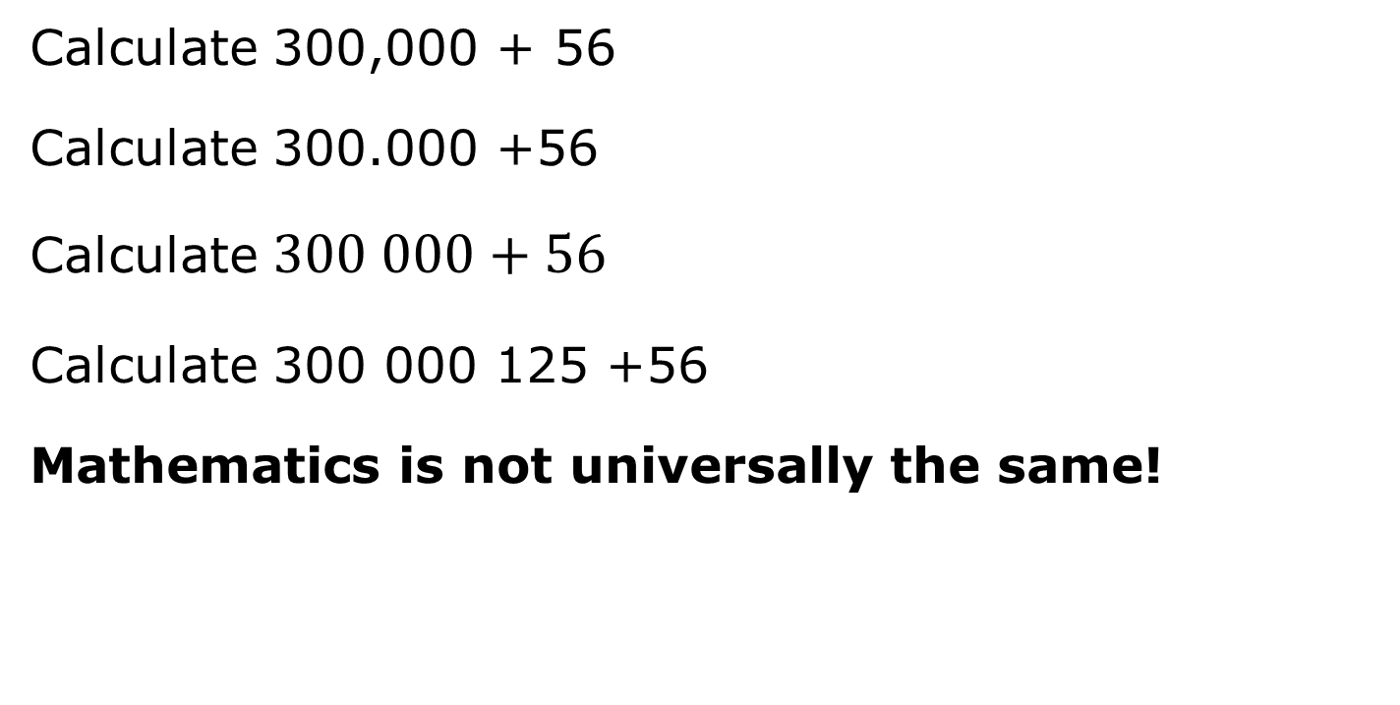
Context and localisation example
Calculate 300,000 + 56
Calculate 300.000 +56
Calculate $300 000+56$
Calculate 300 000 125 +56
Mathematics is not universally the same!

Slide 11
Then there are symbols
Most STEM materials will contain symbols and numbers within the text.
A.T. voices and tools may not read these or worse get the context wrong
a < 2 “a is greater than 2”
$a≤2$ “a is greater than or equal to 2”
“M is a subset of N”

Slide 12
The problem is…
Knowing that the STEAM content is accessible
Ensuring your A.T. can get to the accessible STEAM content
Ensuring your A.T. represents the STEAM content accurately

Slide 13
MathML supporting Math semantics:
$$\frac{a+b}{2}$$
an application of XML for describing mathematical notations and
captures both its structure and content.
XML is NOT page layout language.
LaTeX is a mathematical type-setting markup. It does not contain information on the type of variable – difficult to detect semantics
<math display='block'>
<mrow>
<mfrac>
<mrow>
<mi>a</mi>
<mo>+</mo>
<mi>b</mi>
</mrow>
<mn>2</mn>
</mfrac>
</mrow>
</math>
LaTeX:
\frac{a+b}{2}

Slide 14
LaTeX
Document mark-up language used for technical and scientific material
\documentclass{article}
\title{Cartesian closed categories and the price of eggs}
\author{Jane Doe}
\date{September 1994}
\begin{document}
\maketitle
Hello world!
E &= \frac{mc^2}{\sqrt{1-\frac{v^2}{c^2}}}
\end{document}
$$E=\frac{mc^{2}}{\sqrt{1−\frac{v^{2}}{c^{2}}}}$$

Slide 15
LaTeX continued
Easy to write…. You just need to know the code
WYSIWYG editor - BaKoMa
Can convert to accessible form BUT
But must have file set up correctly from the outset.
University of Bath process – produces “clear print” semi-automatically, further processing needed for speech or braille output

Slide 16
MathJax - www.mathjax.org
JavaScript platform for display of mathematics.
Browser independent renders in HTML+CSS, SVG or MathML
Enter maths in MathML, LaTeX or AsciiMath
Link to MathJax in the web pages that are to include mathematics.
Put mathematics into your web pages so that MathJax can display it.
Now being used to power assistive technology to convert maths notation formats

Slide 17
Useful tools for creating accessible math
Mathtype (Win & Mac)
Add in to Office. Export to main formats including Mathml, LaTeX & Braille
Mathmagic (Win & Mac)
Add in to DTP packages
Text transcript of maths (based on Mathspeak)
Mathcast
Free, open source tool output images or MathML
Microsoft Word
Can copy out equations as MathML
Open Office

Slide 18
Other tools
WIRIS
MathML authoring add-on for websites
Demo page allows MathML & LaTeX to be authored
Accessibility demo page convert equation to speech
MathML Cloud
Convert MathML, LaTeX & ASCII math to speech for alt-tag, images

Slide 19
Alternative formats
Tactile – Touching Maths EU project - schools based for blind students but useful ideas http://touchingmaths.net/
Scanning, screen reading and braille with InftyReader, ChattyInfty and InftyEditor

Slide 20
ePub 3 support for Math?
Problem – lack of reading systems that support math
Need the reading system to render MathML in a format that is compatible with A.T.
https://docs.mathjax.org/en/v2.5-latest/misc/epub.html

