Slide 1
Sue Cullen – Assistant Director
Accessible Technology Initiative, California State University
Dawn Okinaka - Accessible Technology Specialist
Accessible Technology Initiative, California State University
Tom Siechert – ATI Procurement
Program Manager
California State University, Fresno
Taking on the elephant in the room: Implementing innovative procurement processes in a large
University system
Notes:
Background silhouette of a elephant in a field

Slide 2
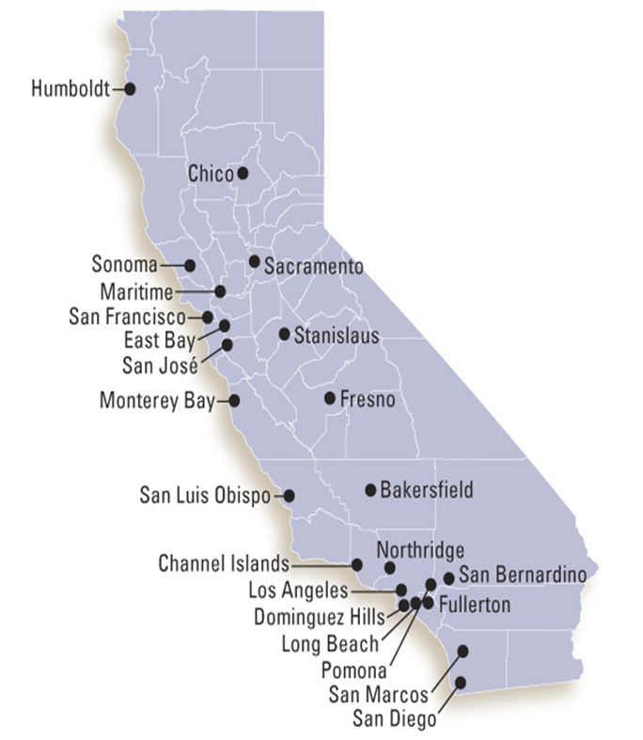
Getting to know the California State University System
23 campuses – 460,000 students, 45,000 faculty and staff
Varying Campus Sizes: From 1,000 – 44,000 students
Most ethnically diverse student body in U.S.
Unique campus cultures, human resources, technical expertise
~ 14,000 students with disabilities registered with our campus disability services offices
Notes:
Image of State of Cal with campuses identified
California State University, Bakersfield
California State University Channel Islands
California State University, Chico
California State University, Dominguez Hills
California State University, East Bay
California State University, Fresno
California State University, Fullerton
Humboldt State University
California State University, Long Beach
California State University, Los Angeles
California State University Maritime Academy
California State University, Monterey Bay
California State University, Northridge
California State Polytechnic University, Pomona
California State University, Sacramento
California State University, San Bernardino
San Diego State University
San Francisco State University
San José State University
California Polytechnic State University, San Luis Obispo
California State University San Marcos
Sonoma State University
California State University, Stanislaus

Slide 3
Expectations
Procuring the most accessible products
Building a culture of accessibility
Promoting institution-wide effort
Driving accessibility improvements to products
Implementing a consistent, repeatable, and effective accessible procurement process

Slide 4
The Challenge
Integrating accessibility into the procurement business process
Campuses implement Accessible procurement differently
Different forms
Different processes
Different evaluation techniques
Vendor
Accessibility knowledge
Meeting CSU Accessibility Requirements

Slide 5
Breaking down the problem
Notes:
Elephant and people figures: https://infocus.emc.com/wp-content/uploads/2012/04/ChoongPicElephant.jpg

Slide 6
Solutions
CSU Accessible Procurement Process
An accessible procurement process that can be adopted and adapted by CSU campuses
Created for and with CSU campuses
Collaborative outreach with Vendors
CSU Guide to Completing a VPAT and Template
Accessibility Roadmap Template
Accessibility Statement Recommendations

Slide 7
What to expect when engaging the CSU.

Slide 8
Expectations
CSU Expectation | Consultation | Vendor Expectation
Accurate VPAT |  | VPAT
Accessibility validation (Demo, Testing) |  | Filled out VPAT
Accessibility Road Map |  | Develop Cycle
Accessibility Statement |  | Commitment to users
Contract Language – to ensure product improvements |  | Contract
Improvements based on Road Map |  | Product improvement overall
Notes:
Table of Expectations:
What the CSU expects, Consultation needed and what the Vendor expects
Accurate VPAT vrs VPAT
Accessibility validation (Demo, Testing) vrs Filled out VPAT
Accessibility Road Map vrs Develop Cycle
Accessibility Statement vrs Commitment to users
Contract Language – to ensure product improvements vrs Contract
Improvements based on Road Map vrs Product improvement overall
All areas need Consultation

Slide 9
A disconnect occurs when a VPAT is used as a checklist.

Slide 10
VPATS
Criteria 1194 | Supporting Features (use defined terms) | Remarks and Explanations | CSU ATN Remarks
Describes a specific guideline | Enter information summarizing a product’s “level-of support” | Enter general comments regarding a product’s “level-of-compliance” | CSU question or concerns
.21(l) When electronic forms are used... field elements, and functionality including all directions and cues. | Supports | All fields have the FOR Attribute and unique ID. Use the <fieldset> and <legend> elements to group and associate related form controls.
.41(c) Support services for products shall accommodate the communication needs of end-users with disabilities. | Supports | Staff are trained in the use of TTY lines and national relay system. Modes include email, phone, chat- chat is an accessible interface. Staff are trained in responding to accessibility related questions
Notes:
VPAT Table
Criteria 1194, Supporting Features, Remarks and Explanation, and CSU ATN Remarks
Good Examples of a vendor filling out the form
21(l) When electronic forms are used... field elements, and functionality including all directions and cues.
Supports
All fields have the FOR Attribute and unique ID.
Use the <fieldset> and <legend> elements to group and associate related form controls.
41(c) Support services for products shall accommodate the communication needs of end-users with disabilities.
Supports
Staff are trained in the use of TTY lines and national relay system. Modes include email, phone, chat- chat is an accessible interface. Staff are trained in responding to accessibility related questions

Slide 11
Criteria Table
Criteria 1194 | Supporting Features (use defined terms) | Remarks and Explanations | CSU ATN Remarks
.22(g) Row and column headers shall be identified for data tables. | Supports |  | How was this tested? column & row header code used throughout?
.22 (a) text equivalent non-text element |  | Some alt text missing | Explain Impact
.31 (f) fine motor skills | Supports with exceptions | Some pages require the use of mouse. | 1194.21(a) is “Supported” for keyboard accessibility This appears to be in conflict.
.22 (d) readable without CSS | Supports |  | Address if function available in proper order w/o CSS
.31 (b) visual acuity | Supports, no known issues |  | Can text size be enlarged to 200% w/o loss of data and function?
Notes:
Table of Examples that do not provide enough information.
22(g) Row and column headers shall be identified for data tables.
Supports
CSU ATN Remarks
How was this tested? column & row header code used throughout?
.22 (a) text equivalent non-text element
Some alt text missing
CSU ATN Remarks
Explain Impact
31 (f) fine motor skills
Supports with exceptions
Some pages require the use of mouse.
CSU ATN Remarks
1194.21(a) is “Supported” for keyboard accessibility This appears to be in conflict.
.22 (d) readable without CSS
Supports
CSU ATN Remarks
Address if function available in proper order w/o CSS
.31 (b) visual acuity
Supports, no known issues
CSU ATN Remarks
Can text size be enlarged to 200% w/o loss of data and function?

Slide 12
Pathway to Inclusion
Enhanced user experience for everyone!
Increased user base
Accessibility Standards increase operability/responsive design
Increased sales - institution looking for compliant products
Socially responsible
Notes:
Red stair image: http://thetalentcode.com/2012/11/07/the-power-of-micropractice-why-5-minutes-makes-a-big-difference/

Slide 13
Tom Siechert
ATI Procurement Program Manager, Senior IT Buyer
Fresno State is piloting CSU Accessible Procurement process

Slide 14
Pilot @ Fresno State
Collaboration with the Accessible Technology Initiative, CSU Office of the Chancellor
Start Date: October 2014
Real-world proof of concept
Deliverables:
Implement CSU Accessible Procurement process
Create training program
Launch outreach program and activities;
Launch new online forms; and
Develop campus capacity to perform hands-on testing

Slide 15
Implementing CSU Accessible Procurement
Keys to success:
Easy for end-users to adapt to new processes
Processes aren’t too “heavy”
Processes need to work for both proactive and reactive purchase requests
Processes need to work regardless of funding source
Challenges:
Requisitions are missing key information
Departments expect, are accustomed to fast turnaround
Large numbers of IT-related purchases (>1600 in 2014)

Slide 16
The need for IT purchases triage
Notes:
Year 2014 Purchases total 161
700 ICT
497 Individual –Use
203 Review for Accessibility (A11Y)

Slide 17
New Processes to Support Accessible Procurement
Resigned Online Requisition form
Gives ability to intelligently “triage” based upon predefined rules/logic
Pass-through: Non-E&IT, pre-approved, low impact (87%)
Further review needed (13%)
Trigger IT Review form (when appropriate)
IT Review Form
Comprehensive approach to array of Enterprise-level considerations:
Accessibility
Information Security
Software Licensing
Enterprise Support (Implementation & Ongoing)
Works across all business units and funding sources
Users can complete [proactive] or at time requisition is generated [reactive]

Slide 18
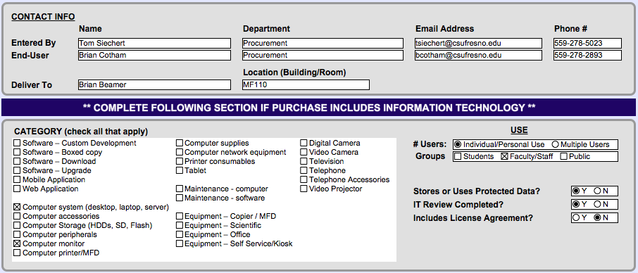
Online Requisition Screenshot
Notes:
Categories of purchase: examples include
software-custom, Boxed copy, Download, Upgrade, Mobile, Web, Computer Supplies, Computer System, Monitor,
Category of Use: Individual/personal use or Multi User, Student, Faculty/staff, Public
Stores or Uses Protected data?
IT Review Completed?
Includes License Agreement?

Slide 19
Goals for Accessible Procurement Process
Goal for Step 1: Gather key information about purchases of E&IT
Buy most Accessible product(s) available in market
Exclude low-impact, pre-approved and non E&IT purchases from process
Goal for Step 2: Determine review process, based upon impact
Goal for Step 3: Identify specific Accessibility gaps/barriers
Work with vendors to remediate gaps in reasonable amount of time
Proactively plan for the provision of alternate access
Goal for Step 4: Ensure contract documents include Accessibility requirements and provisions

Slide 20
STEP 1: Gather Info [End-user]
Goal: Gather key information about purchases of E&IT
How:
End-User completes IT review form. Accessibility related questions include:
What is it?
Who are the End-Users?
How will it be used?
How many people will use it?
Does the use involve a critical program/benefit?
End-User gets VPAT from vendor

Slide 21
STEP 2: Review Info [ATI Designee]
Goal: Determine review process, based upon impact
How:
ATI Designee reviews Accessibility documentation:
IT Review form
VPAT(s)
ATI Designee prioritizes review efforts by impact
Choose review type, tasks

Slide 22
STEP 3a: Review Product [ATI Designee]
Goal: Identify specific Accessibility gaps/barriers
How:
ATI Designee and/or other campus staff complete review steps to find, document gaps/barriers. Review steps may include:
VPAT review
Vendor demo
Automated testing (Free or Enterprise Tools)
Manual testing (Quick or Comprehensive)
End-User testing
ATI Designee completes Review Form
ATI Designee completes Summary & Recommendations
Obtain Accessibility Roadmap
Prepare Equally Effective Alternate Access Plan

Slide 23
STEP 4: Place Order - no bid [Purchasing Department Buyer]
Goal: Ensure all process steps have been completed, ensure that contract documents include Accessibility requirements and provisions
How:
Buyer completes EIT Buyer Checklist to verify completeness and documentation (e.g. bid documents, process, ATI review processes and recommendations)
Buyer drafts contract documents (General Provisions for IT - including Clause 45, Rider(s) to address Accessibility Roadmap, future testing)

Slide 24
STEP 4: Place Order – bid considerations [Purchasing Department Buyer]
Special considerations for bid process:
Ensure bid documents clearly spell-out role of Accessibility
Include Accessibility language in bid specs:
define minimum requirements (e.g. WCAG 2.0 AA, provide VPAT)
describe bid process (demo, testing requirements)
include accessibility as scored criterion (score based upon narrative, testing, demo)
provide an example of required contract language

Slide 25
Questions

