Slide 1
Creating Audio-Tactile Graphics on the Fly
Alexa Schriempf
Penn State University

Slide 2
Disclaimers
Scalable – not yet
Credits:
  Lucia Hasty (Rocky Mtn Braille)
    http://www.tactilegraphics.org/
  Steve Landau (TouchGraphics)
    http://touchgraphics.com/
  Josh Miele (Smith Kettlewell)
    http://www.ski.org/lab/miele-lab
Notes:
]

Slide 3
Pascal’s Triangle
Math 002
Residential course
Blind student with Braille 1 and 2 but no Nemeth skills
Humanities major

Slide 4
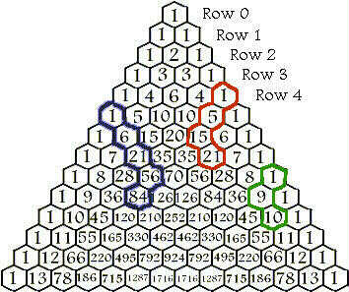
Pascal’s Triangle

Slide 5
Tactile with Braille
Unsatisfactory (for me)
  Too big
  Too inaccurate
  Not independent enough

Slide 6
TouchGraphics’ STEM Binder
https://www.youtube.com/watch?v=eOtHT_flaoY

Slide 7
My First Attempt
TIE and Flexi-Paper by Repro-Tronics
Soundstickers
Braille labeler
X-acto knife
Bandaids

Slide 8
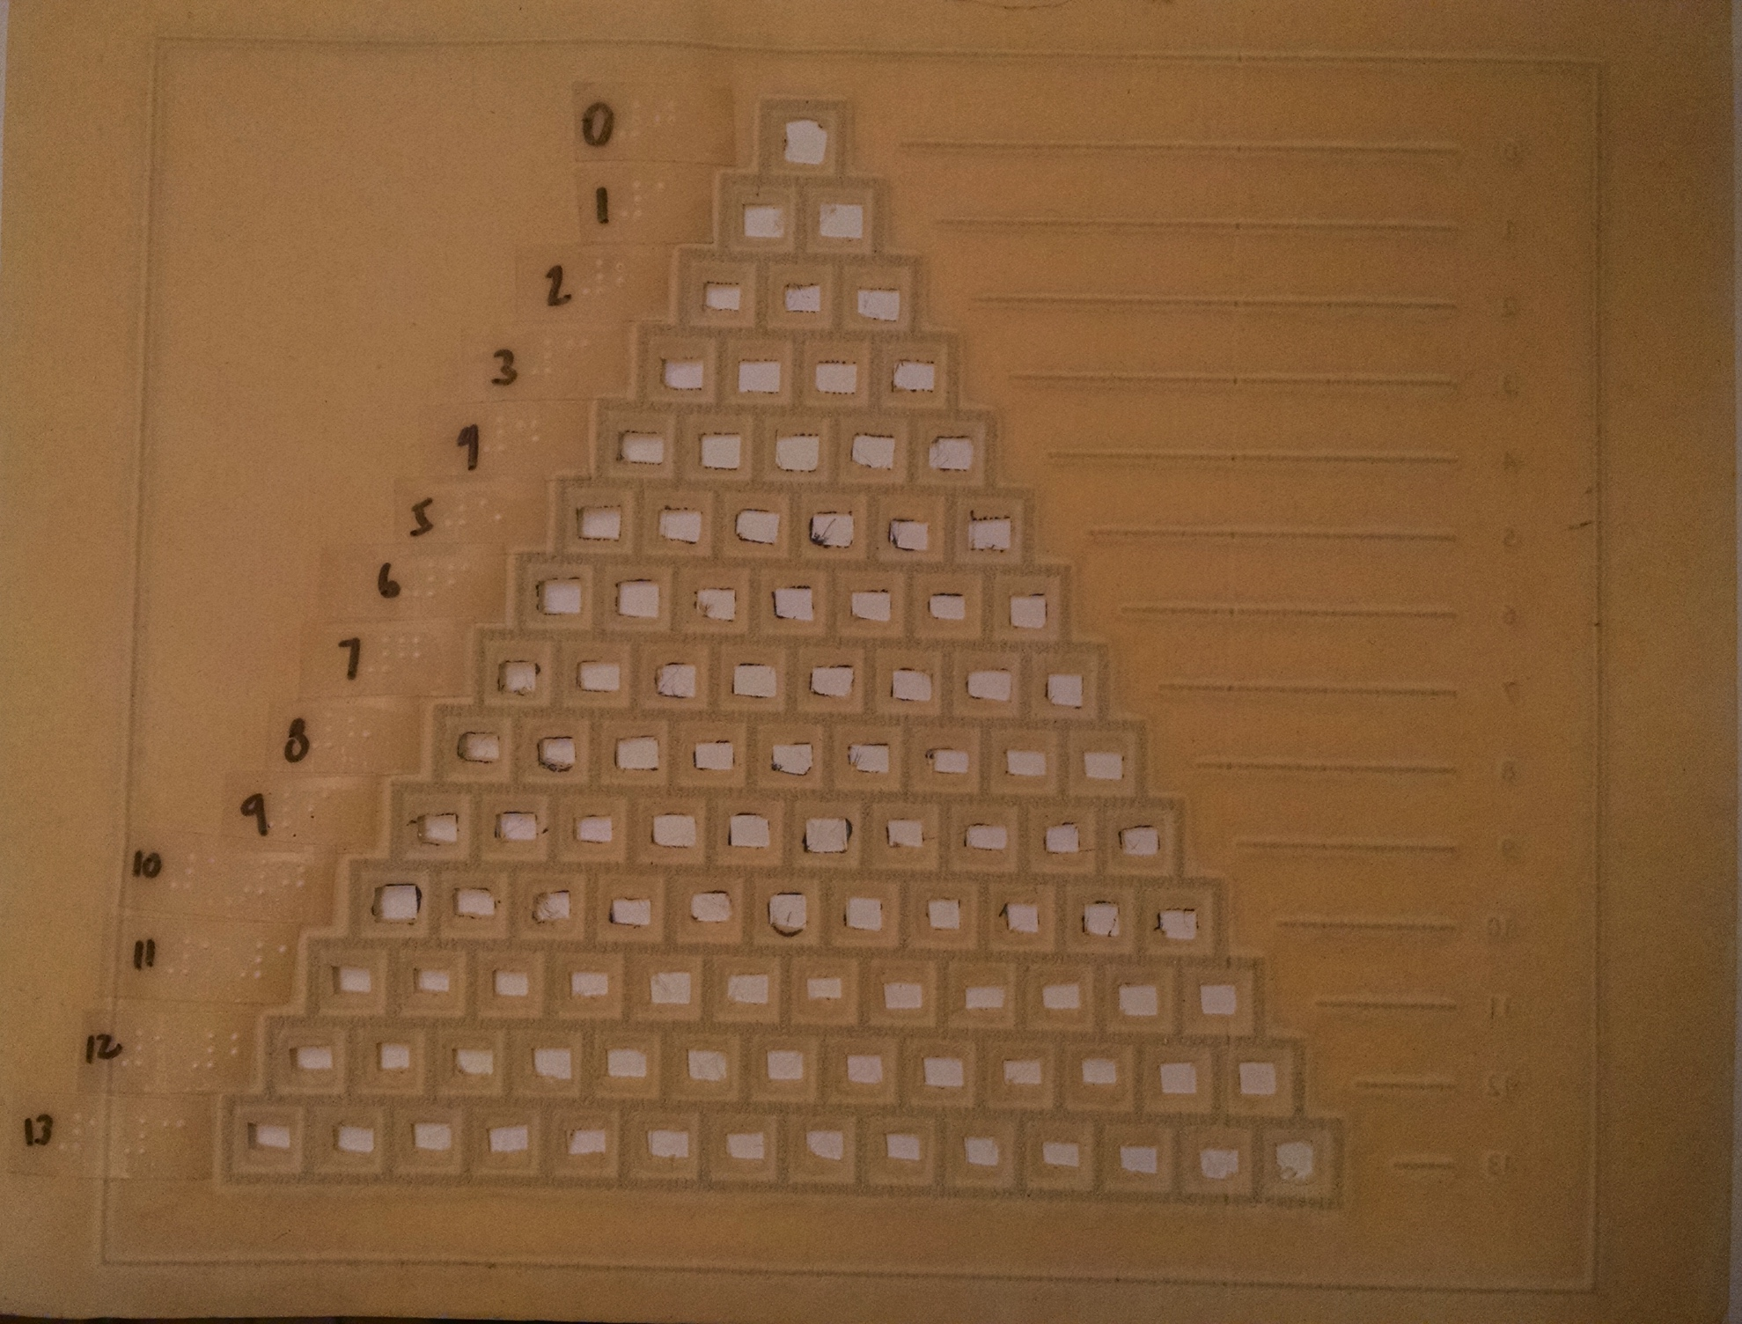
My First Attempt Result

Slide 9
New Plan
Need to use almost all of the sound sticker’s area
Scale the triangle up to 11 x 11
Put stickers directly on, not under, diagram
Ordered a new Swell machine

Slide 10
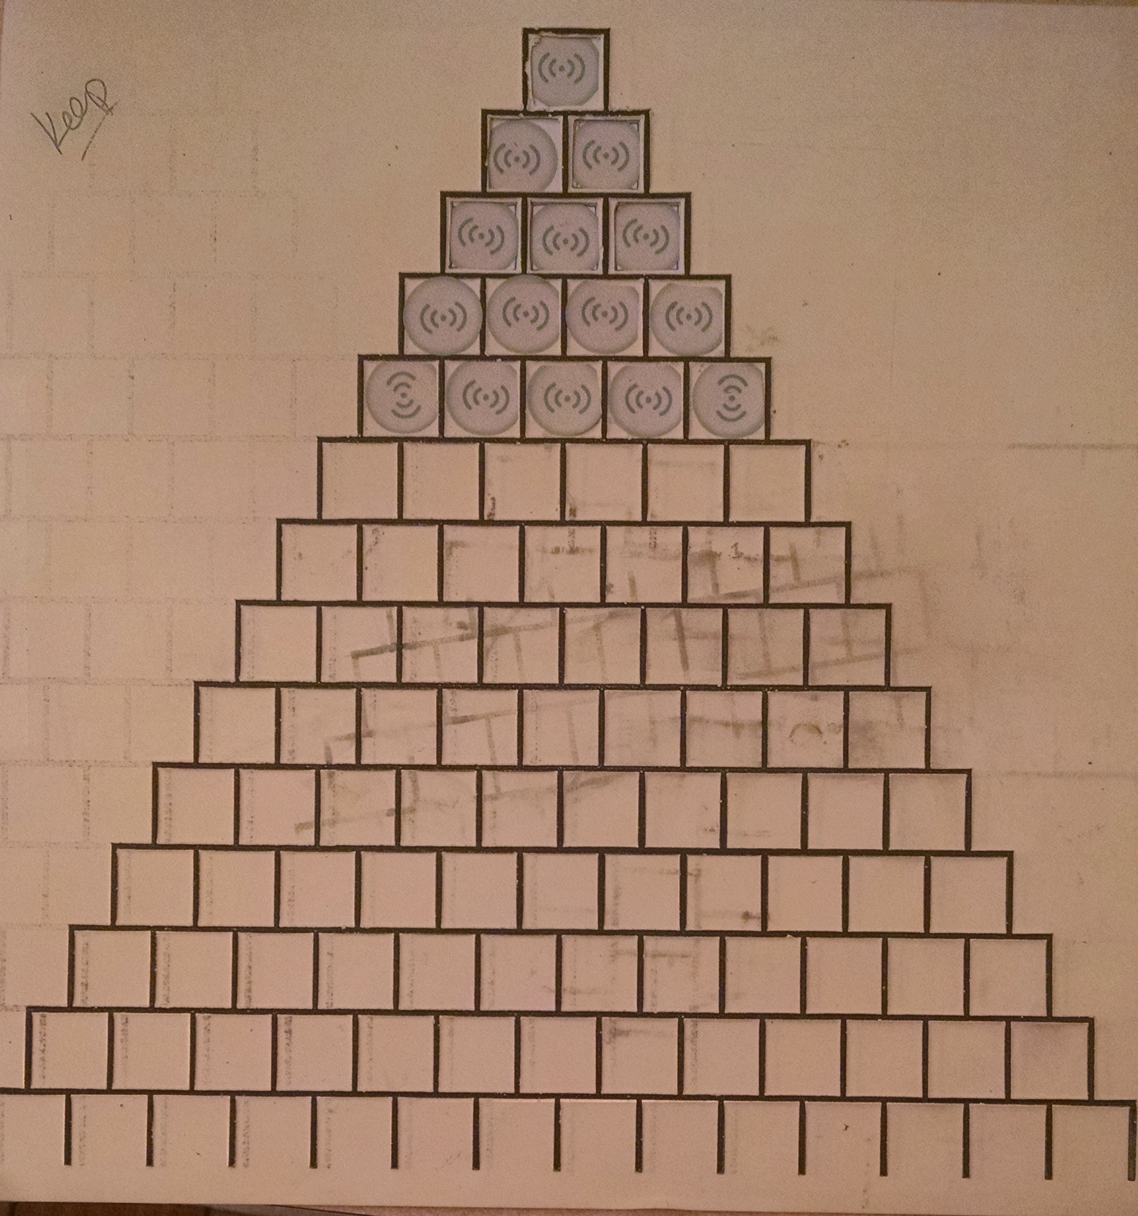
Second Attempt

Slide 11
Testing and Analysis
Observations and Take-Aways:
  No difference between cut-out windows and overlay
  Users drag the pen rather than tap
  Users didn’t immediately grasp concept without verbal introduction

Slide 12
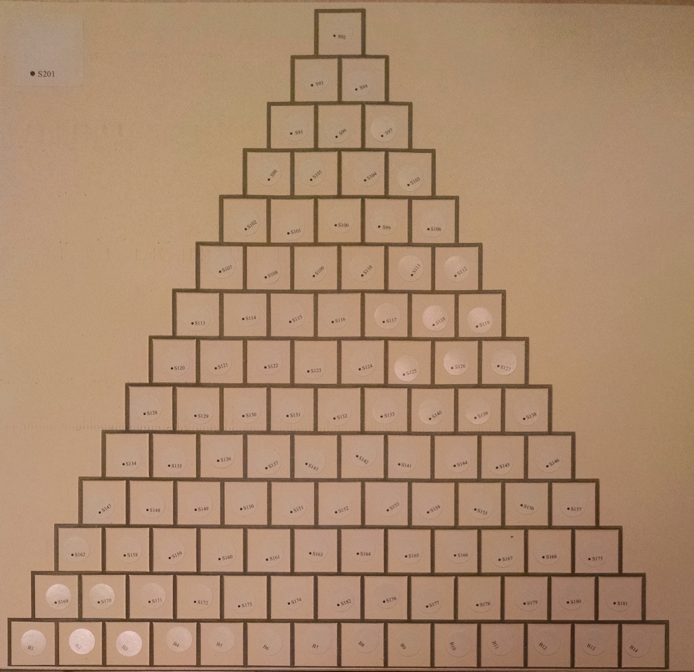
Third Attempt

Slide 13
Pen Friend Benefits
Pen Friend (from RNIB)
  Differently sized stickers!!!
  Accessible pen!!
  No need for Livescribe operator buttons on paper!!
  Camera is more responsive

Slide 14
Lessons Learned
Important to have audio description as well as audio labels
  Upper left corner sticker for overview and orientation
  Image overview description
    Follow guidelines! DIAGRAM/NCAM: http://diagramcenter.org/table-of-contents-2.html
End-user training is helpful:
  Tap not scan
  Use one hand to scan and anchor, one hand to tap

Slide 15
One More (Untested) Hack
Livescribe Paper + 3D Doodler Pen + Livescribe Pen
  Print Pascal Triangle on LiveScribe Paper with ink printer
  Trace over honeycombs with 3Doodler, creating tactile feedback and keeping the placement of the numbers where they need to be.
  Grab the smartpen, hit record, touch number area while reading aloud, then stop recording
  Tip from Josh Miele/Steve Landau
    Hit record button on livescribe notebook paper
    Hit pause immediately in a 1-2 sequence
    Scribble in an area – like you are coloring it in. Doesn’t have to be perfect but get overlapping lines.
    Hit record button
    Put pen near mouth and speak label or whatever content
    Hit the stop button on the livescribe notebook paper.

Slide 16
How-To Resources
Handouts available online with conference site
Email me: ats169@psu.edu
    Soon available at Lucia Hasty’s site:
      http://www.tactilegraphics.org/

