Slide 1
Accessibility Testing:
Is there a gap between development and end user experience that needs to be bridged?

Slide 2
Presenters
Phyllis Petteys - Accessibility Specialist, Disability Services
Karen Sorensen - Accessibility Advocate for Online Courses, Distance Education
Angel Chesimet - Counselor and Accessibility Technician, Disability Services

Slide 3
What does accessible mean?
"Accessible" means a person with a disability is afforded the opportunity to acquire the same information, engage in the same interactions, and enjoy the same services as a person without a disability in an equally effective and equally integrated manner, with substantially equivalent ease of use. The person with a disability must be able to obtain the information as fully, equally and independently as a person without a disability. Although this might not result in identical ease of use compared to that of persons without disabilities, it still must ensure equal opportunity to the educational benefits and opportunities afforded by the technology and equal treatment in the use of such technology.
Source - Resolution Agreement South Carolina Technical College System OCR Compliance Review No. 11-11-600.

Slide 4
_{Outcomes for the session}
Awareness of the gap
The importance of end-user testing
Ways to bridge the gap

Slide 5
Our Perspectives
Web developer with understanding of web standards/guidelines
AT Specialist familiar with obstacles but not necessarily web standards/guidelines
End user tester with graduate education

Slide 6
Discovering the Gap
Photo from: http://wolfinlondon.com/2007/10/07/mind-the-gap/

Slide 7
A More Linear Experience
“the pronounced difference between the blind and sighted students was the manner in which they moved through the material. The sighted students jumped back and forth far more than the blind students who tended to advance through the content in a more linear fashion” (p. 4).
Kearns, L.R., Frey, B.A., McMorland, G. (n.d.) Designing Online Courses for Screen Reader Users, Journal of Asynchronous Learning Networks, Vol. 17; Issue 3.

Slide 8
Consider:
Does an end user need to know html?
Are there benefits to acknowledging that a user may have ways that they feel most comfortable navigating with assistive technology?
Should we consider technology skills of students?

Slide 9
Testing Third Party Software
Often there are claims of accessibility from publishers, but what if our users have a hard time accessing their content? It’s a Gap to providing an accessible experience.
VPATs
Bridge: More end user guides for users of AT needed.
Math accessibility:
Gap: Complex screen reader settings unique to that application.
Gap: Math equations read accurately but cannot be read by a screen reader one character at a time.

Slide 10
Testing Without an End User
Gap: While valuable, it may not show all usability issues
Gap: Keyboard accessibility is not always synonymous with screen reader accessibility
(for example, a button may not be labeled)

Slide 11
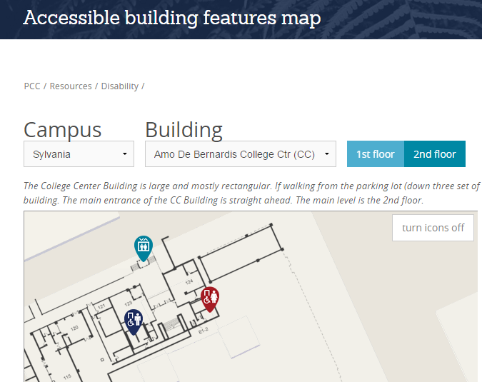

Slide 12
When a website meets accessibility standards
…and a screen reader user doesn’t use the site to its full benefit
Who is responsible for the gap?

Slide 13
Recommended Solutions Ways to bridge the gaps
Involving faculty
Working with publishers
Working with students
Testing & documentation

Slide 14
Bridge: Involving Faculty
Regular appointments where faculty can see how a screen reader user accesses (or doesn’t access) their course and publisher content
Subject area studies
Math
Computer Science, Computer Information Systems, Computer Application Systems

Slide 15
Bridge: Working with Publishers
Invite publishers to be part of the solution
Invite book representatives to testing of their online content
Send feedback and questions to accessibility representatives
Ask that they help develop alternative accessible content
Two accessibility managers from leading publishing companies have attended AT Committee Meetings at PCC

Slide 16
Bridge: Working with Students
Collaboration with the Oregon Commission for the Blind
Provide college readiness training at PCC to ensure and highly recommend level of screen reading skills
Documentation and Orientation Guides to complex platforms
Individual trainings

Slide 17
Bridging the Gaps
In addition to following accessibility guidelines, incorporate end user testing into the development of all digital content. And provide end user guides for users with disabilities.
Encourage developers, publishers and faculty to witness the end user experience even if they are cognizant of accessibility standards.
Develop ways for end users to increase their skills.

Slide 18
Appendix A Testing Documentation
Accessibility Assessment Form
(For accessibility/usability testing 3rd party products)
Name and URL of product:
Tester Name:
Instructor Name:
Testing Date:
Computer Operating System:
Browser Type and Version:
List any browser plug-ins used:
List any special settings to your browser or screen reader:
Can you login?
Can you access help documentation?
How well can you navigate?
Can you complete the different types of assignment questions? (Can you read the assignments, fill in answers and submit them? Sometimes there are different types of questions. Ask instructor to help you find them all.)
Can you check your answers?
If there are study tools, which ones are accessible?
Can you complete a quiz?
Summary
Overall, would you say this product is usable for a student using a screen reader?
Notes:
End-user notes: Tips for the user with a screen reader on settings or navigation tricks you would recommend

