Slide 1
Fostering a Course Accessibility Community of Practice
AHG 2015
November 20, 11:45 am

Slide 2
Co-Contributor
Audra Hilterbran
Instructional Technologist
Academic Technologies
Russ College of Engineering

Slide 3
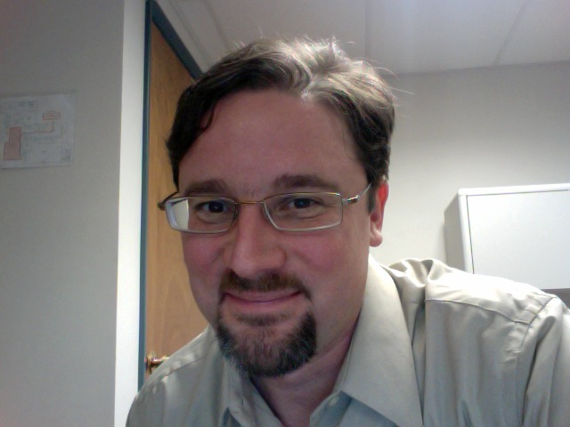
Presenter
Matt Dingo
Instructional Technologist
Academic Technologies
College of Fine Arts
Past experience: digital accessibility designer for trainings in PA

Slide 4
Who are you?

Slide 5
Communities of Practice
Lave, J. and Wenger, E. (1991). Situated Learning: Legitimate Peripheral Participation. Cambridge University Press. Cambridge, MA. ISBN 0-521-42374-0

Slide 6
Definition
COMMUNITIES OF PRACTICE are groups of people who share a concern, a set of problems, or a passion about a topic, and who deepen their knowledge and expertise in this area by interacting on an ongoing basis. Wenger, E., McDermott, R.A. and Snyder, W. (2002). Cultivating Communities of Practice: A Guide to Managing Knowledge. Harvard Business Review Press. Kindle Edition. Cambridge, MA.
Notes:
Decentralizes knowledge base in an organization

Slide 7
Disclaimer
Predisposed to social learning and communities of practice as:
Jazz musician
EFL instructor

Slide 8
Jazz Community Simulations
Notes:
1967- Jamey Aebersold

Slide 9
Communities of Practice
Intentional or unintentional
Intra-, extra- or trans- organizational
Formally or informally convened

Slide 10
The Story of OHIO’s (Course) Accessibility CoP
Intentional
Organizational in AT (Academic Technologies)
Formal
More intentional
Intra-organizational (Ohio University)
Informal
Notes:
CoP joke

Slide 11
Fostering a Course Accessibility CoP
Step 1

Slide 12
Step 1
Gather the Troops
September 2014 – January 2015

Slide 13
Fostering a Course Accessibility CoP
Came from Director of AT who wanted an Accessibility Committee
Develop, clarify and train on the accessibility standards that Instruction Technologists will use to guide course design
9 IT in AT

Slide 14
Elements of a CoP
Domain: Digital Accessibility at OHIO
Community: IT staff in AT; faculty
Practice: Course Accessibility

Slide 15
First Inception of Community
Academic
Technologies/Course Accessibility
ENG
CoFA
IT
IT
IT
IT
CHSP
Comm
IT
IT
BUS
A&S

Slide 16
Fostering Community through Outreach
10 Easy Things You Can Do NOW to
Make Your Course Accessible
Notes:
Tool from which you can open conversation.

Slide 17
First Inception of Community
Academic
Technologies/Course Accessibility
ENG
CoFA
IT
IT
IT
IT
CHSP
Comm
IT
IT
BUS
A&S

Slide 18
Policy

Slide 19
Fostering a Course Accessibility CoP
Step 2

Slide 20
Step 2
Cast a Wider Net
January – July 2015

Slide 21
OIT/
Service Delivery
Regional
Camp
Ed
IT
IT
Academic
Technologies
ENG
CoFA
IT
IT
IT
IT
CHSP
Com
IT
IT
IT
IT
BUS
A&S
IT

Slide 22
Develop a Course Accessibility Training
Unpacking Digital Accessibility
Creating Accessible Word Documents
Best Practices in Closed Captioning and Transcripts

Slide 23
Develop a Course Accessibility Training
Unpacking Digital Accessibility
Why We Do What We Do
History
How Do We Know How to Do What We Do
WCAG 2.0
DoJ Resolution Agreements
Navigation/Screen Readers
Alt Text
Color Contrast Checking

Slide 24
Develop a Course Accessibility Training
Creating Accessible Word Documents
Font Choice
Heading Styles
Bullets and Numbering
Alt Text
Descriptive Anchor Text for Links
Contrast
Header Rows and Table Construction
Document Flow

Slide 25
Develop a Course Accessibility Training
Best Practices in Closed Captioning and Transcripts
Difference between CC and Subtitles; different types of CC files
Amara (hands-on)
Downloading and Correcting a YouTube transcript
Best practices for producing usuability

Slide 26
Fostering a Course Accessibility CoP
Step 3

Slide 27
Step 3
Invite Yourself to Other Communities
October 2014 – November 2015

Slide 28
Student Accessibility Services (SAS)
Accommodations

Slide 29
Web Advisory Group (WAG)

Slide 30
WAG Sub-Committee on Accessibility
Charged to Draft Accessibility Statement
Members
AT
OIT
Engineering
CHSP
Ex officio: SAS

Slide 31
WAG Sub-Committee on Accessibility Recommendations- May 2015
Policy
Infrastructure
Awareness

Slide 33
September 2015
Co-chair of the Universal Design and Assistive Technology Team (UDAT) for the President’s Advisory Council on Disability and Accessibility Planning

Slide 34
Step 4
Cast an Even Wider Net
(Seeking the Elusive Faculty Fish)

Slide 35
UDAT
SAS
President’s and Provost’s Offices
OIT/
Service Delivery
Regional
Camp
Ed
IT
IT
Academic
Technologies
WAG
ENG
CoFA
IT
IT
CHSP
IT
IT
IT
IT
IT
Com
IT
BUS
A&S
University Marketing and Communications
IT

Slide 36
ADA25 Month with City of Athens
October 2015
3 Session Training

Slide 38
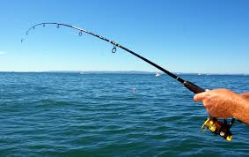

Slide 39
The Case for Communities of Practice
Builds a knowledge base stronger than individuals and teams
Help achieve strategic goals
Connect people
Notes:
As they address current problems, meanwhile, communities are also building sustained value by developing an ongoing practice that will serve the organization’s long-term strategy.Wenger, Etienne; McDermott, Richard A.; Snyder, William (2002-01-08). Cultivating Communities of Practice: A Guide to Managing Knowledge (p. 15). Harvard Business Review Press. Kindle Edition.
communities of practice create value by connecting the personal development and professional identities of practitioners to the strategy of the organization.Wenger, Etienne; McDermott, Richard A.; Snyder, William (2002-01-08). Cultivating Communities of Practice: A Guide to Managing Knowledge (p. 17). Harvard Business Review Press. Kindle Edition.
Relying explicitly on communities of practice fundamentally transforms the landscape of the organization. Domains of knowledge become focal points for connecting people in different units who are working on potentially related projects.Wenger, Etienne; McDermott, Richard A.; Snyder, William (2002-01-08). Cultivating Communities of Practice: A Guide to Managing Knowledge (p. 20). Harvard Business Review Press. Kindle Edition.

Slide 40
Opportunities at OHIO
New CMS
Policy

Slide 41
Forward for OHIO

Slide 42
Questions?
Matt Dingo
Email: dingo@ohio.edu

