Slide 1
Creating Accessible Video Feedback for Distance Learning Students
A Collaboration Between Instructor and Instructional Designer
Julie Fuller, Instructional Designer
University of North Florida

Slide 2
Purpose
This presentation will explore the benefits and challenges of developing and delivering video feedback to distance learning students through a collaborative process between an instructor and an instructional designer.

Slide 3
Essential Questions
Why use video feedback?
Why make video feedback accessible?
What types of technologies and strategies can be used to create accessible video feedback?
With what types of assignments does accessible video feedback work best?

Slide 4
Research: Crook et al.
Instructor Perspective
Student Perspective
Helps articulate assessment criteria & key points
Increases instructor presence
Supports varied learning styles
Access to feedback remotely and on-demand
Emotive aspects of video help increase understanding of feedback
Helps avoid misinterpretations of written feedback
Feedback can be viewed when convenient & replayed
Crook, A., Mauchline, A., Maw, S., Lawson, C., Drinkwater, R., Lundqvist, K., & ... Park, J. (2012). The use of video technology for providing feedback to students: Can it enhance the feedback experience for staff and students?. Computers & Education, 58386-396. doi:10.1016/j.compedu.2011.08.025

Slide 5
Project Phases
Phase 1 – Planning
Phase 2 – Implementation
Phase 3 – Results

Slide 6
Phase 1
Planning

Slide 7
Phase 1 Focus
Phase 1 includes identifying the following:
Willing faculty member
Appropriate distance learning course
Appropriate assignment/assessment
Tools, skills and programs to be utilized
Project roles
Resources for instructor
Best practices

Slide 8
Course Profile
Graduate distance learning course
HUN6123 Sociocultural Influences on Nutrition
Delivered via Blackboard Learn
17 students
1 instructor

Slide 9
Assignment Profile
Types of Assignments
Cultural Group Infographic
Formative or summative
Skills-based
Higher-order thinking skills
Multiple means of expression
Graded by rubric
Create an infographic on a cultural group’s history, food patterns, health and nutrition issues, and diet changes.
Resources for Students
Piktochart video tutorial
Example infographics
Grading rubric

Slide 10
Tools & Programs
Camtasia Screen-casting Video capture Audio capture Video editing Program license required | 3PlayMedia Transcription services Standard service 7 day turnaround (other options) Paid service | YouTube Video hosting Organize in unlisted playlist Videos saved for 2 years Free service

Slide 11
Resources for Instructor
Feedback Form for Instructor
Video Outline
General Information:
Course & student info
Assignment recap
Standardized project intro
Rubric:
Reference rubric categories
Match up student performance
Criteria (3 from rubric):
Constructive comments
Review:
Standardized closing
Instructions for how to proceed
Example Feedback Video

Slide 12
Shared Project Roles
Instructor
Instructional
Designer
• Project guidelines
• Identify assignment
• Develop rubric
• Develop survey
• Review survey data

Slide 13
Individual Project Roles
Instructor
Evaluate assignment
Instructional Designer
Edit raw feedback footage
Submit videos for captioning
Instructor
Provide YouTube link to students
Deploy student survey
Record feedback
Upload videos to YouTube
Deliver feedback videos to ID
Deliver YouTube links to instructor

Slide 14
Project Best Practices
Pre-recording
During Recording
Review the feedback form, video outline & example feedback video
Develop constructive and succinct feedback
Use unbiased language, phrases & comments
Provide additional written comments to students
Use standardized language:
Identify purpose
Address student by name
Instructions for proceeding
Refer to rubric language frequently
Speak in a clear voice
Use appropriate tone & pace
Video no longer than 5 minutes

Slide 15
Best Practices Cont’d.
Accessibility
Camtasia
Use verbal references:
Distance
Location
Exact titles, numbers, names, etc.
Arrangement
Order
Tactile references
Avoid vague language
Video features:
Utilize webcam
Video animations
Cursor FX
Turn off notifications when recording (email, phone, etc.)
Noise reduction

Slide 16
Phase 2
Implementation

Slide 17
Student Communication
Project Purpose
and Benefits
Introduce video feedback project & its purpose in learning module.
Use announcement tool in LMS to inform students of project goals & expected feedback delivery.
Make reference to the project survey in the learning module, announcement, and feedback videos.
Advertise additional points toward assignment grade for completed surveys.

Slide 18
Recording & Editing
Filming Duration
Approx. 10-25 minutes per video
Over the course of 2 days
Video Edits
Zoom in on assignment
Cursor highlight or magnify
Considerations
Time needed to review assignment, film video and populate rubric comments
Turnaround time to students
Export to mp4
Re-filming required for some assignments

Slide 19
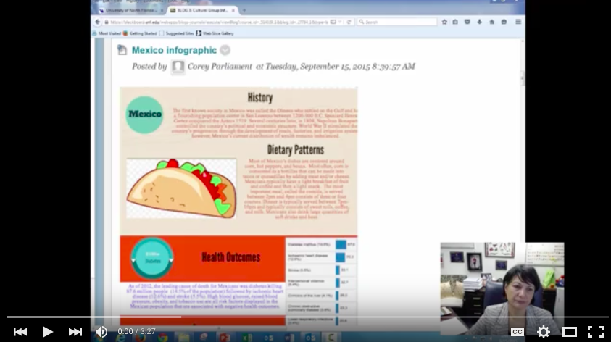
Example Video
Notes:
https://youtu.be/3twyByN0pSI?list=PLUyk3uH-T9NS2Ib7Q2PdJt9FLk5NdfvRT

Slide 20
Video Feedback Delivery
Video links emailed to students directly by instructor
Concern with bandwidth and size of course if hosting in LMS
Video links delivered once all videos were edited, captioned and uploaded to YouTube
Videos will “live” unlisted in YouTube for 2 years
7 day turnaround time from assignment due date to delivery of video links to students
Consider if feedback is necessary to move forward with subsequent assignments

Slide 21
Survey Details
Questions
Goals
10 questions total
8 opinion scale questions
1 yes/no question
1 open response question
Collect student opinion on:
Helpfulness of video feedback content & format
Impact of instructor presence
Quality of video appearance & production
Delivery
Incentive
Survey tool in Bb
After video links were delivered
Optional participation
Worth 5 additional points toward assignment grade if completed

Slide 22
Phase 3
Results

Slide 23
Survey Results
Survey Question | Student Response
Video feedback helped me understand overall assignment better than only receiving written feedback. | 64% Strongly Agree 21% Agree 14% Neither Agree nor Disagree
Personalized feedback made me feel as though the instructor has a vested interest in my success in the course. | 64% Strongly Agree 28% Agree 7% Neither Agree nor Disagree
I used the closed captions feature of my video feedback. | 35% Yes 57% No (7% Unanswered)
Having access to the closed captions feature enhanced the video feedback experience. | 21% Strongly Agree 21% Agree 35% Neither Agree nor Disagree 21% N/A
I would like more personalized video feedback in future online courses. | 78% Agree 21% Neither Agree nor Disagree

Slide 24
Student Comments
“I thought this was nice and personalized. It helps me feel less like a distance student. In addition, it makes it clear that the professor is concerned about my progress and personally graded my assignment.”
“While watching [my] video, I was able to clearly understand the areas that need improving and will apply these details to the next assignment.”
“I thought the use of the pointer as [the instructor] covered each section was valuable because I was able to visually follow [the feedback].”
“I feel as though if I were to complete another assignment like this I would be able to apply the [feedback] that [was] shared easily in comparison to relying on the rubric notes alone.”
“This is a great feature, I wish we had it sooner!”

Slide 25
Student Comments
“I think that the video feedback provided the same information as the written document. I don’t think it’s necessary to provide feedback in both ways.”
“I think that the video feedback is nice, but not a necessity. It took a while to get the feedback returned. If this was a time sensitive situation [in which] another assignment was due based on the first, I would rather have written feedback in a more timely manner.”

Slide 26
Instructor Reflection
“The recording was a small part of the entire grading process. Although I like the idea of a [feedback] video, it took longer than expected…maybe the video is more effective for a small activity, like sending students brief comments about their posts on a discussion board. I will enjoy using [video feedback] as an enhancer for quick feedback on small activities to connect with [students].”

Slide 27
Benefits & Challenges
Benefits
Challenges
Promotes inclusion
Complies with Section 508
Targets multiple learning styles
Contributes to instructor presence
Individualizes the student experience
Applicable to a variety of assignments/assessments
Demonstrates alignment of learning objectives and assignments
Time commitment
Assignment grading
Video recording
Transcript processing
Access to technology
Paid vs. free programs
Technical skills required
Storage space

Slide 28
Gaps
The chosen assignment’s reliance on graphics
An alternative assignment and grading rubric would be necessary for students requiring accommodations.
Unclear whether there were students in the course requiring specific accommodations
This may impact survey results.

Slide 29
Q&A
Julie Fuller, Instructional Designer
University of North Florida
julie.fuller@unf.edu
904-620-5431

