Slide 1
E-Learning Accessibility: What Does An Instructor Need to Know?
Sheryl Burgstahler • sherylb@uw.edu
Director, UW Accessible Technology Services

Slide 2


Two UW centers:
        Access Technology Center (ATC)
          Founded 1984
          Funded by UW
          DO-IT Center
          Founded 1992
          Supported with federal, state,
          corporate, private funds
          Expanded to DO-IT Japan, 2007

Slide 3
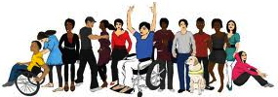
DO-IT promotes…
For students with disabilities:
  self-determination
  empowering use of IT
  success in challenging postsecondary studies & careers
For institutions:
  IT, services, & courses that are welcoming to, accessible to, & usable by all potential students, including those with disabilities

Slide 4

Reference book:
Universal Design in Higher Education (UDHE): From Principles to Practice
Second edition, 2015
>40 authors/co-authors
Peer reviewed
Harvard Education Press
Discount order form on DO-IT website www.uw.edu/doit
Email doit@uw.edu to join our UDHE CoP

Slide 5
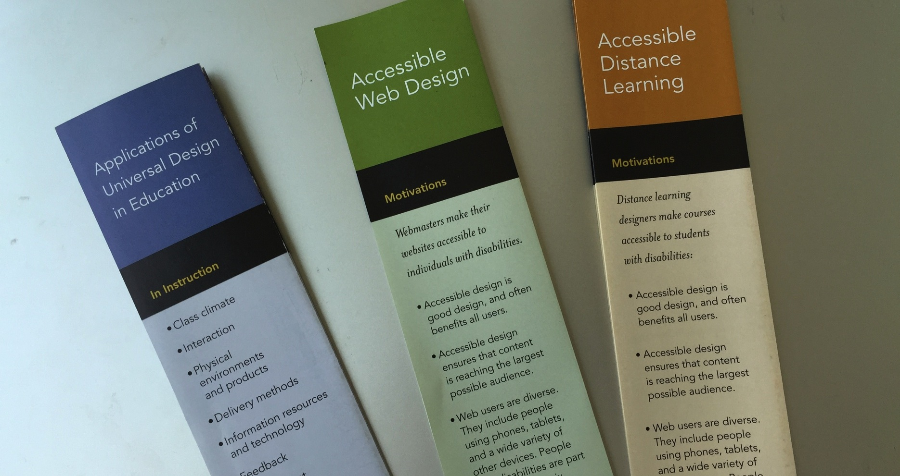

Slide 6
Presentation content
What does it mean for a course to be “accessible?”
What are some strategies & resources for making an online course
  compliant with legal mandates
  welcoming to, accessible to & usable by all potential students?

Slide 7
What do they have in common?
University of Cincinnati • Youngstown State University • University of Colorado-Boulder • University of Montana-Missoula • UC Berkeley • South Carolina Technical College System • Louisiana Tech University • MIT • Maricopa Community College District • Florida State University • CSU Fullerton • California Community Colleges • Ohio State University: University of Kentucky • Harvard University • Miami University in Ohio

Slide 8
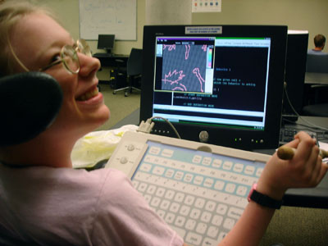
What is the legal basis?
Section 504 of the Rehabilitation Act
The Americans
with Disabilities
Act of 1990 &
its 2008
Amendments
State & local
laws

Slide 9
Definition of “accessible”
“Accessible” means a person with a disability is afforded the opportunity to acquire the same information, engage in the same interactions, & enjoy the same services as a person without a disability in an equally effective & equally integrated manner, with substantially equivalent ease of use. The person with a disability must be able to obtain the information as fully, equally & independently as a person without a disability.

Slide 10
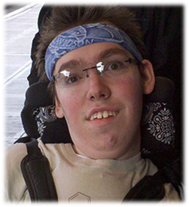
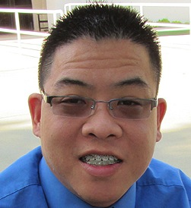
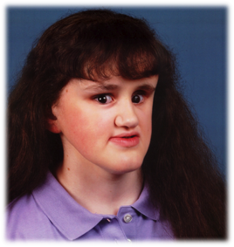
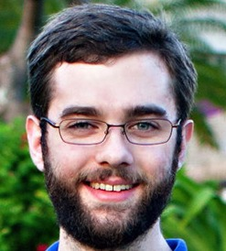
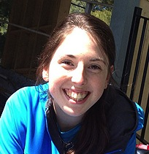
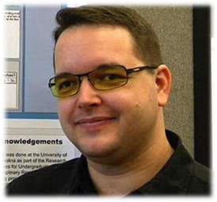
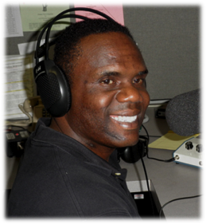
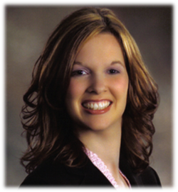
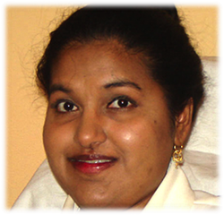
Student characteristics:

Slide 11
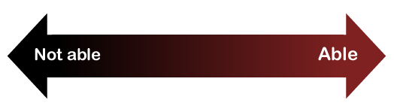
Consider ability on a continuum
see
hear
walk
read print
write
communicate verbally
tune out distraction
learn
manage physical/mental health

Slide 12

Approaches to access:
Universal design
Accommodations
Both are
important!

Slide 13
Most common accommodations
for online courses at UW:
Creating accessible documents, mainly reformatting PDF files
  26,000 pages each quarter
Captioning videos
  55 hours costing > $10,000 each quarter

Slide 14

Rather than relying on accommodations alone…
Consider designing the course to be more welcoming to, accessible to, & usable by a broad audience.

Slide 15
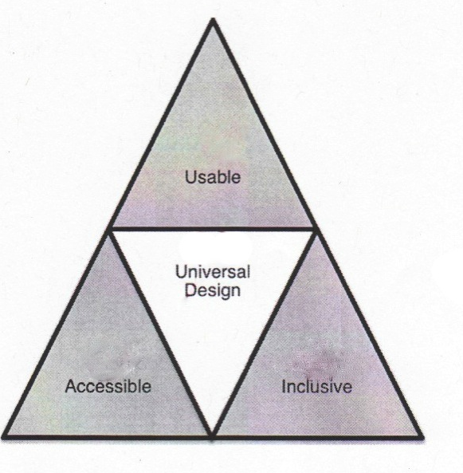
Proactive approaches to access:
Inclusive design
Barrier-free design
Accessible design
Usable design
Design for all
Universal design
…

Slide 16
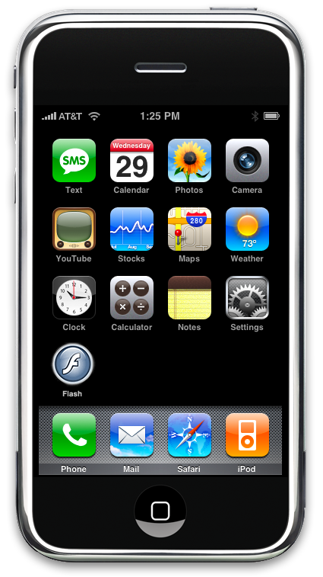
Universal design =
“the design of products & environments to be usable by all people, to the greatest extent possible, without the need for adaptation or specialized design.”
The Center for Universal Design
www.design.ncsu.edu/cud

Slide 17
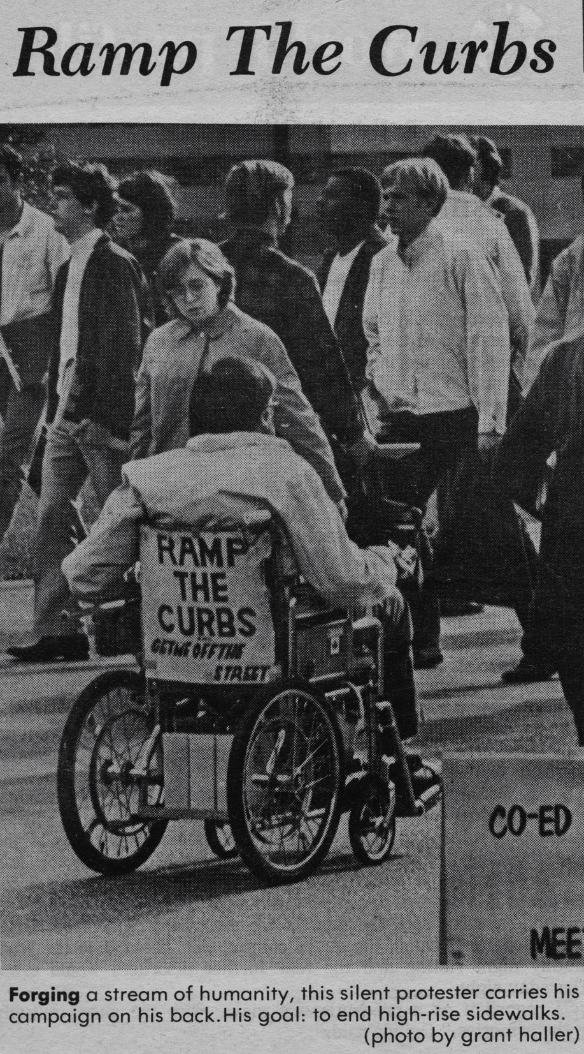
“The Daily”
UW
1970

Slide 18
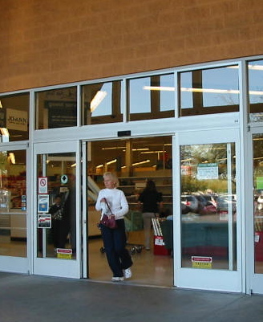
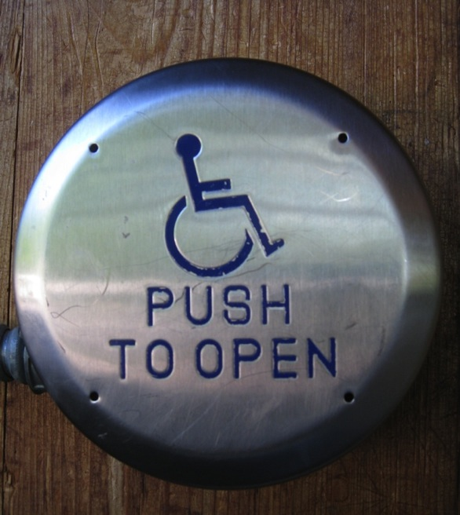
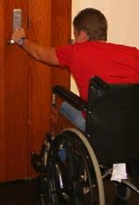
UD on a continuum
Interpreter for deaf student
Uncaptioned video
Captioned video

Slide 19
The first online course at UW
Year: 1995
Instructors: Me & Dr. Norm Coombs
Title: Adaptive Tech. for People with Disabilities
Technology: Email, discussion list, Gopher server, telnet, file transfer protocol
Online materials: In text format
Postal mailed materials: Publications, captioned & audio described VHS videos

Slide 20
Rutgers University
Instructor: Sheryl Burgstahler
Title: Accessibility & Compliance of Online Education
Target: Online instructors, course designers, program administrators
Format: Online, asynchronous, universally designed
Length: 6 weeks, noncredit

Slide 21
Two key issues
Students with disabilities need access to assistive technology (AT)
Online courses need to be universally designed with respect to:
  The learning management system (LMS)
  Instructional materials
  Instructional strategies

Slide 22
Imagine these students in your class…

Slide 23
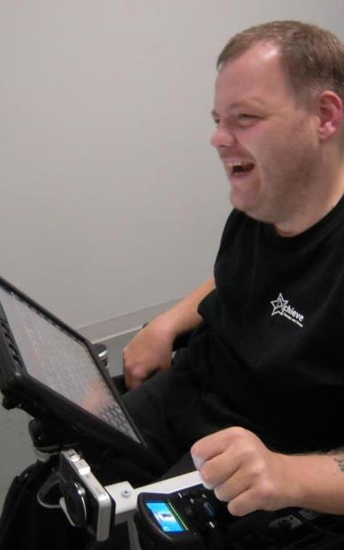
Anthony
AT Specialist
Prentke Romich
grammar/spell checkers
synthesized voice on communication device
touch screen
computer-based environmental control, phone access

Slide 24
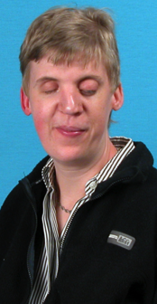
Imke, Ph.D.
Climatologist
National Weather Service
speech output
Braille translation software
Braille display & printer
speech input
Morse code foot switch

Slide 25
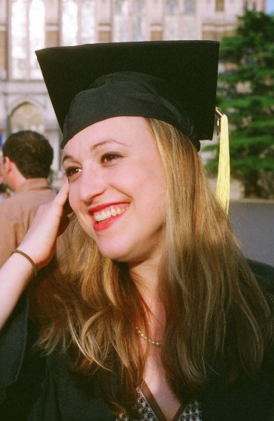
Jessie
BA, Informatics
Business Analyst Amazon.com
speech output
speech input
grammar/spell checkers

Slide 26
In applying UD to online leaning:
Provide multiple ways to:
gain knowledge
interact
demonstrate knowledge
Provide multiple means for:
representation
engagement
action & expression (Center for Applied Special Technology, CAST)

Slide 27
AT: | Therefore:
Emulates the keyboard, but doesn’t perfectly emulate the mouse | Design web, software to operate with keyboard alone
Cannot read content presented in images | Provide alternative text
Can tab from link to link | Make links descriptive
Can skip from heading to heading | Structure with heirarchical headings

Slide 28
A universally designed syllabus:
Is friendly/welcoming
Is structured under subheads logically organized
Is in an accessible format
Includes key information, e.g.,
  Instructor information
  Course description
  Learning objectives

Slide 29
A universally designed syllabus:
  Includes target audience, technical level, OPTIONAL content, expectations
  Shares assignments & grading
  Includes required reading
  Includes statements regarding (1) accessibility & (2) disability-related accommodations

Slide 30
        For web pages, documents, images, videos:
Use clear, consistent layouts & organization schemes for presenting content.
Structure headings (using heading style features built into the Learning Management System, Word, PowerPoint, PDFs, etc.) & use built-in designs/layouts (e.g., for PPt slides).
Use descriptive wording for hyperlink text (e.g., “DO-IT Knowledge Base” rather than “click here”).
Avoid PDFs presented as images (e.g., make sure the text is accessible, that you can copy & paste it); if used, create a text-based alternative.

Slide 31
        For web pages, documents, images, videos:
Provide concise text descriptions of content presented within images.
Use large, bold fonts on uncluttered pages with plain backgrounds.
Use color combinations that are high contrast & can be read by those who are colorblind.
Make sure all content & navigation is accessible using the keyboard alone.
Caption or transcribe video & audio content.

Slide 32
        With respect to instructional methods:
Assume a wide range of technology skills; provide options for gaining needed skills.
Present content in multiple ways (e.g., in a combination of text, video, audio, image).
Address a wide range of language skills (e.g., spell acronyms, avoid or define jargon).
Make instructions & expectations clear for activities, projects, & assigned reading.
Make examples & assignments relevant to wide variety of interests & backgrounds.

Slide 33
        With respect to instructional methods:
Offer outlines & other scaffolding tools.
Provide adequate opportunities to practice.
Allow adequate time for activities, projects, tests.
Provide feedback on project parts & offer corrective opportunities.
Provide options for communicating & collaborating that are accessible to individuals with a variety of disabilities.
Provide options for demonstrating learning.

Slide 34
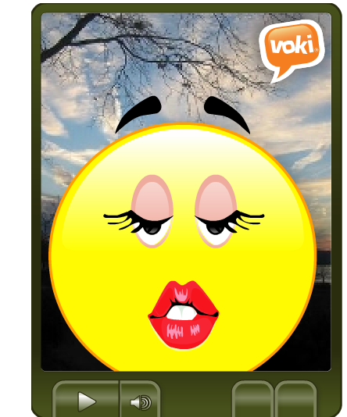
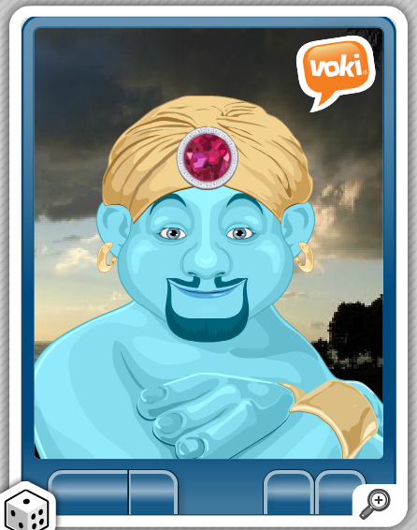
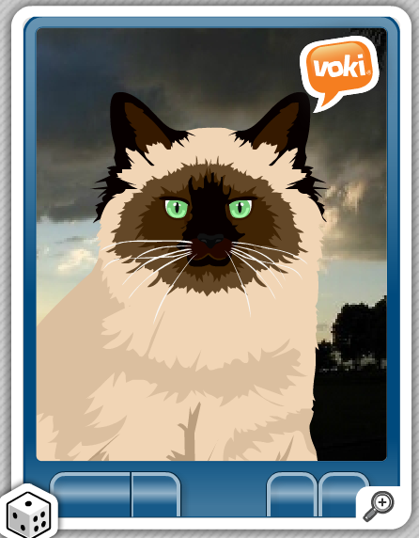
Example: @ Voki.com,
Create & animate your avatar…
How could you make it accessible?

Slide 35
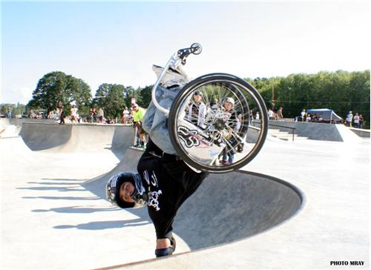
UD – know it when you see it!
…at “skateboard park”

Slide 36
Resources
Sheryl Burgstahler
sherylb@uw.edu
AccessDL
  www.uw.edu/doit/programs/accessdl
& discussion list (sign up)
Stay tuned for AccessCyberlearning

