Slide 1
Accessible Virtual World Interfaces
Blizzard Entertainment's World of Warcraft model
Don Merritt, PhD
University of Central Florida

Slide 2
Agenda
Background
Discovery: An accessible virtual world game
About the players with disabilities
Research and Results
Lessons learned and opportunities

Slide 3
Background
Hillbilly at heart
Broadcasting and teaching
PhD, Texts and Technology
Director, UCF Office of Instructional Resources
UCF Games Research Group

Slide 4
Background
Love video games
Congenital amputee
Relationships between people and technology

Slide 5
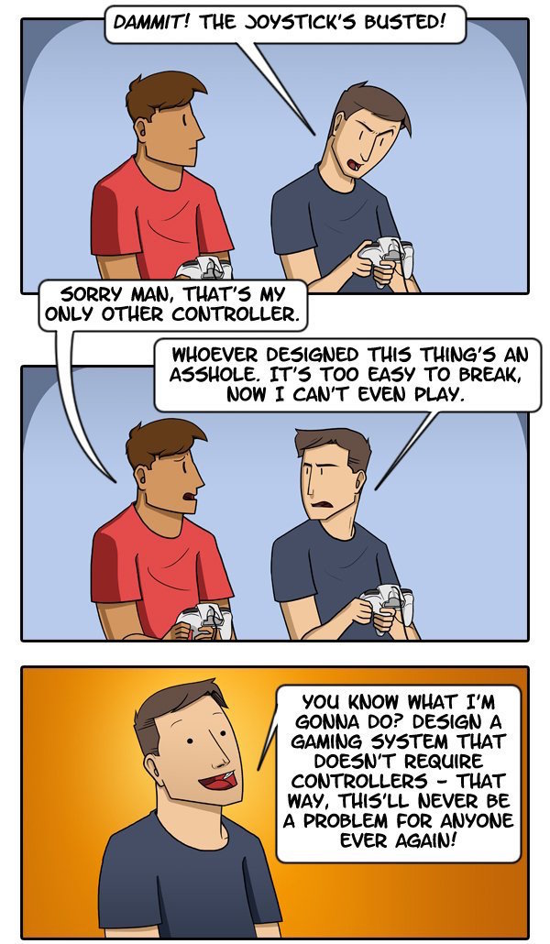
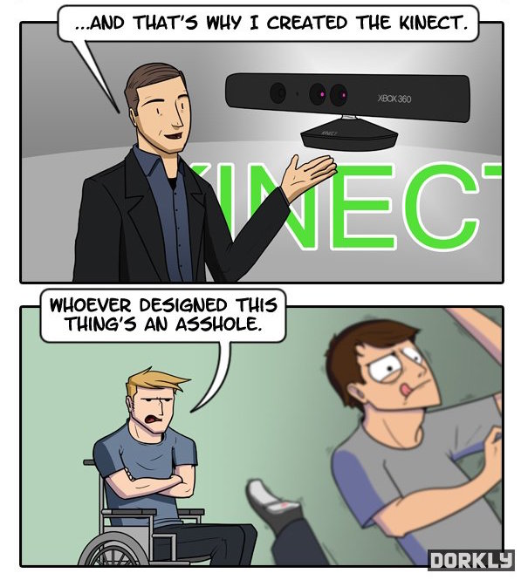
Making Controller History
Julia Lepetit &Andrew Bridgman
April 22, 2013
http://www.dorkly.com/post/51443/out-of-control

Slide 6
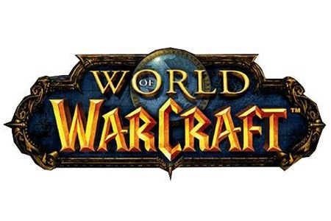

Slide 7
Significant Characteristics
Real-time play
Video-based environment
Rich aural environment
Textual and voice communication
Coordination required between teams for “end-game” content

Slide 8
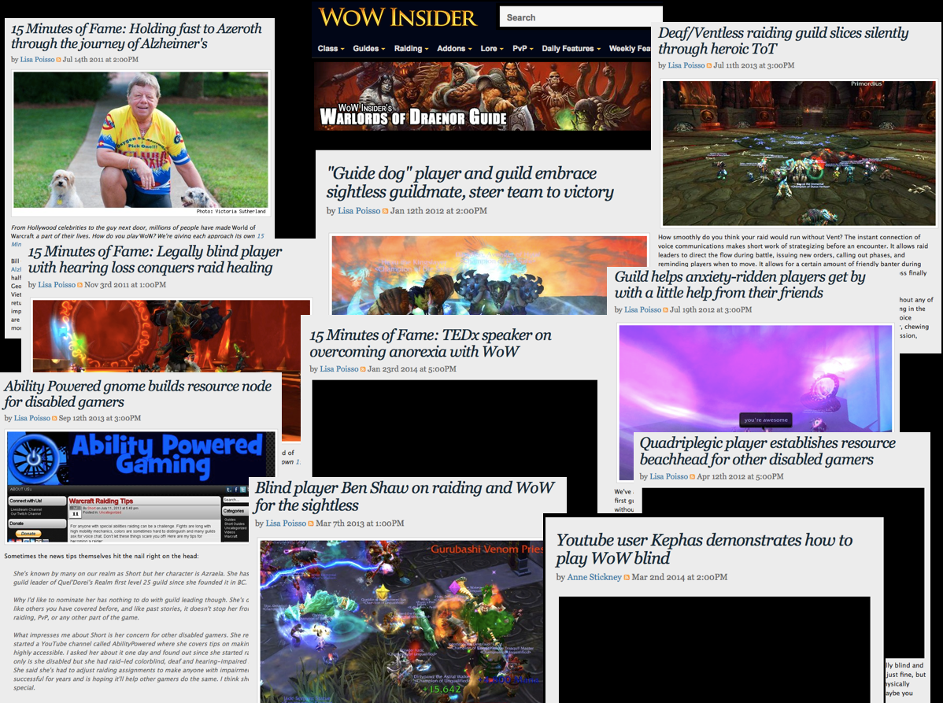

Slide 9
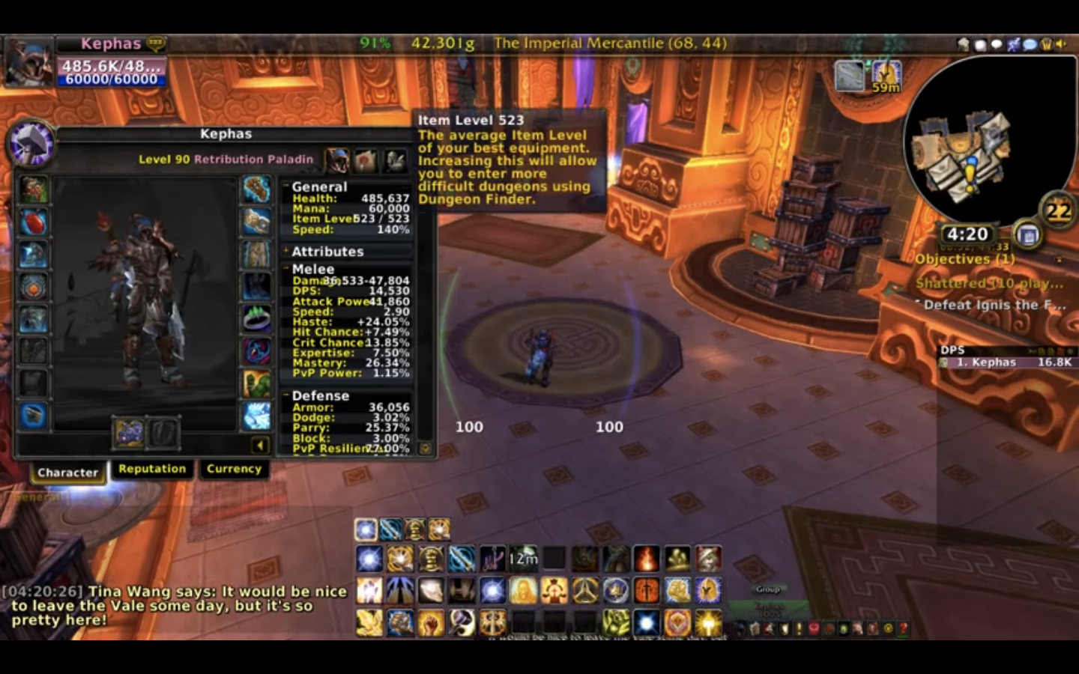
Blind Guy Plays Warcraft TheKephas on Youtube
https://youtu.be/101ZEJF5z_8?list=PL495432DE9C508380

Slide 11
Addons / Mods
Blizzard structured the UI so as to be modifiable by users
These “mods”, or “add-ons”, are written by the users in Lua with no support from Blizzard
Any UI element can be modified and APIs exist for data that isn’t part of the packaged UI

Slide 12
Do addons address specific disabilities of players?

Slide 13
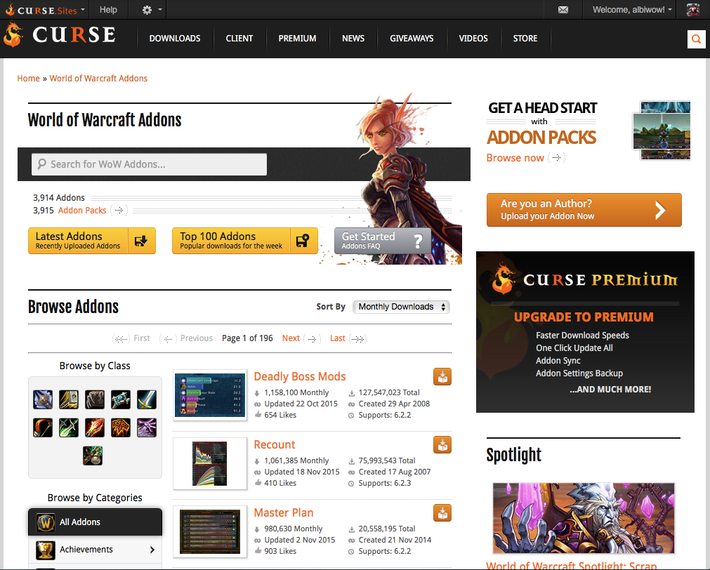

Slide 14
3 Principles of UDL from CAST website
Principle I. Provide Multiple Means of Representation:
1. Provide options for perception: (1.1) options that customize the display of information; (1.2) options that provide alternatives for auditory information; (1.3) options that provide alternatives for visual information.
2. Provide options for language and symbols: (2.1) options that define vocabulary and symbols; (2.2) options that clarify syntax and structure; (2.3) options for decoding text or mathematical notation; (2.4) options that promote cross-linguistic understanding; (2.5) options that illustrate key concepts non-linguistically.
3. Provide options for comprehension: (3.1) options that provide or activate background knowledge; (3.2) options that highlight critical features, big ideas, and relationships; (3.3) options that guide information processing; (3.4) options that support memory and transfer.
Principle II. Provide Multiple Means of Action and Expression:
1. Provide options for physical action: (4.1) options in the mode of physical response; (4.2) options in the means of navigation; (4.3) options for accessing tools and assistive technologies.
2. Provide options for expressive skills and fluency: (5.1) options in the media for communication; (5.2) options in the tools for composition and problem solving; (5.3) options in the scaffolds for practice and performance.
3. Provide options for executive functions: (6.1) options that guide effective goal-setting; (6.2) options that support planning and strategy development; (6.3) options that facilitate managing information and resources; (6.4) options that enhance capacity for monitoring progress.
Principle III. Provide Multiple Means of Engagement:
1. Provide options for recruiting interest: (7.1) options that increase individual choice and autonomy; (7.2) options that enhance relevance, value, and authenticity; (7.3) options that reduce threats and distractions.
2. Provide options for sustaining effort and persistence: (8.1) options that heighten salience of goals and objectives; (8.2) options that vary levels of challenge and support; (8.3) options that foster collaboration and communication; (8.4) options that increase mastery-oriented feedback.
3. Provide options for self-regulation: (9.1) options that guide personal goal-setting and expectations; (9.2) options that scaffold coping skills and strategies; (9.3) options that develop self-assessment and reflection.

Slide 15
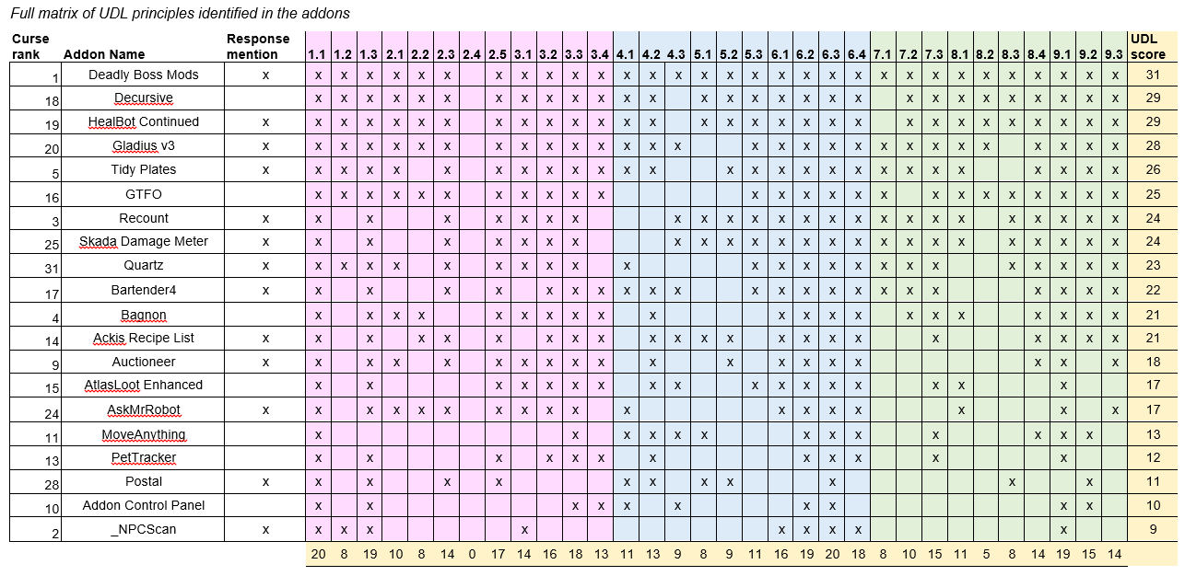

Slide 16
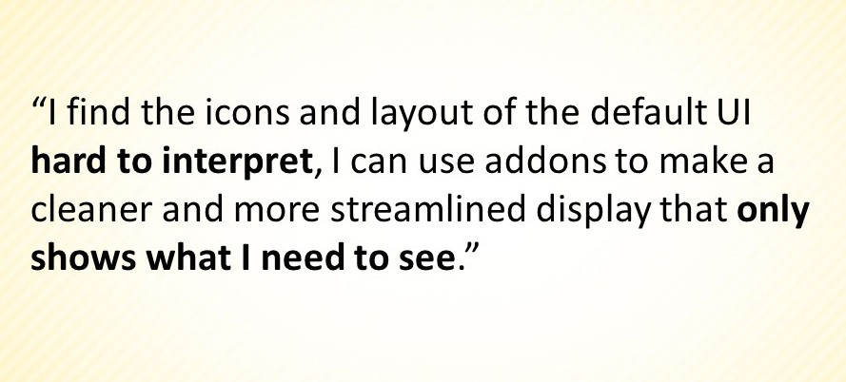
Addons fit into UDL principles

Slide 17
Do players with disabilities who manage their experience with addons have a “deeper” identity immersion experience with the game than players with disabilities who do not?

Slide 18
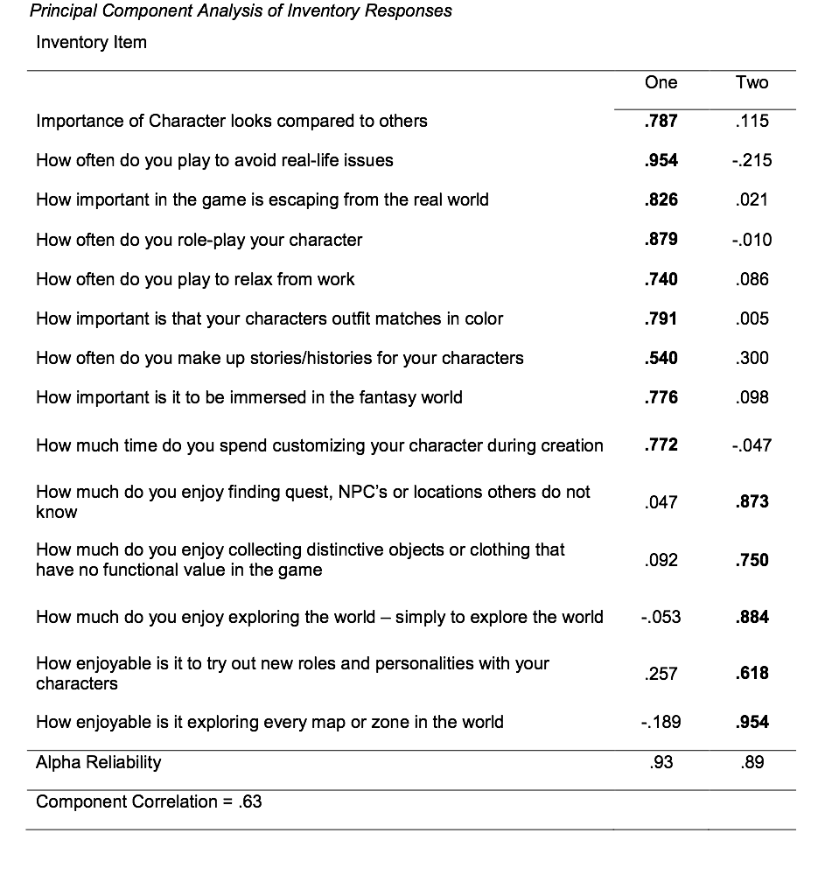

Slide 19
Discovery
(and a little role-play)
How much do you enjoy finding quest, NPC’s or locations others do not know?
How much do you enjoy collecting distinctive objects or clothing that have no functional value in the game?
How much do you enjoy exploring the world – simply to explore the world?
How enjoyable is it exploring every map or zone in the world?
How enjoyable is it to try out new roles and personalities with your characters?

Slide 20
McLuhan, Understanding Media
Media as prosthetic
Zimmerman and Salen
Three schema for understanding games: Rules, Play, Culture
Rules: the system of play (interface embodies rules) Navigation and information feedback
Play: the space between gamer and game where experience takes place
Culture: the design of a game embodies the values with which it was made

Slide 21
Lesson 1
It is possible for people with many different ability levels and challenges to engage with, find meaning within, and enjoy virtual worlds.

Slide 22
Lesson 2
Immersion in a virtual environment for a person with a disability is enhanced (enabled?) by the community of that environment as well as the technologies of the environment.
(Create places people want to populate!)

Slide 23
Lesson 3
Accessibility is a natural tendency for environments where users can create and / or modify the UI themselves.
Unfortunately this is easier in closed environments.

Slide 24
Lesson 4
Accessibility is likely to improve over timme so we must build worlds / environments that will be persistent.
Notes:
I do see this issue of flexible interface design as a more critical one for virtual worlds meant for education and learning. In this area I would recommend that publishers closely consider the inferential systems of meaning of these environments and from that consideration develop a common standard for flexible UI design. This might include a shared API library or at the very least a common understanding and implementation of the major elements of the UI function (navigating the virtual worlds, exploration tools such as opening or interacting with objects, etc.). In conjunction with a user development community similar to the addon community for World of Warcraft it should then be possible to broaden the appeal and impact of these types of systems. The goal is not to make all educational or learning environments look the same. Rather the goal is building a base framework upon which those with very specific needs can get the same educational experience as everyone else using that system.

Slide 25
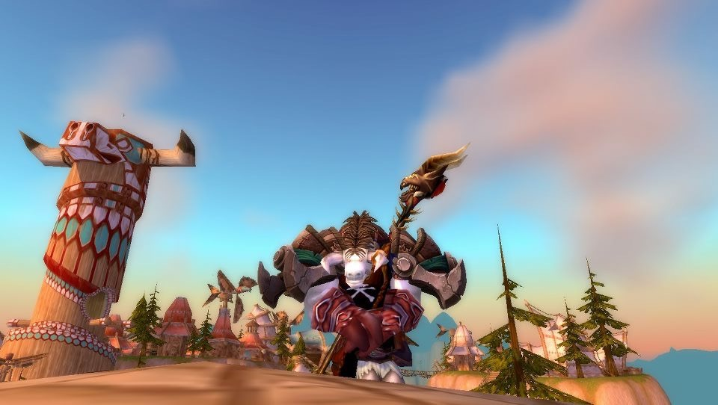
Don Merritt
don.merritt@ucf.edu
@donmerrittucf
The impact of user-generated interfaces on the participation of users with a disability in virtual environments: Blizzard Entertainment's World of Warcraft model
https://login.ezproxy.net.ucf.edu/login?auth=shibb&url=http://search.ebscohost.com/login.aspx?direct=true&db=cat00846a&AN=ucfl.033397193&site=eds-live&scope=site

