Slide 1
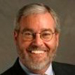
Best Practices for Integrating Closed Captioning with Mediasite Lecture Capture
Sam McCool
Instructional Technology Manager
Nevada State College
Lily Bond
Marketing Manager
3Play Media
lily@3playmedia.com

Slide 2
Agenda
Benefits of captioning
Accessibility laws + lawsuits
Operational considerations for captioning
Captioning workflow with Mediasite
Demo of Nevada State College’s integration with Mediasite + 3Play Media

Slide 3
Benefits
Accessibility for hard of hearing
48 Million
Americans with hearing loss

Slide 4
Benefits
80%
Of people who use captions
don’t have hearing disability
Accessibility for hard of hearing
Better comprehension
Flexibility to view in noise-sensitive environments

Slide 5
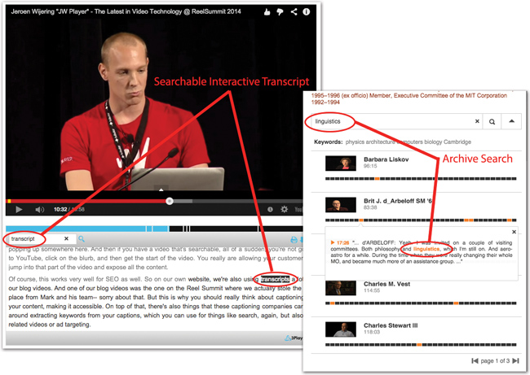
Benefits
97%
Of users said searchable
transcripts enhanced experience
Accessibility for hard of hearing
Better comprehension
Flexibility to view in noise-sensitive environments
Interactive video search

Slide 6
Benefits
Accessibility for hard of hearing
Better comprehension
Flexibility to view in noise-sensitive environments
Interactive video search
SEO: more inbound traffic
7.3%
Increase in views
from captions

Slide 7
Benefits
Accessibility for hard of hearing
Better comprehension
Flexibility to view in noise-sensitive environments
Interactive video search
SEO: more inbound traffic
Reusability
50%
Students who use transcripts for study guides

Slide 8
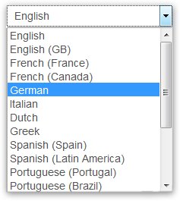
Benefits
Accessibility for hard of hearing
Better comprehension
Flexibility to view in noise-sensitive environments
Interactive video search
SEO: more inbound traffic
Reusability
Translation to foreign languages

Slide 9
Benefits
Accessibility for hard of hearing
Better comprehension
Flexibility to view in noise-sensitive environments
Interactive video search
SEO: more inbound traffic
Reusability
Translation to foreign languages
May be required by law

Slide 10
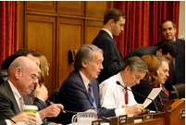
Accessibility Laws
Rehabilitation Act: Sections 508, 504
Covers federal agencies and orgs with federal funding
Assistive Technology Act
ADA: Titles II, III
Covers public and commercial entities
Lawsuits: What is a “place of public accommodation”?
CVAA
Covers Internet content that aired on TV
Includes video clips

Slide 11
About 3Play Media
Captioning + transcription + translation
MIT spinout in 2007
Based in Cambridge, MA

Slide 12
About 3Play Media
Captioning + transcription + translation
MIT spinout in 2007
Based in Cambridge, MA
1,600+ customers in higher education, government, corporate, & media

Slide 13
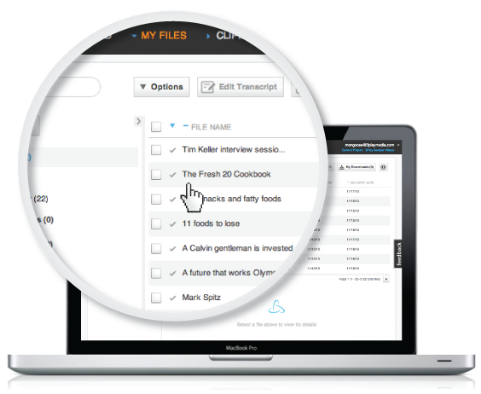
3Play Media’s Goal: Simplify the Process
Online Account System
Fast + Reliable Turnaround
Automated Workflows
50+ Caption Formats
Caption Import
Video Search Tools
Spanish Captioning

Slide 14
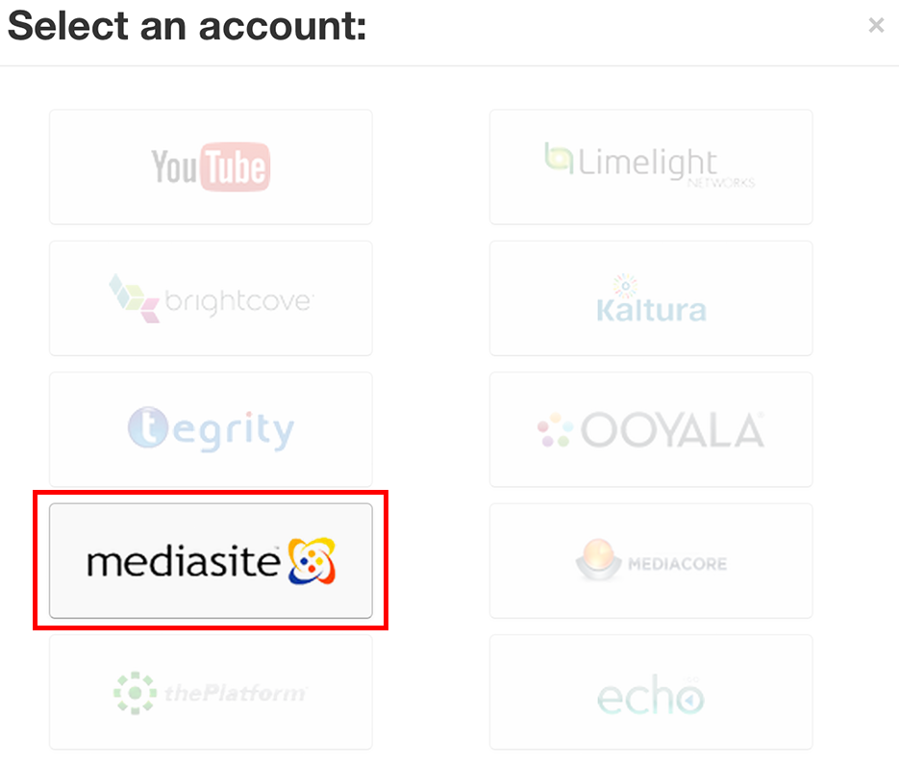
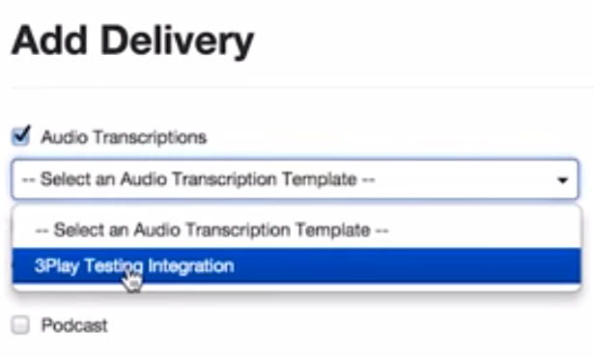
Integrations
Effortless integration with many platforms + lecture capture systems
Mediasite Integration

Slide 15
Developing a Plan for Accessibility
Guiding Principles (not policy)
Student Service
Innovation
External appraisal of procedures
Getting buy-in
Task force committee
Faculty Senate

Slide 16
Video Captioning Strategy
“Just in Time”
Short videos
Amara
YouTube
Lecture length
Subscription specs
Mediasite integration

Slide 17
Caption Service Requests
KBox Support Center
Workflow for a caption ticket
Communication flow
RCSD (Resource Center for Students with Disabilities) – controls process
InTech (Instructional Technology) – documents all work flow for RCSD
Instructors – cc’d on ticket, informed
Students – privacy protected

Slide 18
Importance of Streamlining Service
Just in time service
Last minute requests (status quo)
Accommodation process
Start of term
During term
Planned requests for service
Unplanned requests (after the event)

Slide 19
Why 3Play Media?
Integration with Mediasite
Recommendations from colleagues & vendors
2013 AHG Conference

Slide 20
DEMO

Slide 21
Q&A
Sam McCool
Instructional Technology Manager
Nevada State College
Lily Bond
Marketing Manager
3Play Media
lily@3playmedia.com
21

