Slide 1

UDL from the Ground Up
Part 2
November 18, 2015
Deb Castiglione, EdD, ATP
Universal Design & Instructional Technology Specialist, Center for the Enhancement of Learning & Teaching (CELT), University of Kentucky
http://png-images.ru/trava/

Slide 2


University of KY
Lexington
Public
Land Grant
Research
Shared Governance
http://www.vapg.com/healthylifestyles/healthylifestyles.html
http://pawssss.com/waste_facts/

Slide 3
Deb Castiglione
University of Kentucky
Center for the Enhancement of Learning & Teaching (CELT)
Universal Design & Instructional Technology Specialist
May 2014

Slide 4
UK
UDL Initiative

Slide 5

UDL Initiative Roadmap
http://www.doylelandscapes.ie/blog

Slide 6
Philosophy

Slide 7
Year One
The Dream Stage

Slide 8
Year One
UDL

Slide 9
Year One
May 2014 – July 2015
Campus-wide needs analysis Roadmap UDL advisory committee UDL workshops Online UDL module Tips & collegial coffees Procured Read&Write Gold Awareness

Slide 10
Year Two
Reality Check

Slide 11

Year Two
UDL
www.southernspray.com
Notes:
New Provost
Reorganization
New Senior Vice Provost for Academic Excellence

Slide 12

Year Two
 | August 2015 – July 2016
Market Read&Write Gold (partners) DE: Delivery course UDL course proposals UDL Community of Practice/Faculty Champions Captioning guidelines/proposal Incorporate UDOIT (Canvas) Empirical evidence UDL checklist, web content, blog, resources
http://www.lawnmowersdirect.co.uk/blog/category/garden-machinery/lawnmowers/

Slide 13
Year Three
Re-Evaluation

Slide 14
Year Three
UDL
http://pawssss.com/waste_facts/

Slide 15
Year Three
 |  | August 2016 – July 2017
To be determined

Slide 16
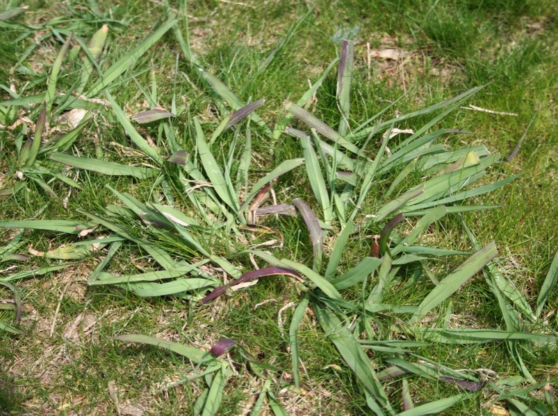
Learnings
Lower Expectations
Little Successes
Patience / Time
Alternative Routes
Minimal Control
Evolving Role
Incorporate, Don’t Isolate
Just-in-Time Education
My Priority
http://350sav.fotomaps.ru/weeds-in-lawn.php

Slide 17
Successes
Read&Write Gold
Quality Matters (Standard 8)
UDL to eLII Call for Proposals
eLII UDL Module
Distance Education: Delivery Course
Student Panel

Slide 18
Deb Castiglione, EdD, ATP
deb.castiglione@uky.edu
859-257-9685

