Slide 1
Need a little usability?
What you can learn from usability testing
Whitney Quesenbery
Center for Civic Design

Slide 2
To understand accessible UX we have to look at real people and real behavior.

Slide 3
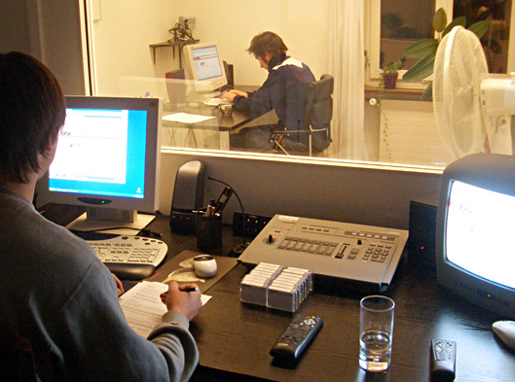
Maybe you think usability testing has to look like this
Photo: www.unic.com

Slide 4
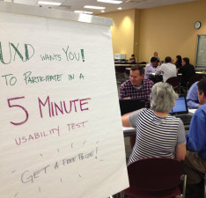
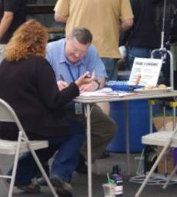
Usability testing can also look like...
Photos: UXBlog.com and Jenny Greeve

Slide 5
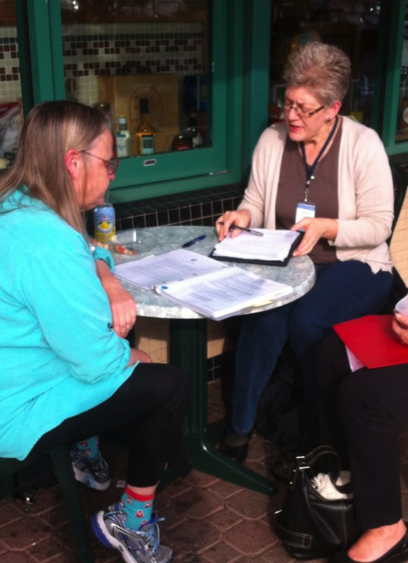
What makes it a usability test?
We observe behavior
Quietly
And use the results to inform design
Notes:
Observing behavior:
How people use the site or app
How easily they meet their goals
What causes confusion or problems
Quietly
Don't explain or demo.
Watch what they do.
Listen to their comments.
Take their problems seriously.
Use the results to inform design

Slide 6
Where usabilty testing fits in an accessibility program
Principle | Testing Mode | What it tests
Perceivable | Inspection | Basic accessibility errors
Robust | Code review | Use of coding standards Semantic structure
Operable | Check using AT Expert review | Interaction using keyboard, screen reader, other AT
Operable / Understandable | Usability testing | Use by real people
Notes:
Another way to think about this is in layers from easy to hard to test.
After all, if there are simple, basic accessibiity errors, why bother going further. Get them fixed.

Slide 7
Prioritize problems by their impact on people
Type of problem | What it means
Slammed doors (critical) | Barriers that stop someone from using an app or feature successfully – or at all
Frustrating (serious) | Problems that slow someone down, or force them into work-arounds
Annoying (moderate) | Things that make the experience less pleasant (maybe even enough to leave)
Noisy (minor) | Minor issues that damage credibility but are unlikely to cause problems

Slide 8
What questions do you want to answer with a usability test?

Slide 9
Understand the question you are asking
If we want to know:
Which design helps users complete tasks more effectively?
We are asking a question that is
Comparative, quantitative (errors, time)
(and why they made those mistakes)
If we want to know:
Do users understand how to approach a task?
We are asking a question that is abut
Mental models, variability, qualitative insights
(and how prevalent each model is)

Slide 10
Helpful models for thinking about usability
A’s Ability, aptitude, attitude
(what users bring to the interaction)
E’s Efficient, effective, engaging, error-tolerant,
easy to learn
(dimensions of usability)
Use Useful, usable (operable), desirable
(context of use)

Slide 11
The As help you think about diverse participants
Attitude
motivation, emotion, risk tolerance, persistence, optimism, tolerance for frustration
Aptitude
current knowledge, ability to make inferences or innovate solutions, expertise, habits
Ability
physical and cognitive attributes
Source: Dana Chisnell "Character Creator" http://www.slideshare.net/danachisnell/character-creator
Notes:
A tool to help you focus on the attributes that matter
Account for what the user brings to the table
Identify both center and outliers

Slide 12
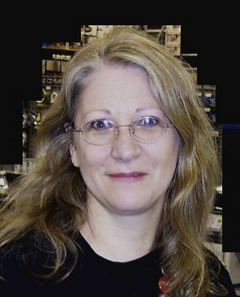
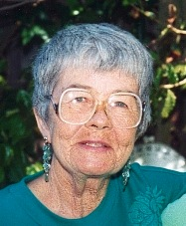
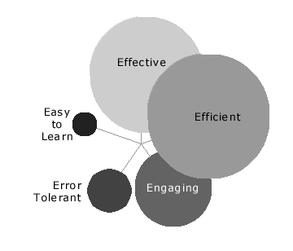
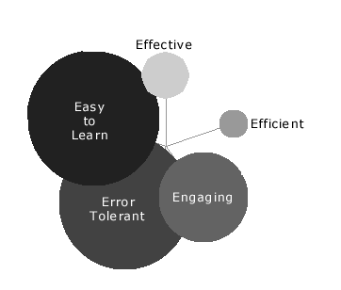
Different users – and different contexts of use change user needs
Notes:
We can be diffeent because we see a task differently.
When the two applications were merged, the staff and customers needs both had to be met.

Slide 13
5Es help you plan usability tests
Usability Goal Types of usability testing needed
Effective
Evaluate tasks for how accurately they were completed and how often they produce errors
Efficient
Time tasks with realistic tasks and working versions of the software
Engaging
User satisfaction surveys to gauge acceptance
review logs for ‘time on site’
Error-tolerant
Construct task scenarios to create situations with potential problems
Easy to learn
Control how much instruction is given to test participants, or recruit participants with different levels of knowledge

Slide 14
The recipe for planning a usability test
Location and context: formal informal
Recruiting: defined opportunistic
Activities: instructed tasks free tasks
Questions: structured unstructured
Data collection: observation task/data only
Results quantitative qualitative

Slide 15
A few examples of questions and how we answered them
These examples all come from work on elections and civic design..but the principles apply to any project.

Slide 16
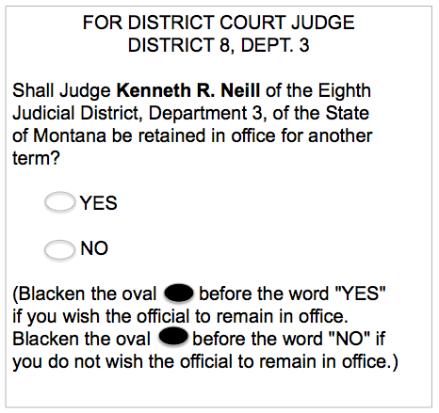
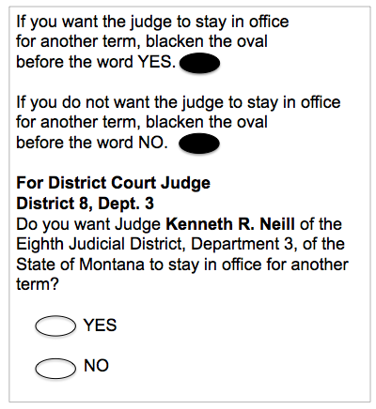
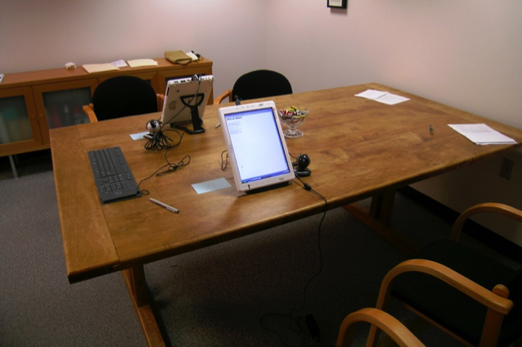
Comparing two designs
Can a design improve user performance?
Plain vs. traditional language
About this project
  45 participants
  3 lab setting, 8 days
  2 moderators
  Instructions for voting
  Careful observation
  Satisfaction survey
We learned about
  Voter accuracy
  Order effects
  Voter preference
Results
  Statistical analysis
  Participant preference

Slide 17
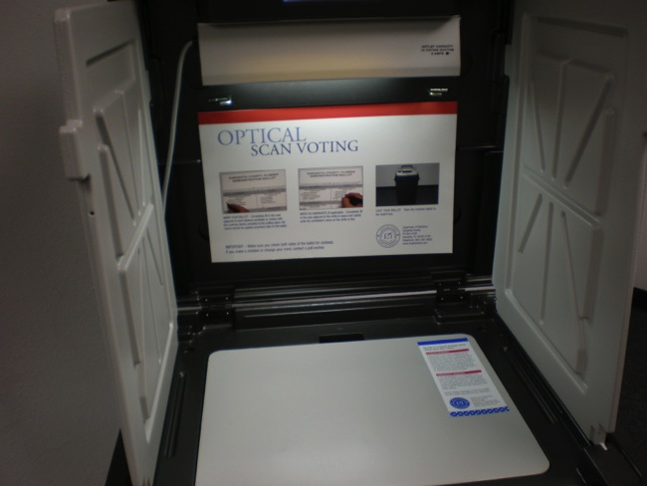
Testing a new design
What problems might voters have with a new ballot design?
About this project
  1 of 5 similar tests
  10 participants
  1 locations, 1 day
  2 moderators + 1 others
  Self-defined tasks
  Observation
  Post-task questionnaire
We learned about
  Navigation on the ballot
  Instructions
Results
  Found pattern of errors for one interaction
  Time on task

Slide 18
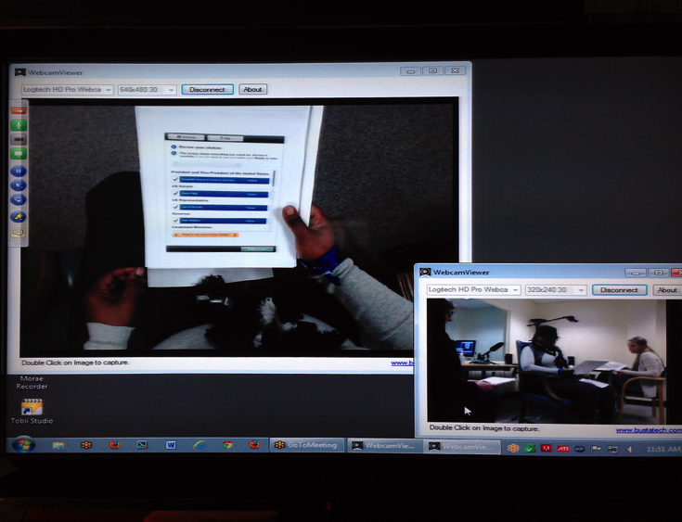
Exploring new ideas
Can we extend a design to new audiences?
About this project
  Research project
  Paper prototyping
  Low literacy
We learned about
  What they understsand
  Navigation
  Instructions
  Interactions
Results
  Simplified everything for a clear, universal design
http://anywhereballot.org
http://civicdesigning.org/featured-story/rapid-responsive-radical-the-anywhere-ballot-is-born/
Notes:
The 'Anywhere Ballot'
Designed through iterative testing with low literacy participants

Slide 19
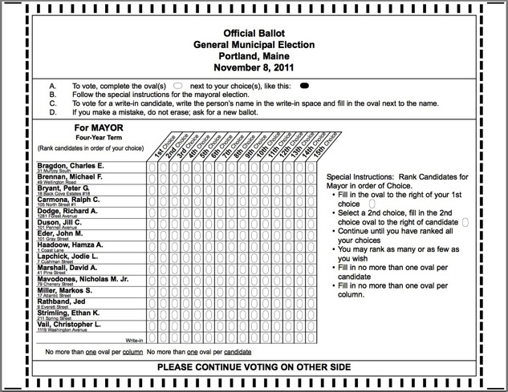
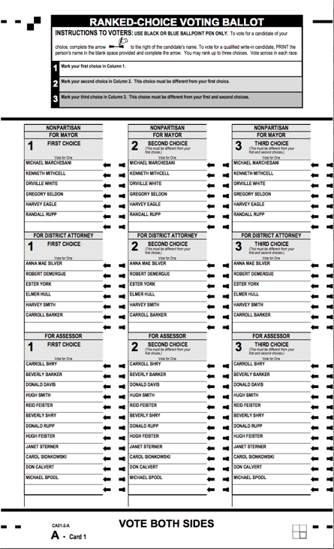
Learning about comprehension
Can voters explain and act on that understanding?
About this project
  20 participants
  4 locations, 1 day
  8 moderators
  Self-defined tasks
  Minimal observation
We learned about
  Navigation on the ballot
  Instructions
  Mental models of counting
  Whether there’s a problem
Results
  Qualitative insights

Slide 20
Tips and tricks for successful usability sessions with diverse users

Slide 21
Think beyond the "task"
Are your research sessions flexible enough to adapt to a range of interaction styles?
Are you open to variations in how they complete tasks?
Are you flexible about the length of time for each session?
Can you adapt the session to react to unexpected barriers?

Slide 22
Getting set-up is part of the session
  Watch how participants get comfortable in a new place, on a new system, or in a new situation.
Allow time for participants to get settled in the space and identify where everything is.
Make sure they are comfortable with your system or that theirs connects to the network and other technology.
Learn how they set audio volume, colors, or speech speed.

Slide 23
Be flexible about devices
Using their device
Their choice of browsers or apps
Their assistive technology and settings
How they set up their preferences
But there may be problems with a prototype
Using your device
Tested with your app, site, prototype
Control of browser and application versions
But they on a system they don't know
Small differences in settings can be disorienting

Slide 24
Decide on the research location
At your site, look for
Availability of public transportation, parking
Friendly reception area for an assistant
Space in the room for wheelchairs or dogs
At their site, be sure to check
Reliable internet
Quiet area for the session
Know how and exactly where you will meet
Rules for use of the space

Slide 25
Consider your recording options
  Check for conflicts between assistive technology and recording software.
Avoid recording on the participant's computer. It can interfere with AT the participant's interactions.
Use WebEx or GoToMeeting to display the participant's screen on a second computer and record from there.
Use an 'over-the-shoulder' camera to record the screen.

Slide 26
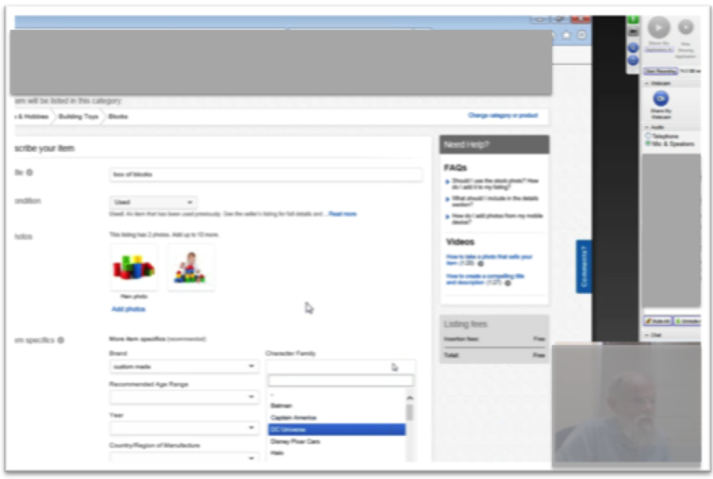
Recording setup with screen sharing
GoToMeeting recording does not capture faces.
Check the audio setup to avoid tech conflicts.
The participant computer connects by telephone (but doesn't dial in).
The room mic on the recording computer captures audio.
External speakers for system and screen reader audio.
This setup also allowed remote observers to watch easily.

Slide 27
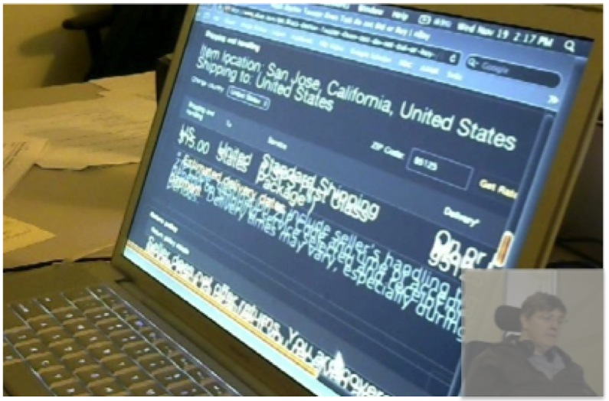
Recording setup with 2 cameras
  Morae has an option to record from two cameras.
  The screen camera is on a stand just to the right of the participant.
  The face camera is on a stand across the table.
External speakers for system and screen reader audio.
A mic on the Morae computer captures the room audio.
This setup is also useful when you have a mix of devices. An adjustable stand lets you put the camera overhead to see a tablet, too.

Slide 28
Be prepared. Don't panic.
Sharing a web address or task instructions
Set up bookmarks
Have easy-to-type page with links
Send a text message
Getting past accessibility barriers
Decide in advance how (and when) you will assist with problems.
Be prepared by knowing the site well.
Know when you will abandon a task or ask them to persist.

Slide 29
Above all, be human.

Slide 30


Storytelling for User Experience
with Kevin Brooks
Global UX
with Daniel Szuc
A Web for Everyone
with Sarah Horton
http://rosenfeldmedia.com/books/a-web-for-everyone/

Slide 31



Whitney
UX research, plain language, accessibility, civic design
http://civicdesign.org
AUX Personas
Personas shown in the presentation are available here:http://rosenfeldmedia.com/books/a-web-for-everyone/
A Podcast for Everyone
on UIE All You Can Learn, iTunes, Rosenfeld Mediahttp://rosenfeldmedia.com/books/a-web-for-everyone/#a-podcast-for-everyone
https://itunes.apple.com/us/podcast/a-podcast-for-everyone/id833646317

Slide 32
Bonus slides:
Planning a usability program

Slide 33
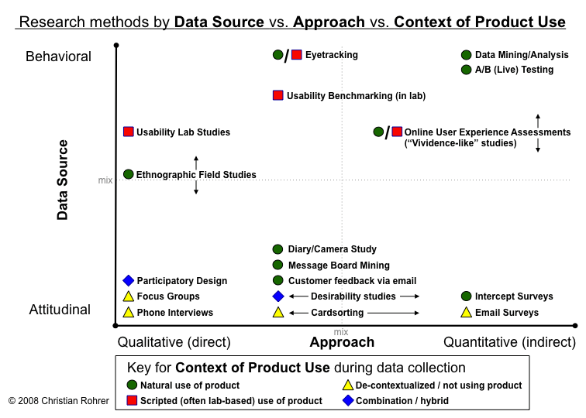
Look for a balance of methods by approach and context of use

Slide 34
Use the right tool at the right time
Many Users
Market research
Satisfaction surveys
A-B Testing
Stakeholder interviews
Summative testing
Card sorting
Early in Project
Evaluation of Designs
Comparative benchmarking
User observation
Iterative evaluation of prototypes
Ethnography
Walkthroughs
Expert Reviews
Few Users

Slide 35
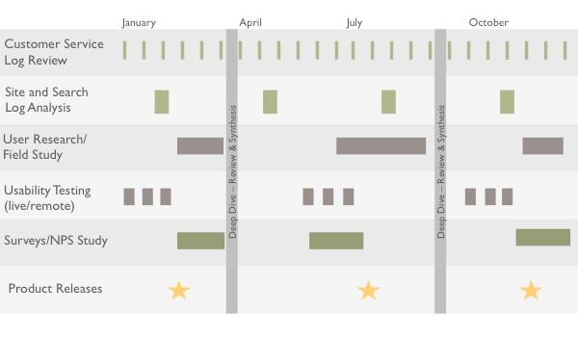
Look for the 'cadence' of what kind of usability work you do at different times
Seeing the Elephant: Defragmenting User Research by Lou Rosenfeld
http://alistapart.com/article/seeing-the-elephant-defragmenting-user-research

