Slide 1
New Developments in Image and Math Content Accessibility 2.0
Lucia Hasty, Rocky Mountain Braille Associates
Sue-Ann Ma, Benetech
November 19, 2015

Slide 2
Benetech (the Bookshare folks)
370,000 trade titles, textbooks and periodicals
350,000 members
500 publishing partners
45 countries
8 million ebooks downloaded
http://bookshare.org
Notes:
Bookshare:
With federal education funding, providing books to students at $20 a student per year and dropping
Helping shape what accessible book delivery should look like here in the US and the in the rest of the world (e.g. Kenya or Canada)

Slide 3
The DIAGRAM Center
DIAGRAM: Digital Image and Graphics Resources for Accessible Materials
2015: Received our second US DoE award
Make it easier, faster, and cheaper to create and use accessible educational materials for children and students with disabilities
Partnership between Benetech & US Fund for DAISY
Collaborating with the accessibility community to develop open source tools and services, available globally
Learn more: http://diagramcenter.org
Notes:
More new educational materials that are born accessible
More use of new tech to create AEM, especially STEM
More knowledge of the accessibility features specific to the needs of students with disabilities
Community of technology developers, publishers, and end users build knowledge and contribute to the development of tools/services

Slide 4
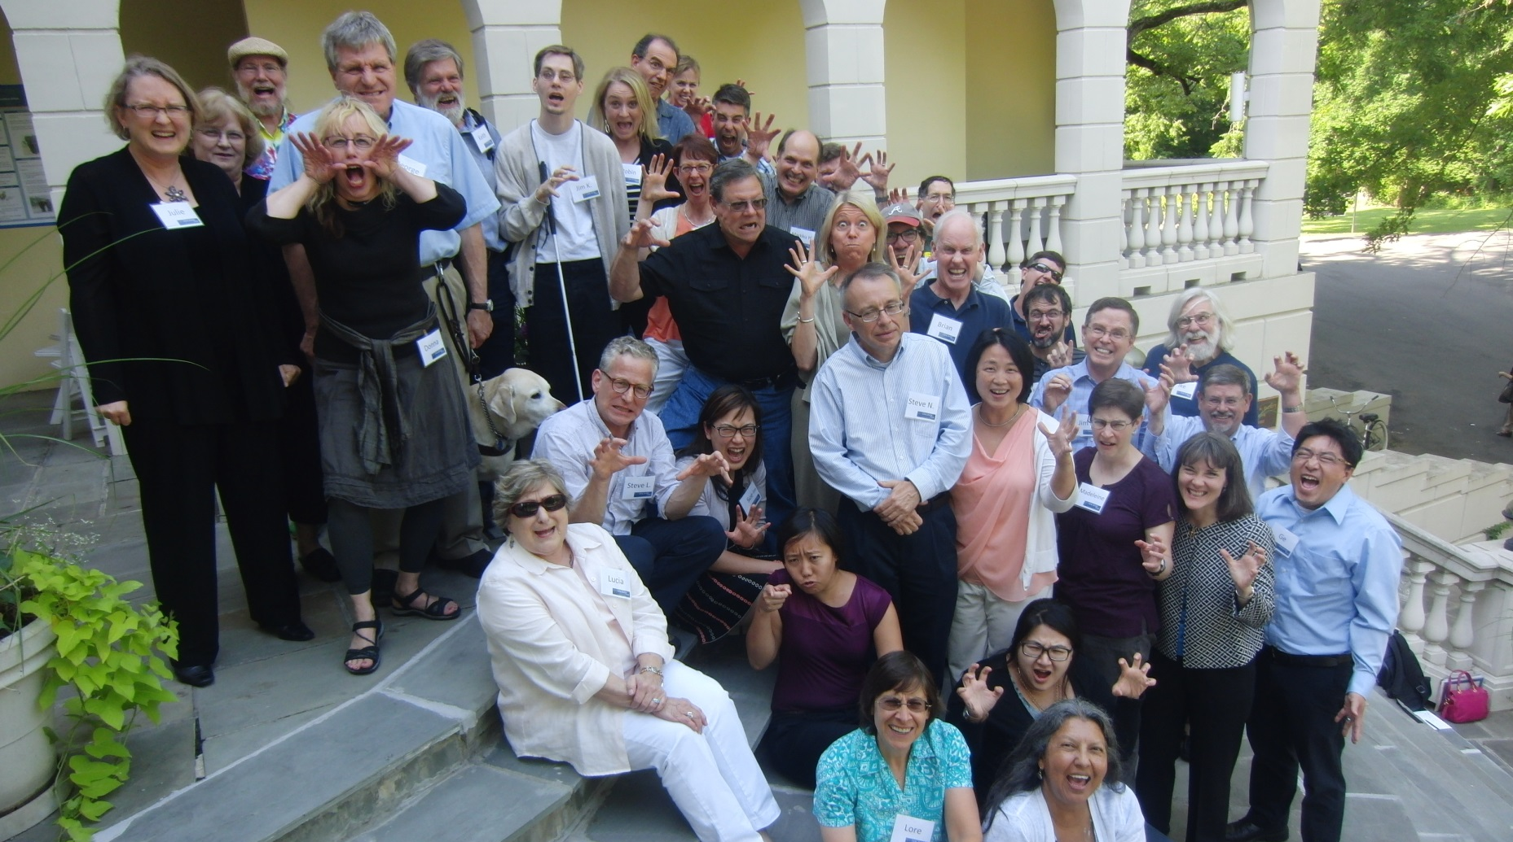
DIAGRAM Center Community
“Most wonderful collaboration I have ever been a part of.”
– DIAGRAM Community Member
Notes:
Image: Posed group photo of about 40 DIAGRAM community members standing on steps making "scary" faces.
We believe that our “Born Accessible” vision for images can best be achieved by creating communities of people who are working on solutions to accessible images and bringing them together so that we can share and align our work for the greatest benefit of our end users: students with print disabilities who need to understand the images in digital books and web sites.
We have a 27-member Advisory Board with Technologists, Educators, Publishers, Accessibility experts, Student/Parent reps. Working Groups with 20+ members: Outreach, Tools, Standards, Content, Math, Tactile Graphics. Our working groups and advisory board members include representatives from Google, Adobe, Pearson, Learning Ally, the APH, NFB, National Braille Press, Humanware, American Thermoform, Design Science, Smith-Kettlewell Eye Institute, and many more. We are a community of experts passionate about accessible images.

Slide 5
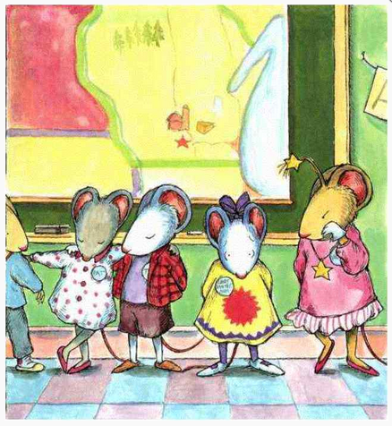
“A picture is worth 1000 words”
“If I had a name like yours, I’d change it, “Victoria said as the students lined up to go home.
I wish I could, thought Chrysanthemum miserably.
Notes:
People say a picture is worth a thousand words
…but what happens when the picture goes missing?
This is similar to a blind person’s experience reading a book.
So how do we bring the picture back for those who are not able to access it through standard print?

Slide 6
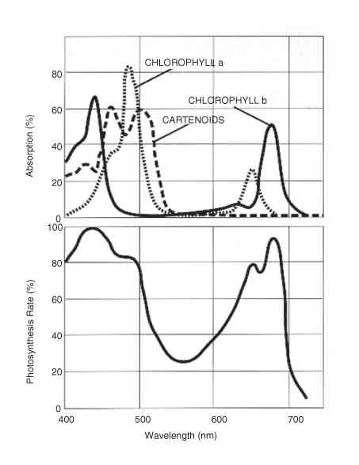
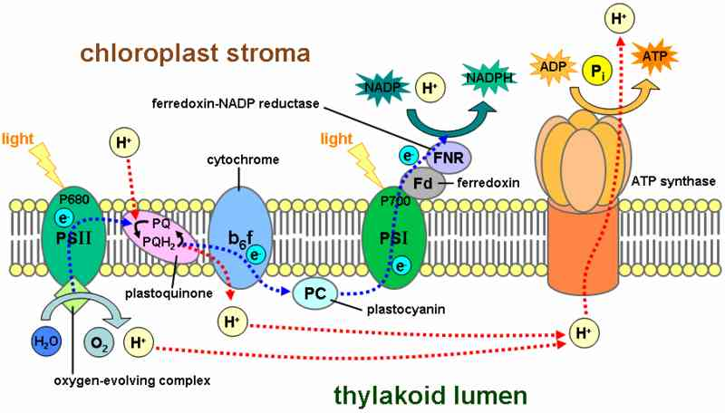
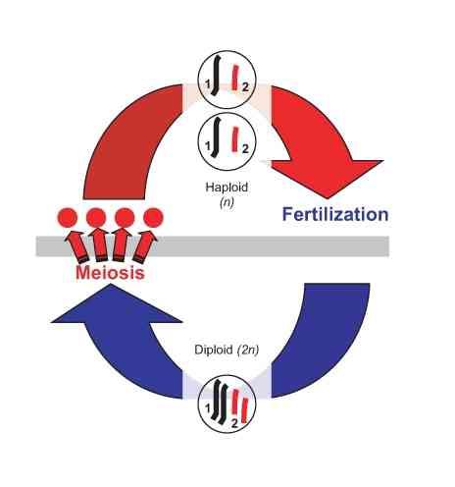
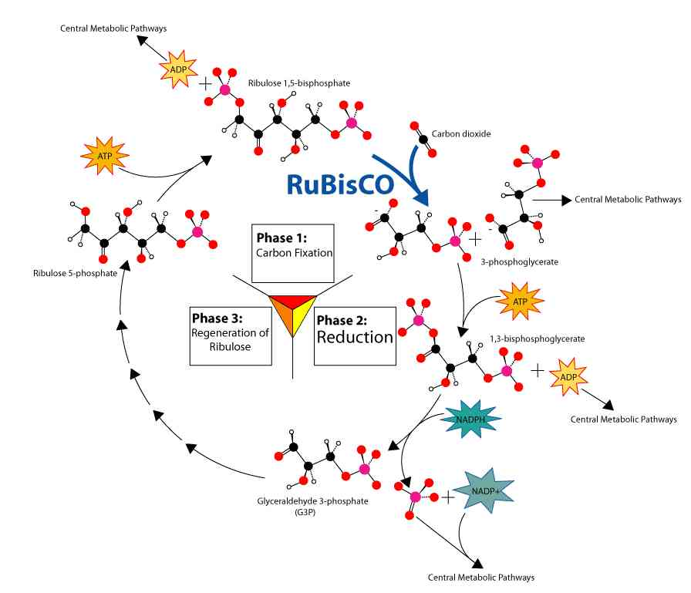
Critical Diagrams Found in STEM
Notes:
Images: Collage of complex STEM images, including biological processes, molecular structure and diagram of chloroplast stroma.
Screen readers already handle text very well. But, often there is no way for a reader to know what image contains unless it is described or unless another alternative is available. What you see here is a collection of complex images a textbook in the Bookshare collection, “CK-12 Biology I.” In cases like these, if the image has not been pretty thoroughly described in the text, alt text simply won’t be sufficient to convey the meaning of the images. And the meaning might depend pretty heavily on the context in which the image appears.

Slide 7
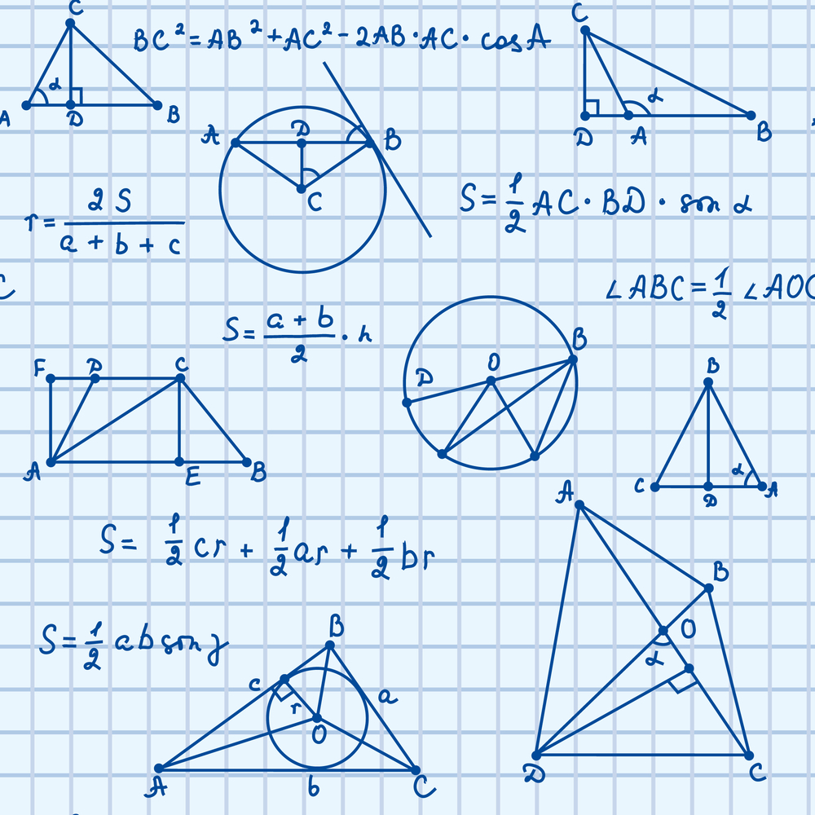
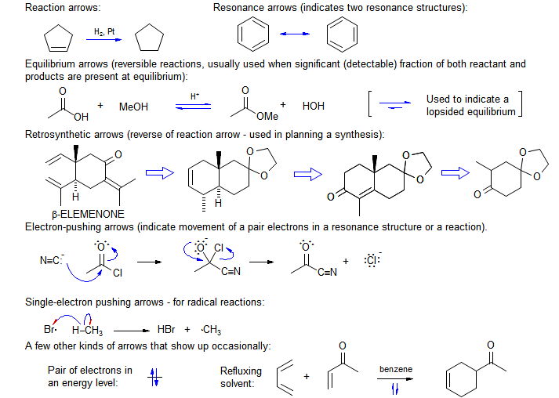
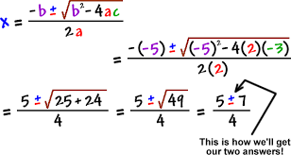
Math & Symbolic Notations
Notes:
Images: Collage of math and symbolic notation images including chemical bond and structure notation, geometric shapes with labels, and math

Slide 8
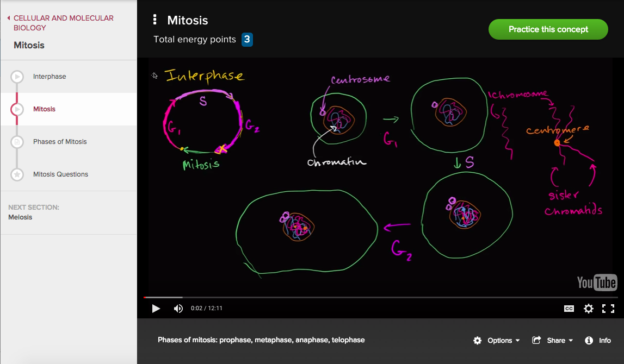
Videos
Notes:
Image: Screenshot of video from Khan Academy, showing a hand-drawn diagram of cellular mitosis process. Embedded in lesson navigation system and using YouTube player:
Source: https://www.khanacademy.org/science/biology/cellular-molecular-biology/mitosis/v/mitosis

Slide 9
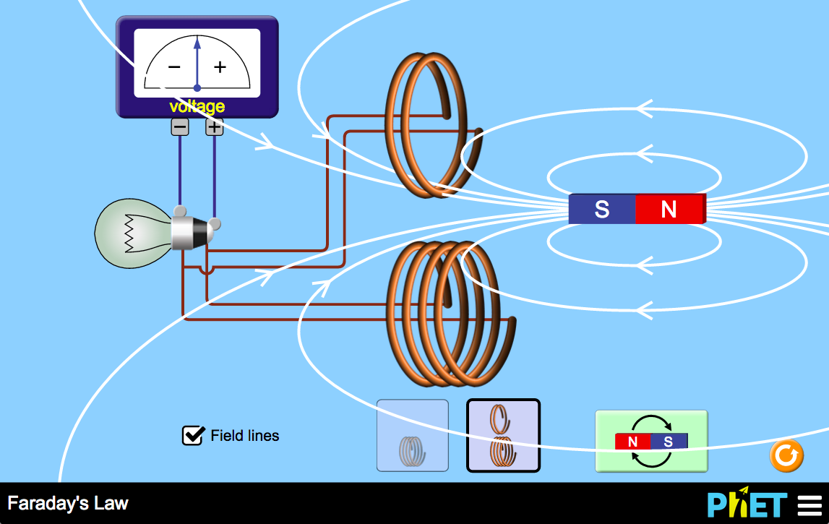
Interactives, Simulations, Games
Notes:
Image: Screenshot of physics simulation demonstrating Faraday's Law. Includes coils attached by to lightbulb and voltage meter. A magnet surrounded by magnetic field lines is meant to be inserted into the coils to produce voltage.
https://phet.colorado.edu/sims/html/faradays-law/latest/faradays-law_en.html

Slide 10
And Beyond…
Notes:
Image: Child wearing virtual reality head gear sitting in front of a Yamaha grand piano.
Through the use of Fove’s eye-tracking technology, the headmount recognises the user’s eye movement. The user blinks on one of the many panels within the interface to trigger the preferred note, which is then conveyed to the piano,” explains the Eye Play the Piano website.
http://www.theguardian.com/technology/2015/jan/14/disabled-play-piano-eyes-virtual-reality-headset
Virtual reality, wearables, the internet of things, etc.

Slide 11
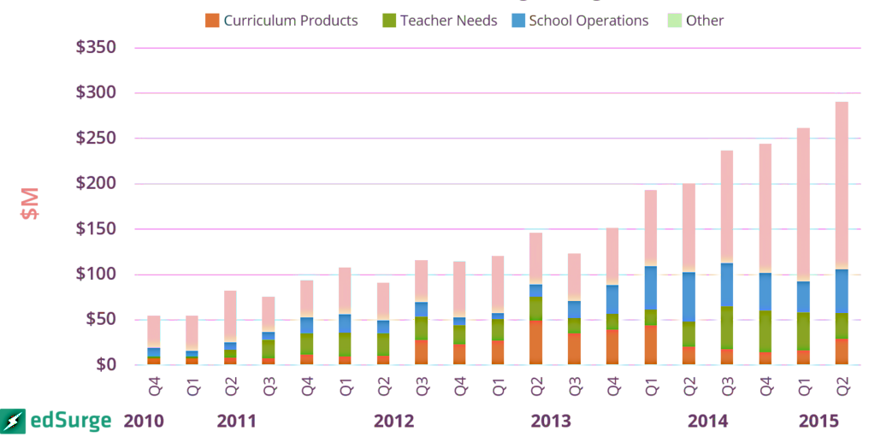
Time of Challenge and Opportunity
285 million: people with vision impairment worldwide (39 million are blind and 246 have low vision)
$1.6 billion: new edtech investment in first half of 2015
Notes:
References:
number of people with vision impairment: http://www.who.int/mediacentre/factsheets/fs282/en/
numbers on U.S. edtech market: https://www.edsurge.com/news/2015-07-29-education-technology-deals-reach-1-6-billion-in-first-half-of-2015
Image: Chart showing four quarter rolling average, steady increase in quarterly investment in U.S. K-12 Edtech. Increase from about $50 million in Q1 of 2010 to almost $300 million in Q2 of 2015.

Slide 12
Basic Image Accessibility

Slide 13
Accessible Images: Challenges
Expertise
Lack subject-matter expertise
Not familiar with accessibility & standards
Lack guidelines for a broad range of image types
User-Centric Resources & Guidelines
Time to find references
Time & Cost
Cost-benefit: limited impact when produced adhoc
Time to get trained up on best practices
Minimal examples produced by experts
Time & cost required to produce content
Confusing standards that are constantly evolving
Individuals possess varying levels of expertise
Unsure how incorporate new technologies
Notes:
Accessible Images: Challenges:
Expertise
Lack subject-matter expertise
Not familiar with accessibility & standards
Individuals possess varying levels of expertise
Time and Cost
Time to find references
Time to get trained up on best practices
Time and cost required to produce content
Cost-benefit: limited user reach when produced adhoc
User-Centric Resources & Guidelines
Lack guidelines for a broad range of image types
Minimal examples produced by experts
Confusing standards that are constantly evolving
Unsure how to incorporate new technologies

Slide 14
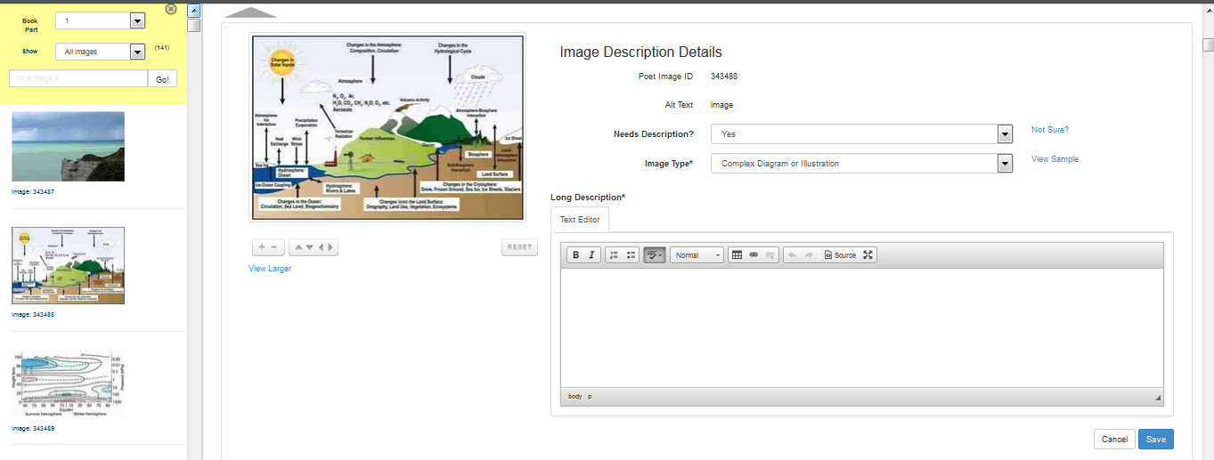
Poet Image Description Tool
Simplified framework for entering descriptions
Applies the latest standards
EPUB3 and DAISY support
Link to Poet: (https://diagram.herokuapp.com/)
Notes:
Poet:
Tools parses out images and prompts user to enter descriptions
Emphasizing template-based framework for entering descriptions (DAISY, EPUB3)
Allows content owner to add what they need without having to follow constantly changing technical standards

Slide 15
Poet Image Description Training Module
Notes:
Word and HTML version of DIAGRAM Image Description Guidelines available at: http://diagramcenter.org/table-of-contents-2.html#book

Slide 16
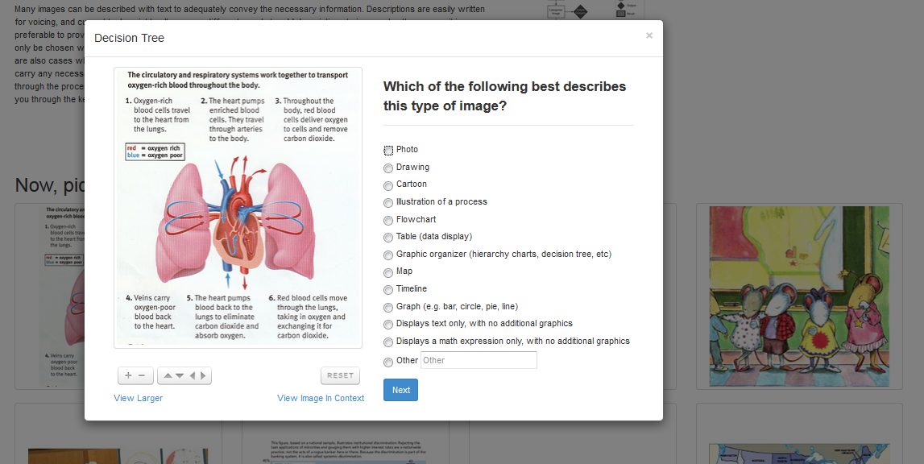
When to describe
Notes:
https://diagram.herokuapp.com/training/when_to_describe

Slide 17
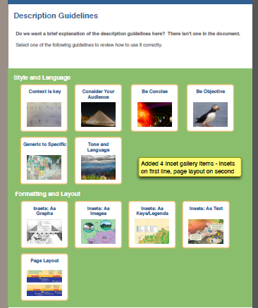
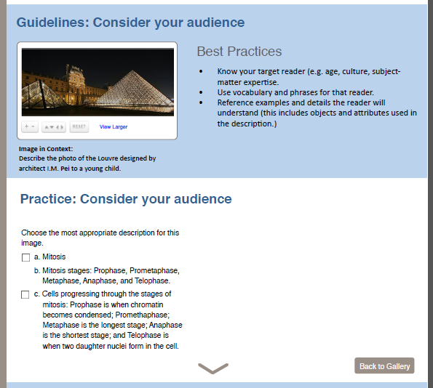
How to describe
Notes:
General guidelines that apply when writing descriptions for any image/diagram

Slide 18
General Image Guidelines
Category | # | Image Type
Style & Language | 1 | Context is Key
 | 2 | Consider Your Audience
 | 3 | Be Concise
 | 4 | Be Objective
 | 5 | General to Specific
 | 6 | Tone & Language
Formatting & Layout | 7 | Insets
 | 8 | Page Layout
Notes:
Table of General Style Guides:
Style & Language
Context is Key
Consider Your Audience
Be Concise
Be Objective
General to Specific
Tone & Language
Formatting & Layout
Insets
Page Layout
Example of a general guideline for Consider Your Audience
General Guidelines:
Know your target reader (e.g. age, culture, subject-matter expertise).
Use vocabulary and phrases appropriate for the reader.
Reference examples and details that the reader will understand (this includes objects and attributes used in the description).
Description: this is a photograph of the Louvre Museum in France at night. The entrance to the museum is a large pyramid made out of glass.
Image in Context:
This photograph of the Louvre is part of an introduction to a chapter in a history textbook for young children.
The description uses language and introduces shapes appropriate for a young child.

Slide 19
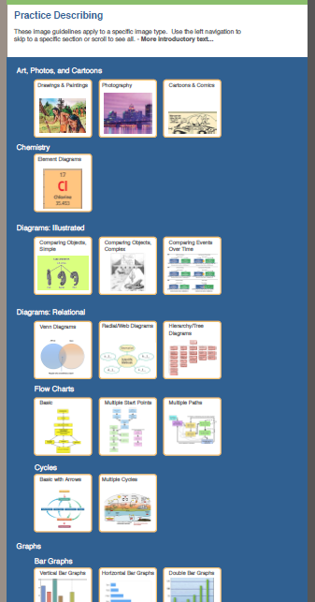
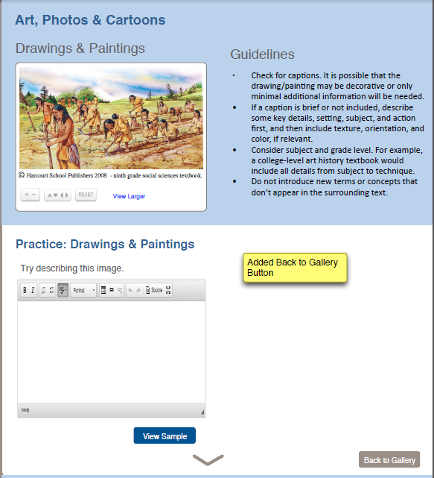
Practice describing
Notes:
Additional, self-paced resource allowing users to practice writing image descriptions.
Original NCAM Image Guidelines
Through a series of grants funded by the National Science Foundation and The US Department of Education, NCAM has been researching and developing methods for creating effective and efficient text alternatives to images so that kids and adults who are blind and visually impaired could have equal access to learning materials.
NSF funded research focused on refining description approaches for STEM images. Reviewed hundreds of descriptions and dozens of images types, then narrowed focus to the most commonly used images in STEM for the highest impact, for example: line graphs and bar charts. This research included rounds of surveys with b/vi STEM professionals (scientists, mathematicians, etc) and user-testing with higher ed students who were b/vi.
The recommended approach encourages: Brevity, focus on Data, Clarity and Consistency in language, Navigation Control via HTML lists and tables.
Further research projects funded by the DoED focused on description for K-12 students, for images used in assessments. This included images found in a widening set of disciplines including ELA and social studies.
In addition, NCAM has collaborated with content authors and publishers in describing tens of thousands of images for clients in K-12 and higher ed. both in instruction and assessment.
Benetech worked with:
One-off image slams: corporations, various organizations
Partner programs: Brigham Young University, Mission Middle College
Industry partners: Elsevier, Wiley, Imagineering Art
To collect feedback on:
Suggested refinement of the original examples from the STEM Description Guidelines
Generated expanded list including additional categories

Slide 20
Examples, Guidelines & Templates
Notes:
Incorporates template-based description guides from Touch Graphics and MathTrax

Slide 21
Expanded Image Categories & Types
Category | # | Image Type
Art, Photos & Cartoons | 1 | Drawings & Paintings
 | 2 | Photographs
 | 3 | Cartoons & Comics
Chemistry | 4 | Chemical Element
Diagrams: Illustrated | 5 | Comparing Objects, Simple
 | 6 | Comparing Objects, Complex
 | 7 | Comparing Events Over Time
Diagrams: Relational | 8 | Venn Diagrams
 | 9 | Radial/Web Diagrams
 | 10 | Hierarchy / Tree Diagram
 | 11 | Flow Charts
 | 12 | Cycles
Graphs | 13 | Bar Graphs
 | 14 | Line Graphs
 | 15 | Pie Graphs
 | 16 | Scatter Plots
Maps | 17 | Geographic Map
 | 18 | Political Map
Mathematics | 19 | Graphs
 | 20 | Math Diagrams
 | 21 | Geometry
 | 22 | Equations & Expressions
Tables | 23 | Simple
 | 24 | Complex
Text Only Images | 25 | Nutrition Label
 | 26 | Timeline
# | Image Type
1 | Bar Chart
2 | Complex Diagram/Illustration
3 | Flow Chart
4 | Line Graph
5 | Mathematical Equation
6 | Pie Chart
7 | Scatter Plot
8 | Standard Diagram/Illustration
9 | Table
10 | Venn Diagram
Notes:
Expanded from 10 to 26 “Image Types”, expanding beyond STEM to include templates for images such as maps, photos, and art. Also applied categories for grouping ease.

Slide 22
Beyond Basic Text Descriptions

Slide 23
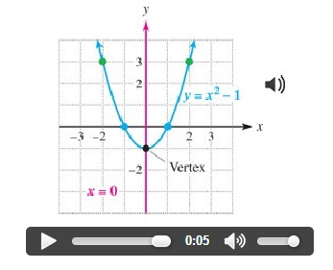
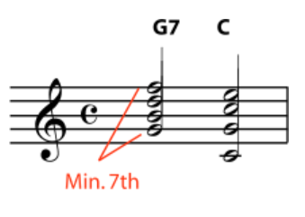
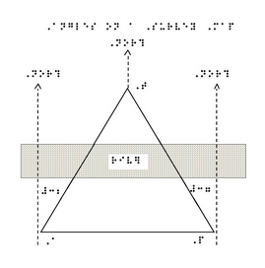
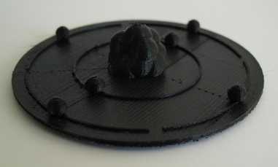
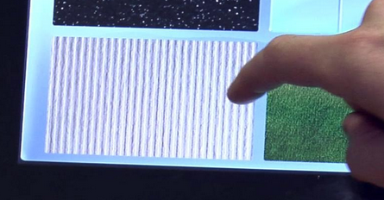
Alternative Image Access Modes
[MusicXML]
[Tactile Graphic]
[Sonification]
A diagram shows properties for the element Chlorine from the periodic table of elements. Atomic number, 17. Element symbol, Cl. Element name, Chlorine. Atomic mass, 35.453.
[Text Description]
[3D]
[MathML]
[Haptic]
Notes:
Modalities covered in the accessible image sample book (technical specs for EPUB and DAISY)

Slide 24
Accessible Image Sample Book
Released May 2015
Free online resource with examples of accessible images & alternatives
Includes commentary on treatments and sample code
Sample Book available at: http://diagramcenter.org/samplebook/index.xhtml
Original Webinar (2014): http://diagramcenter.org/webinars.html#aisb
Notes:
Sample Book available at: http://diagramcenter.org/standards-and-practices/accessible-image-sample-book.html.
Version 1 released March 2014 and version 2 released May 2015.
This is meant to be a technical resource, including multimodal commentary on correct treatment of content and provides sample code snippets for DAISY and EPUB
Product of the DIAGRAM Content Working Group (dozen+ active contributors)

Slide 25
Making Digital Math Accessible
See
(sqrt 54 = x^3)
“Start Root 54 End Root equals x cubed”
Hear
Notes:
Initial Goal of MathML Cloud was to ensure digital math is displayed and read aloud correctly and sufficiently for those with a visual impairment, but soon realized the digital math problem extends beyond those with visual impairments.

Slide 26
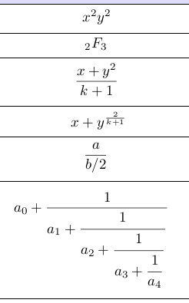
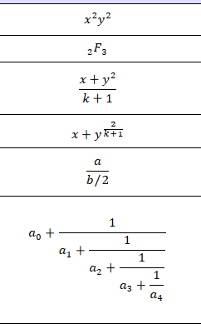
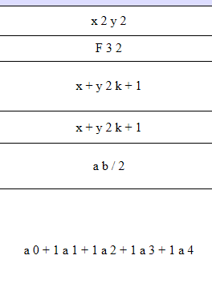
Visual Rendering of Math by Browsers
Browser 1
Browser 2
Browser 3
Notes:
Details about visuals:
Browser 1: PNG by TeX on Firefox
Browser 2: MathML by browser on Firefox
Browser 3: MathML by browser on Chrome or IE
Sample equations pulled from Mozilla’s “MathML Torture Test”: https://developer.mozilla.org/en-US/docs/Mozilla/MathML_Project/MathML_Torture_Test?redirectlocale=en-US&redirectslug=Mozilla_MathML_Project%2FMathML_Torture_Test

Slide 27
Aural Rendering of Math Across ATs
NVDA
Orca
Voiceover
Notes:
Audio recordings of sample math equation using various AT with Firefox from: http://www.maths-informatique-jeux.com/blog/frederic/?post/2015/05/06/MathML-Accessibility
Visual rendering of equation from MathJax website: https://www.mathjax.org/

Slide 28
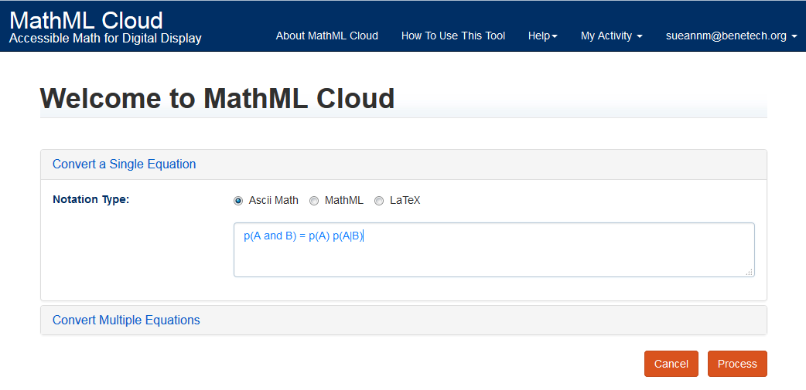
One Accessible Math Production Tool
MathML Cloud: https://mathmlcloud.org/
Notes:
2014: Benetech receives award from Microsoft to address the digital math problem
Partners: MathJax (AMS) + Google’s ChromeVox to produce MathML Cloud
MathML Cloud = one-stop solution to ensuring digital math is accessible, regardless of variations in MathML support across various readers
MathML Cloud Webapp (demo tool) available at https://mathmlcloud.org
Input equation
ASCII: p(A and B) = p(A) p(A|B)
URI: https://mathmlcloud.org/#/equation/55a4313a6125a5a80ff4aa88

Slide 29
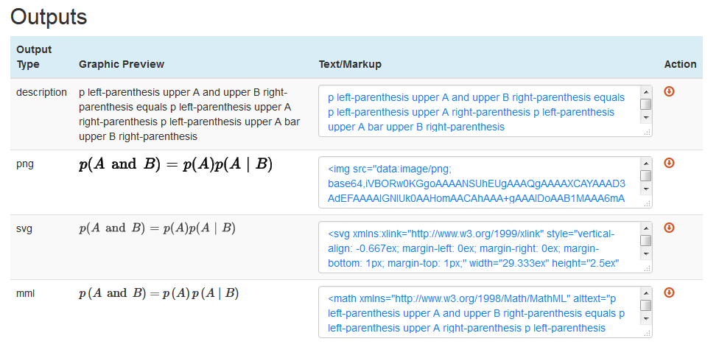
Customized to Different Workflows
Notes:
Supports varying levels of math support across digital platforms and tools.

Slide 30
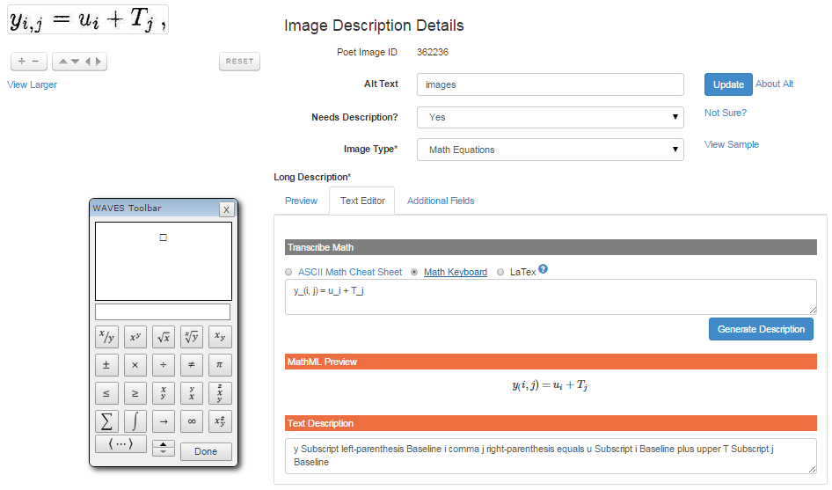
Poet Math Editor
Notes:
Retrofitting files that present math as images

Slide 31
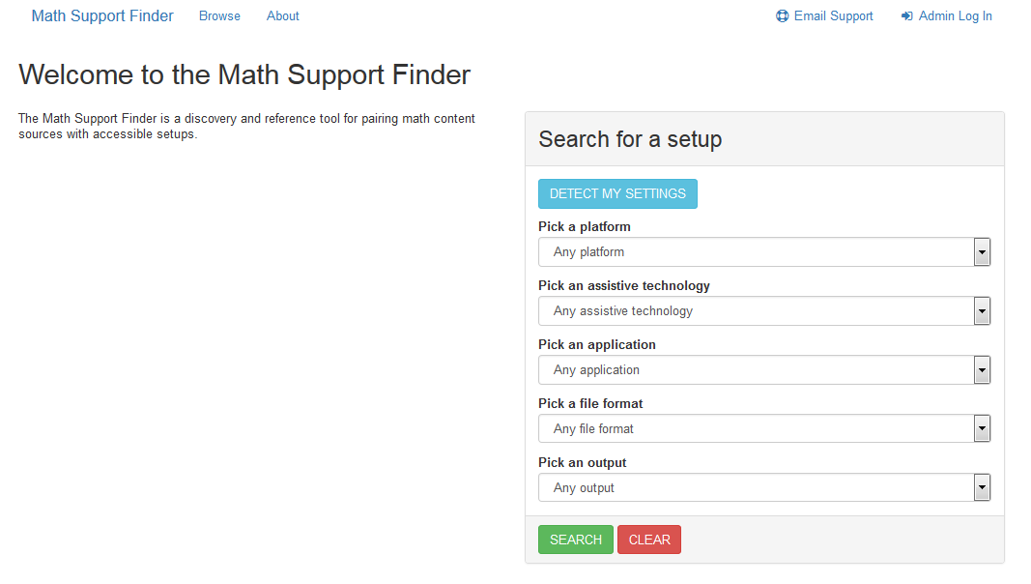
Reading Digital Math Accessibly
Math Support Finder [BETA]: http://msf.mathmlcloud.org/
Notes:
Next step after the production of accessible math content is to help users discover what tools can be used to read math accessibly.

Slide 32
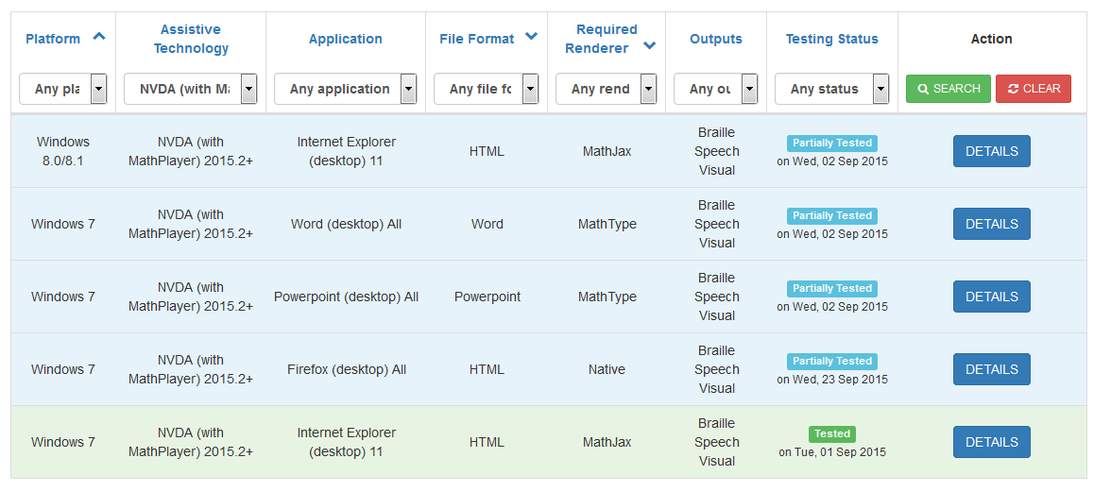
NVDA (+MathPlayer) Support?
Notes:
Search according to tools used by the end-users. In this example, five results are returned when searching for configurations using NVDA (+MathPlayer) MathML in Mozilla Firefox and Microsoft Internet Explorer.

Slide 33
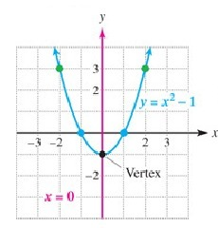
Sonification
Uses non-speech audio to convey information used to help perceive data aurally
MathTrax: application created by NASA that provides sonification for mathematical graphs
Available at: http://prime.jsc.nasa.gov/mathtrax/

Slide 34
2D Tactile Graphics
Tactile representations of graphics
Not exact copies – remove extraneous details & focus on key elements required to understand the content
When a brief text description is insufficient
Commonly used for:
Charts, diagrams & schematics (STEM)
Maps (Geography)
Notes:
Image of heart and lungs. This tactile graphic is also accompanied by a key page, in braille, which will guide the reader through the image.

Slide 35
Haptics: Digital Tactile Graphics
Notes:
Haptics: Interactive Tactile Exploration in a Digital World
Sample file available at: http://diagramcenter.org/adding-haptic-feedback-to-epub3-books.html

Slide 36
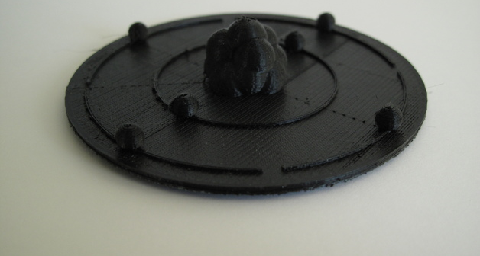
3D Objects
Increasing prevalence of printers + appeal of universal design
Challenges: access to files, printers, expertise
Often used for:
Complex shapes (e.g. saddle point)
Multiple views/angles (e.g. plant cell)
Relationship between parts (e.g. chemical compound)
Movement (e.g. gears)
Quick Start Guide
Notes:
3D Quick Start Guide available at: http://diagramcenter.org/wp-content/uploads/2015/09/3D-Printing-In-Education-Quick-Start-Guide.docx

Slide 37
3D Technology – Impact Video
Notes:
Video available at: https://benetech.box.com/s/1lnw9nynh1xdwn2d2srox41p1lqpg204

Slide 38
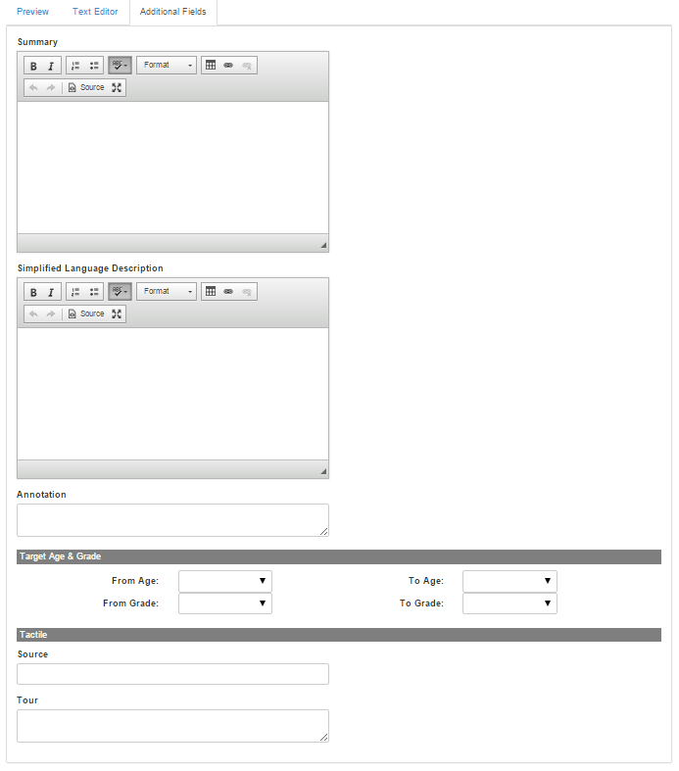
Diagrammar “Content Model”
Diagrammar supports access modes like alternative text-based descriptions and 2D tactile graphics
3D objects in review
Working the Readium and ETS to create pilot examples
Will see expanded model as new technologies emerge

Slide 39
Diagrammar - Providing Alternatives
Diagrammar Includes:
Summary
Simplified Language Description
Annotation
Target Age & Grade
From Age, To Age
From Grade, To Grade
Tactile
Source
Tour
3D…to be added…
Notes:
Diagrammar: prototype and pilot in progress with ETS and Readium. This prototype provides a preview to what’s coming up with the DIAGRAM+ award, catering to audiences with different needs

Slide 40
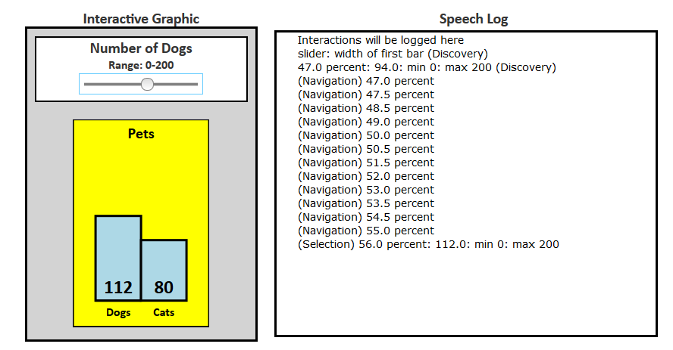
Interactive Content/Widgets
Widget Link:
http://diagramcenter.org/accessible-slider.html
Notes:
Image: On left side is title “Interactive Graphic” with a slider the user can manipulate to change the number of dogs selected (from 0-200) in relation to cats (fixed at 80). On the right side is the “Speech Log” which records interactions as the user manipulates the slider.

Slide 41
Accessibility Metadata for Discovery
Notes:
Searching for accessible content using Google tools:
Top: Google CSE
Bottom: Googles Structured Data Testing tool

Slide 42
Looking Ahead to 2016
Build out the Poet Image Description Training Module
Add data for the Math Support Finder
More best practices for creating 2D and 3D content
Prototype an accessible image repository/registry, starting with commonly encountered STEM objects
More Interactive widgets, interactives, videos and other digital content
Adoption of Accessibility Metadata to assist discovery
…and much more…

Slide 43
Questions?
Lucia Hasty <lucia@tactilegraphics.org>
Sue-Ann Ma <sueannm@benetech.org>

Slide 44
References
Benetech:
benetech.org
bornaccessible.org
DIAGRAM Center:
DIAGRAM Center website: diagramcenter.org
DIAGRAM Blog: http://blog.diagramcenter.org/
Accessible Image Sample Book:
Sample Book available at: http://diagramcenter.org/samplebook/index.xhtml
Original Webinar (2014): http://diagramcenter.org/webinars.html#aisb

Slide 45
References (continued)
Image Descriptions:
Poet Describer Tool: https://diagram.herokuapp.com/
Image Description Training: https://diagram.herokuapp.com/training/when_to_describe
Image Guidelines document: http://diagramcenter.org/table-of-contents-2.html
Math:
MathML Cloud: mathmlcloud.org
Math Support Finder: msf.mathmlcloud.org
Tactile Graphics (2D/3D)
BANA Tactile Graphics Guidelines: http://www.brailleauthority.org/tg/
Tactile Graphics How-Tos: http://www.tactilegraphics.org/
3D Quick Start Guide: http://diagramcenter.org/wp-content/uploads/2015/09/3D-Printing-In-Education-Quick-Start-Guide.docx

