Slide 1
Text Alternatives in Computer-Adaptive Assessments
NWEA: Elizabeth Barker
NCAM: Bryan Gould

Slide 2
Text Alternatives
Image descriptions for pictures, graphs, charts, tables, and other graphics
Supports students who may use text-to-speech and refreshable braille

Slide 3
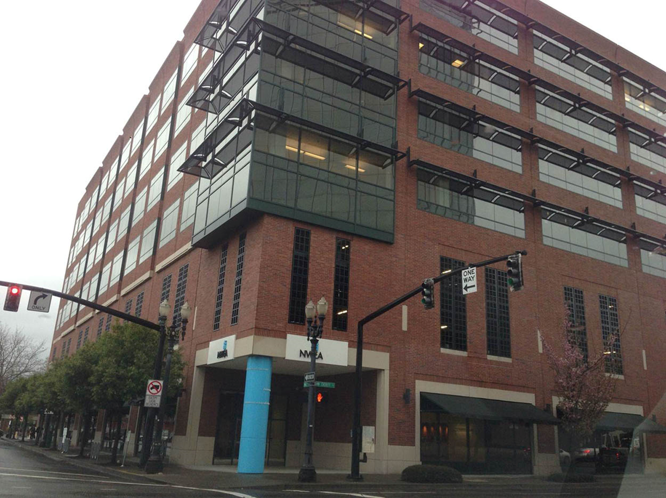
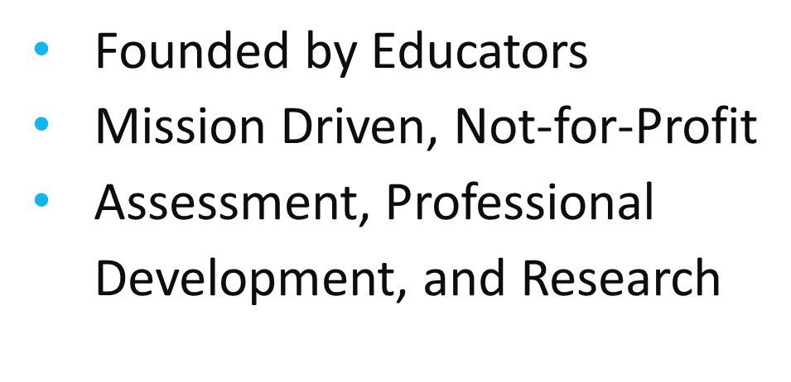

Slide 4
Computer adaptive assessments, unique to each student
MAP grade 2-10, Reading, Language, Science, and Mathematics
MPG K-2, Reading and Mathematics

Slide 5
A Challenge: Getting Buy-In
We’re not going
away…
Education, education, education!
Presentations
A voice at meetings, discussions, etc. Crash if you have too!
Lunch and Learns
Fostering a workplace culture where an accessibility mindset is the norm.
Identify others in your organization who might want to work with you on this topic.
New product development with accessibility in mind.
Be an Accessibility Advocate in your organization.

Slide 6
A Challenge: Getting Buy-In
This is the
business
case…
Top leadership buy-in is critical.
Having a influential individual back and/or drive your accessible technology initiative sets the tone for your organization's accessibility mindset.
Education, education, education!
Mission drivers
Market/Commercial Drivers
Legal drivers
Cost drivers

Slide 7
Our Steps to Remove Barriers
CAST
HTML/QTI
WCAG 2.0
Proof of Concept
NCAM

Slide 8
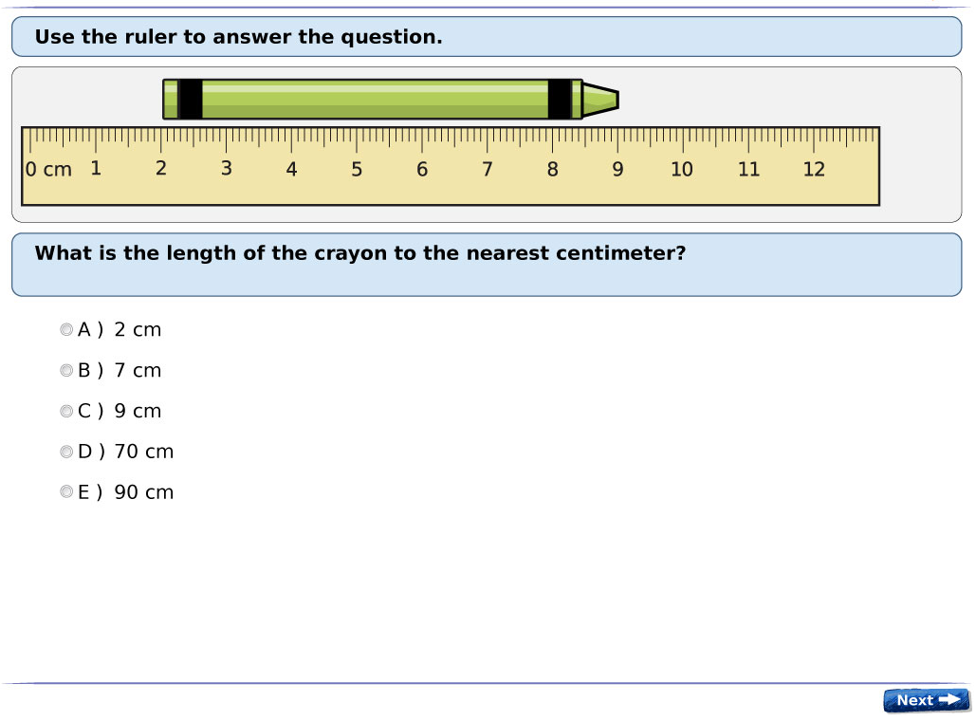
Conception to Execution
Step 1: Image descriptions for item bank
Notes:
After determining A) we’re going to pursue this and B) establishing organizational support, we have to make the project a reality.
Image: An NWEA test item with an illustration of a crayon and a ruler, asking the student to find the length of the crayon. Alt tag for this image would be: “A crayon is next to a centimeter ruler. The base of the crayon is at 2 centimeters, and the tip is at 9 centimeters”

Slide 9
Immediate Work
Technical Development
Item Construction
Conversion to QTI Format
Support for alternative text
Test Delivery
Exposing alternative text to screen readers
Enabling other accessible behaviors, e.g. keyboard navigation
Notes:
It’s not as simple as “add alt tags to test items”; all surrounding systems must support alternative text properly
QTI = Question and Test Interoperability specification, produced by IMS Global. Designed to provide a standardized format for storing items & tests.

Slide 10
Challenges/Examples
When you can’t provide alternate text
Decorative/visual bias/excessive complexity
Impact on psychometric validity
Notes:
Though students don’t all see the same items in an adaptive test, we must ensure that there is a suitable pool of items for the adaptive selection engine to get its best results. i.e., we want to make sure that all relevant goal areas are provided to students using accessibility features.

Slide 11
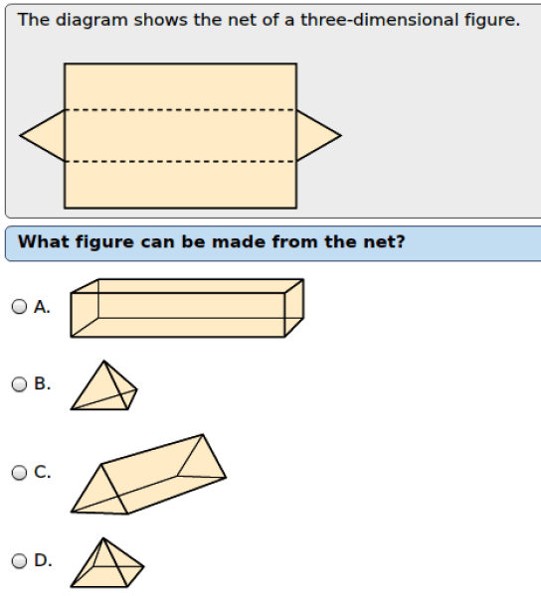
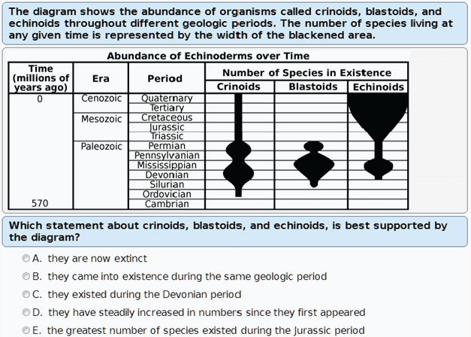
Challenges/Examples (cont’d)
Notes:
Item 1: A test item with images of four fish of varying size, asking students to identify which fish is shortest.
Item 2: A test item with a "net" diagram of a three-dimensional figure, asking students which figure could be made from that net.
Item 3: A test item with an overly complicated table/chart combination image

Slide 12
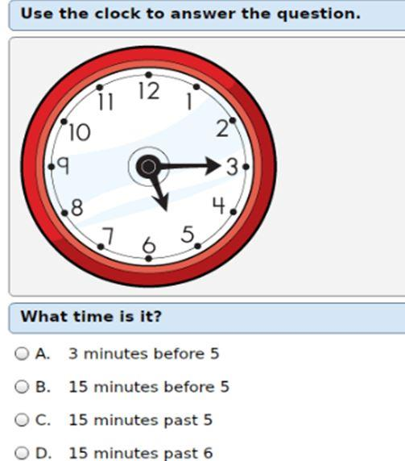
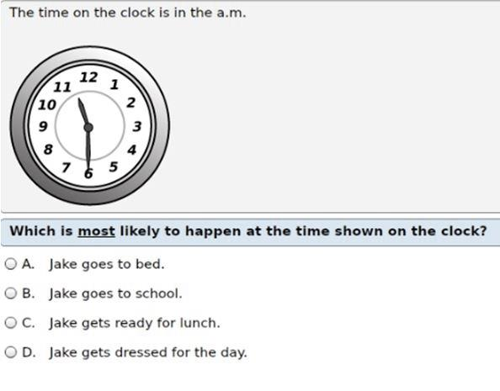
Challenges/Examples (cont’d)
Cueing/instructional level/disciplines
Notes:
Similar images aren’t always described in the same manner. Must take into account the intent of the item, the expected instructional level of students seeing the item, whether the description gives away the answer, and whether subject-matter-specific vocabulary is required for effective description.
Image 1: A test item with an image of an analog clock asking the student to identify what time the clock shows. The alternate text for the image would read “The short hour hand points just after 5. The long minute hand points to 3”
Image 2: A test item with an image of an analog clock asking the student about what activity occurs at the displayed time. The alternate text for the image would read “The analog clock shows eleven thirty a.m.”

Slide 13
External Support
Text Authoring for Existing Bank
9533 test items containing 1-5 images each
Over 11000 images to review
Guidelines/Style
Formal standards for content within image descriptions are lacking
Consistency required for test validity
Notes:
Emphasize – content and delivery

Slide 14
…NCAM brings accessible media and technology into homes, schools, workplaces, and communities…
Research, development and solutions
Technology
Standards
Content
Compatibility
Training and outreach
Notes:
NCAM is a research, development and consulting group housed within Boston’s public television station, WGBH, producer of Frontline and dozens of other PBS programs – and the birthplace of broadcast captions and descriptions. NCAM works with partners in education, entertainment, transportation, health care, and the arts to develop accessibility solutions - wherever text, images, audio or video is used.

Slide 15
NCAM
NSF
DoED
DoED
Notes:
Through a series of grants funded by the National Science Foundation and The US Department of Education, NCAM has been researching and developing methods for creating effective and efficient text alternatives to images so that kids and adults who are blind and visually impaired could have equal access to learning materials.
NSF funded research focused on refining description approaches for STEM images. Reviewed hundreds of descriptions and dozens of images types, then narrowed focus to the most commonly used images in STEM for the highest impact, for example: line graphs and bar charts. This research included rounds of surveys with b/vi STEM professionals (scientists, mathematicians, etc) and user-testing with higher ed students who were b/vi.
The recommended approach encourages: Brevity, focus on Data, Clarity and Consistency in language, Navigation Control via HTML lists and tables.
Further research projects funded by the DoED focused on description for K-12 students, for images used in assessments. This included images found in a widening set of disciplines including ELA and social studies.
In addition, NCAM has collaborated with content authors and publishers in describing tens of thousands of images for clients in K-12 and higher ed. both in instruction and assessment.

Slide 16
NCAM
Hired editors with experience in instruction, publishing, and item writing. We trained them in accessibility.
Variety of subjects: science, math, ELA
Multiple rounds of review for description and copy accuracy. Editors worked collaboratively on small batches of similar items.
Helped to improve descriptions and reduce burnout

Slide 17
NCAM
Open communication with NWEA SMEs to ensure the description was appropriate for grade and construct.
Documented description approaches
Reviewed for Visual Bias
Descriptions were tested with Screen Readers
Notes:
Through a series of grants funded by the National Science Foundation and The US Department of Education, NCAM has been researching and developing methods for creating effective and efficient text alternatives to images so that kids and adults who are blind and visually impaired could have equal access to learning materials.
NSF funded research focused on refining description approaches for STEM images. Reviewed hundreds of descriptions and dozens of images types, then narrowed focus to the most commonly used images in STEM for the highest impact, for example: line graphs and bar charts. This research included rounds of surveys with b/vi STEM professionals (scientists, mathematicians, etc) and user-testing with higher ed students who were b/vi.
The recommended approach encourages: Brevity, focus on Data, Clarity and Consistency in language, Navigation Control via HTML lists and tables.
Further research projects funded by the DoED focused on description for K-12 students, for images used in assessments. This included images found in a widening set of disciplines including ELA and social studies.
In addition, NCAM has collaborated with content authors and publishers in describing tens of thousands of images for clients in K-12 and higher ed. both in instruction and assessment.

Slide 18
NCAM
NCAM is working with NWEA developers to create accessible interactive items, also called Technology Enhanced Items (TEI)
choice multiple
drag/drop
click/pop

Slide 19
NCAM
Choice multiple
choose more than one answer
text or images
All users must be able to…
identify each answer choice
convey each answer as a form control
select/unselect answers from the keyboard
receive confirmation
identify state when reviewing

Slide 20
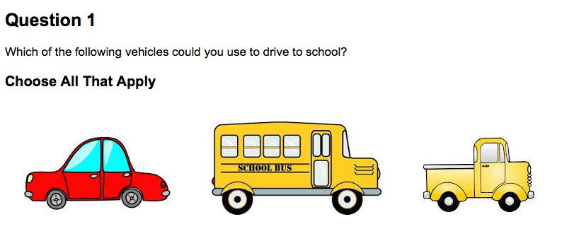
NCAM

Slide 21
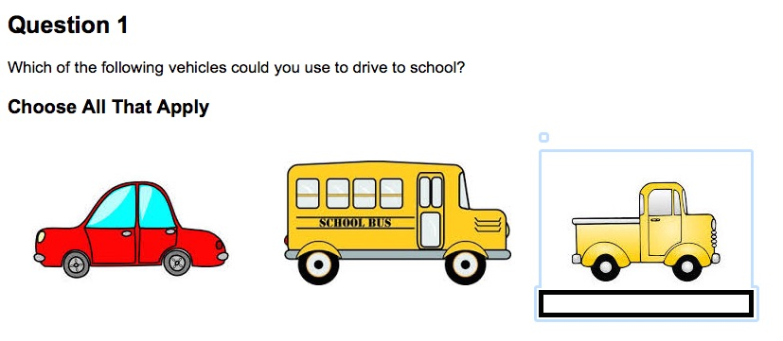
NCAM
identify each answer choice
alt
convey each answer as a form control
role=“checkbox

Slide 22
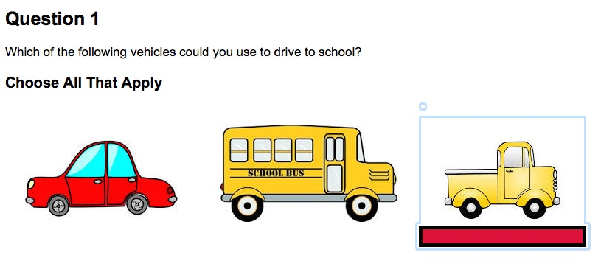
NCAM
select/unselect from keyboard and screen reader
spacebar/key combination
receive confirmation
“truck, checkbox checked”

Slide 23
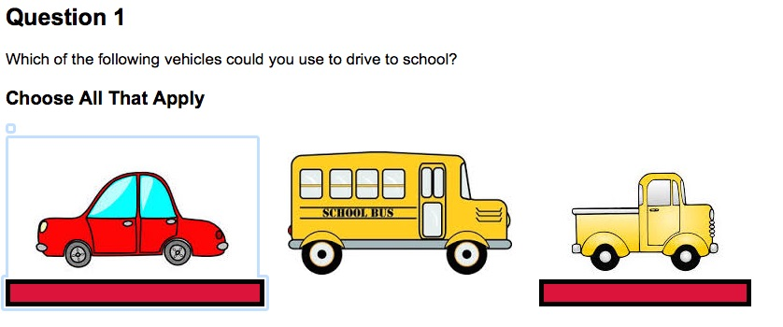
NCAM
identify state when reviewing
“car, checkbox checked; school bus, checkbox not checked; truck, checkbox checked”

Slide 24
Maintaining Process
Step 2: Develop an operational process to continue development internally
Internal training/skills
Documentation
Role of Content Specialists
Subject-matter experts on hand for consultation
Across disciplines: Reading, Language Usage, Mathematics, General Science
Notes:
ELIZABETH!! You can train all of your subject matter experts, or you can train a group dedicated to producing alternative text. In our case, the task fit in well for my team to provide the text while finalizing the items.
Writing alternative text is not a common skill; best to train internal staff rather than try to hire someone just for this purpose. Copy Editor background well suited to the task, they are accustomed to using brief, precise language wherever possible and are able to adapt to style requirements of different kinds of writing/items
Keep expert guidance close at hand, it’s very nice to have an arrangement where you can consult with experts as-needed

Slide 25
Current Progress
Alt-tags
Keyboard Only
Item Aids
Test Aids
Screen Reader
User Testing
Notes:
Longdesc W3C finally approved and in standards
Accessible Rich Internet application

Slide 26
Keeping the Momentum
Keeping accessibility visible.
What to do when access- ibility isn’t top priority?
Tackle “low-hanging fruit.”
What to do when it IS a priority?
Formal team – opportunities for education
Funding – where does the money come from?

Slide 27
Current Challenges
We’ve got alternative text…
Now what?!
Delivering on our platform
New frontiers for our TEIs
How do we alt-tag interactions?
Readiness for Braille and large print
Availability of technologies in schools
Early learning
emergent-readers

Slide 28
Questions?
Contact information:
Elizabeth.Barker@nwea.org
Bryan_Gould@wgbh.org

