Slide 1
Motivating Accessibility Adoption on Campus
Cyndi Rowland, Director WebAIM; National Center on Disability and Access to Education Center for Persons with Disabilities; Utah State University
Janet Sedgley, EITA Coordinator; Manager of Accessible Technology Services, University of Montana

Slide 2
In our brief time today …
Why motivational approaches matter
A little about what we know
How institutions have attended to motivation
Your stories and a conversation

Slide 3
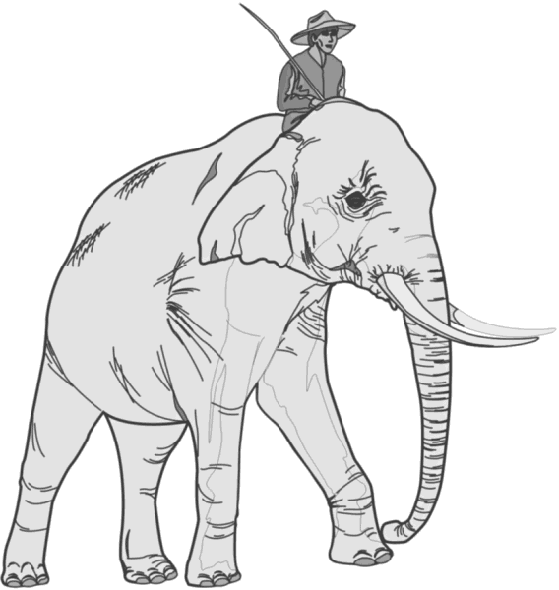
Why motivational approaches matter
We seldom do (the rider) anything we don’t feel (the elephant)
What looks like a people problem is often a situation
What looks like laziness is often exhaustion
What looks like resistance is often a lack of clarity.
(Summary of “Switch: How to Change Things When Change Is Hard,” Chip Heath and Dan Heath, 2010)

Slide 4
Types of motivators
Ethical motivations (emotional)
Legal & standards-based motivations
Business motivations
(http://webaim.org/articles/training/motivate#types)

Slide 5
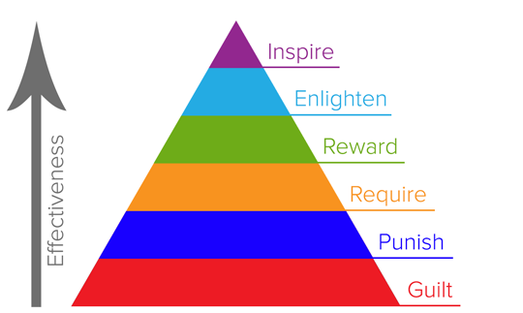
WebAIM’s Hierarchy for Motivating Accessible Changes

Slide 6
A little about what we know
Reporting on our experiences
7 motivational examples from the field
Role of improvement, impact, emotions
The importance of customization

Slide 7
7 Motivation Examples
1. Provide direct incentives
An honorarium to distance ed faculty to make their coursework accessible
Include “making it accessible” part of merit increases
Create systems of recognition amongst peer types or units
2. Make production of accessible materials as easy as possible
Provide Just-In-Time resources
Integrate accessibility into the faculty helpdesk function
Send out accessibility tip of the month postcards
From: NCDAE (Sept 2014). Motivating faculty and staff to act on web accessibility. Retrieved, http://ncdae.org/resources/tips/motivating.php

Slide 8
Motivation Examples
3. Tie their accessibility work into the personal experiences of others
Create stories for the campus, faculty, and staff newsletters
Create or use videos that highlight the experiences of those with disabilities trying to access digital content. Play it during new hire orientation or faculty or staff meetings. Send out a link to the campus community to view. Some good examples include:
Care to Comply
A personal Look at Accessibility in Higher Education
IT Accessibility: What Campus Leaders Have to Say
From: NCDAE (Sept 2014). Motivating faculty and staff to act on web accessibility. Retrieved, http://ncdae.org/resources/tips/motivating.php

Slide 9
Motivation Examples
4. Use the positive influence of peer groups
Create professional elitism around those who engage in accessibility work
Create and provide online badges, awards, or certification for recognition of work towards accessibility. These should then be visible online.
From: NCDAE (Sept 2014). Motivating faculty and staff to act on web accessibility. Retrieved, http://ncdae.org/resources/tips/motivating.php

Slide 10
Motivation Examples
5. Nobody wants to fail or be humiliated. Create the right climate and culture for training & supports
Training and technical assistance must match the users.
Create a training culture where people feel safe to ask questions, make mistakes, and learn in positive ways.
Create a buddy system or social structure for learning.
Establish an accessible expert inside each unit or department, they may be seem more approachable if they are known and housed in the same location.
Establish clear expectations of what they should do, and what they should not have to do. Give them training on the first and let them know what to do with the second.
From: NCDAE (Sept 2014). Motivating faculty and staff to act on web accessibility. Retrieved, http://ncdae.org/resources/tips/motivating.php

Slide 11
Motivation Examples
6. Tie accessibility into issues faculty and staff feel are important
Efficiency is key? Show them how this saves them some time
Student outcomes are key? Show them how this helps students learn
Promotion and tenure are key? Get accessibility into the P&T review process
Promotion & raises are key? Add accessibility work to the merit raise or annual evaluation process
From: NCDAE (Sept 2014). Motivating faculty and staff to act on web accessibility. Retrieved, http://ncdae.org/resources/tips/motivating.php

Slide 12
Motivation Examples
7. Communicate the reality that failure to produce accessible materials opens the institution to legal complaints and action.
Share stories of peer institutions where this has happened before. While this negative approach should not be a focus, for some it will motivate them to action.
From: NCDAE (Sept 2014). Motivating faculty and staff to act on web accessibility. Retrieved, http://ncdae.org/resources/tips/motivating.php

Slide 13
A little about what we know
Importance role of
Improvement
Impact
Emotions

Slide 14
Motivation must be customized across campus constituent groups
Administrators
Faculty
Staff
Technicians
Students
Visitors

Slide 15
Administrators
Business case related to fiscal management and efficiency
Support for administration priorities & goals
Tie to the institutional mission
The role of accessibility and accreditation / continuous quality improvement
Message: “Higher efficiency saves money.”

Slide 16
Faculty
Benefits of accessible ICT (documents, media, educational environments, software)
For them
For their students
Motivating factors:
Provide as much support as possible
Highlight small successes
Message: “It doesn’t take much time.”

Slide 17
Staff
Documents “born accessible” are flexible and work easily into a number of situations
ICT accessibility adjustments make campus more consistent
ICT accessibility adjustments mean that you won’t have a crisis to support when students change courses
Message: “Accessible documents are needed in today’s office environments, since many end up online”

Slide 18
Technical Staff
Using accessible ICT mean that you won’t have has many individual accommodations / modifications to support
The accessible ICT conversation can lead to creative collaborations across campus
Consolidation of accessible ICT centrally can save support needs and money
Message: “Taking the greater technical ‘burden’ and leading the way provides a more smoothly running campus. Effort in implementation, fewer support calls later.”

Slide 19
Students
Message: “Use the resources provided to make your life easier. Let us know when something isn’t working.”

Slide 20
Generic motivational messages
Accessibility is important
Accessibility is easy
Accessibility is a challenge
Accessibility is a process
(http://webaim.org/articles/training/motivate#motivating)

Slide 21
What we learned from the Survey

Slide 22
Strategizing
Persuasion techniques
Coalition building ideas

Slide 23
Your stories and a conversation

Slide 24
Thank you!
Cyndi Rowland; Cyndi.Rowland@usu.edu; 435-797-3381
Janet Sedgley; janet.Sedgley@umontana.edu; 406-243-5452

