Slide 1
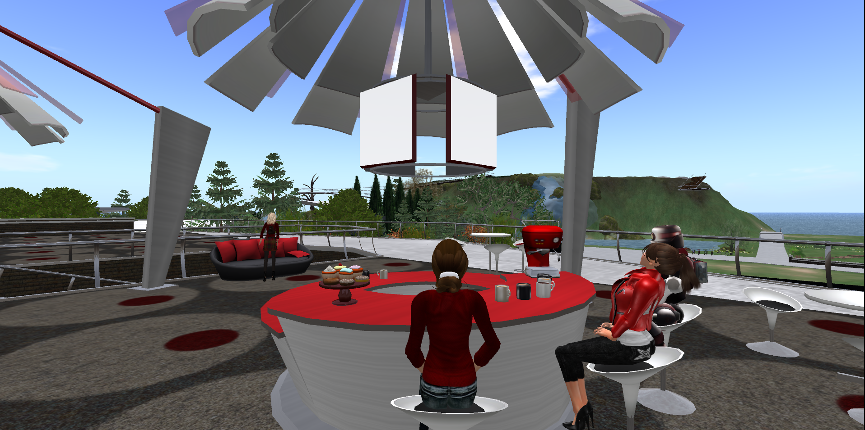
Connect, Learn, BreakThru: Summative Findings from Five Years of Electronic Mentoring in STEM Education

Slide 2



Georgia STEM Accessibility Alliance (GSAA)
Funded by a grant from the National Science Foundation (NSF), Research in Disabilities Education (RDE), Grant Nos. 1027635 and 1027655. BreakThru is a collaboration between the Georgia Institute of Technology and the University of Georgia.
Notes:
GT, GPC, UGA, Clarke, Greene, Gwinnett

Slide 3
GSAA Collaborative Leaders
University of Georgia
Noel Gregg (ngregg@uga.edu)
Gerri Wolfe (gwolfe@uga.edu)
Georgia Institute of Technology
Robert L. Todd (robert.todd@coa.gatech.edu)
Chris L. Langston (chris.Langston@coa.gatech.edu)
Nathan W. Moon (nathan.moon@cacp.gatech.edu)

Slide 4

What is BreakThru?
Online learning and mentoring community
Connects students and mentors virtually
Promotes accessibility and achievement in Science, Technology, Engineering, and Math (STEM) courses

Slide 5
Project Goals
The project serves as a pipeline between secondary and postsecondary institutions to strengthen students with disabilities’ capacities to access and succeed in STEM programs across critical junctures: high school > two-year college > four-year college > graduate school.
The overall project goals are to increase the retention of students with disabilities who are enrolled in STEM classes and majors and the number of students participating in BreakThru mentoring activities.

Slide 6
NSF Project Goals
Retain Students in Virtual Mentoring and STEM Majors:
  Year-to-year persistence rate of at least 50%.
Enroll to Virtual Mentoring:
  105 unduplicated high school students with disabilities by end of project period.
  65 unduplicated two-year students with disabilities by end of project period.
  55 unduplicated four-year students with disabilities by end of the project period.

Slide 7
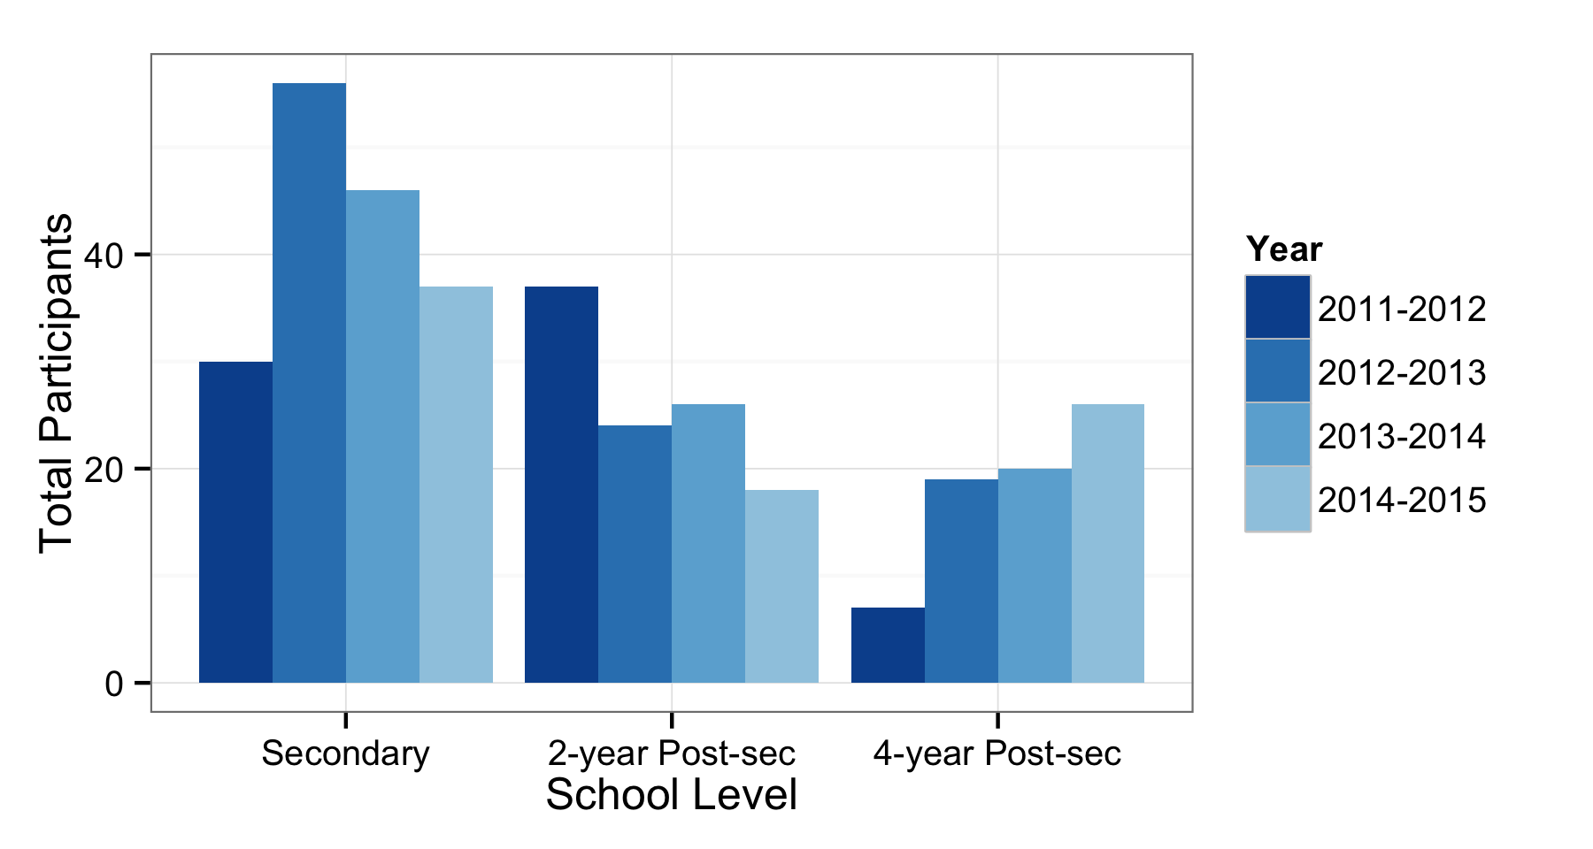
GSAA Total Participation

Slide 8
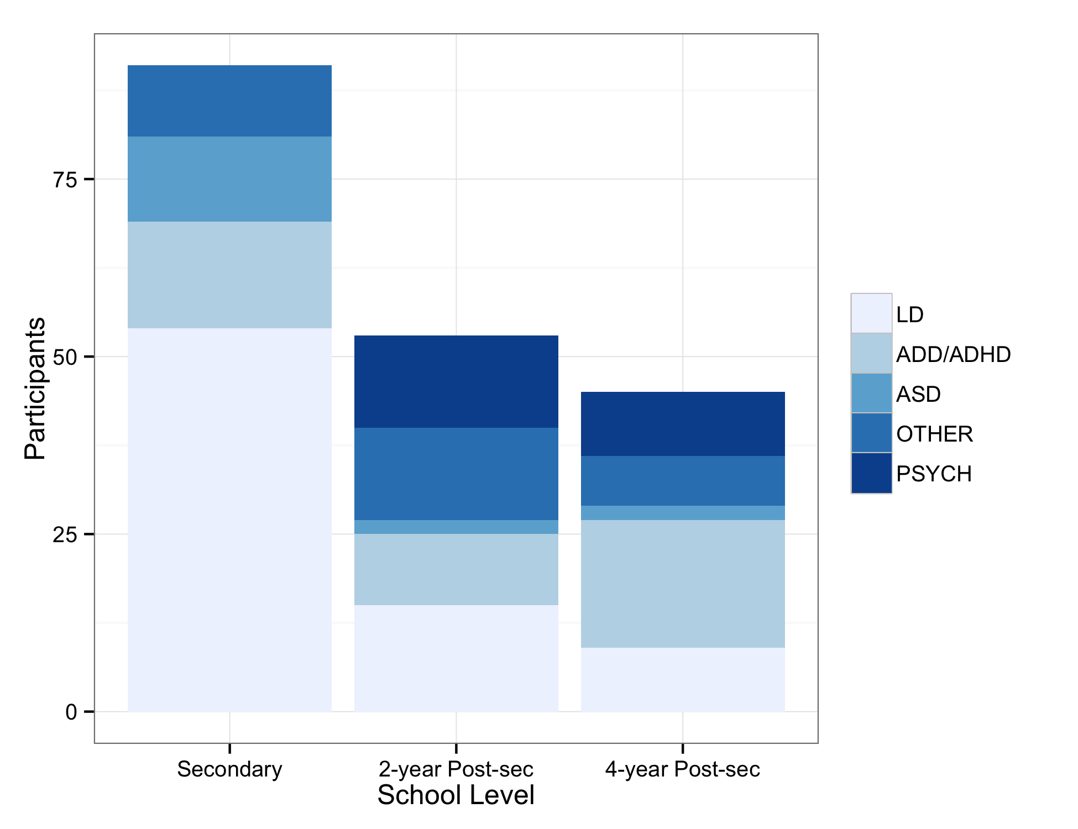
GSAA Participation by Disability
Notes:
The population of students with learning disabilities, attention deficit/hyperactivitydisorder (ADHD), and autism spectrum disorder (ASD) represented the largest numbers of individuals at both the secondary and postsecondary levels who self selected to participate and remain active in e-mentoring activities
Include this slide if you want to show the majority types of SwD

Slide 9
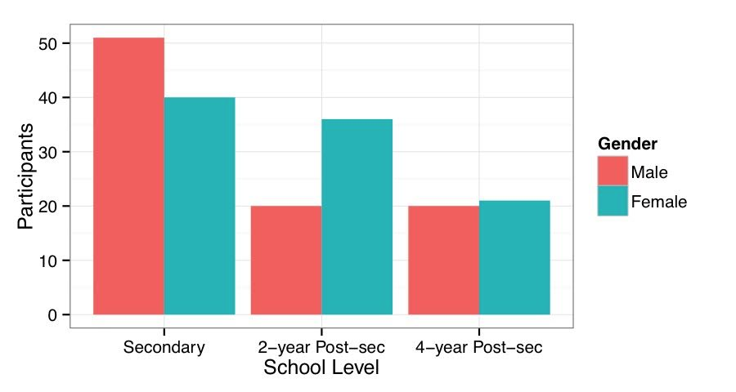
GSAA Participation by Gender
Notes:
Reminder that incidence of SwD in secondary schools is usually more males to females, particularly in relation to LD and ADHD populations

Slide 10
Goal 1: Retain Students in Virtual Mentoring

Slide 11
Continuing vs. New Students

Slide 12
Goal 2: Enroll to Virtual Mentoring

Slide 13
E-Mentoring Effectiveness
Five Indicators of E-Mentoring Efficacy
Personal Responsibility
Satisfaction
Communication - Quantity
Communication - Quality
Support Seeking Behaviors
Notes:
Five Indicators of E-Mentoring Efficacy
1. Personal Responsibility
“Degree to which the mentor enhances interpersonal development among mentees”
2. Satisfaction
“Sense of fulfillment in the mentoring relationship”
3. Communication-quantity
“Satisfaction with the frequency and duration of communication (extent)”
4. Communication-quality
“Satisfaction with the quality of communication”
5. Support Seeking
“Degree of support provided (academic and personal)”

Slide 14
E-Mentoring Constructs -Spring 2015
Constructs | Mean | Rank
Personal Responsibility | 4.10 | 2
Satisfaction | 4.09 | 3
Communication-quantity | 3.85 | 5
Communication-quality | 4.24 | 1
Support Seeking | 4.07 | 4

Slide 15
Personal Responsibility
Personal Responsibility | n | Mean | Assessment | Strongly Disagree (1) | Disagree (2) | Neutral (3) | Agree (4) | Strongly Agree (5 )
a. Based on what my mentee has shared, I believe the mentee uses strategies that help him/her become better organized. | 30 | 4.20 | Good | 0% | 3% | 13% | 43% | 40%
b. The mentee and I have discussed how to communicate his/her disability needs to others. | 30 | 3.93 | Attention | 3% | 7% | 13% | 47% | 30%
c. My mentee and I have discussed STEM opportunities. | 29 | 4.17 | Good | 3% | 7% | 3% | 41% | 45%
d. The mentee seems to have more confidence in his/her ability to be successful in STEM courses than when we first began working together. | 30 | 4.07 | Good | 0% | 7% | 13% | 47% | 33%
e. Over the time we have worked together, my mentee has become more interested in STEM classes. | 30 | 3.87 | Attention | 0% | 7% | 33% | 27% | 33%
f. My mentee has talked with me about career and life goals. | 30 | 4.33 | Good | 0% | 7% | 10% | 27% | 57%

Slide 16
Satisfaction
Satisfaction | n | Mean | Assessment | Strongly Disagree (1) | Disagree (2) | Neutral (3) | Agree (4) | Strongly Agree (5)
a. During mentoring, my mentee has been comfortable asking any questions he/she might have had. | 30 | 4.13 | Good | 0% | 10% | 13% | 30% | 47%
b. Through the mentoring experience, my mentee has learned and grown as a STEM student. | 30 | 3.93 | Attention | 0% | 3% | 30% | 37% | 30%
c. I understand the struggles my mentee faces. | 30 | 4.23 | Good | 0% | 3% | 13% | 40% | 43%
d. My mentee and I are a good match for each other. | 30 | 4.07 | Good | 0% | 7% | 23% | 27% | 43%

Slide 17
Communication - Quantity
Communication | n | Mean | Assessment | Not at all Satisfied (1) | Dissatisfied (2) | Neutral (3) | Satisfied (4) | Very Satisfied (5)
a. How satisfied were you with the number of times you communicated with your mentee each week? | 30 | 3.67 | Attention | 0% | 23% | 17% | 30% | 30%
b. How satisfied were you with the length of the mentoring sessions? | 30 | 4.03 | Good | 0% | 13% | 7% | 43% | 37%

Slide 18
Communication - Quality
Communication | n |  | Assessment | Strongly Disagree (1) | Disagree (2) | Neutral (3) | Agree (4) | Strongly Agree (5)
a. The mentee is open and honest in communicating with me. | 30 | 4.33 | Good | 0% | 7% | 10% | 27% | 57%
b. The mentee seeks help from me when needed. | 30 | 4.17 | Good | 0% | 7% | 17% | 30% | 47%
c. The mentee is engaged and receptive to assistance. | 30 | 4.23 | Good | 3% | 7% | 10% | 23% | 57%

Slide 19
Support Seeking
Support Seeking | n | Mean | Assessment | Strongly Disagree (1) | Disagree (2) | Neither (3) | Agree (4) | Strongly Agree (5)
a. The mentoring experience has enabled the mentee to push beyond what is comfortable or easy. | 30 | 3.93 | Attention | 0% | 3% | 33% | 30% | 33%
b. During mentoring, my mentee shares his/her thoughts and feelings. | 30 | 4.10 | Good | 3% | 7% | 7% | 43% | 40%
c. I have been able to help my mentee get the information and resources he/she needs. | 30 | 4.33 | Good | 0% | 0% | 10% | 47% | 43%
d. The mentoring experience has helped my mentee solve problems. | 30 | 4.07 | Good | 0% | 3% | 23% | 37% | 37%
e. The mentoring experience has helped my mentee make life decisions. | 30 | 3.93 | Attention | 0% | 3% | 30% | 37% | 30%

Slide 20
Changes in Student Characteristics
Five Measures of Changes in Student Internal Characteristics
Intent to Persist
Self-Advocacy
Self Determination
Science Affect (Positive and Negative)
Math Affect (Positive and Negative)
Notes:
Self-Advocacy
“Ability to effectively communicate, convey, negotiate or assert one’s interests, desires, needs, and rights”
Self Determination
“Ability to act as the primary causal agent in one's life and set goals and make decisions that are unrestricted from undue external influence or interference”
Science Affect
Positive: “Science as interesting and enjoyable and useful for one’s career”
Negative: “Anxiety about performing well on science exams and uneasiness when doing a science experiment”
Math Affect
Positive: “Math as interesting and useful for one’s future”
Negative: “Anxiety about solving problems, general confusion, and uneasiness when solving problems.”

Slide 21
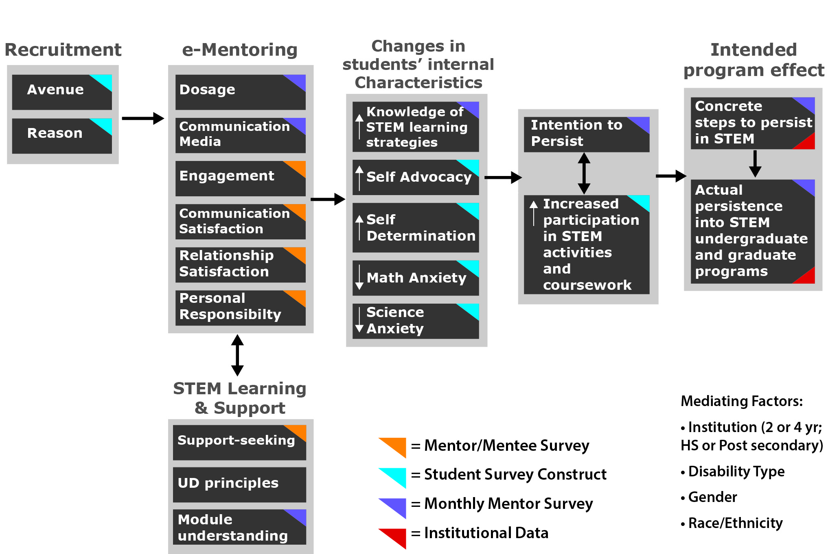
Theory of Change – In Brief

Slide 22
Changes in Internal Characteristics Postsecondary - Overall

Slide 23
Changes in Internal Characteristics
Secondary – Overall

Slide 24
Effectiveness of Virtual Worlds and Communications Platforms
Selection of Communications Platform
Text (E-mail, Facebook, SMS)
Voice (Second Life, Skype, Telephone)
In-person
2. Usage Characteristics for Second Life
Frequency and Concurrency
Use of Badging and Features

Slide 25
Communication Methods
Table 1. Communications Methods Utilized Across 5 Reporting Periods
Survey Responses | Text |  |  | Voice |  |  | In Person
 | Email | Facebook | SMS | Second Life | Skype | Phone
Secondary Mentees Total (=36) | 81% | 8% | 75% | 47% | 11% | 69% | 61%
Post-Secondary Mentees Total (n=61) | 97% | 31% | 57% | 52% | 20% | 69% | 15%
Secondary Mentors Total (n=43) | 84% | 5% | 67% | 44% | 16% | 70% | 44%
Post-Secondary Mentors Total (n=61) | 97% | 31% | 57% | 32% | 20% | 69% | 15%
Notes:
Participants generally reported a higher frequency of usage with communication platforms with which they were already acquainted. Email and phone, unsurprisingly, were reported as the most commonly used communication methods. Interestingly, SMS was reported as a more frequent method of communication than traditional telephone among secondary mentees. Regarding Second Life specifically, adoption was slightly higher among post-secondary mentors and mentees.

Slide 26
Total VLR Users Per Month
Fig. 1. Fall 2012 – Fall 2014 Total VLR Users per Month
Notes:
3 years of user data mapped onto months. What we see is a typical trend with high usage early in the semester during Fall when training are required, and then a drop off until the next semester. Months coinciding with large, organized events hosted by the project have much higher peaks.

Slide 27
Peak Concurrency
Fig. 2. Sep – Nov 2012 Peak Concurrency by Day
Notes:
Peaks again coincide with major training events or the annual Kick Off (Sept 20). Without the presence of an organized event, peak concurrency remains low. However, mentorship activity remains high throughout the project through other channels.
This data shows island activity prior to Gamification efforts in in late 2012 / early 2013.

Slide 28

Gamification
The intent was to direct more users to the VLR through the use of interactive elements, giving students something to do besides mentoring.
Notes:
Symposium Attendee
Basic Training
Lake Angler
Clean Water
Kick-Off Attendee
Build 101
Coral Reef Angler
Wildlife
Traveler
Sea Angler
Botany
Scavenger Hunt
Master Angler
Light in a Bottle

Slide 29
2013 Badge Interactions
Notes:
Gamification made no significant impact on the usage of the VLR. However, increased numbers of trainings, activities, and special events *did* push additional traffic to the VLR on those specific days. In a nutshell, the VLR is a useful tool but not perceived as a standard mode of communication. It’s something different from a phone call, text, or IM, and it is not considered a primary tool for most participants.

Slide 30
Total Logins 2012 - 2014
Notes:
Gamification made no significant impact on the usage of the VLR. However, increased numbers of trainings, activities, and special events *did* push additional traffic to the VLR on those specific days. In a nutshell, the VLR is a useful tool but not perceived as a standard mode of communication. It’s something different from a phone call, text, or IM, and it is not considered a primary tool for most participants.

Slide 31
Broader Impacts
BreakThru is intended to provide broad impact through:
its applicability to students and faculty who are separated geographically, and
through its potential to gather a national/international network of STEM stakeholders
The digital media model is scalable to secondary and postsecondary institutions broadly. Its foci on universal design for learning and inclusion of accessible materials are aimed at assisting all students in need.

Slide 32
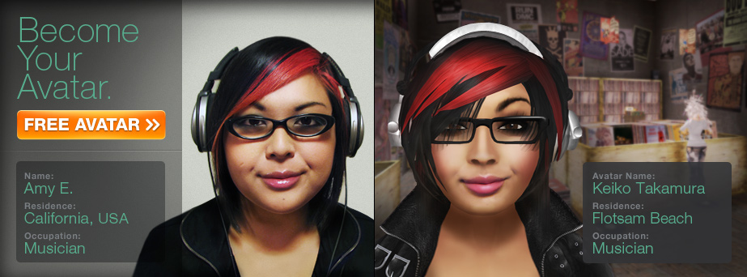
In Brief: Benefits of Virtual Worlds
Mediated consequences
Individualization
Creative Solutions
Immersion
Collaborative Learning
Control over Personal Representation
Access to Mentors

Slide 33
The Good, the Bad – the Avatars
Avatars in virtual worlds and other forms of online engagement can offer important affordances:
Immersion
Active engagement
Creating
Making real-world disabilities - disappear

Slide 34
The Good, the Bad – the Avatars
But virtual avatars and other online tools can create significant barriers:
Complexity of access and use
Student and teacher reluctance to accept as educational tools
Information technology issues
Privacy, security, distraction

Slide 35
Technology Considerations
Platforms evolve faster than research projects
Hardware requirements sometimes cause a barrier
Participants increasingly rely on mobile technology
Convenience and costs as drivers
Most readily available platform is typically chosen
  89% of Americans age 18-29 use social media.
  Students are best reached through tools they already know.

Slide 36
Mentoring Conclusions
Mentoring in Second Life and other virtual worlds holds great promise
Careful development of environment with disability-related tools is essential
Supplement with additional communication methods
Giving students passive activities wasn’t effective.
Providing live training, guest speakers, or special events drove traffic to the VLR.

Slide 37
Mentoring Conclusions
Imperative that students and mentors form a lasting mentoring relationship.
Retention starts early by choosing the right participants.
Mentor and mentee applicants are screened and matched through an active process

Slide 38
Final Thoughts
Deeper research on efficacy of e-mentoring
Increased focus on duration and modes of communication and quality of mentoring relationship
Wider range of communications technologies, especially mobile technologies
Focus on understanding qualitative factors rather than just increasing enrollment, retention, and graduation

Slide 39
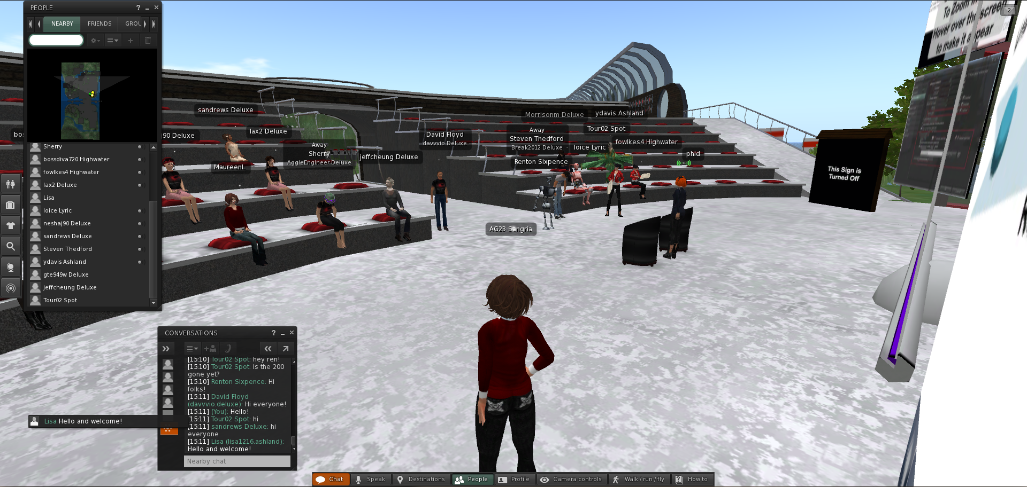
Questions?

Slide 40
BreakThru Contacts
University of Georgia
Noel Gregg (ngregg@uga.edu)
Gerri Wolfe (gwolfe@uga.edu)
Georgia Institute of Technology
Robert Todd (robert.todd@coa.gatech.edu)
Chris Langston (chris.Langston@coa.gatech.edu)
Nathan Moon (Nathan.moon@cacp.gatech.edu)

