Slide 1
Strategic Campus Collaborations
Advancing Knowledge about Accessibility at The University of Arizona
Dawn Hunziker
IT Accessibility Consultant
University of Arizona

Slide 2
Objectives
Learn about the University of Arizona’s itAccessibility Team structure and our top-down/bottom-up approach
Learn how strategic collaborations and participation in campus projects increase accessibility and networking
Learn about the impact achieved in the academic and electronic and information technology environments

Slide 3
itAccessibility Steering Committee
itAccessibility Steering Committee
Chief Information Officer
Chief Security Officer
ADA/504 Coordinator
Office of Institutional Equity
Office of General Counsel
Disability Resources
Dean of Libraries

Slide 4
Purchasing and Business Managers

Slide 5
University Information Technology Services (UITS)

Slide 6
Non-Academic Department Collaborations

Slide 7
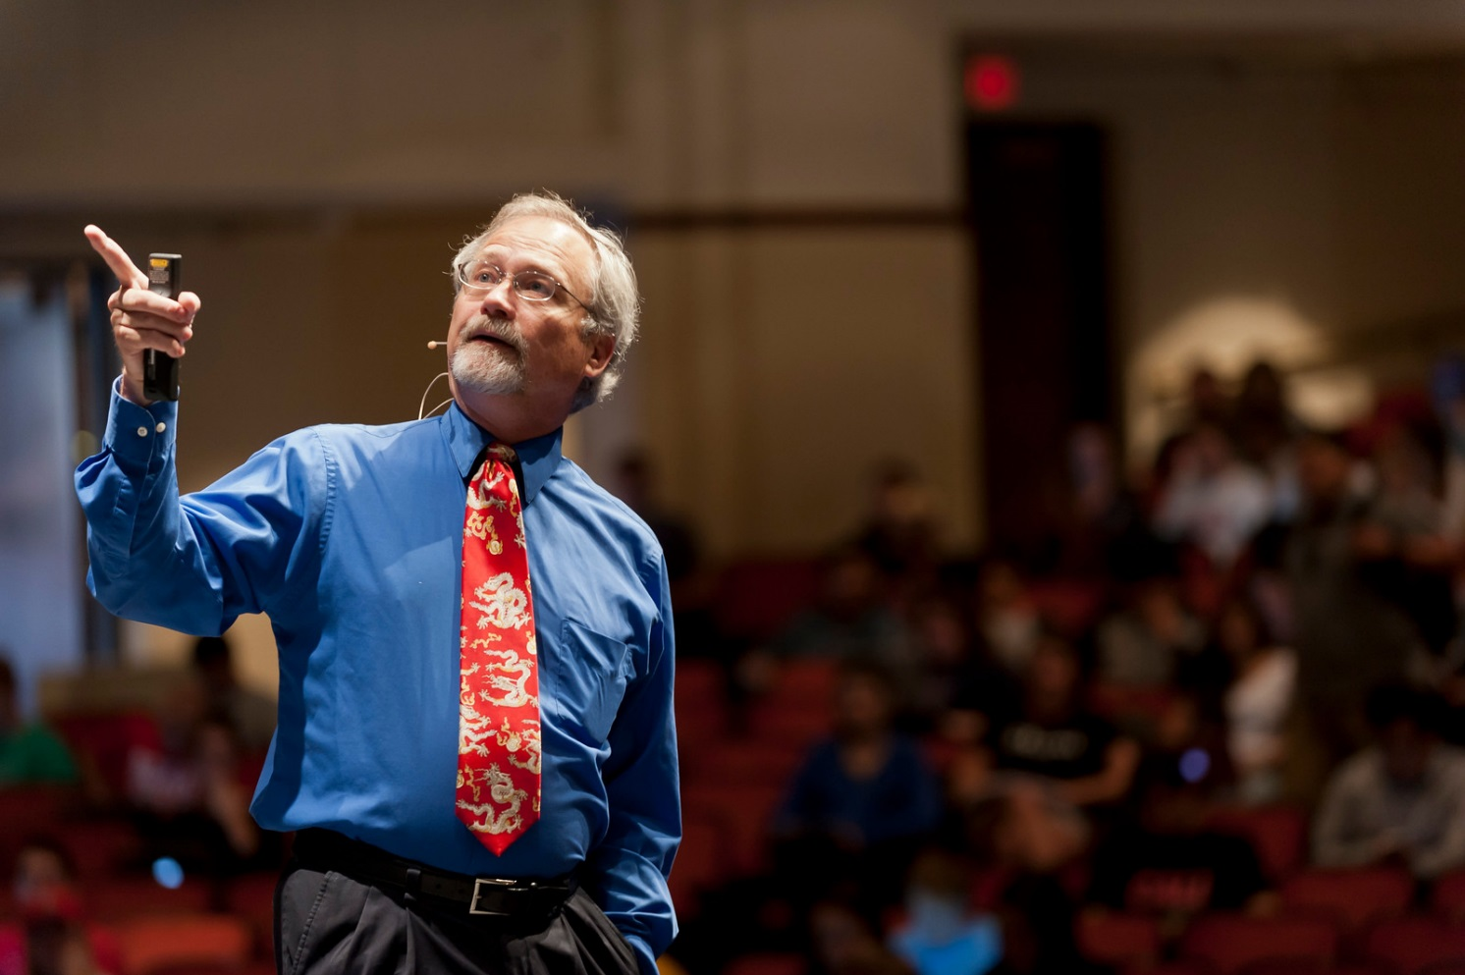
itAccessibility in the Curriculum
Faculty
Instructors / Graduate Teaching Assistants
Instructional Designers
Support Staff

Slide 8
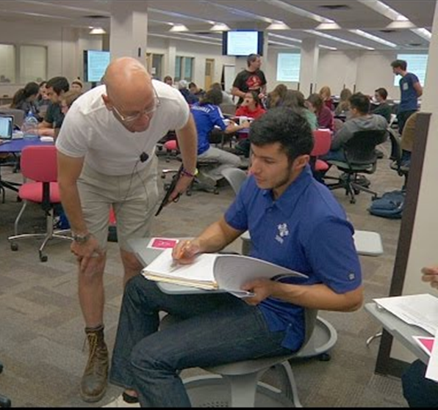
itAccessibility in the Learning Spaces
UA Online and Hybrid
MOOCs
Collaborative Learning Spaces

Slide 9
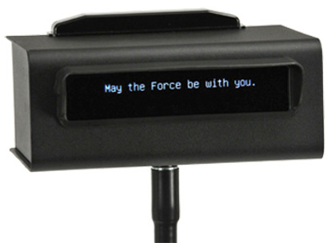
Captioning
Growing awareness of benefits of captioning
UA created a guidelines for our “University Commitment to Captioning” http://itaccessibility.arizona.edu/guidelines-standards/captioning-commitment
Increased outreach → Collaborations for itAccessibility

Slide 10
Accomplishments
VPAT information in RFP process
Includes adding accessibility into contract agreement in specific instances
Involvement in campus-wide technology decisions and purchases
Established a process to facilitate captioning across campus
Access is part of the process rather than an end consideration with multiple departments who are now serving as models
Our circle of accessibility champions has grown significantly

Slide 11
Continuing to Grow
Faculty/Instructors, Instructional Designers and Grad TAs
Continue outreach across campus
Fine-Tuning provision of campus-wide captioning service

Slide 12
Methods that Work
Network – Communication!
Attend those optional meetings and information sessions
Sign up for campus-wide communications so you are “in the know”
Reach out when you see an issue, offer to help / provide resources
Use a carrot, not a stick
Be prepared to fully participate to find a solution
Don’t be afraid to say “We should be involved in this project!”
Create your team – include others from across campus to champion accessibility

Slide 13
Contact Information
itAccessibility Team – http://itaccessibility.arizona.edu Email: itaccessibility@email.arizona.edu
Dawn Hunziker IT Accessibility Consultant University of Arizona Disability Resources hunziker@email.arizona.edu

