Slide 1
Building Inclusivity into Online Learning
(abbreviated version)
Kirsten Behling, MA
Suffolk University, Boston Massachusetts
Notes:
This version of the PPT includes all relevant content. It omits the transition and activity based slides.

Slide 2
What is online learning?
Traditional | Web-facilitated | Blended | Online
0% of content delivered online | 1-29% of content delivered online | 30-70% of content delivered online | 80% or more content delivered online
Notes:
Allen, I.E., & Seaman, J. (2007). Online nation: Five years of growth in online learning. Needham, MA: Sloan Consortium. Retrieved 25 June 2015, http://www.babson.edu/Academics/Documents/babson-survey-research-group/online-nation.pdf

Slide 3
The types of online learning being offered – POD Data, 2014

Slide 4
What are institutions doing to educate faculty about how to teach online?
75% of institutions are providing LMS training for faculty.
70% have technology trainings for faculty.
69% provide training specific to blended or online courses.
5% of these trainings include information on building accessible courses.
Notes:
POD data, 2014

Slide 5
Bottom Line: Accessible courses are not a concern
There is a lack of awareness of the importance of access.
It is assumed that SWD are taken care of by ODSs (but only 11% self-identify).
Faculty do not have time.
There is no incentive (financial or reduced course load) to participate in trainings.
Institutional buy-in is surface level only (there is an agreement that something needs to be done, but no directive).
Notes:
POD data, 2014

Slide 6
Advocating for SWD and the law
  “Although the language of the ADA does not explicitly mention the Internet, the Department has taken the position that title III covers access to Web sites of public accommodations.”
  ADA Title III regs, Guidance and Analysis, DOJ

Slide 7
Re-defining “Place of Public Accommodation” and our focus
Big picture (university –wide):
Narrower focus (courses):
Institutional Webpage
Internal portal
Mass communication
Databases
Registration
Library databases
Print release stations
Physical amenities with digital/online components
LMS
Online learning
MOOC/SPOC
Webinar platforms
Course/Lab simulation software
Course specific infrastructure

Slide 8
Online learning by the numbers
As of 2012
94.5% of higher ed institutions had some form of online learning.
62.4% offer full online programs.
70% of chief academic officers think that online learning is “critical to their institution's long-term strategy.”
Notes:
Allen, I.E., & Seaman, J. (2007). Online nation: Five years of growth in online learning. Needham, MA: Sloan Consortium. Retrieved 25 June 2015, http://www.babson.edu/Academics/Documents/babson-survey-research-group/online-nation.pdf

Slide 9

Students in the online environment
In 2012 – 7.1 million students took at least one online course
Online courses attract:
  Non-traditional students
  Part-time students
  Students with disabilities
Notes:
Allen, I.E., & Seaman, J. (2007). Online nation: Five years of growth in online learning. Needham, MA: Sloan Consortium. Retrieved 25 June 2015, http://www.babson.edu/Academics/Documents/babson-survey-research-group/online-nation.pdf

Slide 10
Retention rates in online learning are not great
Retention rates tend to be 10% – 20 % lower than face-to-face classes (depending on the institution).
College freshman who enroll in online courses their first semester are more likely to drop out of college.
Retention rates are higher among full-time students, than part-time students.
Students who are not as academically prepared for college have higher online drop out rates.
Retention rates are higher at institutions whose admission’s criteria is less selective.
Notes:
Allen, I.E., & Seaman, J. (2007). Online nation: Five years of growth in online learning. Needham, MA: Sloan Consortium. Retrieved 25 June 2015, http://www.babson.edu/Academics/Documents/babson-survey-research-group/online-nation.pdf

Slide 11

Retention rates may be the result of barriers to online courses
Language-based issues
Limited access to technology
Lack self-motivation
The lack of supervised structure is difficult
Conflicting priorities
No clear path to accommodations

Slide 12
Students with disabilities and online courses
Students with these disabilities tend to take online courses:
  Chronic health disabilities
  Mental health
  Poor executive functioning
Online learning is attractive because:
  It can be done from anywhere
  It can be done at a different pace than face-to-face courses
  Participation is somewhat anonymous

Slide 13
Barriers to high retention for SWD in online courses
Choice of avoiding seeking help for disability – remaining anonymous
Unwillingness to ask the professor for help
Availability of the professor
Lack of clear direction on how to receive accommodations
Professor is unsure how to accommodate SWD
Course content is inaccessible

Slide 14
Primary areas where access is an issue
Learning Management Systems
Publisher Content
Faculty Content

Slide 15
Cases that have influenced online learning
Florida State – “Clickers/LMS”
Harvard - “Webcast Captions”
MIT – “Webcast Captions”
Louisiana Tech – “Online/Hybrid”
Miami University – “Alt format materials and LMS”
Penn State – “Course Management System”
University of Colorado – “Course Management System”
Notes:
http://www.d.umn.edu/~lcarlson/atteam/lawsuits.html

Slide 16
Penn State Settlement – LMS focus
National Federation of the Blind (NFB) complained that a variety of computer and technology-based websites were inaccessible.
The settlement agreement included:
  Complete a technology accessibility audit;
  Develop a corrective action strategy based on the audit findings;
  Develop a policy and accompanying procedures;
  Institute procurement procedures;
  Bring all university websites up to WCAG 2.0;
  LMS must be accessible.

Slide 17
Publishers are slowly getting into the game….
No legal settlements thus far
Closest thing we have to a federally supported format is: NIMAC (National Instructional Materials Access Center) ←IDEA

Slide 18
Harvard/ MIT Case – Faculty generated content
National Association of the Deaf (NAD) sued MIT and Harvard for the non-inclusive nature of their MOOCS
The complaint: that they failed to include captions on the materials that they posted online for consumption by the general public.
Those videos with captions, YouTube, are inaccurate. They are largely computer generated.
NAD is seeking a change in conduct, not money damages.

Slide 19

How are some institutions handling online learning and access?

Slide 20
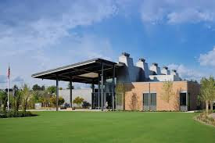
Portland Community College
“A Grass Roots Effort”

Slide 21

Temple University
Forward Thinking

Slide 22
University of Central Florida
UDOIT
http://online.ucf.edu/teach-online/resources/udoit/
UDOIT will identify “errors” and provide “suggestions” in the following areas of your course (in Canvas):
  Announcements
  Assignments
  Discussions
  Files (i.e., .html files)
  Pages
  Syllabus

Slide 23
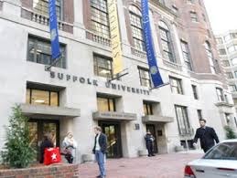
Suffolk University
“This is an Opportunity, Not a Punishment”

Slide 24
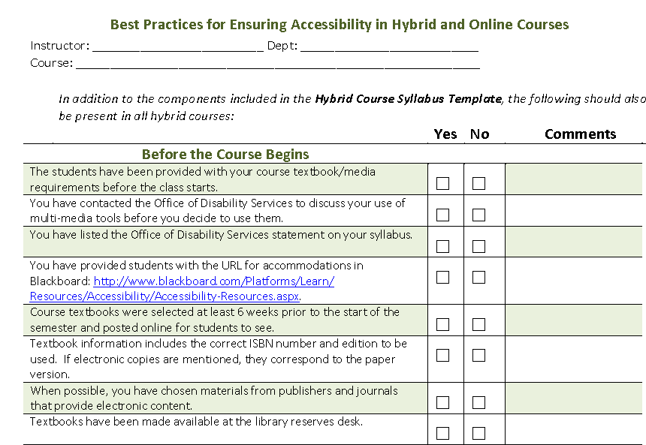
The Online Learning Check List

Slide 25
Online Course Developed and Required

Slide 26
Faculty lack training
Left to themselves, most faculty cut and paste their materials into their LMS with no attention to course design or accessibility.
Faculty often use software and websites that are not institutionally supported.
If course design assistance is offered, accessibility is largely absent from those conversations.
Poorly designed courses, with regards to content and access, lead to higher drop out rates.

Slide 27
The importance of keeping it simple cannot be stressed enough
Minimum accessibility considerations that faculty can/ should handle:
  Documents
  Images
  Videos
  Animations
  Forms
  Page/Site Navigation
  Links/URLs

Slide 28
1. Word Documents
Potential uses
Potential problems
Informational handouts
Exams, quizzes, assessments
Method of highlight certain links that a student might need to access
Used for convey messages through images
Handouts are inaccessible
Poor format, difficult to read through
Links may break, be unexplained or inaccessible.
Images are unreadable or are difficult to relate to the course w/o explanation

Slide 29
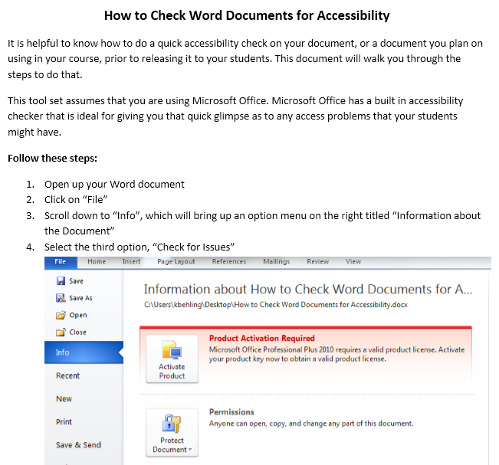
Checking previously made/ used
Word docs for accessibility

Slide 30
Quick tips for creating accessible Word documents
The 6 items to consider when creating a document are:
  Using the “styles” feature
  Font style and size
  Spacing
  Graphs/ charts/ images
  Tables
  Hyperlinks

Slide 31
2. PowerPoint Presentations
Con’s of PPTs:
Pro’s of PPT:
Reliance on a stand-alone tool
Concern that PPT can over simplify material into bulleted lists
Can be designed poorly, difficult to understand the message
Graphics that are unexplained are difficult to comprehend without guidance
Graphically interesting
Students can come back to it as needed
Helps faculty to organize their teaching
Allows for more of an interactive experience given the online environment

Slide 32
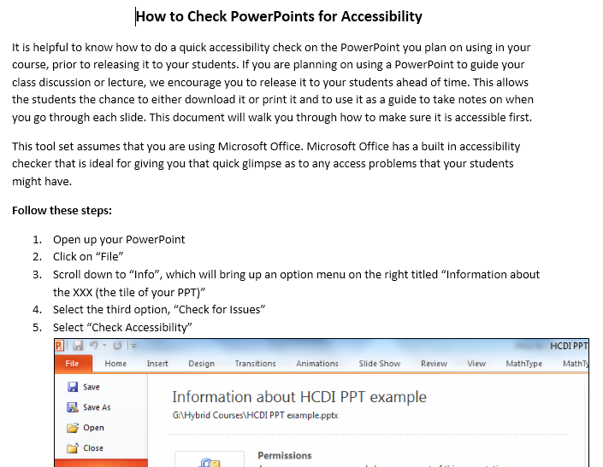
Checking previously made/ used
PPTs for accessibility

Slide 33
Quick tips for creating accessible PPTs
The 6 items to consider when creating a document are:
Accessible backgrounds
Font style and size guidelines
Spacing, bullets, transitions
Hyperlinks
Graphs/ charts/ images
Audio/ video transcripts

Slide 34
3. Excel Documents
Excel is being used in increasing frequency in college courses
Across subjects, no longer limited to math and business courses
Some courses actually teach students how to use Excel
Faculty argue that most careers will have some type of exposure to Excel, hence it’s importance

Slide 35
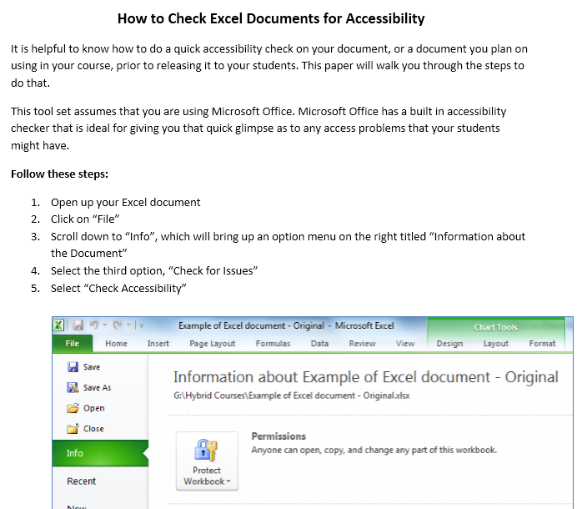
Checking previously made/ used
Excel docs for accessibility

Slide 36
Quick tips for Tips for creating accessible Excel documents
The 4 items to consider when creating a document are:
Font style and size
Appropriate labeling
Graphs (color, labels, and alt-text tags)
Hyperlinks

Slide 37
4. PDF Documents
Native PDFs:
Scanned PDFs:
Native PDFs are generated from an electronic source - such as a Word document, a computer generated report, or spreadsheet data.
These have an internal structure that can be read and interpreted.
These PDFs are typically accessible or can be converted fairly easily.
Scanned PDFs are documents that have been digitally captured.
The quality of these documents may be questionable.
These documents are largely not accessible.

Slide 38
Checking previously made/ used
PDFs for accessibility

Slide 39
Quick tips for Tips for creating accessible PDFs
The 3 key things to consider when creating an accessible PDF are:
Transitioning from a Word document to a PDF
How to handle pre-made PDFs
Tagging PDFs

Slide 40
5. Audio/Visual Content
Instructor benefits:
Student benefits:
Focus on a module
The ability to demonstrate a concept
Stimulate online discussion
Provide a common base of knowledge among the students
Research has shown that classes with some video components lead to:
  Improved tests results
  Higher scores on writing assignments
  More active class discussions
  More creative approaches to problem solving

Slide 41
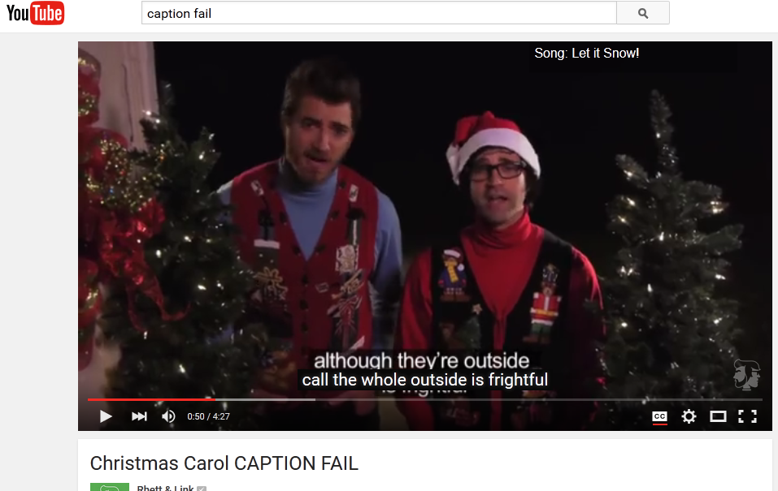
Be cautious of audio-captioning

Slide 42
The variety of resources various from institution to institution
One faculty’s experience:
“As far as I have been told to date, it is my responsibility to ensure all of the videos I show are captioned. Thus, if I have one that needs captioned, then I need to figure out how to pay for it. At the moment, I am trying to make a case with my department to pay for it. I haven't received a response yet. If they don't pay for it, then I will use my own funds.
I haven't received this specific request from DS or a student, I just want to be mindful of captioning. For now, I am not planning on sharing the video because it will not be captioned in time. This example illustrates what many faculty experience, and I'm describing just to give you some perspective.”

Slide 43
Quick tips for tips for using accessible audio/ video files
There are a number of factors to consider when you are thinking through access in regards to audio and video files. They include:
Where is the file from?
What is your time frame?
What is your expertise with captioning and descriptive video?
What is your budget?

Slide 44
6. And then there are the websites faculty ask students to visit…
Websites
Online journals
Wikis
Blogs
Web searches
Library databases
Social media
Alternative course websites
Others?

Slide 45
“The 6 Simplest Web Accessibility Tests Anyone Can Do”
Unplug your mouse and/ or turn off your trackpad
Turn on High Contrast Mode
Turn off Images
Check for Captions or Transcripts
Click on Field Labels
Turn off CSS
Notes:
http://www.karlgroves.com/2013/09/05/the-6-simplest-web-accessibility-tests-anyone-can-do/

Slide 46
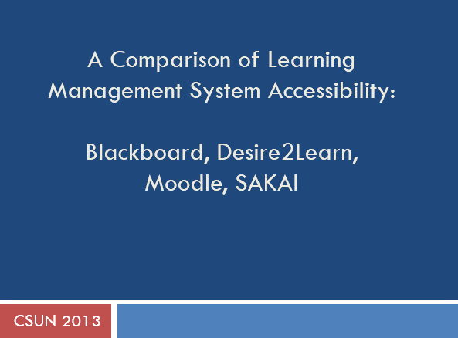
LMS and Accessibility
Hadi Rangin's 2013 Blog “A Comparison of Learning Management System Accessibility”
Looks at: BB, Desired2Learn, Moodel, and SAKAI

Slide 47
Influencing the procurement process
Determine if the vendor has an accessibility statement.
Determine if there is a contact at the vendor who deals with access issues.
Ask the vendor if they have filled out a VPAT.
Review the VPAT and ask for next steps and timelines for fixing those issues.
Secure a testing site from the vendor to run in house tests.
Require an institutional employee to test the usability and accessibility of the product with a screen reader.
Summarize the findings from the vendor contact information, VPAT and self-test and submit to CIO.

Slide 48
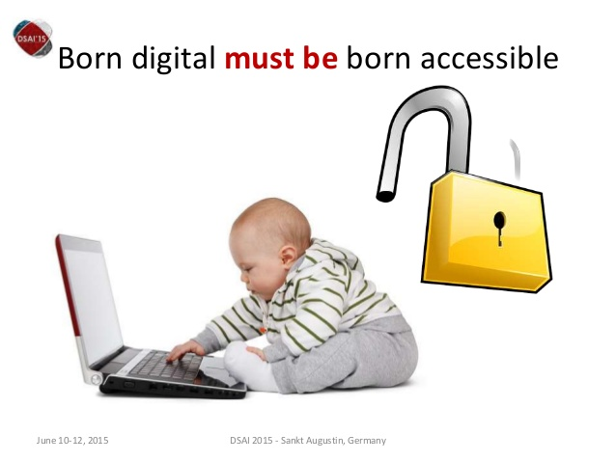
Influencing publishers

Slide 49
Meet/ write with publishers
Invite publishers to your school
Invite faculty using their materials to that meeting
Demo accessibility issues with screen reader in front of them
Demand to know what their response will be
Don’t end the meeting until you have a timeframe and contact person

Slide 50
How do you get accessibility to become a staple in the minds of your colleagues?

Slide 51
Going back to the POD study: Institutions support faculty in these ways:
Created online resources for faculty re: accessibility [45]
Syllabus statement about accessibility [73]
Worked with faculty one-on-one [111]
General training for faculty in online or hybrid/blended teaching [62]
Created a task force [44]
Notes:
POD data, 2014

Slide 52
Strategies for gaining administrative and faculty support
Step 1: Identify who can help you:
  Who are your allies on your campus?
  Who else will be affected by online learning?
  Who else has a vested interested in online success?

Slide 53
Strategies for gaining administrative and faculty support
Step 2: Pick one place to focus your efforts:
  Among your group, whose concern seems the most pressing?
    Specific courses or programs that are being offered
    Specific faculty or departments that are teaching
  Can you combine your own concern with theirs?
  Identify possible solutions to that concern (be detailed, who will do what, what finances are needed, what technologies, etc.)

Slide 54
Strategies for gaining administrative and faculty support
Step 3: Identify what you have and do not have:
  Given your primary concern, what is available (resources, staff, finances) at your institution to begin to address the problem?
  Think outside of the box, how can you use the resources that you do have to increase awareness and action?
  What is missing? In an ideal world, what do you need to fix your concern? (staff, resources and finances). Be exact in your needs.

Slide 55
Strategies for gaining administrative and faculty support
Step 4: Establish agreed upon procedures for online courses:
  How are courses approved?
  Do faculty need training?
  Do students need to take a readiness quiz?
  What software can and cannot be used?
  Who on campus is a resource to faculty? Students?
  How will accommodations be provided?

Slide 56
Strategies for gaining administrative and faculty support
Step 5: Make the procedures known:
  Identify who the procedures affect the greatest population of students
  Determine the best way to make faculty aware of them
    Universal Design increases access for more learners
    It’s the “right” thing to do
    Legally you have to!
  Identify who should be the messenger
  Determine where the procedures should “live”

Slide 57
Strategies for gaining administrative and faculty support
Step 6: Repeat all of the steps with a different area to focus on:
  Identify your next area of concern with your allies (another academic department, program or MOOC etc.).
  Repeat the process.
  Things should be easier this time around if you’ve been successful.

Slide 58
Lessons learned
Online learning is an opportunity to be proactive in terms of access for all learners.
Don’t take on this task alone, form partnerships and find allies.
Baby steps count… baby steps can lead to rumors which can lead to larger buy-in.
Don’t be afraid to cite the law, but come to the table with solutions.
Be patient, but nag too.

Slide 59
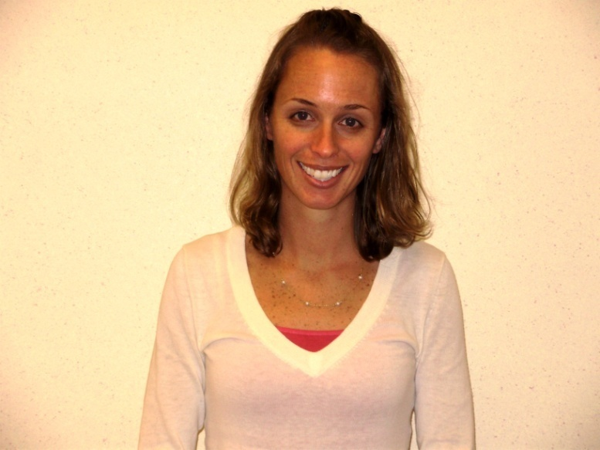
For more information please contact:
Kirsten Behling, MA
Suffolk University
Office of Disability Services
617-994-6820
kbehling@suffolk.edu
Notes:
Included on this slide is a picture of me, Kirsten Behling.

