Slide 1
Accessibility Policy and Implementation across Units at Michigan State University

Slide 2
Objectives
Nate: Show what a11y policy and implementation looks like at MSU (15 min).
Kate: Show what a11y looks like at the college level at MSU (15 min).
Phil: Provide examples of a11y innovation at MSU (15 min).
James: Discuss challenges and issues applying a11y standards in higher education (15 min).
All: Small group discussion around your accessibility questions.
Notes:
Nate introduces everyone

Slide 3
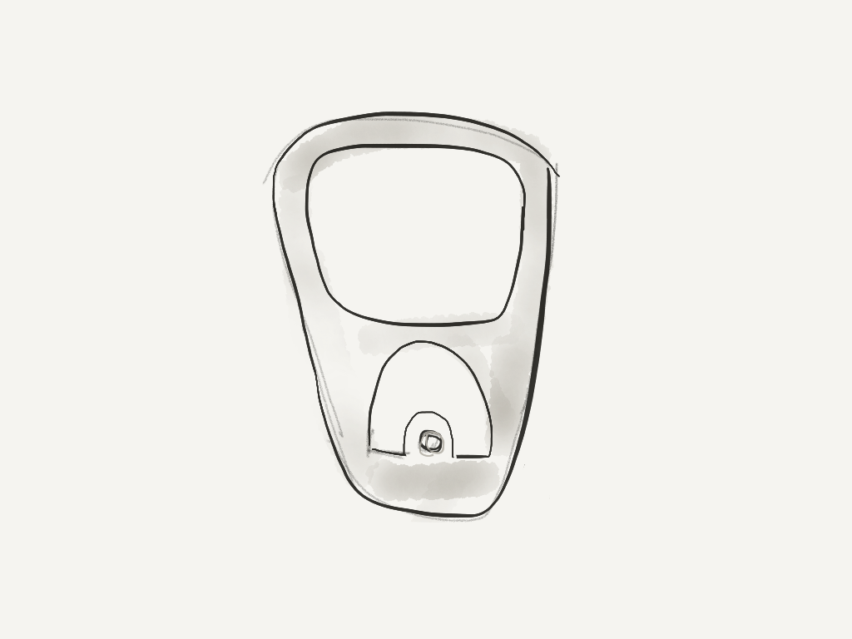
Notes:
I think that recycling is a great metaphor for us to consider as we think about accessibility on our campuses. Do you remember recycling back in the early 1990’s? Pop tabs were the only part of a typical pop can that could be recycled. It was frustrating trying to gather those pop tabs, keep track of them, and get them recycled, but we did it! Even though the process was not super friendly, we did it because we wanted to recycle, and it was the right thing to do.

Slide 4
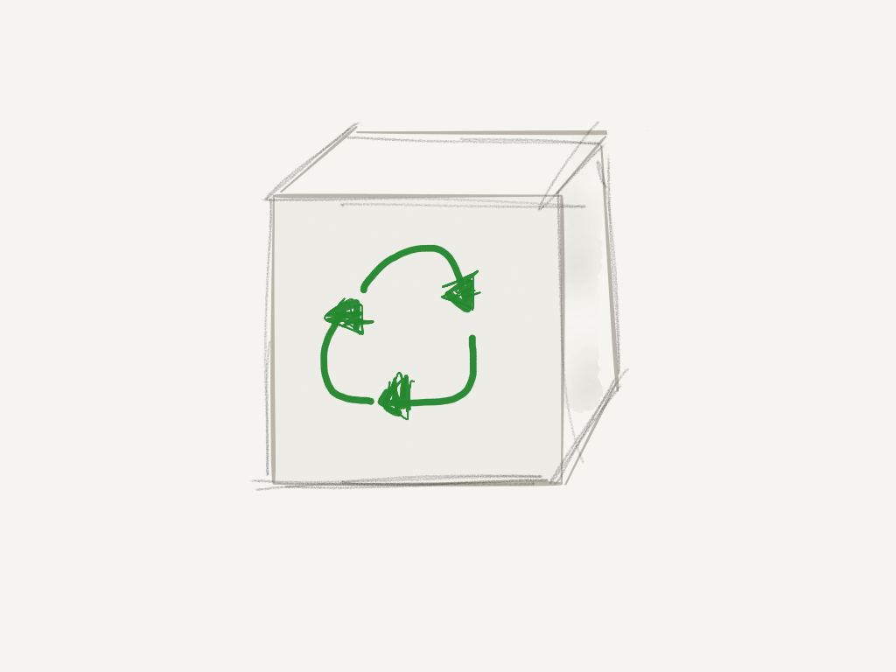
Notes:
Fast forward to today: Recycling is as easy as ever. There is no need to separate plastic bottles, glass jars, or cardboard, and you don’t even need to leave your home in order to do your part! All you have to do today is throw all of your recyclables into a clear bag, and - in theory - the trash company will pick them with your garbage.

Slide 5
“Tab to bag” Accessibility Culture Continuum
Notes:
Taking this metaphor further: If you imagined continuum that begins with “not easy” and ends with “very easy,” where would you say that your institution’s culture is today in regards to “ease of use” for content creators to make their content more accessible?
Is it not easy for your content creators to make their content more accessible?
Is it very easy for your content creators to make their content more accessible?

Slide 6
“Tab to bag” Accessibility Culture Continuum (cont’d.)
Notes:
At MSU, I would say our culture is in the lower third of the continuum. We need the software that we use every day to “force” us to create accessible content from the start. That will continue to push us towards the “easy to use” end of the scale.

Slide 7
Plan and Resources
Web Accessibility Policy at MSU
Web Accessibility Implementation Plan
5 Year Compliance Plans
1 Year Self-Reviews
EIT Accessibility Purchasing Recommendation
Notes:
Web Accessibility policy at MSU: http://webaccess.msu.edu/Policy_and_Guidelines/web-accessibility-policy.html
EIT Accessibility Purchasing Recommendation: http://webaccess.msu.edu/Policy_and_Guidelines/purchasing/index.html

Slide 8
Plan and Resources (cont’d.)
Web Accessibility Working Group
Accommodating Technology CAFE
Web Accessibility Liaisons
webaccess.msu.edu
tutorials, templates, training & other resources
Student interns

Slide 9
Notes:
A picture of a few of our students in our new accessibility lab.

Slide 10
Notes:
Another picture of our students in our new accessibility lab. Students from across disciplines learn how to remediate documents and evaluate products and services at Michigan State Unviversity.

Slide 11
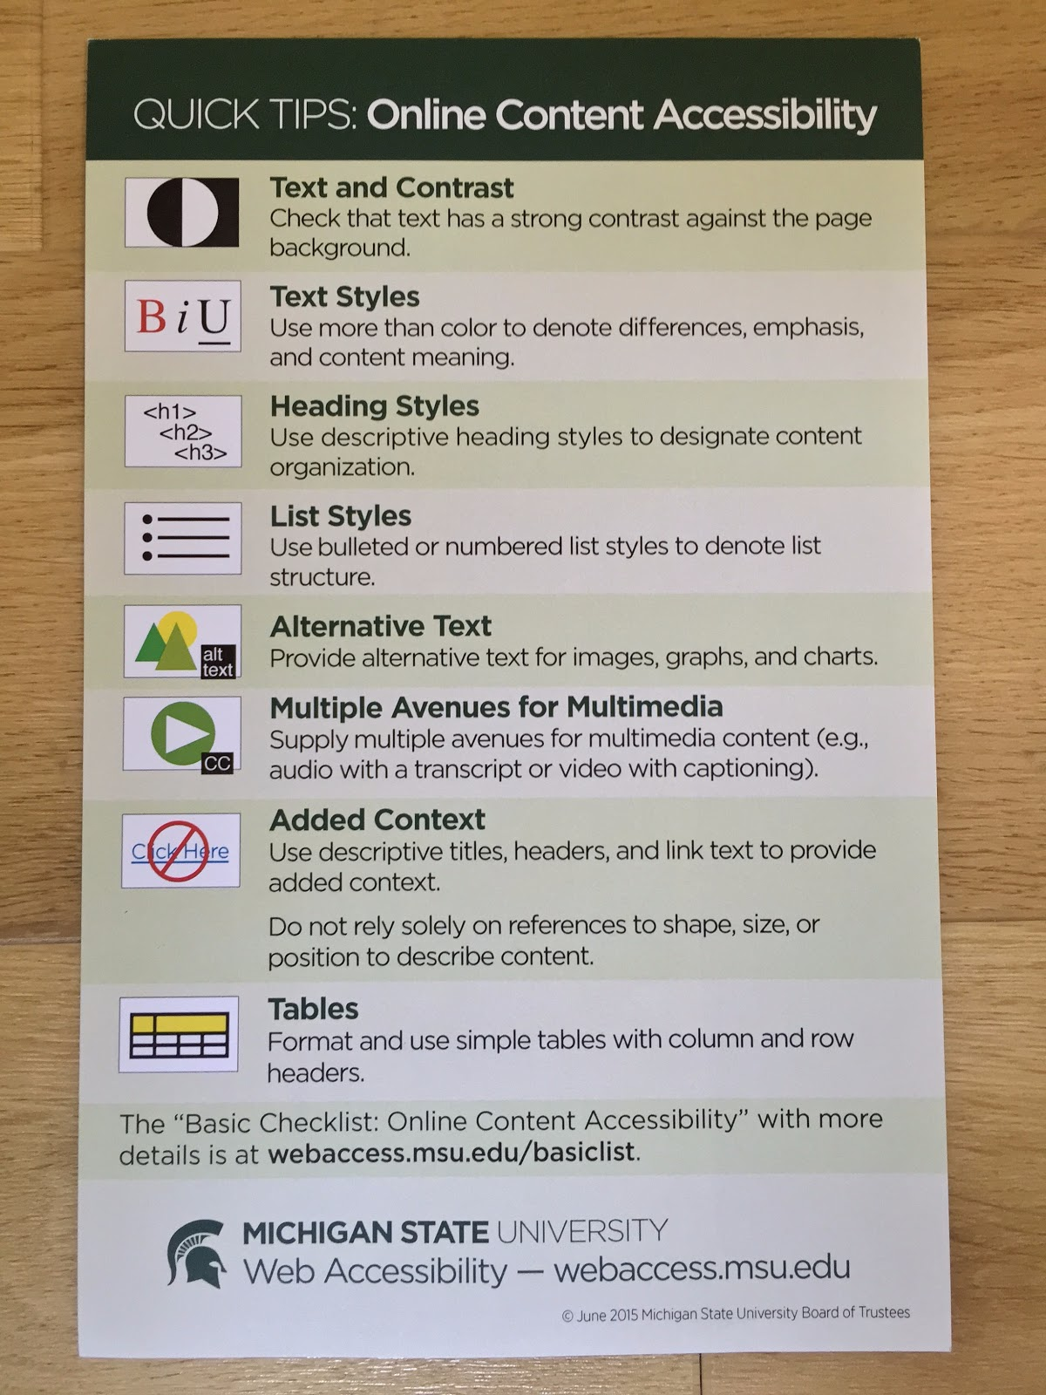
Notes:
This checklist is intended to be starting point for making documents and websites accessible at MSU, and should be used in conjunction with the tutorials on webaccess.msu.edu. This checklist is not comprehensive-the MSU Web Accessibility Policy requires full conformance with the Technical Guidelines (WCAG 2.0 AA).

Slide 12
College of Arts & Letters
A Closer Look

Slide 13
General CAL Organization
People
Assistant Dean for Technology and Innovation
Academic Specialist and team of student interns
Creativity Exploratory (http://ce.cal.msu.edu/)
Pathways to Entrepreneurship
Funded projects in 2014
Notes:
http://ce.cal.msu.edu/

Slide 14
Making Learning Accessible
Original intent and purpose
How MSU policy changes impacted the project
Fall 2014 university-wide policy change

Slide 15
CAL 5 Year Plan
General outline
Where are they now?
Making Learning Accessible conference on November 13th

Slide 16
“Tab to bag” Accessibility Culture Continuum
Notes:
Take 2-3 minutes of “I” time and reflect on where your institution is on this “culture continuum.”
Is accessibility at the forefront of thoughts as content is created? When products are procured?
Next, get into groups of two or three and take 5-7 minutes to share your reflection, and brainstorm ways that you can move the line forward.
Lastly, share with the group.

Slide 17
Accessibility Process Innovation
Attacking problems from different perspectives

Slide 18
Advocacy Work
I studied accessibility during my undergrad
I worked for UARC
I worked for CAL
I work for MSU IT Services
The Making Learning Accessible project
The Making Learning Accessible conference
Studying accessibility in my graduate program

Slide 19
As a student…
I created tutorial content and supervised students who participated.
I created trainings for faculty and staff.
I created a checklist for use in course evaluation kick-off meetings.
I designed and supervised the writing of a WCAG 2.0 course evaluation methodology.
I trained other students. I trained staff. I trained faculty.

Slide 20
Working with students
Students bring diverse expertise into accessibility conversations.
Students doing course evaluations:
cheap
effective
beneficial to students and to MSU, and to future employers

Slide 21
Students are Innovators
Innovation, boldness
Students can be fire-starters and can be powerful in that they require less censorship
Inherent argument for accessibility
Bring new skills to the fold
Have more time to design, write, code, and remediate in their hours

Slide 22
Designing Innovation
As a student: course design evaluation
As an employee: purchasing, process, EAP

Slide 23
Innovation 1. Course Design Evaluation

Slide 24
1. Course Design Evaluation
A script, a way of interacting with a whole
WCAG 2.0 Conformance Requirement: Process
A course is not accessible unless all of the learning objectives are achieved in an accessible way in an “equivalent amount of time with substantially equivalent ease of use” throughout the entirety of the course
PDFs, videos, etc. are just parts.
The whole has to be accessible, including knowledge delivery system

Slide 25
Innovation 2. Procurement & Process

Slide 26
2. Procurement & Process
Incorporating user feedback/reporting of accessibility bugs in renewals
Every website should have an accessibility bug report form in its footer
Risk reduction
Prioritization
Developing proactive backwards design strategies and implementing these into Purchasing procedures
EAP

Slide 27
WCAG 2.0 and Higher Ed
Challenges applying accessibility standards in a university

Slide 28
WCAG 2.0 and Higher Ed
Challenges applying accessibility standards in a university

Slide 29
My Role at the University
User Experience Researcher at Usability/Accessibility Research and Consulting
PhD Student in Educational Psychology and Educational Technology
Research interests focus on accessibility and learning disabilities

Slide 30
Challenge 1. Understanding the Standard

Slide 31
Understanding the Standard
Having strong understanding in a core team gives you flexibility
Creating documentation and training helps you to avoid misconceptions
Create documentation that helps all stakeholder

Slide 32
Challenge 2. Mismatched Priorities

Slide 33
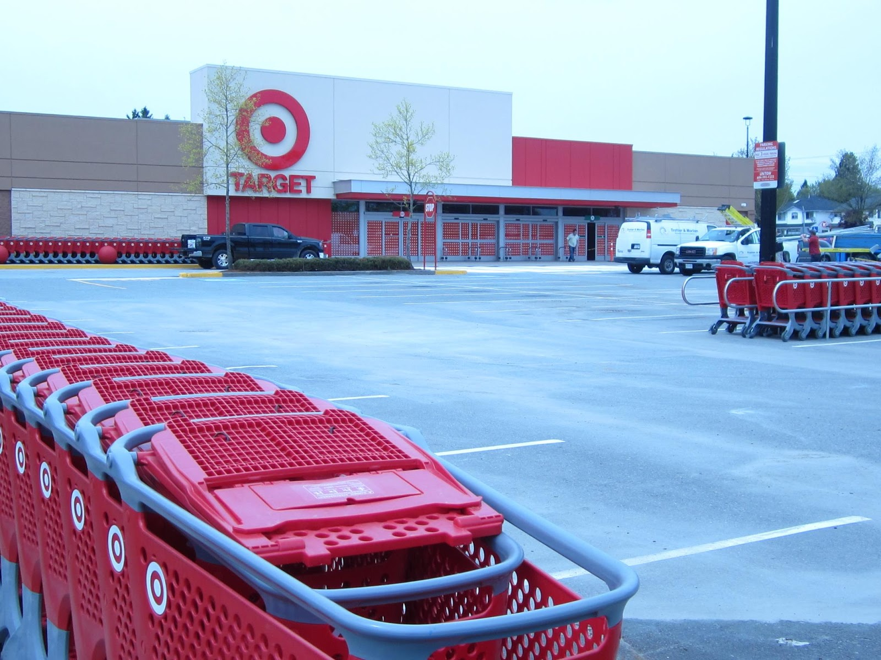
Parallels
Notes:
The image in this post has been shared with the Creative Commons Attribution 2.0 Generic License (CC by 2.0). This work is attributed to Kristiantiholov: https://upload.wikimedia.org/wikipedia/commons/thumb/7/71/Target_store_Scottsdale_Centre_in_Delta%2C_BC.jpg/1280px-Target_store_Scottsdale_Centre_in_Delta%2C_BC.jpg

Slide 34
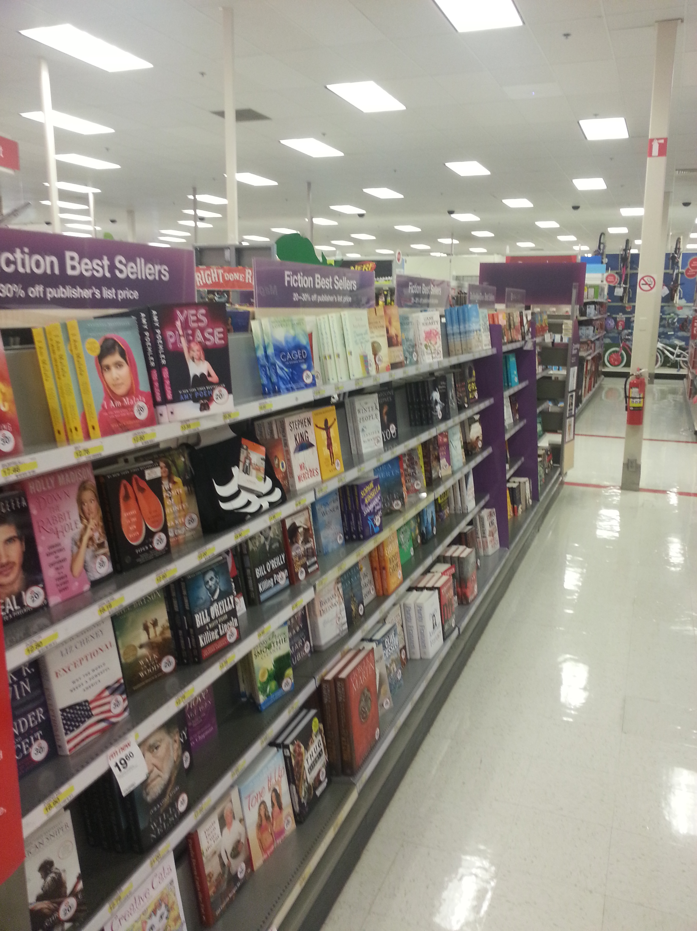
Parallels Continued

Slide 35
Mismatched Legal Expectations
Universities
Essential service is Education
Usually have a “brick and mortar” location
Use Chafee Amendment to provide access
Vendors
Essential service often is retail
Often don’t have a “brick and mortar” location
Don’t have direct responsibility under the Chafee Amendment

Slide 36
Chafee Amendment
Makes content free to individuals with qualifying disabilities, but...
Access is still difficult, often not timely, and often not equivalent
Under many interpretations the definition of a qualifying disability is narrower than under other disability laws (Rose, et. al., 2009)
Content can’t be shared (meaning it often has to be remediated more than once and doesn’t fully support inclusion)
Notes:
Rose, D. H., Hasselbring, T. S., Stahl, S., & Zabala, J. (2009). Assistive technology, nimas, and UDL. In Gordon, D. T., Gravel, J. W., & Schifter, L. A., (Eds.), A Policy Reader in Universal Design for Learning. Harvard Education Press. 8 Story Street First Floor, Cambridge, MA.

Slide 37
Challenge 3. Universal Design v. Accommodation

Slide 38
Accessibility in an Academic Context
When applying accessibility standards it's important to think about what your university is already doing
Universities have mechanisms for accommodation
Accommodation gives you flexibility
University's responsibilities go beyond conformance

Slide 39
Accommodation v. Universal Design
Accommodation can be more costly and will usually have greater liability
As technology changes expectations for universal design rise
Accommodation misses students
Burden of proof is on students
Not all students disclose

Slide 40
Changes in Technology
Universal Design becomes easier
Equal accommodation becomes less effective
When students can access articles instantly from anywhere, timeliness of access for individuals with disabilities becomes more important

Slide 41
College Students with Learning Disabilities
Of college students identified as having a learning disability in k–12, only 24% notified their university, and only 17% received an accommodation

Slide 42
Don’t only ask: “Does this meet the standard?”
Ask “Does this reduce our liability?”
Ask “Does this reduce cost?”
Cost in providing accommodation/remediation
Cost in training content creators
Cost in political capital

Slide 43
Challenge 4. “Accessibility Supported Ways”

Slide 44
Accessibility Supported Ways
“Web content technology is "accessibility supported" when users' assistive technologies will work with the Web technologies AND when the accessibility features of mainstream technologies will work with the technology”
Notes:
http://www.w3.org/TR/UNDERSTANDING-WCAG20/conformance.html#uc-accessibility-supported-definition-head

Slide 45
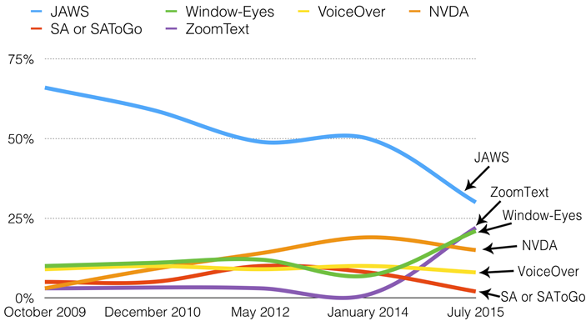
WebAIM survey

Slide 46
Spartans Will.
Remove barriers to access.

Slide 47
Get in touch!
Nate Evans – Manager, Digital Content & Accessibility, MSU: ne@msu.edu
Kate Sonka – Academic Specialist, College of Arts and Letters (Educational Technology team), MSU: ksonka@msu.edu
Phil Deaton – Web Accessibility Specialist & Web Developer, Digital Content & Accessibility, MSU: deatonph@msu.edu
James Jackson – User Experience Researcher, Usability/Accessibility Research and Consulting, MSU: jamesedj@msu.edu

Slide 48
Discussion Questions
Nate – What are the top level challenges for university-wide accessibility implementation and strategy that you face?
Kate – How do you navigate the policies of central administration with the needs of the individual unit?
Phil – How do you innovate current strategic accessibility design to increase the influence of process in procurement, evaluation, and development?
James – How do we address forthcoming accessibility challenges (e.g., copyright)?

Slide 49
Get in touch!
Nate Evans – Manager, Digital Content & Accessibility, MSU: ne@msu.edu
Kate Sonka – Academic Specialist, College of Arts and Letters (Educational Technology team), MSU: ksonka@msu.edu
Phil Deaton – Web Accessibility Specialist & Web Developer, Digital Content & Accessibility, MSU: deatonph@msu.edu
James Jackson – User Experience Researcher, Usability/Accessibility Research and Consulting, MSU: jamesedj@msu.edu

