Slide 1
All About Video
Terrill Thompson
University of Washington
tft@uw.edu
Ken Petri
The Ohio State University
Petri.1@osu.edu
Sean Keegan
President, ATHEN
sean@athenpro.org

Slide 2
Agenda
9:00 – 10:30 Overview & hands-on activity
10:45 – Noon Captioning Tools & Methods (Part 1)
1:30 – 3:00pm Captioning Tools & Methods (Part 2)
3:30 – 4:30pm Strategies, workflows, & funding models

Slide 3
Overview

Slide 4
Video can be inaccessible to...
People who are unable to hear the video
People who are unable to see the video
People who are unable to operate a mouse
People who don't understand the spoken language
People who need to search the video's content
People who are unable to play the video (due to deaf-blindness, bandwidth, technology limitations, or a busy schedule)

Slide 5
Our mission this morning
Explore all aspects of video accessibility using HTML5 and Able Player

Slide 6
HTML5 Media Supports Accessibility
Captions
Subtitles
Audio description (as text)
Adjustable playback rate

Slide 7
But the players all look different

Slide 8
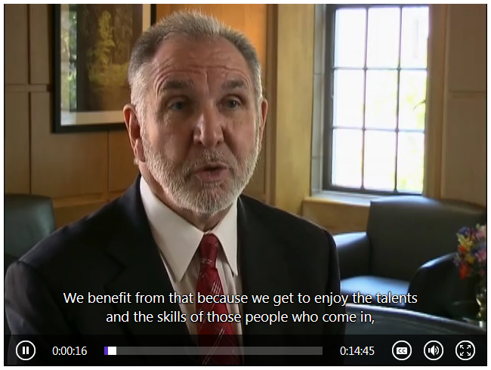
And some are more accessible than others

Slide 9
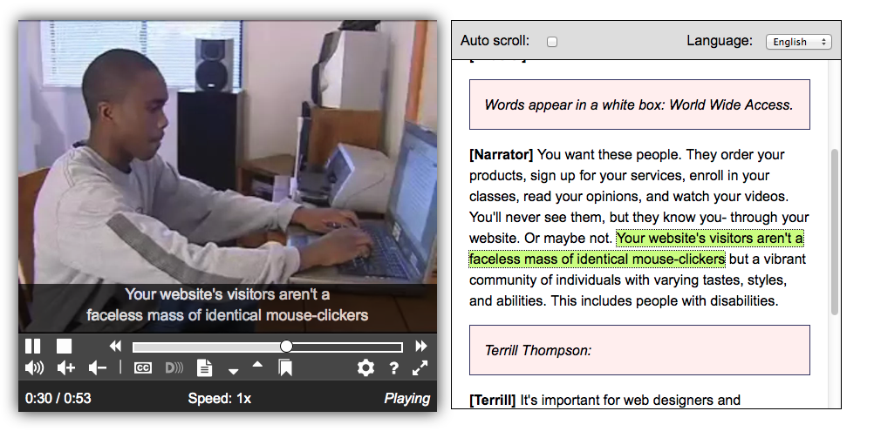
Able Player improves accessibility and works across browsers

Slide 10
See it live at uw.edu/doit/video

Slide 11
Instructions for Hands-on Activity
Open sandbox.html in WordPad
Try it using various browsers
Make it an Able Player
Add captions
Add subtitles
Add chapters
Add audio description (two different ways)
Add sign language

Slide 12
Step 3. Make it an Able Player
<video controls data-able-player>
<source src="media/wwa.webm">
<source src="media/wwa.mp4">
</video>
Notes:
Might also need to use data-translation-path

Slide 13
Step 4. Add captions
<video data-able-player>
<source src="media/wwa.webm">
<source src="media/wwa.mp4">
<track kind="captions" src="media/wwa_captions_en.vtt" srclang="en" label="English">
</video>

Slide 14
Step 5-7a. Add subtitles, chapters, & description (as text)
<track kind="???" src="media/???.vtt" srclang="???" label="???">
Change kind to "subtitles", "chapters", "descriptions"
For each, change filename, srclang, and label

Slide 15
Step 7b. Add a separate described version of the video
<video data-able-player>
<source src="media/wwa.webm"
data-desc-src="media/wwa_described.webm">
<source src="media/wwa.mp4"
data-desc-src="media/wwa_described.mp4">
</video>

Slide 16
Step 8. Add sign language
<video data-able-player>
<source src="media/wwa.webm"
data-sign-src="media/wwa_sign.webm">
<source src="media/wwa.mp4"
data-sign-src="media/wwa_sign.mp4">
</video>

