Slide 1
Accessibility as Design Innovation
Using design thinking methods to create an accessible user experience by innovating from diverse needs.
Whitney Quesenbery
@whitneyq
@awebforeveryone

Slide 2
What do you see in this picture

Slide 3
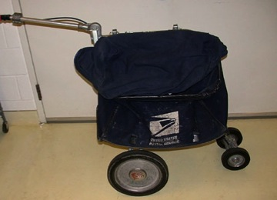
Which of these are for people with disabilities?

Slide 4
Thinking differently about design

Slide 5
Principles for Accessible UX

Slide 6
Principles for Accessible UX
People first
Clear purpose
Solid structure
Easy interaction
Helpful wayfinding
Clean presentation
Plain language
Accessible media
Universal usability

Slide 7
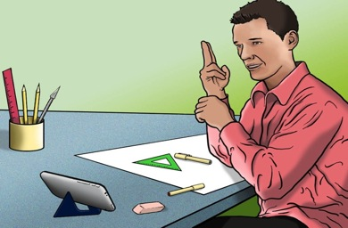
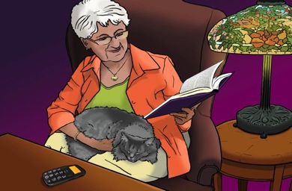
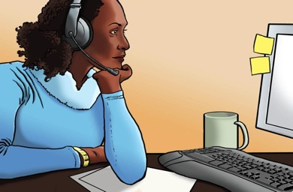
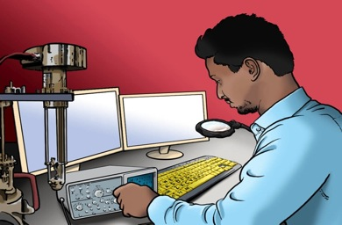
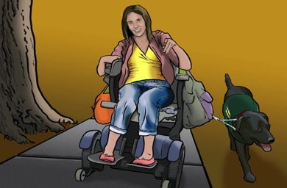
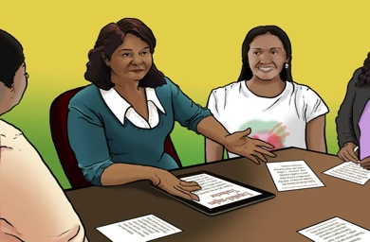
People first
Steven
Carol
Lea
Vishnu
Emily
Trevor
Maria
Jacob

Slide 8
Clear purpose: Well-defined goals
People enjoy products that are designed for the audience and guided by a defined purpose and goals.
Design for mobile first because... mobile forces you to focus!
(November 2009)
http://www.lukew.com/ff/entry.asp?933

Slide 9
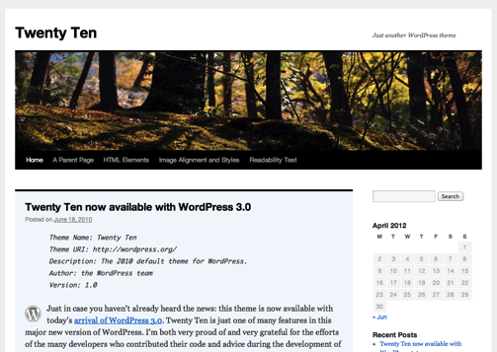
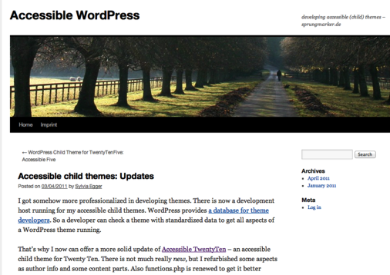
Solid structure: Built to standards
People feel confident using the design because it is stable, robust, and secure.
Which of these is accessible?

Slide 10
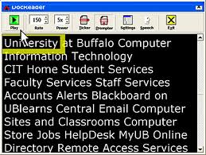
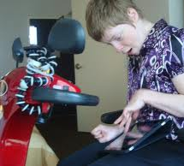
Easy interaction: Everything works
People can use the product across all modes of interaction and operating with a broad range of devices.
What's the same?
What's different?

Slide 11
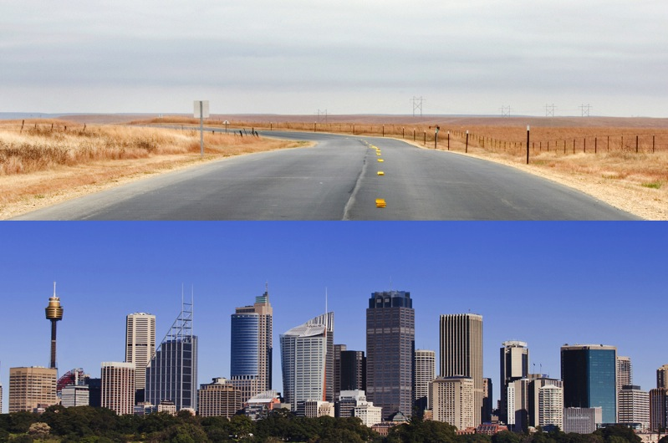
Helpful wayfinding: Guides users
People can navigate a site, feature, or page following self-explanatory signposts.

Slide 12
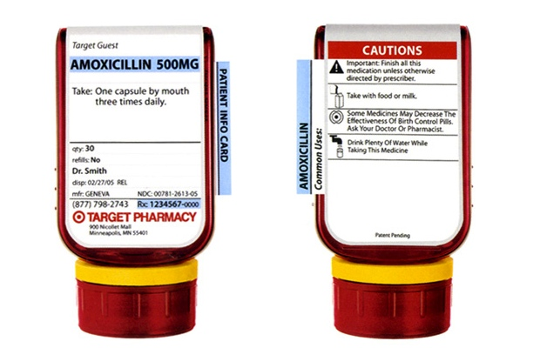
Clean presentation: Supports meaning
People can perceive and understand elements in the design.
How does the visual design support people?

Slide 13
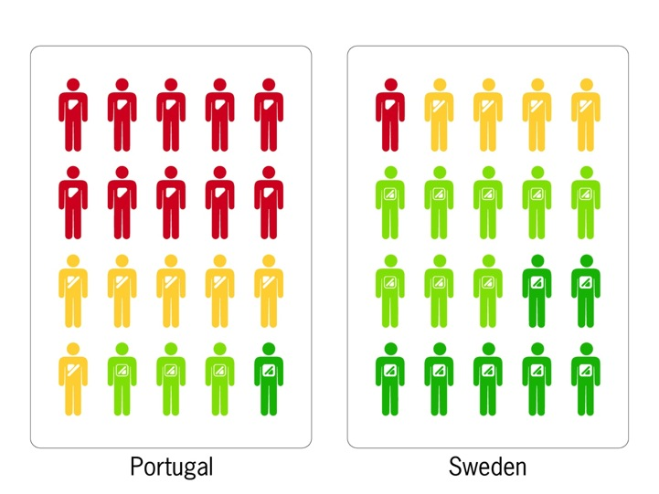
Plain language: Creates a conversation
People can read, understand, and use the information.
Sandra Fisher Martins www.youtube.com/watch?v=tP2y0vU7EG8

Slide 14
Accessible media: Supports all senses
People can understand and use information contained in media, such as images, audio, video, animation, and presentations.
Notes:
Graham Pullen, author of Design Meets Disability
http://research.microsoft.com/apps/video/default.aspx?id=103405

Slide 15
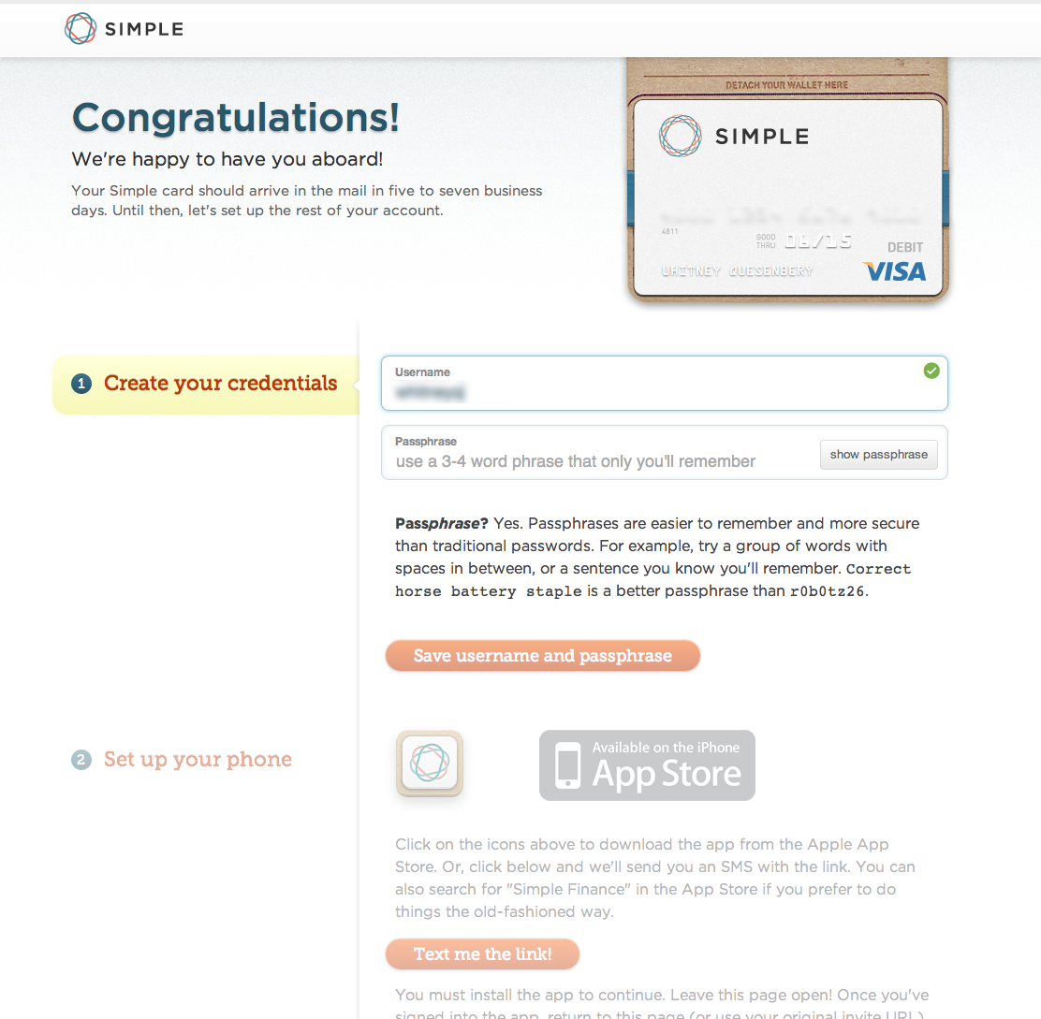
Universal usability: Creates delight
People can focus on the experience and their own goals because the product anticipates their needs.
Notes:
Remove barriers, so everyone can focus on what they came to your site to do.
Delight users by anticipating what they need and (unobtrusively) providing support.
And when the whole thing stacks up: you know what customers need, the structure is sound, and all the way up, you get a strongly integrated product.
Transition:

Slide 16
Journey Maps

Slide 17
Emotional arc
https://www.pinterest.com/annettefranz/customer-journey-maps/
Where are the valleys in the journey?

Slide 18
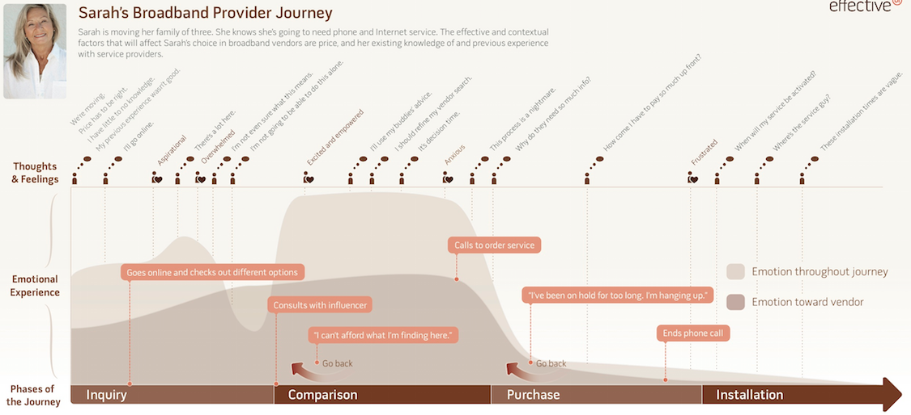
A sequence with emotional states documented
https://www.pinterest.com/pin/493214596661228035/

Slide 19
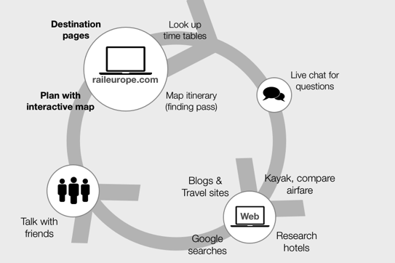
Journey vs. aspects of the experience
Stages of the journey with guiding principles bs
Doing
Thinking
Feeling
Experience
and opportunties the map suggests
http://www.adaptivepath.com/uploads/images/RailEurope_CXMap_FINAL%20copy_001.png

Slide 20
Design Studio

Slide 21
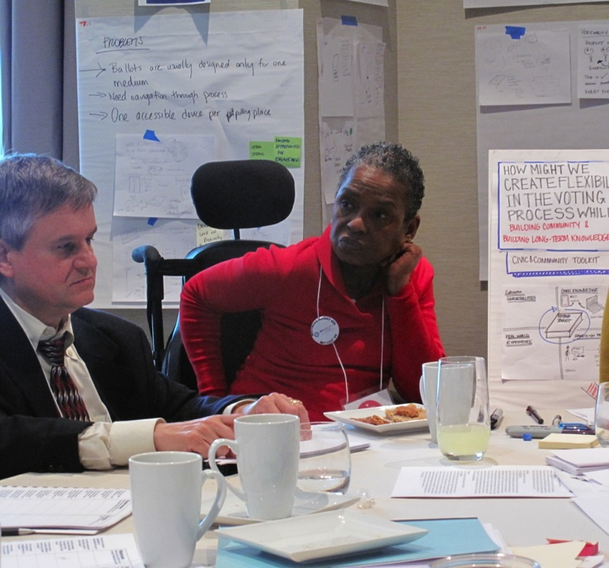
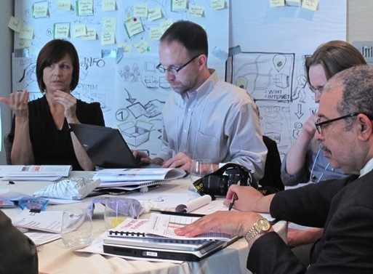
A better way to collaborate

Slide 22
What is the Design Studio
A process for bringing a team together to generate ideas from research, explore design solutions, and review them.
Motivated by
The need to fit into an agile process with its rapid sprints.
Wanting to make sure that design decisions were informed by research, even in that fast environment
A desire to bring the whole team together in the design process
Constructive evaluation – appreciation, not just critique
Agile user centered design: enter the design studio - a case study – Jim Ungar and Jeff White
http://dl.acm.org/citation.cfm?id=1358650

Slide 23
Process
The process includes research and design work leading up to the studio workshop
Research
user research done as preparation is the basis for design decisions
Design
can be done in advance or can be the first step in a design studio
Studio
workshop to explore alternative ideas, make decisions, consolidate deigns
Participants can include designers and non-designers
Ideate Collaboratively Using Design Studio – Jeff Patton
http://www.agileproductdesign.com/downloads/quickrefs/patton_design_studio.pdf

Slide 24
How to run a design studio
Pre-work: Decide on the scope of the day
Gather research materials, create a design brief.
First design sketches
Each participant generated 3-5 quick sketches. They should be rough, and illustrate 1 idea, not be a fully formed product design.
Presentation and critique
Each sketch is presented by the author. Participants then review the sketches, adding notes or comments. In some studios, participants vote on the best ideas (especially if there are a lot of them)
Second round
Each group or participant refines a design idea that got positive comments. Sometimes ideas are combined and a pair might work together. The critique process is repeated.
Decisions
The final result of the day is a decision about which ideas to carry forward (and some that may go in the backlog)

Slide 25
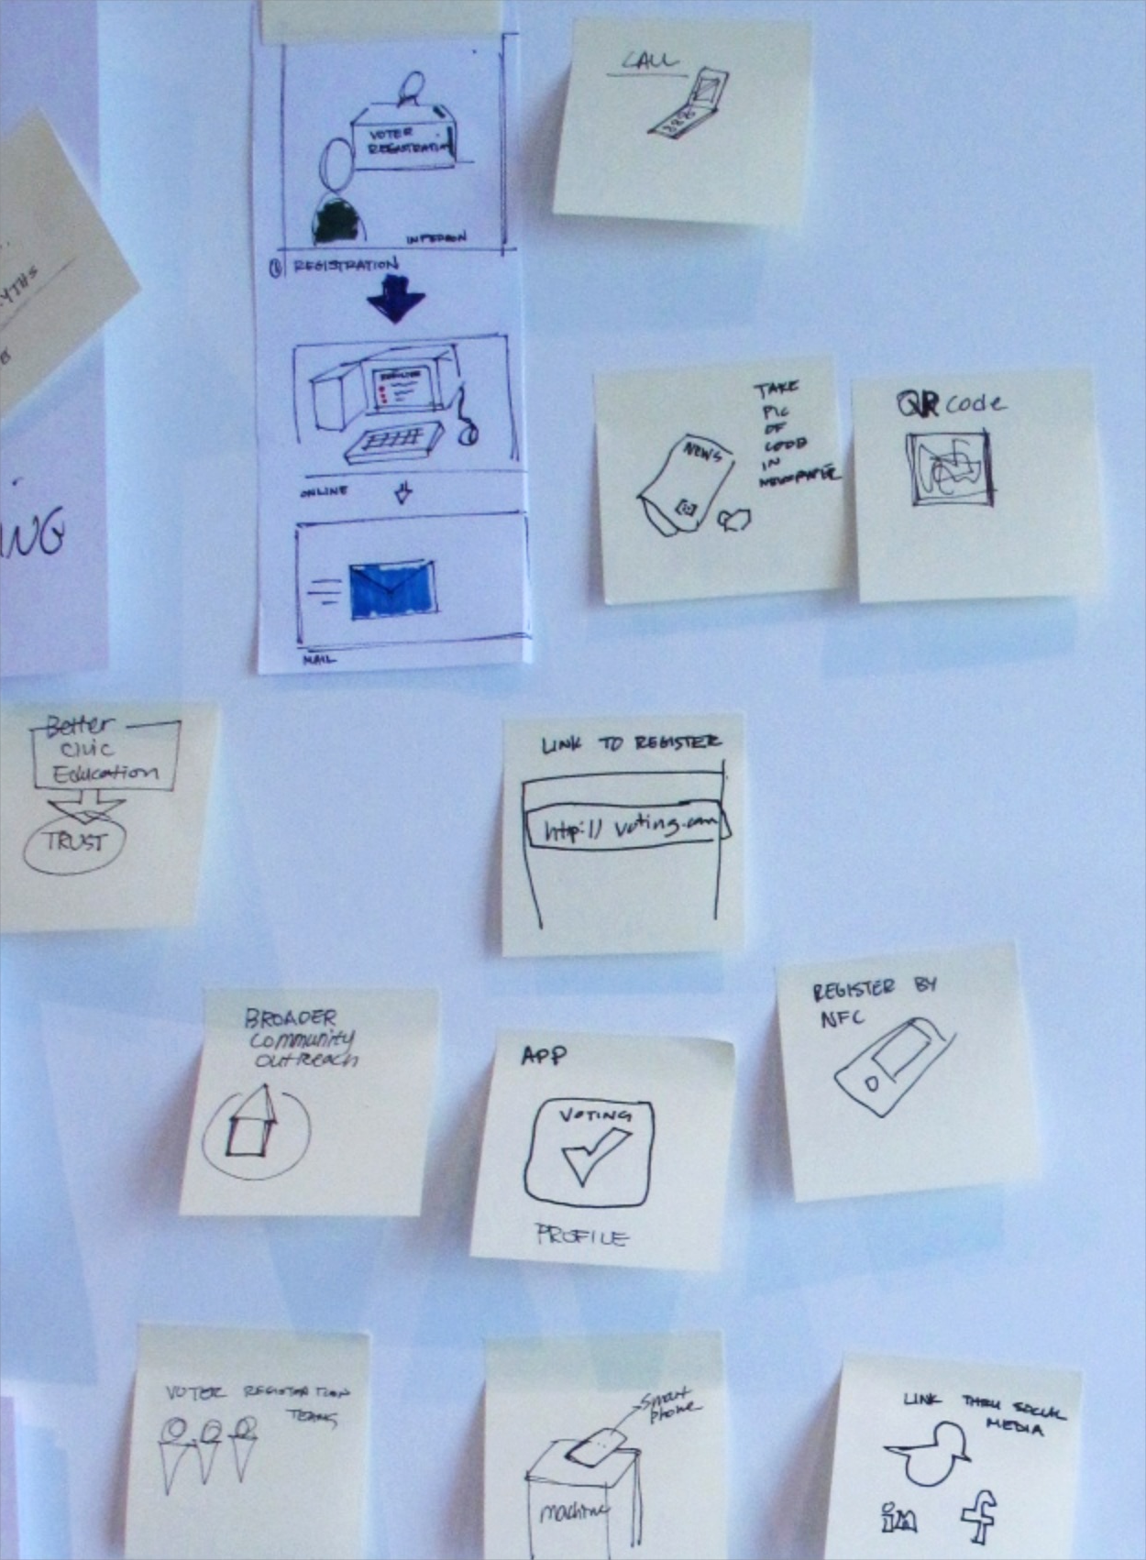
Visual reminders of early ideas
Accessible Voting Technology workshop at Georgia Tech

Slide 26
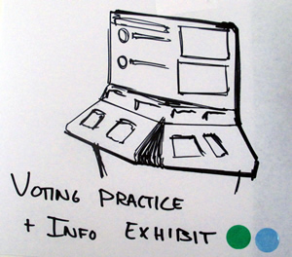
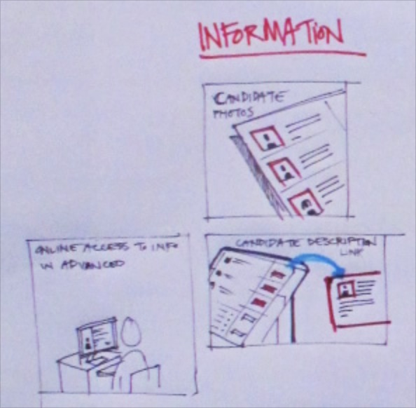
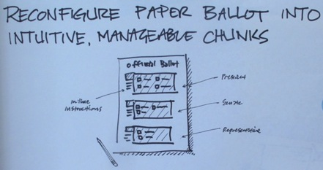
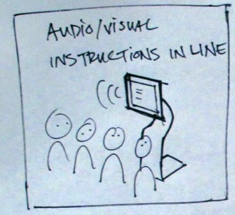
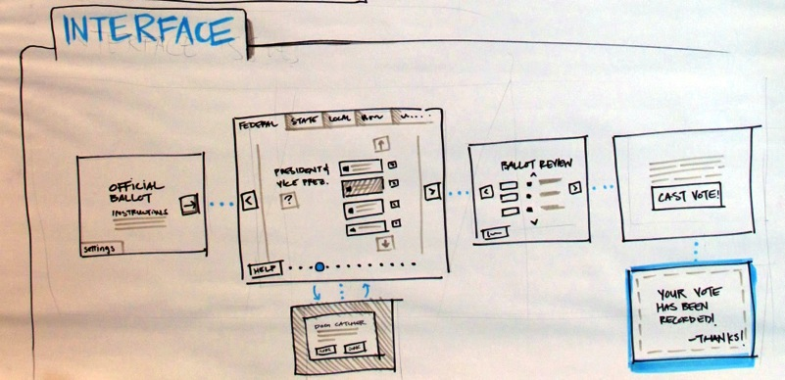
Initial Concepts
Accessible Voting Technology workshop at Georgia Tech

Slide 27
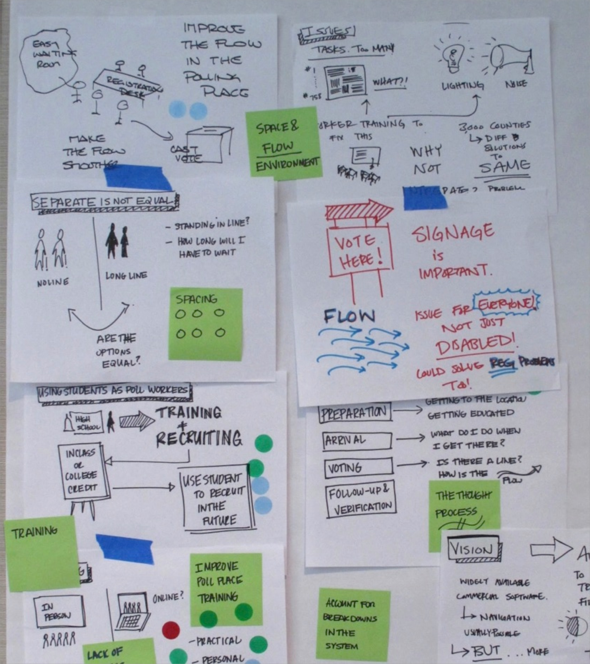
With comments and voting
Accessible Voting Technology workshop at Georgia Tech

Slide 28
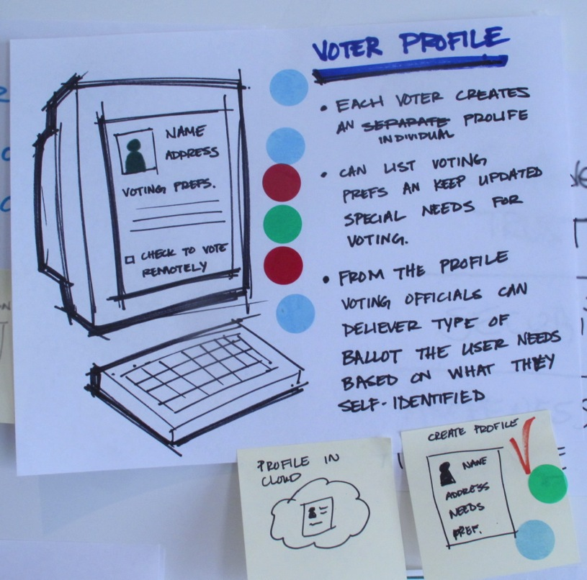
One concept, sketched out
Accessible Voting Technology workshop at Georgia Tech

Slide 29
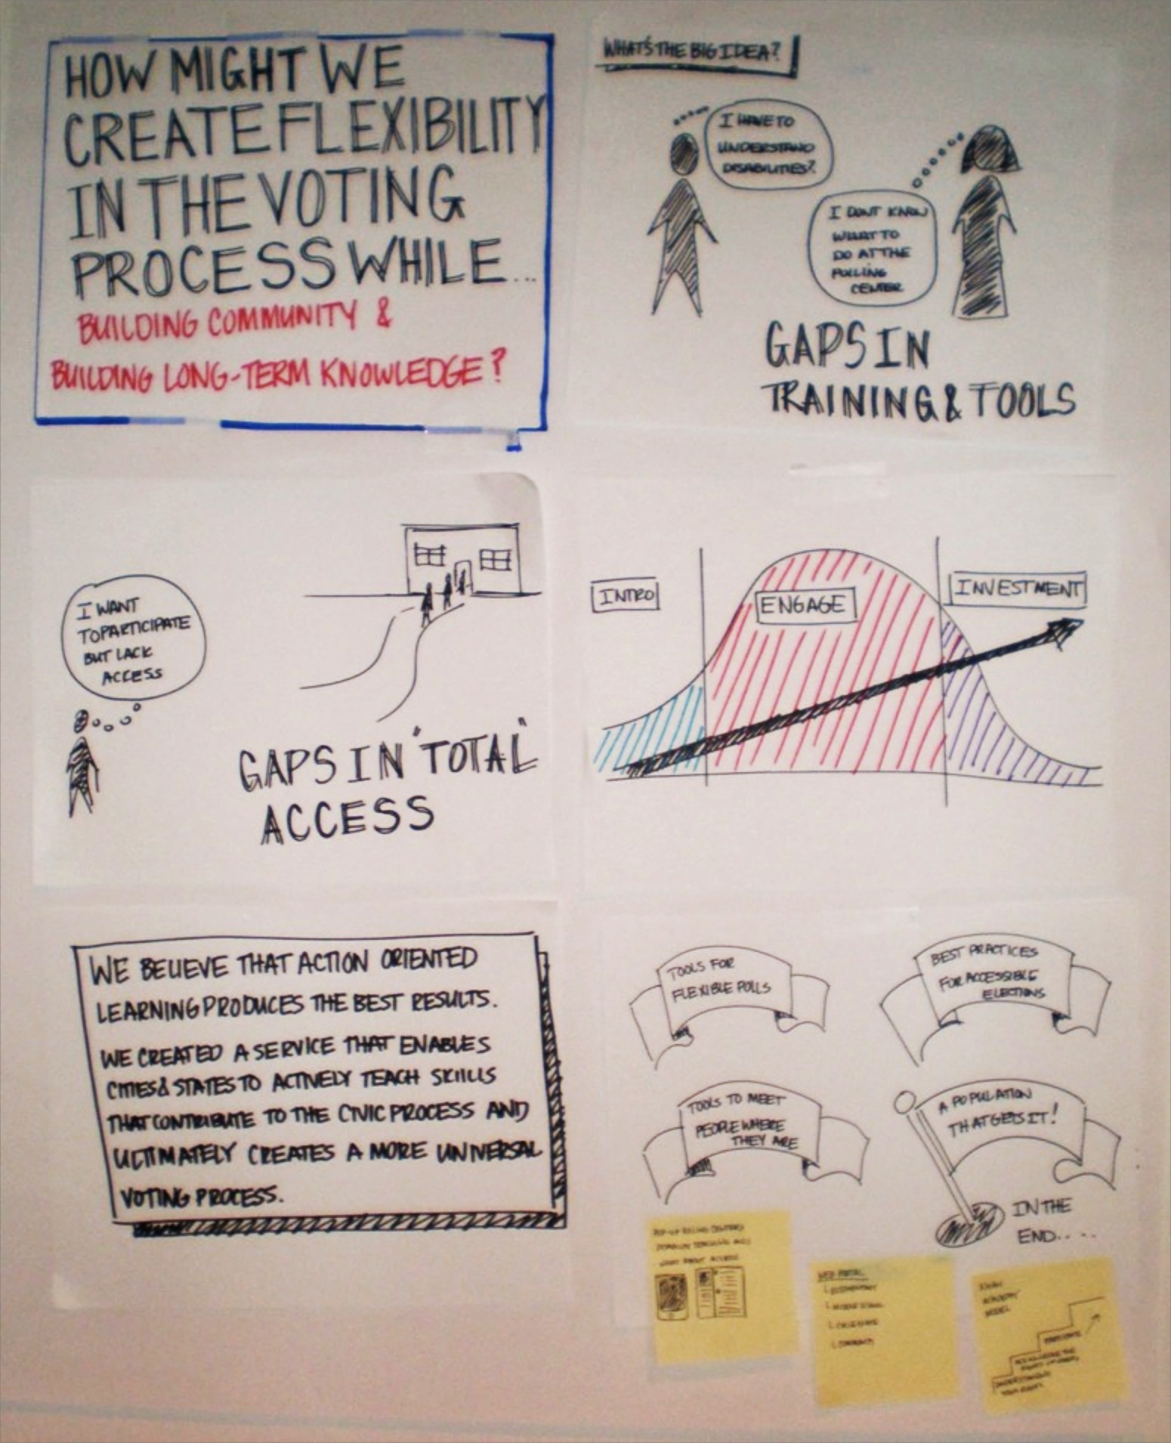
One design concept worked into a poster
Accessible Voting Technology workshop at Georgia Tech

Slide 30
Let's try it
Let's think about how to make it easier for people to use public transportation.

Slide 31
Meet the personas
Charlie
High functioning on the autism spectrum, but not comfortable in crowds.
Tasha
Running a business as an independent blind woman. Gadget geek.
Mary
Older adult with fading hearing. Kept the books for the family business, but not comfortable with devices.
Amy
Single working mother with a lively 2 year old in tow.
Minjun
New citizen, still learning English
Angela
Person with quadripelegia. Uses a power wheelchair, service dog, and typing stick.

Slide 32
First sketches 15 minutes
First design concepts
Working alone, come up with 3-5 ideas for ways to make it easier to use public transportation.
What is the barrier or problem it solves?
Who does it help – which persona are you thinking about? Who else would use it?
What's the medium or techology?
Where does it fit in the journey?
Create a quick sketch to illustrate the problem you are solving and your concept. Not a whole design, but a diagram, cartoon, rough screen... that helps explain your idea.
Go for quantity, and don't get bogged down.

Slide 33
Share the concepts
Present the concepts
In your groups, each person presents their concept.
You have one minute for each concept
The group can ask for clarification or add notes, but do not get bogged down in discussion

Slide 34
Refine the idea
Each group works together to further develop the concept
You can
Combine ideas
Adjust the concept to make it more universal
Identify
Steps in the journey the concept represents
Potential barriers it can help avoid
And how it will create delight

Slide 35
Ask a different question!

Slide 36
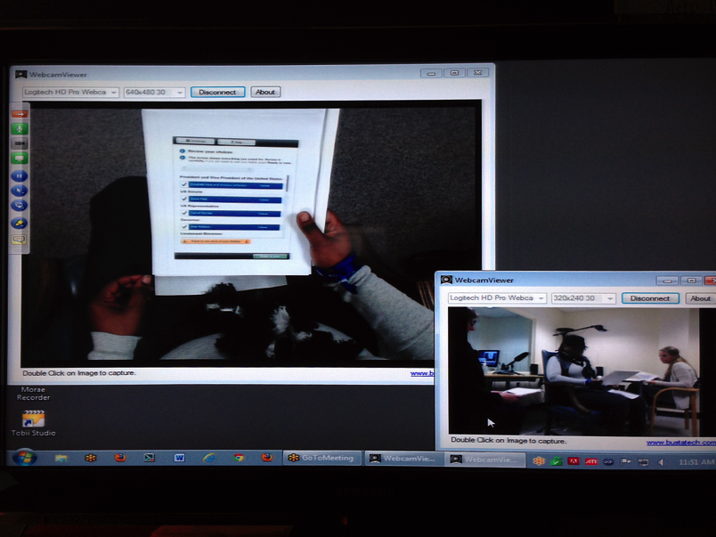
Design for extremes
In the Anywhere Ballot, we asked whether we can design an accessible ballot that will work for people with low literacy and low civic engagement.
Photos: The Anywhere Ballot, usability testing setup. University of Baltimore

Slide 37
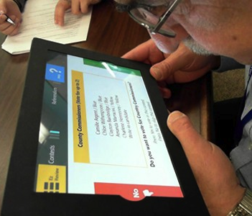
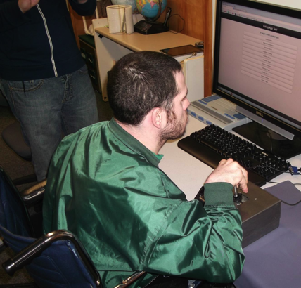
Change the question
The EZBallot asked, "What if we started with a linear process?"
In Voting with Joy, MSU asked, "What if we changed the input method?"
Photos: MSU: testing a joystick. CATEA: testing dual switch navigation on EZBallot.

Slide 38
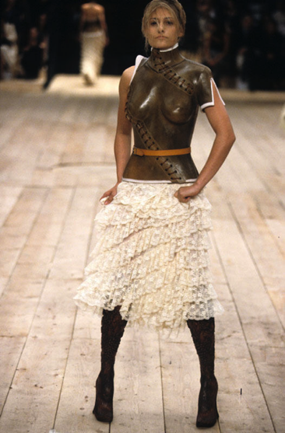
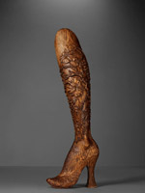
Create a new perspective
Design can make hidden things visible.
Aimee Mullins: My 12 pairs of legs: http://www.ted.com/talks/aimee_mullins_ prosthetic_aesthetics.html
Photo: blog.metmuseum.com: Alexander McQueen legs
http://blog.metmuseum.org/alexandermcqueen/tag/no-13/

