Slide 1
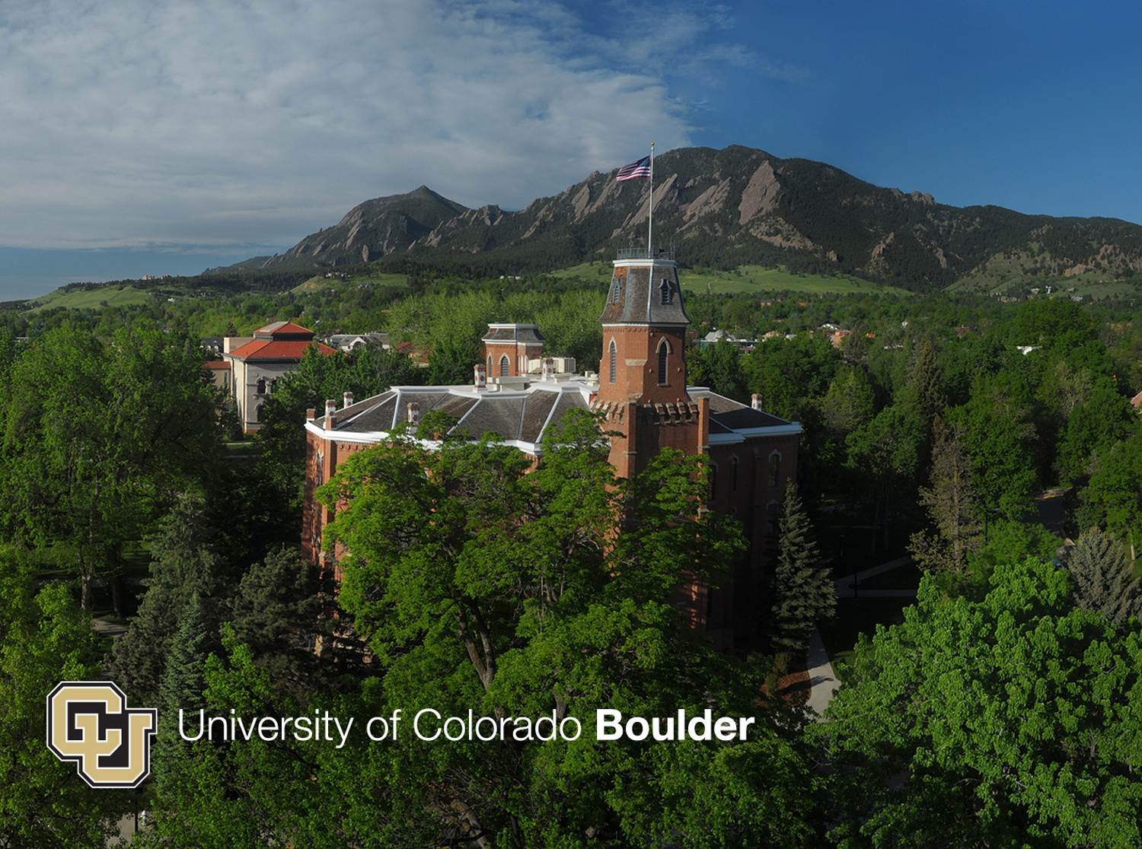
Headline
Notes:
Jill

Slide 2
Lessons Learned: How the University of Colorado Boulder is Addressing Digital Accessibility
Presenters: Jill Sieben-Schneider, Mark Werner, John Meister, Paul O’Brian
Notes:
Jill

Slide 3
Learning Outcomes
Attendees will understand the University of Colorado’s Department of Justice investigation regarding information and communication technology accessibility barriers and will be able to identify key remediation techniques that the institution is implementing to address the investigation.
Attendees will be able to identify information and communication technology accessibility barriers at their institutions and discuss potential solutions.
Notes:
Jill – finish by 3:00 mark

Slide 4
Definitions
Information and Communication Technology (ICT): means any electronic system or equipment, and content contained therein, used to create, convert, communicate, or duplicate data or information. The intent of this definition is to capture an inclusive spectrum of current and emerging technology.
“Digital Technology” and ICT used interchangeably
Notes:
Jill- finish by 5:00 mark

Slide 5
Pre-DOJ Era
No policy or standards
Study done and shelved
Budget deficit in DS, staffing, increase in students
Difficult relationships
Risk management approach
Notes:
John - Not that this was all bad. Put in context of economy, hiring, etc. – finish by 8:00 mark

Slide 6
DOJ Letter
Investigation under Title II of ADA
On behalf of students with blindness or low vision
Narrowed scope to specific audience, specific disability
Provided focus to response
Notes:
Paul

Slide 7
DOJ Letter
Further specificity: 6 areas cited
Google Apps for Education
Email, documents, spreadsheets, calendar, etc.
Digital textbooks “not made accessible in a timely way”
Less an alt format issue than a timing issue
Digital signs only in visual, touchscreen format
Notes:
Paul – “This is included in your handouts”

Slide 8
DOJ Letter
Further specificity: 6 areas cited
University portal
Registration, Bill payment, Scholarship information, Advisor appointments
Websites for homework and course-related content
Desire2Learn (our LMS), McGraw Hill Campus, Carnegie Mellon OLI, Kaltura, Turnitin, etc. etc….
Online placement and diagnostic exams
ALEKS (math), WebCape (languages), homegrown
Notes:
Paul – finish by 15:00 mark

Slide 9
CU’s Response
Initial answer
Gather DS staff, ADA Coordinator and OIT service managers for cited services, along with University General Counsel
Each service manager drafted analysis of current accessibility state for each cited service
Commitments made for auditing, documentation, remediation and structural organization changes
Notes:
Mark

Slide 10
CU’s Response
Project created
Project Manager appointed
Initial struggles around scope, barriers
Resolution project has two aims:
Address the issues cited in the DOJ letter
Create a structure that will allow CU to foster a culture of accessibility, and continuously improve accessibility of both new and legacy ICT
Notes:
Mark

Slide 11
CU’s Response
Project structure
Executive team, steering team, working group
4 working teams, each co-chaired by OIT and DS/ADA staff, to address DOJ investigation
Policy
Remediation
Support
Communications
Notes:
Mark – show project structure chart – finish by 22:00 mark

Slide 12
CU’s Response
External engagement
The Paciello Group (TPG) engaged to help draft a roadmap for long-term change.
Interviewed over 100 people from a variety of areas
Reflected their feedback to executive level
CU hosted a 2-day symposium of peer institutions who are leaders in ICT accessibility and/or have been through similar investigations:
University of Montana (OCR Reference No. 10122118)
NC State (OCR Reference No.’s 11-98-2046, 11-99-2055, and 11-99-2142)
UC Berkeley (http://dralegal.org/sites/dralegal.org/files/casefiles/settlement-ucb.pdf)
Temple University
University of Washington
Notes:
John

Slide 13
CU’s Response
Changes in OIT
Appointment of Chief Digital Accessibility Officer
Program Manager for Accessibility
Universal Instructional Designer
Usability/Accessibility Lab created
Managed by staff
Hired students with disabilities
Changes in DS
Assistive Technology Lab renamed the Alternate Format Production Access Center
Transition of assistive technology duties to OIT
Captioning responsibilities now shared with OIT
Hiring of two Disability Access Coordinators
Hiring of an Accommodation Business Support Specialist to accommodate remediation work of DS Program Manager
Notes:
John – show staff org chart? – finish by 28:00 mark

Slide 14
Team Outcomes
Remediation
Some done and some still ongoing
Policy
Vetted to CU community and higher level stakeholders with final policy being introduced to Board of Regents; approved in September 2015
Communication
Creation of accessibility web site
www.colorado.edu/accessibility
Support
Recommendation to Executive Team: new hires and organizational structures
Notes:
Jill– finish by 30:00 mark
Policy: http://www.colorado.edu/accessibility/sites/default/files/attached-files/ICTPolicyFINALDRAFT%20feb.pdf
Standards: http://www.colorado.edu/accessibility/sites/default/files/attached-files/ICTStandardsFINALdraft%20feb.pdf

Slide 15
Closing of DOJ Investigation
Received Closing of Investigation letter in late May of 2015
Goal Unchanged
Create an IT environment that ensures that a person with a disability is afforded the opportunity to acquire the same information, engage in the same interactions, and enjoy the same services as a person without a disability in an equally effective and equally inclusive manner, with substantially equivalent ease of use.
Taken as a compliment to our commitment, but on the other hand we will miss having that clear imperative to apply to vendors, campus depts.
Notes:
Jill 33:00 mark. – Show IT governance chart. Included in handouts. A lot of work has been completed but much more work is still required. The initial remediation of Google and D2L is complete and we have completed remediation of Qualtrics, Turnitin, and Voicethread. In some cases remediation involves providing guidance for faculty and staff to know how to use accessibility features, sometimes we need to provide work-arounds for known issues, or (as in the case with Qualtrics), we have turned off specific features.
We have completed many audits including for example D2L, various portal functions, and placement exams. Audits have been completed using both the campus accessibility testing lab and outside vendors, OIT has also completed an audit of all digital signs on campus and has begun a project to create a service to provide digital signage service and establish requirements for departments for whom the campus service will not meet their needs.
We are also working to address new services both for OIT, campus departments (for example a new life-safety mobile application) and university wide applications (for example, the upgrade of the new human resources and financial management system).
There is much more work to be done including digital text books, placement exams, digital signs, and other academic resources are in progress.
We know more than what the DoJ listed is not accessible, the campus has hundreds of IT services over 1000 web sites. The ongoing program OIT is creating will prioritize and address these but it will take time.
As part of Dan’s dual campus and system administration role he is working with System Administration both to address critical university wide services (such as HR and timesheets) and consider how to help address accessibility with the other campuses.
It is important to note at this point that not everything can immediately be made accessible. Services with accessibility issues will be published on the accessibility web site so that we can be transparent about campus decisions.

Slide 16
Lessons Learned
Principles
Must have executive buy-in. The higher level your support, the better your chance of success. The difference between support and prioritization.
Investigation not necessarily a bad thing. Sometimes a clear crisis is what drives learning & growth. (And can help produce that buy-in.)
Put the “other” outside the organization
Accessibility is a process, not a toggle
All steps are good steps. Cultural shift is a long game.
Notes:
Mark 38:00 mark

Slide 17
Lessons Learned
Principles
Make relationships the foundation of your approach. E.g. co-leadership of teams. Open dialogue between silos.
Transparency. Don’t be afraid to show weakness, discuss flaws.
A formal project management approach can aid with scope, structure, time allotment/deadlines, prioritization, etc.
An approach grounded in ethics/morals, not just compliance. Inspire allegiance rather than mere obedience. More than just risk management.
User experience as a guiding star. The level above accessibility.
Notes:
Paul 43:00 mark

Slide 18
Lessons Learned
Resources
Policy and accompanying standards
Accessibility and Usability Lab
TPG engagement
Notes:
John 45:00 mark

Slide 19
Insights
Analogy to Title IX
Analogy to Security
Cuts across all areas of IT. Should be built in from the beginning. Realization dawning on vendors.
Again, start from relationships and communication. Coalitions, town halls, shared governance, public feedback, working with fiefdoms, “pre-wiring”
Be okay with slowing the process down if needed regardless of timeline. Do it right the first time.
Include procurement
Think broadly – who else needs to be included?
We missed some colleagues initially: Library, Bookstore, Various IT shops on campus
Notes:
Jill 50:00 mark

Slide 20
Our Contact Info
Jill Sieben-Schneider, Assistant Director of Disability Services: jill.schneider@colorado.edu
Mark Werner, Associate Director of Academic Technology: mark.j.werner@colorado.edu
John Meister, Director of Disability Services: john.meister@colorado.edu
Paul O’Brian, OIT Supervisor: paulobrian@colorado.EDU
Notes:
Jill

