Slide 1
Central Access
Central Access
Central Access
Central Access

Slide 2
Presenters
Wendy Holden
Manager of Disability Services
Central Washington University
Marshall Sunnes
Coordinator of Central Access
Central Washington University

Slide 3
What We’re Covering
Who We Are
Central Access’s Approach to Math Accessibility
Tools to Get the Job Done

Slide 4
Take-Aways
No “one size fits all” solution to math
You can make accessible math Word docs
CAR reads math
CAR Check and CAT are resources to get you there

Slide 5
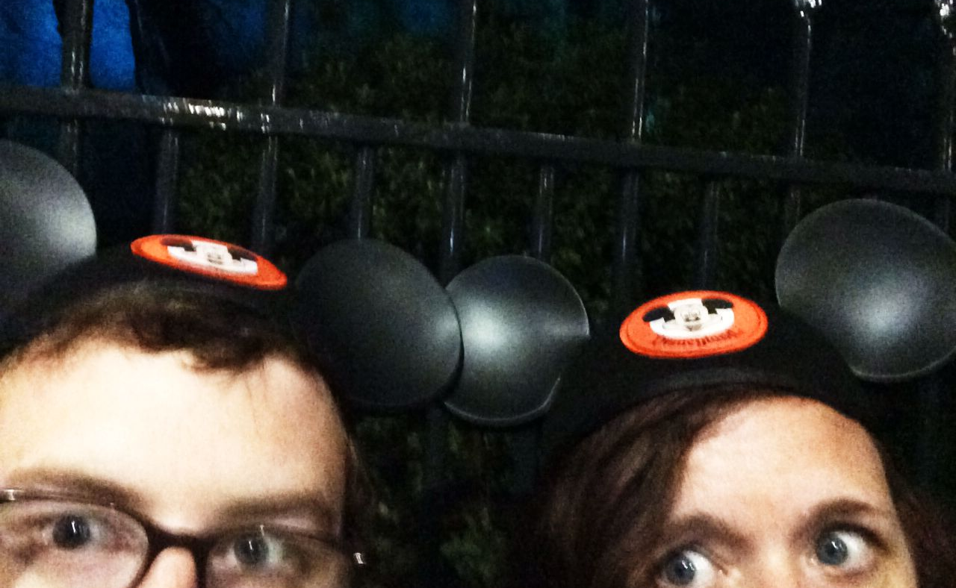
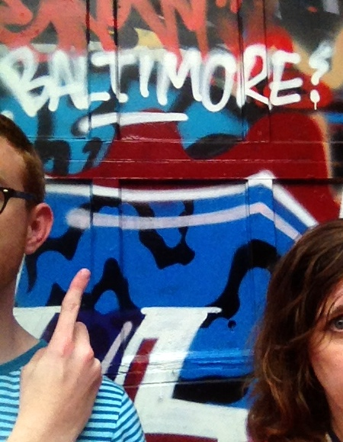
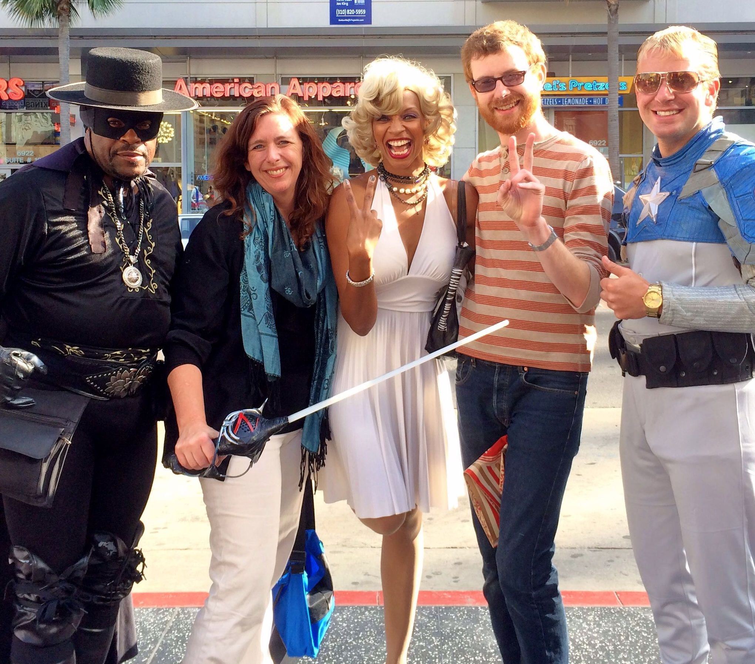
Notes:
If you’d told us three years ago that we would be a part of this conversation about math accessibility, we would have laughed. We have had the opportunity to work with people with vast experience and incredible knowledge.

Slide 6
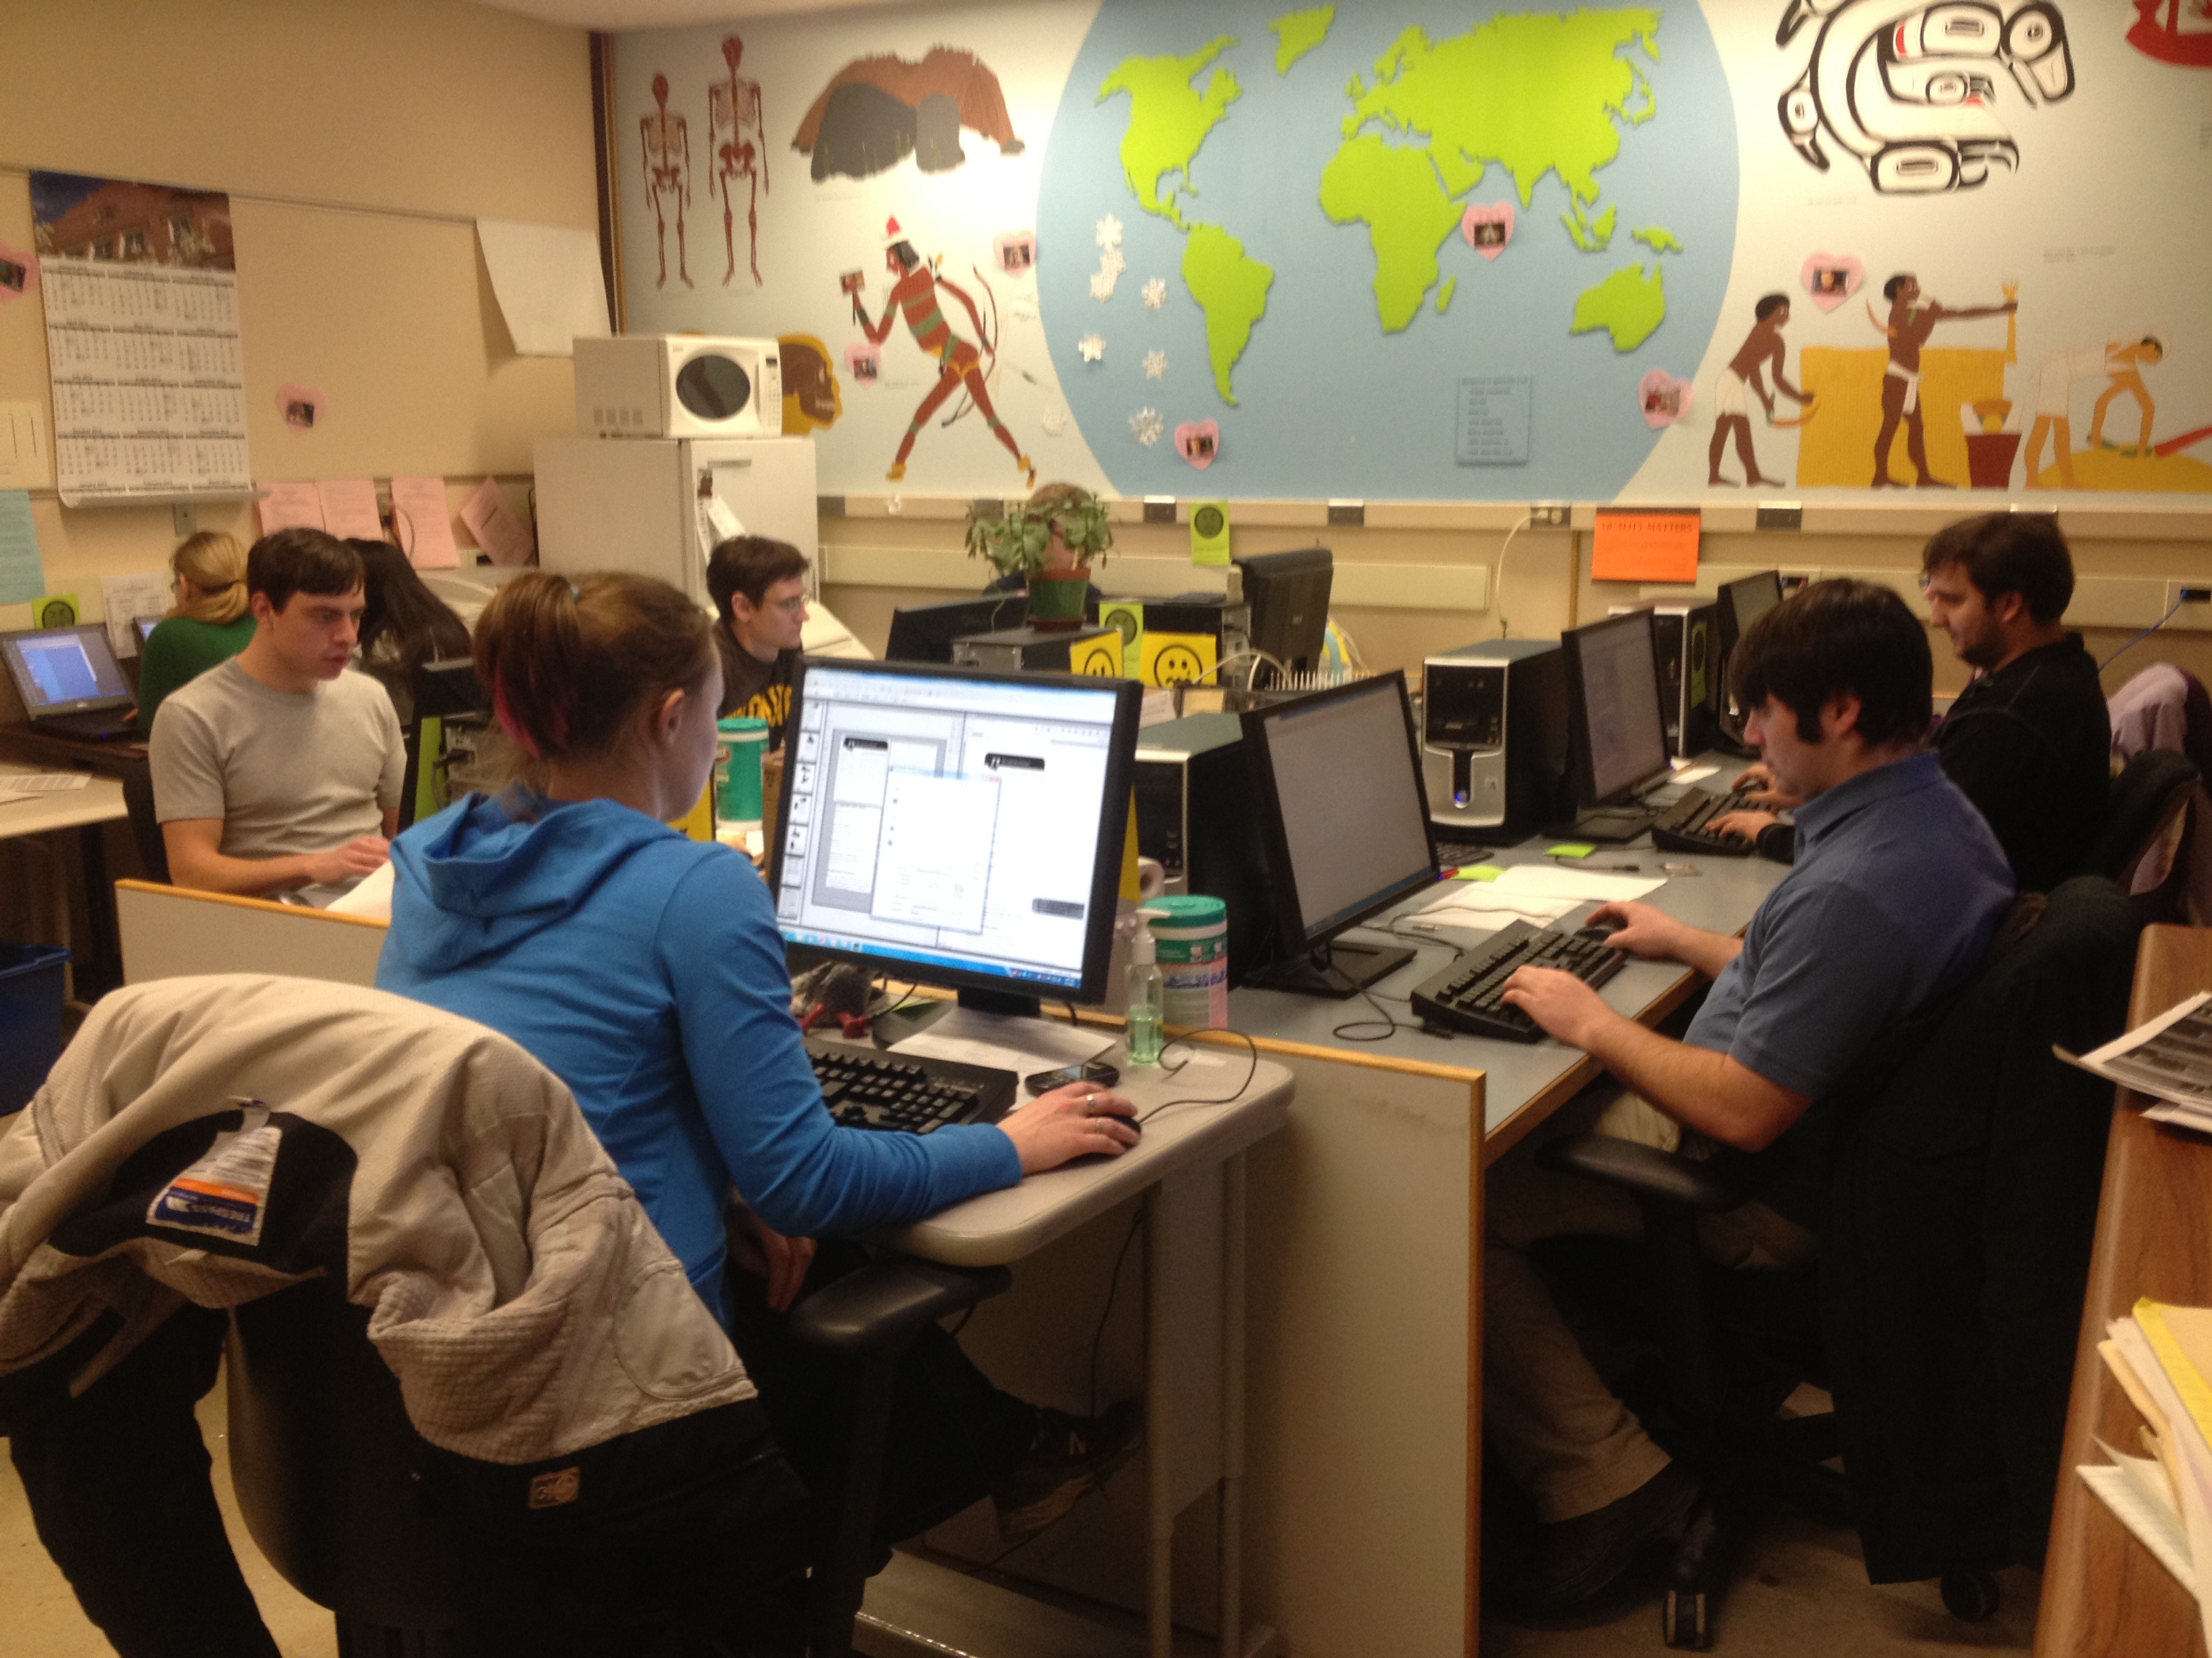
Notes:
Marshall and I began working together three years ago in a crowded alt production lab on a remote corner of the campus of Central Washington University. I was a temp hourly with no experience in accessibility or higher ed and Marshall was a student employee.

Slide 7
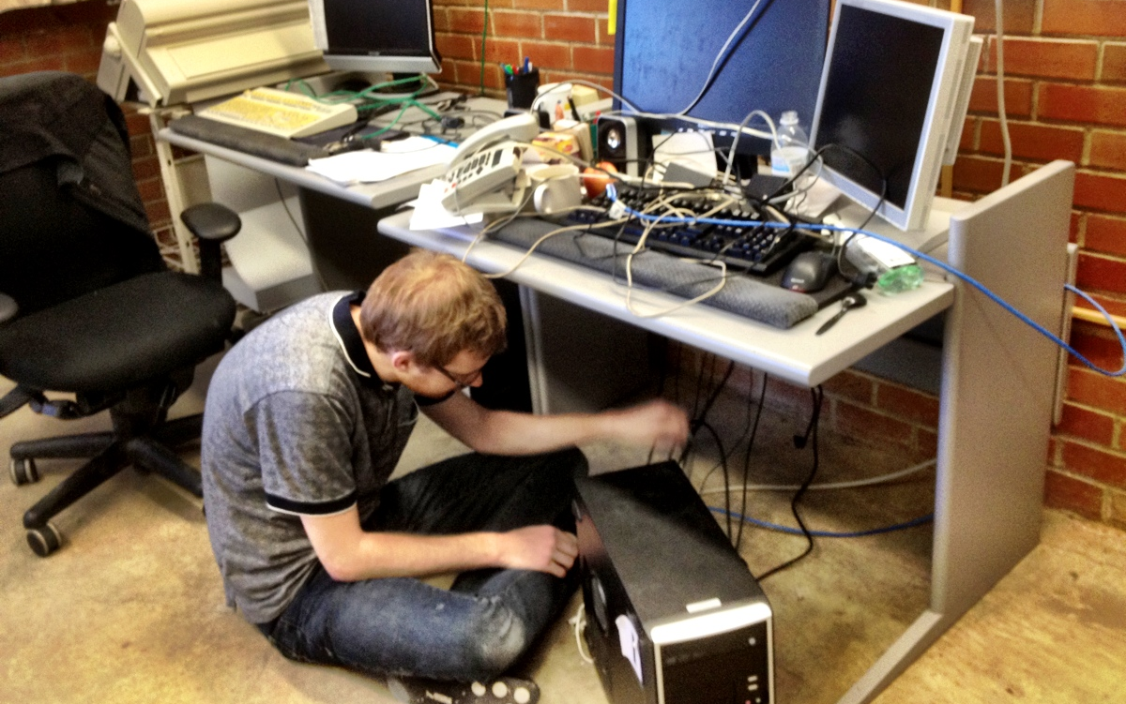
Notes:
We were located in a building on the other side of campus from our department, and as a self support business we were a bit of an oddity in the Human Resources department. As a result we became very good at creative problem solving and being resourceful. We embraced the philosophy that it is better to ask forgiveness than permission.

Slide 8
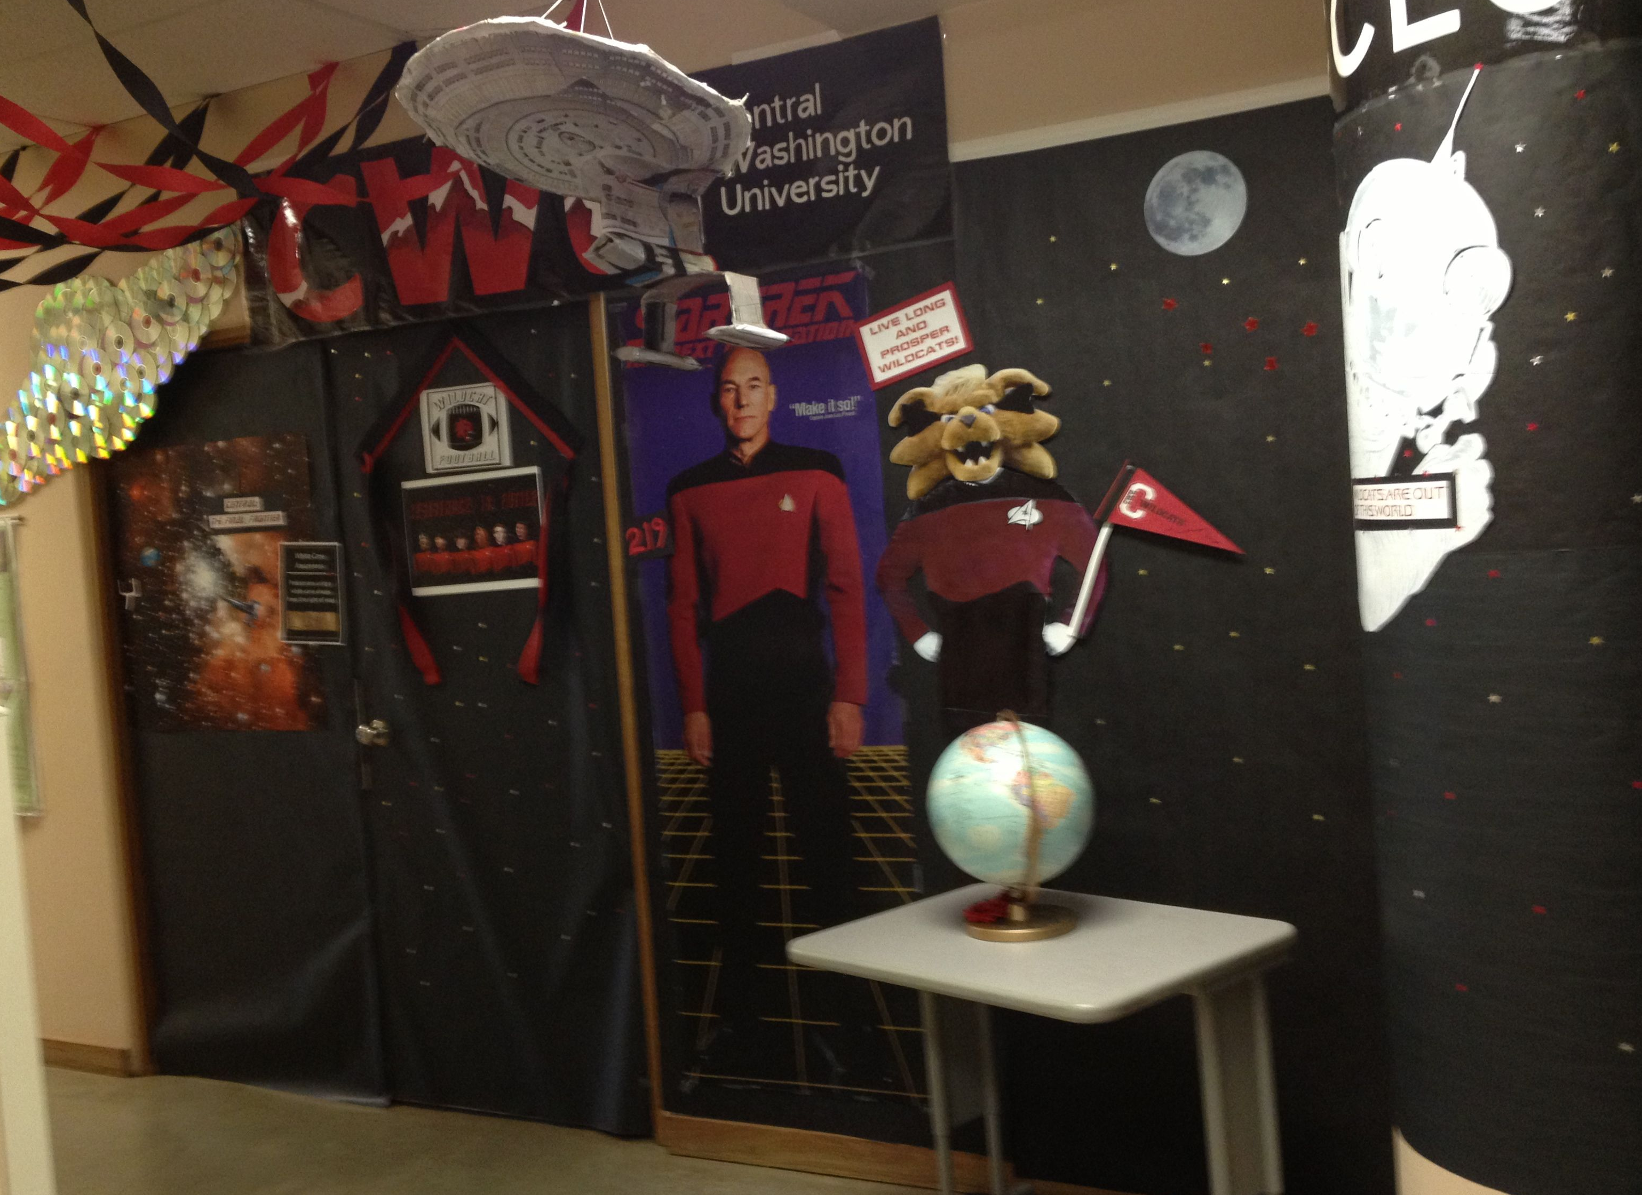
Notes:
Being a bit isolated had its perks. We were able to decorate our door like this, and leave it this way for over a year before anyone suggested we tone it down. Figuring things out on our own also meant that we were free from limits that rational people might have imposed on themselves.

Slide 9
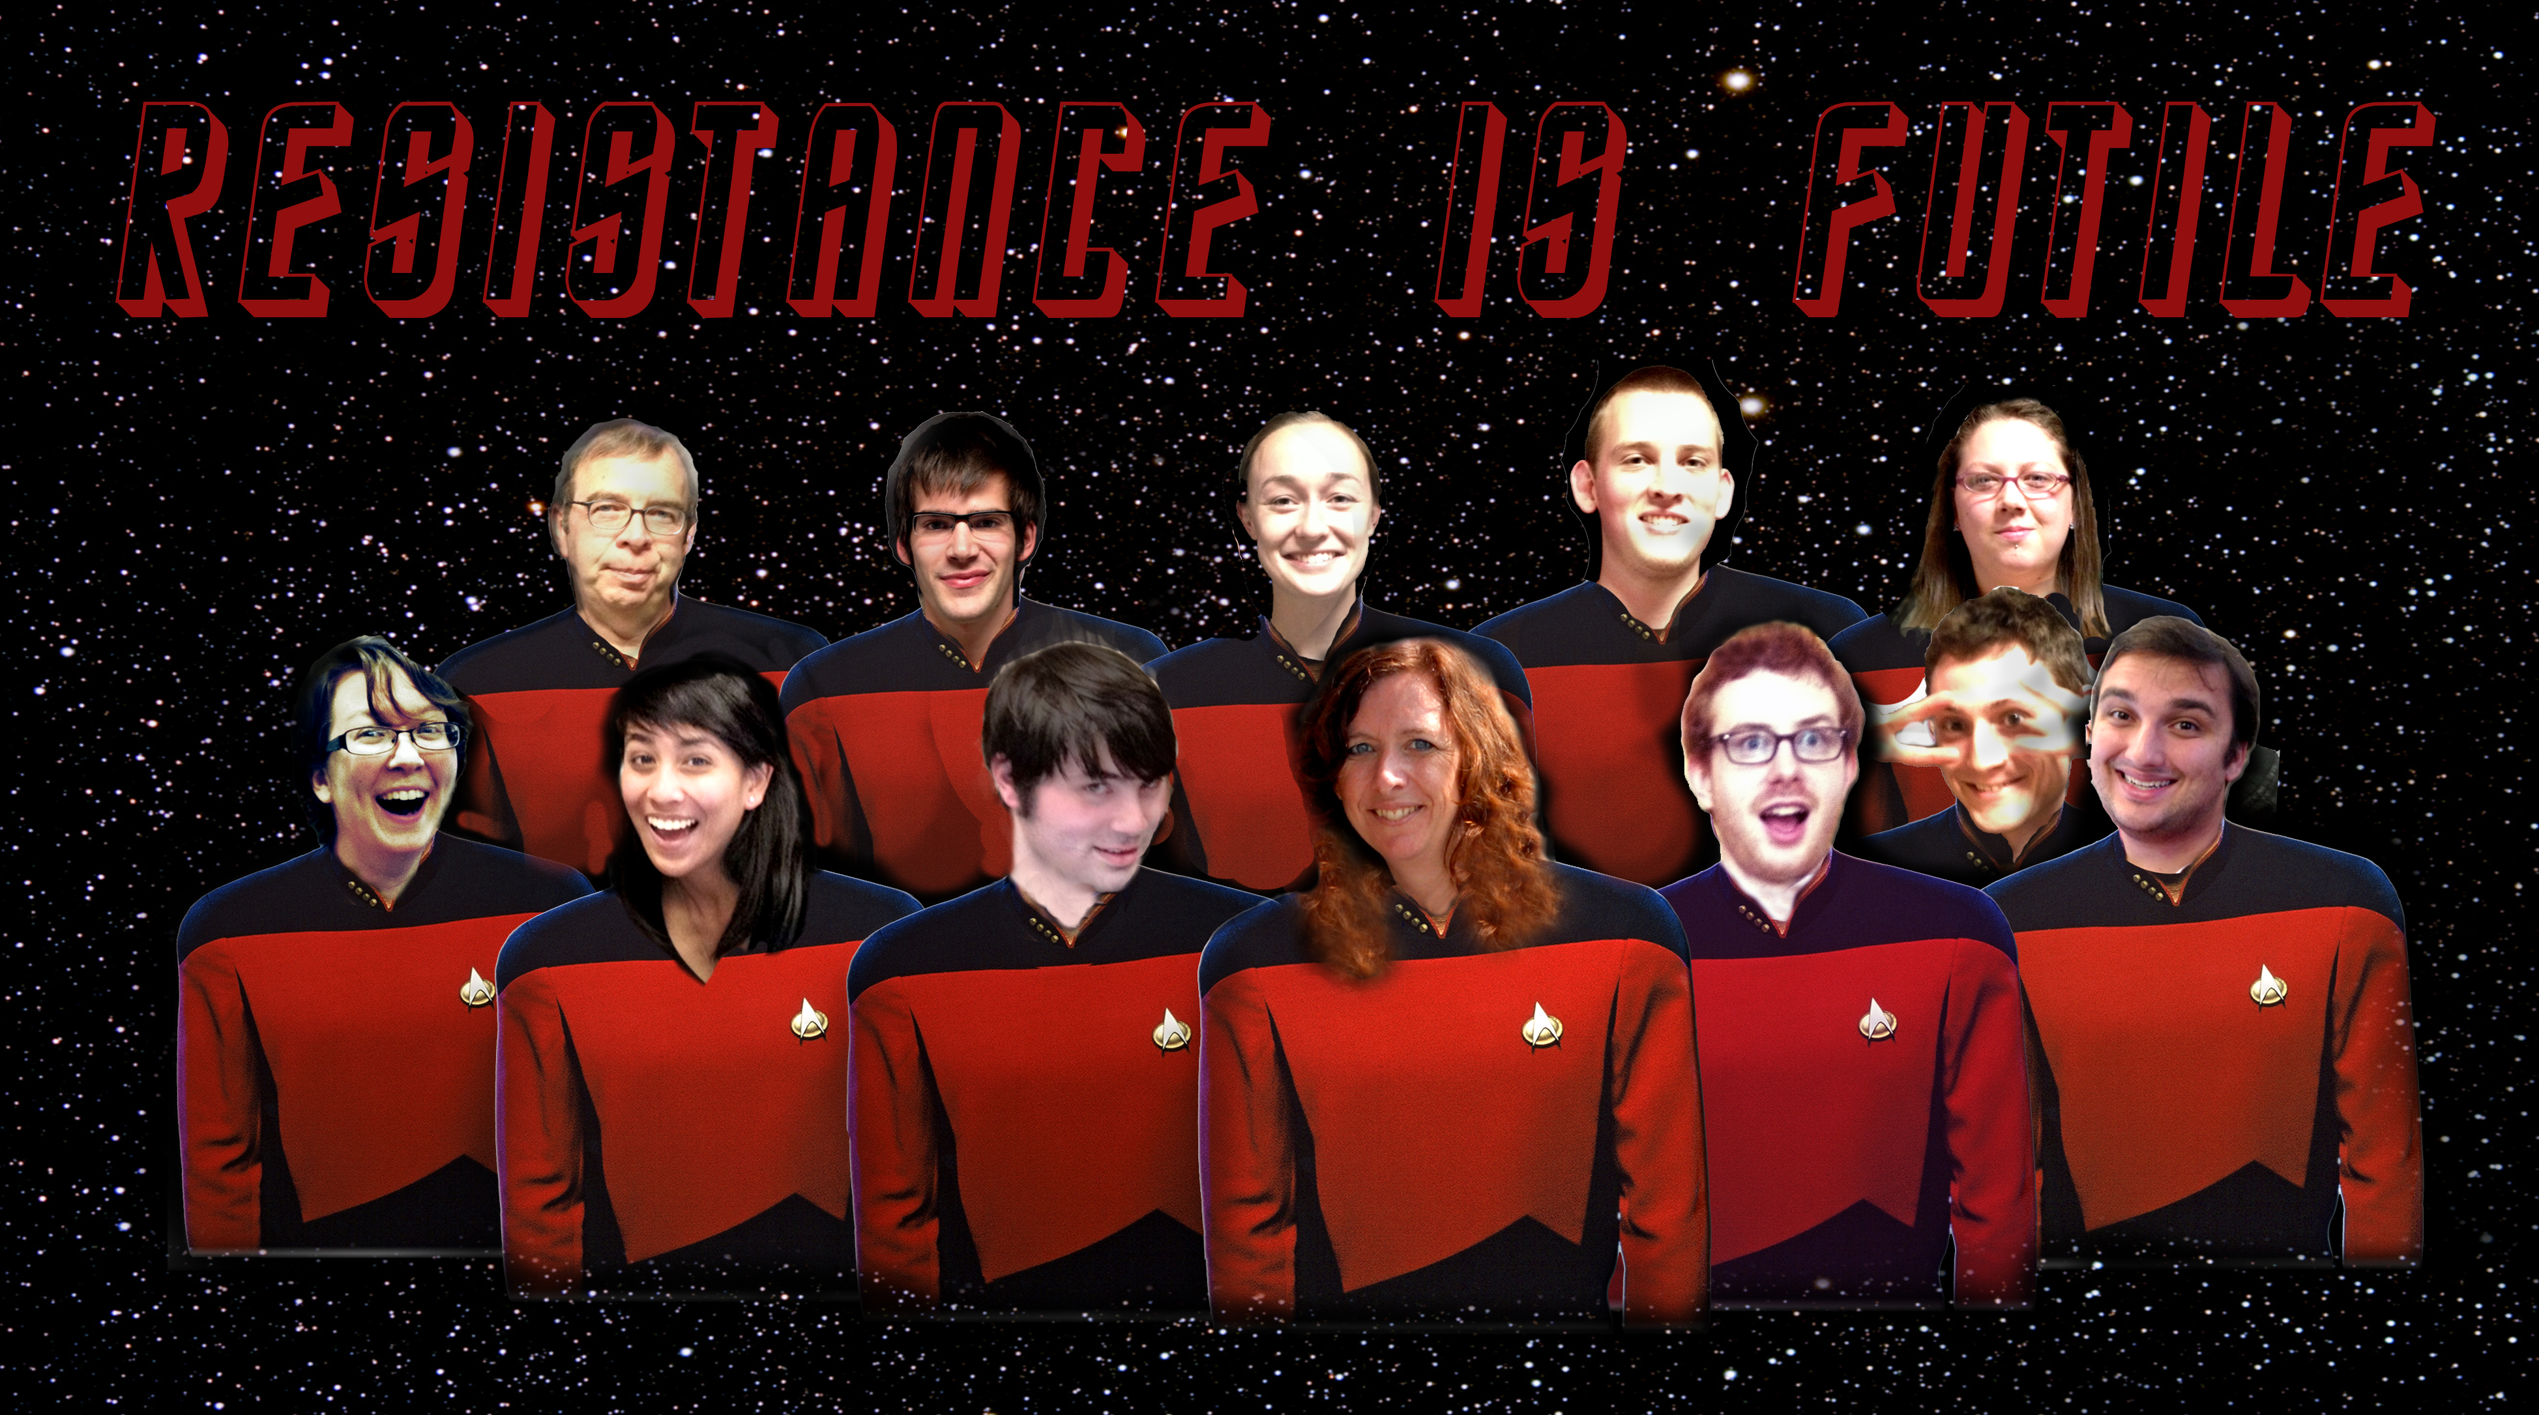
Notes:
Added this slide just for Wink. She has a much more impressive Star Trek connection than we do, we share a love of all things nerdy, including Star Trek.

Slide 10
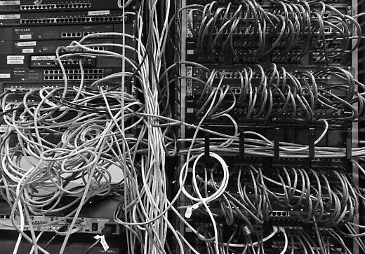
Notes:
Prior to the creation of CAR, Central Access produced materials in a variety of formats. Each format had slightly different rules for editing and different post production procedures. Ensuring that the documents were correctly edited required technicians to consult different tip sheets for each format. Post production was even more problematic. Producing audio files at the correct rate, with the desired voice, saved in the requested format demanded a great deal of individual attention.

Slide 11
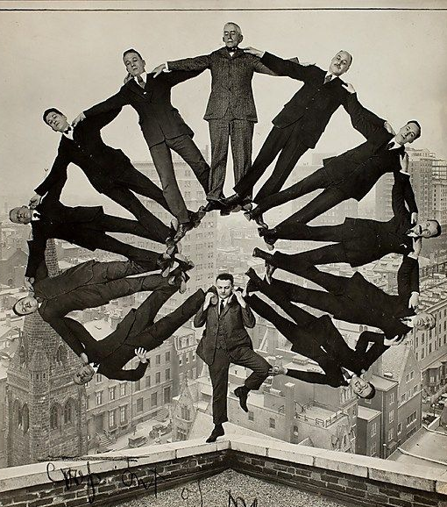
Notes:
In addition to providing materials to students attending CWU, Central Access produces materials for schools across the country. Typically we receive the projects that are too difficult, or books that have been requested too late to be produced in house. For many of our projects the requested completion date is ASAP. When I started on September 1st, I had no idea what I was walking into. Trying to balance the needs of internal and external clients was overwhelming. I spent most of October apologizing for not being able to meet deadline. (Actually..most October avoiding people and most of November apologizing) but you get the idea.

Slide 12
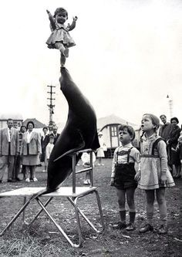
CENTRAL ACCESS RE
Notes:
Marshall and I were putting in long hours and had student technicians using every computer we could get our hands on. We couldn’t work any harder so we knew we needed to find a way to work smarter. We needed to find a way to balance the need for efficiency without compromising the quality of the final product. Of course the most challenging projects were math.

Slide 13
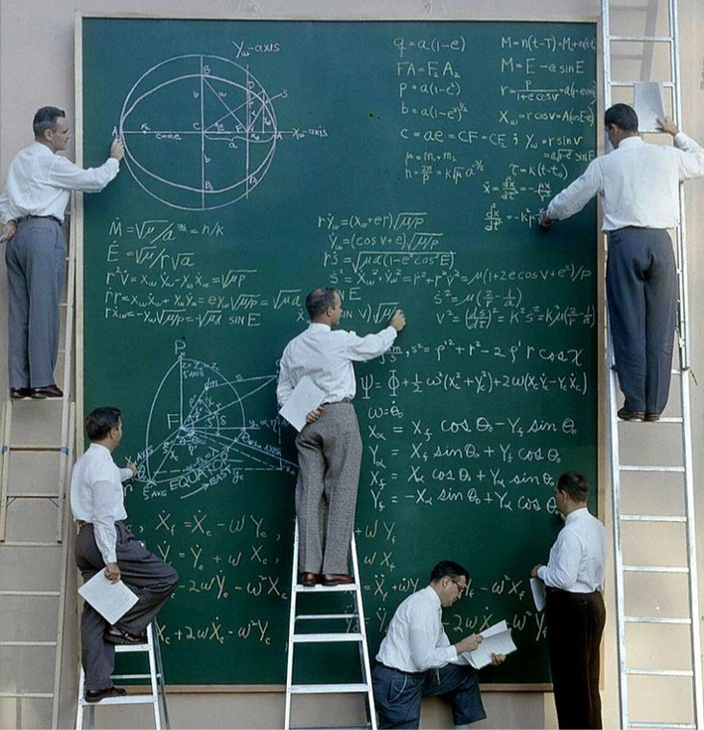
Notes:
Students who require math in an alternative format have had few options for accessing their materials. MathPlayer was a popular choice however upgrades in web browser technology eliminated that option. We had completed an entire quarter’s worth of materials for a student and he was unable to use. The other option was MathDAISY. This conversion process was time consuming and prone to technical glitches. Files containing math equations required hours to convert. Occasionally files would fail to convert for unknown reasons. Error messages provided no information and locating the problem, which could be as minor as an extra space before an equation, was like finding a needle in a haystack. This type of delay created post production backlogs in the lab and made it difficult to meet project deadlines.
I can remember one particular occasion where we had edited an entire book but were having trouble getting the materials through the pipeline. The client was frustrated, their student was frustrated and we were frustrated. The worst part was that the work that mattered was done.

Slide 14

Notes:
We started brainstorming another way to help students access math.
We began working with a group of students from a CS class who needed a senior project. Their work formed the basis for the Central Access Reader. When the project was done we hired Spencer Graffe, the student who had taken the lead in the group project to continue his work.

Slide 15
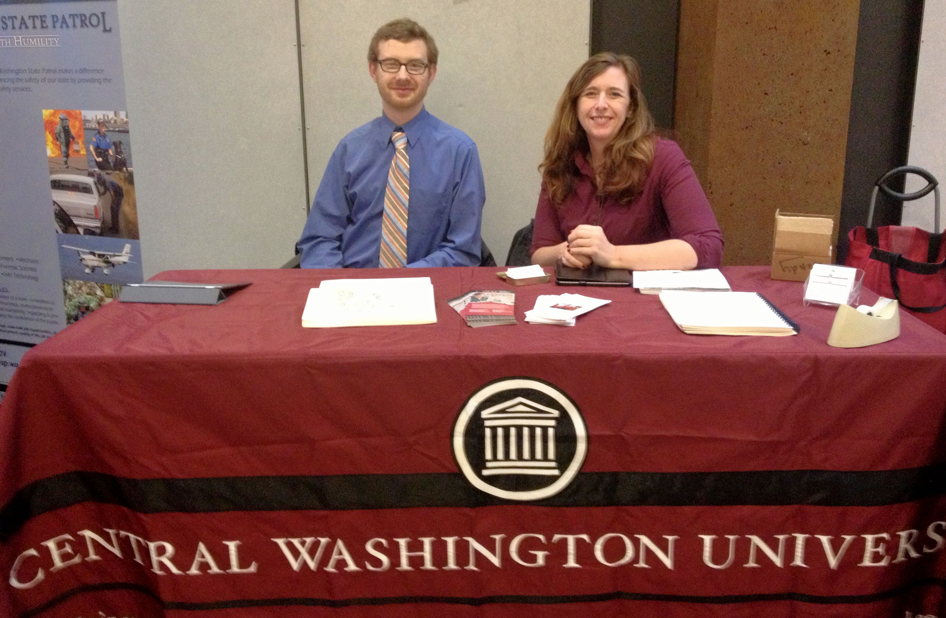
Notes:
Around this time our responsibilities shifted. Marshall went from a student employee to a full time employee to the Coordinator of Central Access. I went from spending my days in the lab with the paper mache Enterprise to working in the HR office surrounded by grown ups. I met with students to determine accommodations, handled faculty education, campus outreach and whatever else came my way. Working in this new role gave me the opportunity to explore ways that people interacted with alt format and identify ways to improve their experience.

Slide 16



Software Covered

Slide 17
Central Access Reader
Text-to-Speech
Opens Word Docs & Pasted Text
Highly Customizable
Reads Math
Exports to MP3 & HTML
STUPID SIMPLE

Slide 18
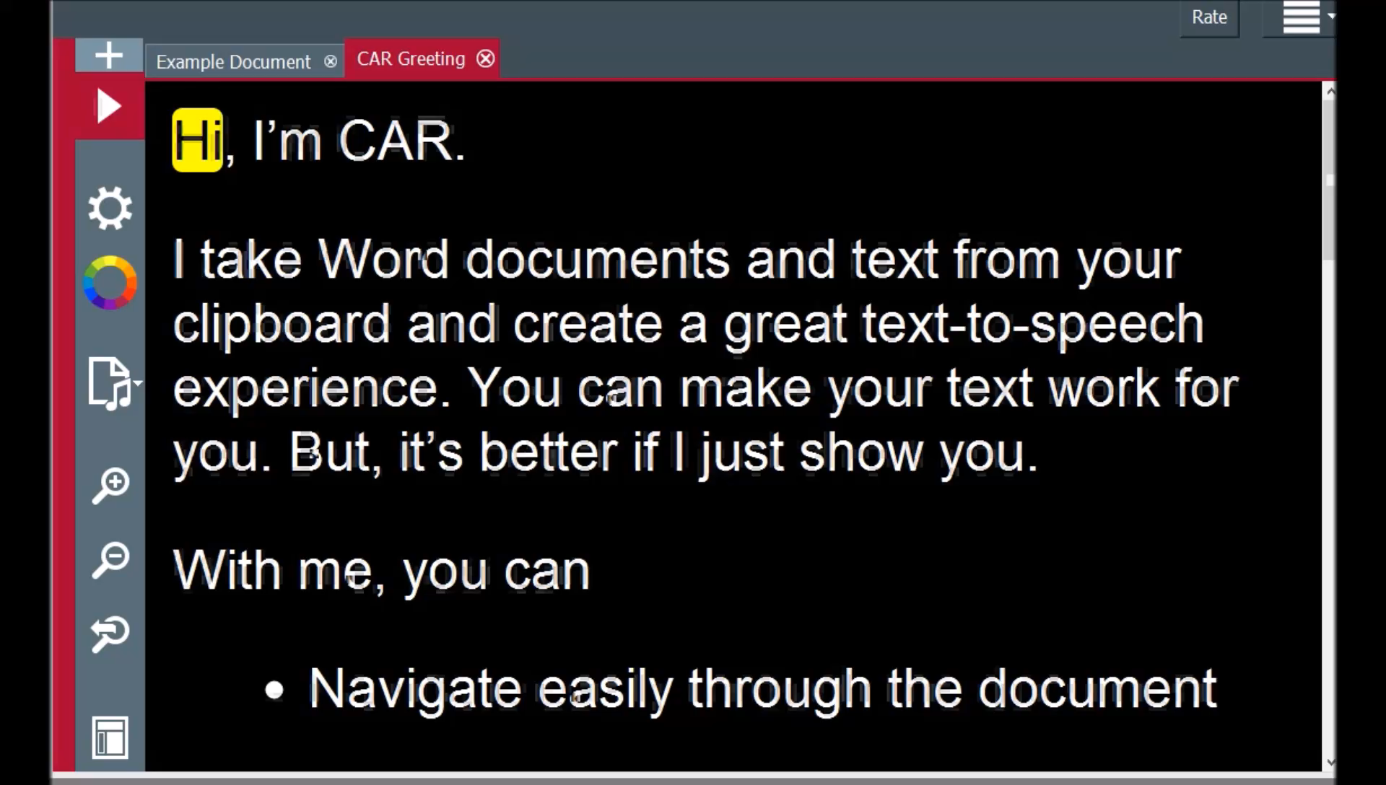

Slide 19
CAR Check
Add-in for Windows Word
Made With Faculty in Mind
Fixes Big Accessibility Issues
Stealth Teaching

Slide 20
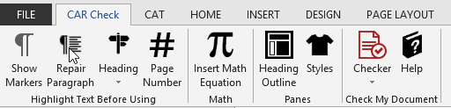

Slide 21
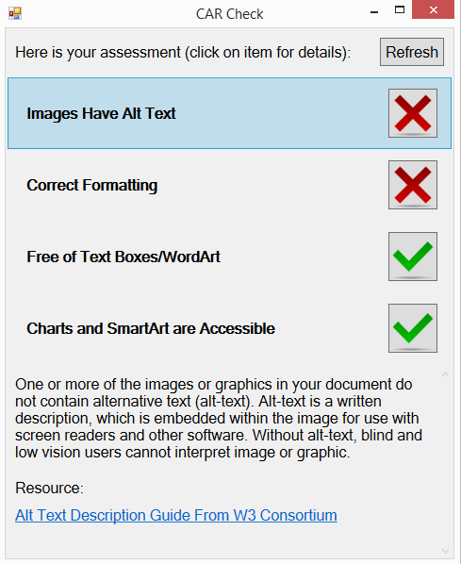

Slide 22
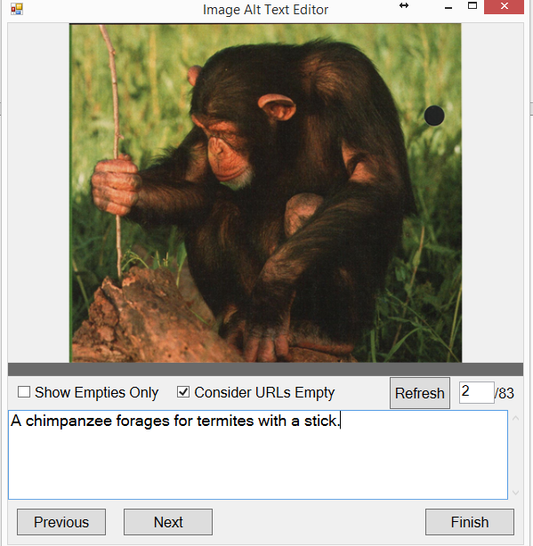

Slide 23
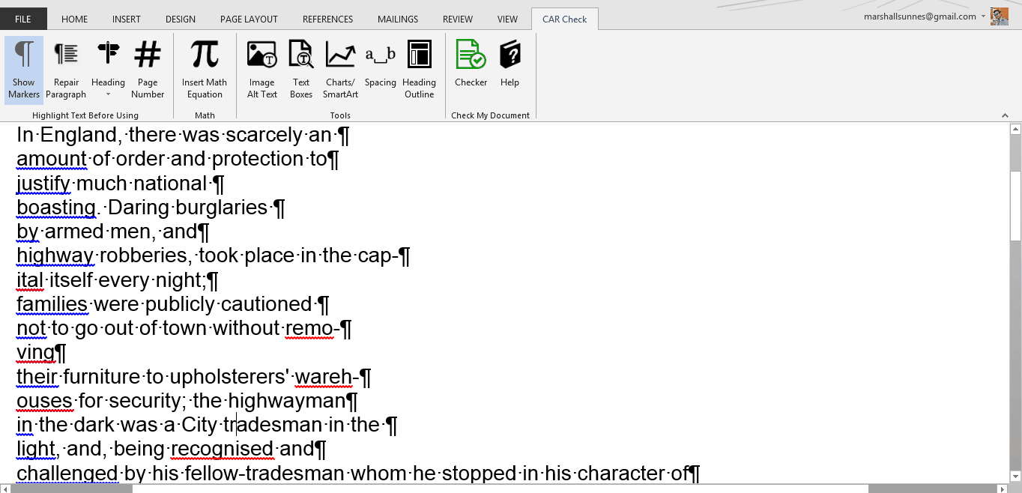
Repair Paragraph

Slide 24
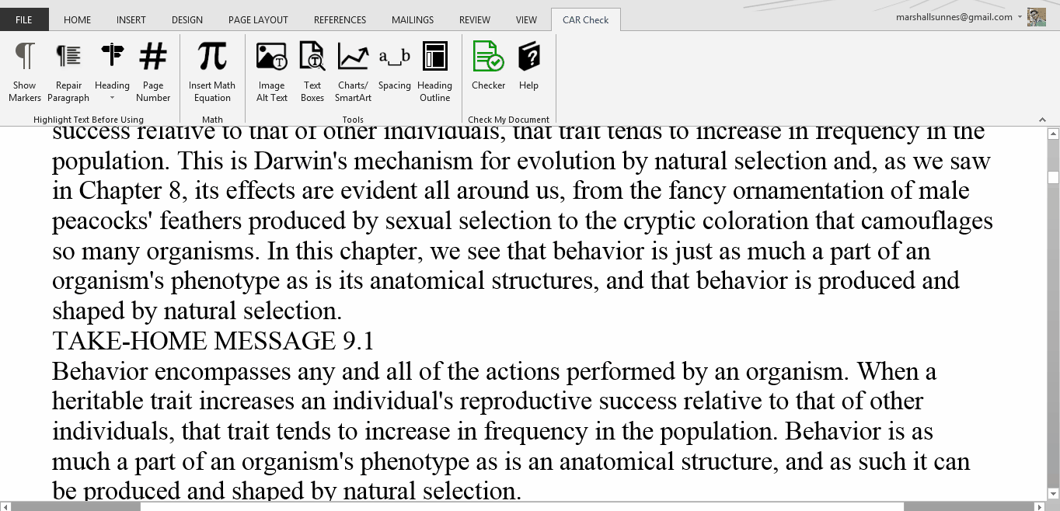
Mark Headings Easily

Slide 25
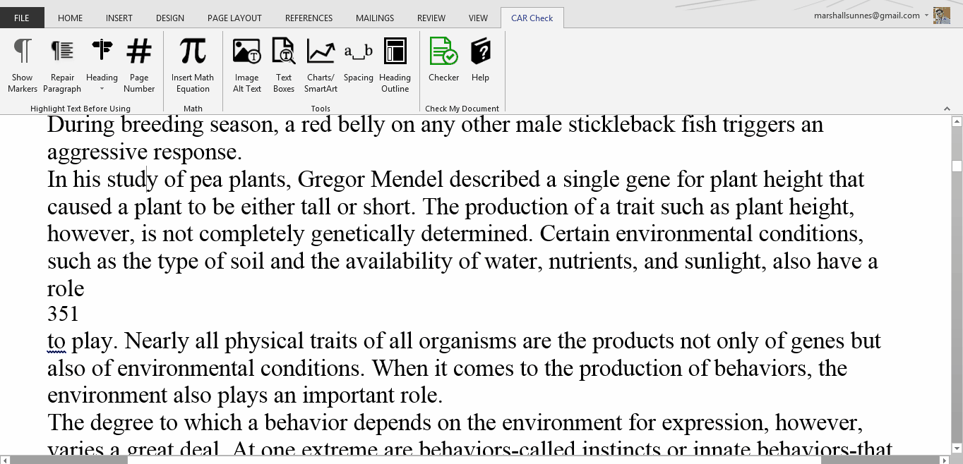
Mark Pages Easily

Slide 26
Central Access Toolbar
Add-in for Windows Word
Made Alt-Media Labs in Mind
HUGE Processing Time-Saver
Tools & Reference in One

Slide 27
DEMO

Slide 28
Central Access Reader (CAR) | CAR Check | Central Acccess Toolbar
FREE Mac + PC Central Access Website | FREE BETA Windows Word Central Access Website | Invitation Only BETA Windows Word Contact Central Access

Slide 29
Want to BETA test CAT?
centralaccess@cwu.edu

