Slide 1
Math Accessibility on the Web: A Journey of Wailing and Gnashing of Teeth
Greg Kraus
University IT Accessibility Coordinator
North Carolina State University
@gdkraus

Slide 2
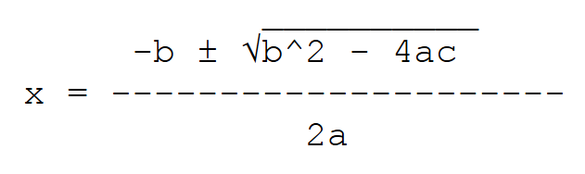

When I was your age…
ASCII Math

Slide 3
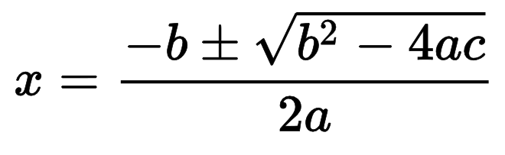
Pictures of Math
alt=???

Slide 4
Alternative Text for Math
alt = “fraction minus bee plus minus. square root of bee squared minus 4 ay c, end root over, 2 ay, end fraction”

Slide 5
MathPlayer
Requires Internet Explorer 9
Lets users interact with and explore mathematical expressions

Slide 6
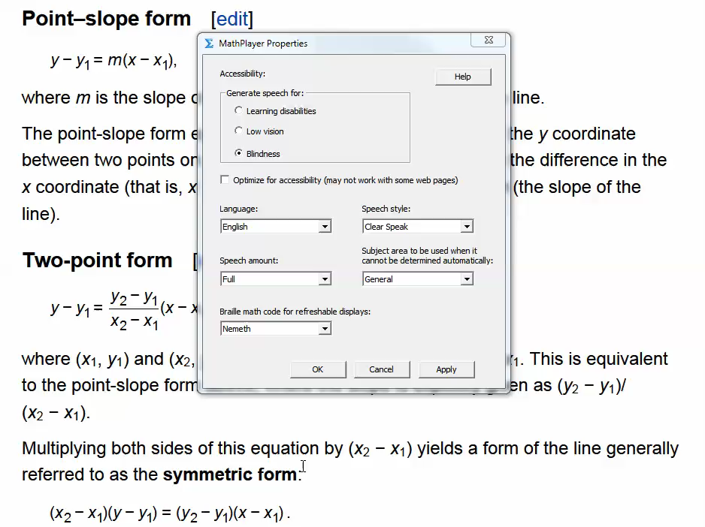

Slide 7
How to Write Math
MathML
  Standard language of the Web
  Most people don’t write straight MathML
LaTeX
  Specialized format which requires JavaScript libraries to render correctly
  Many people already know how to write TeX
MathType

Slide 8
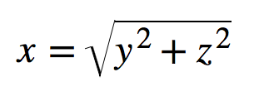
MathML
<math>
<mrow>
<mi>x</mi><mo>=</mo>
<msqrt>
<mrow>
<msup>
<mi>y</mi>
<mn>2</mn>
</msup>
<mo>+</mo>
<msup>
<mi>z</mi>
<mn>2</mn>
</msup>
</mrow>
</msqrt>
</mrow>
</math>

Slide 9
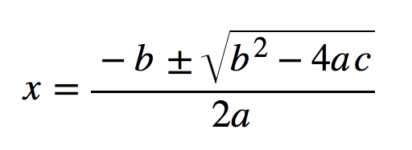
MathML (Quadratic)
<mrow>
<mi>x</mi>
<mo>=</mo>
<mfrac>
<mrow>
<mrow>
<mo>-</mo>
<mi>b</mi>
</mrow>
<mo>&PlusMinus;</mo>
<msqrt>
<mrow>
<msup>
<mi>b</mi>
<mn>2</mn>
</msup>
<mo>-</mo>
<mrow>
<mn>4</mn>
<mo>&InvisibleTimes;</mo>
<mi>a</mi>
<mo>&InvisibleTimes;</mo>
<mi>c</mi>
</mrow>
</mrow>
</msqrt>
</mrow>
<mrow>
<mn>2</mn>
<mo>&InvisibleTimes;</mo>
<mi>a</mi>
</mrow>
</mfrac>
</mrow>

Slide 10


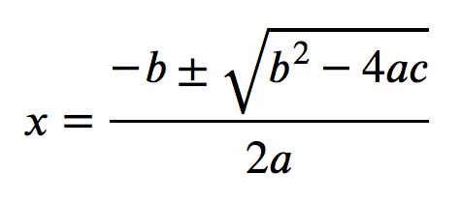

MathML Support in Browsers
Safari (v.7)
Chrome (v.38)
Internet Explorer (v.11)
Firefox (v.33)
Opera (v.25)

Slide 11
Which MathML?
Presentation MathML
Content MathML
  Very little support for this format
Notes:
http://cnx.org/contents/064e85de-6ba2-43ab-bbd0-fd7daf5a6c34@1/Presentation_MathML_Versus_Con
http://docs.mathjax.org/en/latest/mathml.html#content-mathml

Slide 12
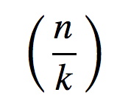
Presentation MathML (fraction)
<mrow>
<mo>(</mo>
<mrow>
<mfrac linethickness=“medium">
<mi>n</mi>
<mi>k</mi>
</mfrac>
</mrow>
<mo>)</mo>
</mrow>

Slide 13
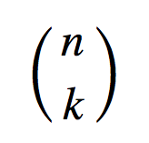
Presentation MathML (binomial coefficient)
<mrow>
<mo>(</mo>
<mrow>
<mfrac linethickness="0">
<mi>n</mi>
<mi>k</mi>
</mfrac>
</mrow>
<mo>)</mo>
</mrow>

Slide 14
Presentation vs. Content MathML
Presentation
<mrow>
<msup>
<mi>b</mi>
<mn>2</mn>
</msup>
<mo>&#x2212;</mo>
<mn>4</mn>
<mi>a</mi>
<mi>c</mi>
</mrow>
Content
<apply>
<minus/>
<apply>
<power/>
<ci>b</ci>
<cn>2</cn>
</apply>
<apply>
<times/>
<cn>4</cn>
<ci>a</ci>
<ci>c</ci>
</apply>
</apply>

Slide 15
Content MathML with Multiple Expressions
Content
Presentation (variation 1)
Presentation (variation 2)
Presentation (variation 3)

Slide 16
f(x)
Function of x?
F times x?

Slide 17
3cm²
3 centimeters squared?
3 times c times m squared?

Slide 18
LaTeX
    \[x = \frac{{ - b \pm \sqrt {{b^2} - 4ac} }}{{2a}}\]
      \[ \] delimiters
    What LaTeX looks like in browsers?
    \[x = \frac{{ - b \pm \sqrt {{b^2} - 4ac} }}{{2a}}\]

Slide 19
MathJax
Draws math on Web pages
  http://www.mathjax.org/
Accepts multiple math input formats
  MathML
  LaTeX (TeX)
    \[x = \frac{{ - b \pm \sqrt {{b^2} - 4ac} }}{{2a}}\]

Slide 20
Adding MathJax to a Web Page
<script type="text/javascript”
src="http://cdn.mathjax.org/mathjax/latest/MathJax.js? config=TeX-AMS-MML_HTMLorMML">
</script>

Slide 21
MathType
Software to graphically create math and convert to multiple formats
  Similar functionality to MC Office equation editor
  http://www.dessci.com/en/products/mathtype/
Can convert from LaTeX to MathML
  Preferences: Workspace Preferences: Allow TeX language entry from keyboard
Can export to a variety of formats
  Preferences: Cut and Copy Preferences

Slide 22
Technology Demonstrations
iOS with VoiceOver
Safari with VoiceOver
Chrome with ChromeVox
Internet Explorer with JAWS 16
Internet Explorer with JAWS, MathJax, and MathPlayer

Slide 23
Browser and AT Support
Platform | Display MathML | Interact MathML | Display MathJax | Interact MathJax | Notes
IE 9, JAWS | No | No | Yes | Yes | Needs MathPlayer
IE 11, JAWS 16 | No | No | Yes | Yes | Potential bugs still, and requires MathJax
NVDA, FF | Yes | No | Yes | No | Some development work occurring
Safari 10.9, VO | Yes | Yes | Yes | No | MathJax causes VO to read math incorrectly. Potentially buggy as well
iOS 8.1, VO | Yes | Yes | Yes | No | MathJax causes VO to read math incorrectly. Seems more accurate than desktop version
Chrome 38, CV 40 | No | Partial | Yes | Partial | Chrome does not understand some MathML elements. CV reading speed is slow

Slide 24
KaTeX
Kahn Academy
Faster rendering than MathJax
  “turbocharging inaccessibility”
  (No accessibility support)
https://github.com/Khan/KaTeX

Slide 25
MathML
Advantage
  The language of the Web
Disadvantages
  No one writes in MathML
  Not all browsers can display it
  Only one browser and screen reader supports it

Slide 26
MathJax
Advantages
  Displays correctly in any browser
  Allows you to write in LaTeX (TeX)
  More AT support (often via MathPlayer)
Disadvantage
  Breaks accessibility support in Safari

Slide 27
Summary
MathPlayer in IE is fundamentally broken (because of change in architecture of IE)
Safari and VO with plain MathML does a good job
  MathJax messes up Safari and VO
IE and JAWS 16 is starting to do a good job with MathML or LaTeX
  But this always requires MathJax
Chrome and CV has some support
  Requires MathJax

Slide 28
So what to do?
Personally…
  70% leaning toward MathJax
  30% leaning toward MathML
Browser sniffing for Safari?

