Slide 1
360 degrees:
Approaching Accessibility in Math from all sides
Wink Harner, Moderator
Co-Presenters:
Greg Kraus University IT Accessibility Coordinator, North Carolina State University
Todd Schwanke McBurney Disability Resource Center, University of Wisconsin – Madison
Wink Harner Assistive Technology Specialist, Southern Oregon University
Sean Keegan Associate Director, Assistive Technology, Stanford University
Marshall Sunnes Coordinator, Central Access, Disability Services Central Washington University
Wendy Holden Disability & Accessibility Consultant, Disability Services, Central Washington University

Slide 2
AN OVERVIEW - MORNING
Introduction
1. Greg Kraus – North Carolina State University
“making content accessible proactively using
MathJax,” using NVDA and MATH PLAYER, an overview of
“In a perfect world…”
2. Todd Schwanke – University of Wisconsin, Madison
“Nemeth Braille: an overview of workflows,
strategies, tools, resources, & future
developments”
Break
3. Wink Harner - Southern Oregon University
“MATH TALK with SCIENTIFIC NOTEBOOK & DRAGON
NATURALLYSPEAKING” using dictation software as math input
and exporting to MATHML, LATEX, HTML and NEMETH
BRAILLE
LUNCH – 12:00 – 1:30

Slide 3
AN OVERVIEW - AFTERNOON
4. Sean Keegan – Stanford University
“Alternate Format Production for STEM
Content with Infty Reader”
bReak
5. Marshall Sunnes & Wendy Holden – Central Washington
University
“CENTRAL ACCESS READER & TOOLBAR – Text-
to-Speech screen reading for math”
Q & A 3:45 – 4:30 by presenter panel

Slide 4
making content accessible proactively using MathJax
Greg Kraus – North Carolina State University
- Math formats on the Web
- Challenges with the formats
- Making the formats work with assistive
technologies
- Focus on making content accessible
proactively using MathJax.
- Demonstration of how to use MathJax.
MathJax is an open source Javascript display engine for math that works in all browsers.
http://www.mathjax.org/

Slide 5
using MathJax
Learn about the landscape of accessible math on the Web, including browser support, and how to author math to leverage MathJax and what implementation issues still need to be considered.
MathJax provides a way to more easily publish accessible math on the Web while utilizing common math standards such as MathML, TeX, and LaTeX.

Slide 6
Workflows, Strategies, Tools & Resources in Nemeth Braille Production
Todd Schwanke - University of Wisconsin, Madison
Introduction to Nemeth Braille
Considering challenges in Nemeth Braille production and higher education instruction
Creating structured math and preparing for the possibility of creating Braille
Planning timelines and workflows to match courses
Tools, resources, and strategies for production
Tools, resources, and strategies for students

Slide 7
MATH TALK with SCIENTIFIC NOTEBOOK & DRAGON NATURALLYSPEAKING
Wink Harner - Southern Oregon University
Introduction & demo of Math Talk w/Scientific Notebook using Dragon NaturallySpeaking to dictate math.
For use in the Windows environment using Dragon NaturallySpeaking 12.0 & up
Includes:
pre-Algebra Algebra
Trigonometry Calculus
Statistics Graphing

Slide 8
MATH TALK with SCIENTIFIC NOTEBOOK & DRAGON NATURALLYSPEAKING
Input via dictation and
Export to:
MathML
HTML
TEX & LaTeX
Transcribe to Nemeth Braille
Demonstrates usability for those unable to manipulate a mouse or keyboard, as well as for certain writing disabilities such as dyscalculia.
Quicker input via dictation for alt text production

Slide 9
Alternate Format Production for STEM Content with Infty Reader
Sean Keegan – Stanford University
Infty Reader:
  is an OCR program for math
  requires specific steps and file parameters for accurate conversion
  may not always be the best production tool for converting STEM materials
  is designed for production purposes
  Other Infty tools may provide alternate solutions for students to interact with math

Slide 10
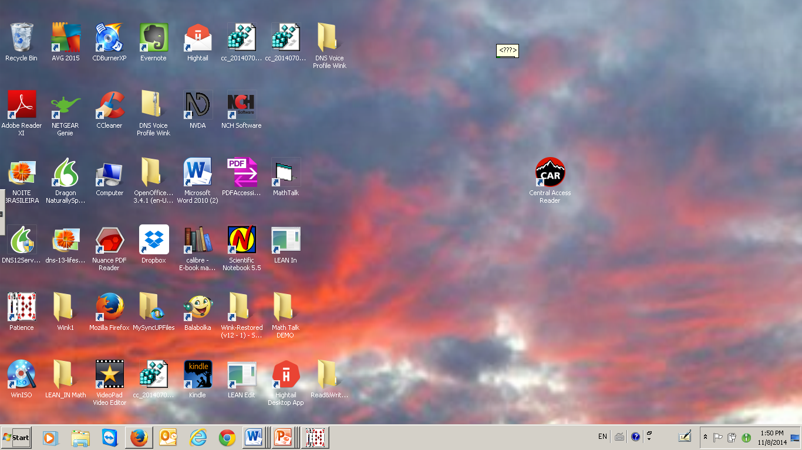
Preparing and Accessing STEM Materials with CAR & CAT
Wendy Holden & Marshall Sunnes
Central Washington University
Central Access Toolbar (CAT) greatly reduces processing time for STEM alternative media.
- transforms materials from INFTY into
manageable projects
- provides powerful custom tools to mark
documents quickly
- prepares documents for other formats:
Braille, DAISY, Large Print, etc.

Slide 11
Preparing and Accessing STEM Materials with CAR & CAT
Central Access Reader (CAR) is a powerful STEM content reader (text-to-speech)
- Access math content in CAR directly
- Export to MP3 or HTML
- Math reading is fully customizable

Slide 12
Q & A
Panel of presenters will field questions from both on-site and virtual audiences

