Slide 1
Meeting Everyone’s Needs:
Redesigning an
Online Introduction to Accessibility Course for Faculty

Slide 2
TODAY’S SESSION
Amy Netzel
Accessibility Technologist
Wake Tech CC
Serena Reavis
Instructional Technology Specialist
NC State U
SESSION DESCRIPTION
This presentation will provide an overview of the redesign of Wake Technical Community College's online accessibility course for faculty. The redesign address challenges raised in the initial course and reflects a switch to usability-focused design.

Slide 3
Session Overview
Wake Tech’s introduction to accessibility
Training results and faculty feedback
Redesigning the faculty experience

Slide 4

Poll One
What is an instructor’s role in terms of accessibility?
https://www.polleverywhere.com/free_text_polls/RLo4ezeSzUk90CH/web

Slide 5

Slide displaying image of Wake Tech’s logo
Notes:
Wake Tech’s story: Accessibility Initiative developed by administrator out of worry of suit. Initial process developed with input from two major people--not instructors. These people decided that faculty members were the main line of defense in accessibility and should be responsible for ensuring accessibility in classes.

Slide 6

Faculty members have direct access to students

Slide 7
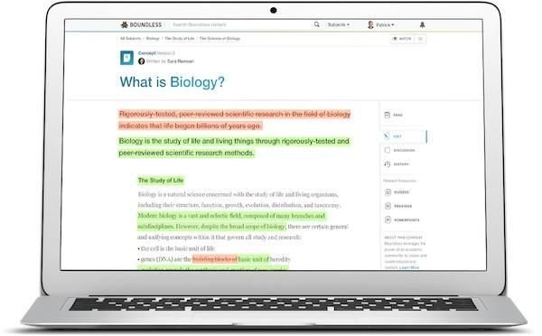
Faculty members design the content

Slide 8

Faculty members must make everything accessible

Slide 9
Overview of Training Course
Six lessons covering:
  Fundamentals
  Documents
  Presentations
  Multimedia
  Course Design
  Course Assessment
A timed final assessment that had to be passed with at least 70%

Slide 10
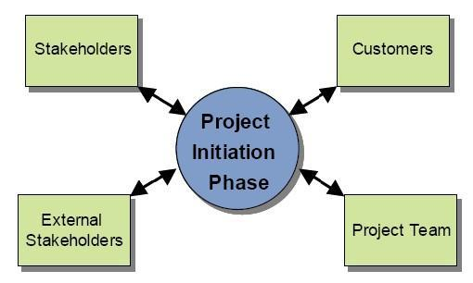
Limitations of Development Process
Notes:
Stakeholders were eventually included, instructors and department heads, in an accessibility committee. The Project Team was given from May-July to create an online course for all faculty members. Faculty Members were required to take and pass the class to continue to teach.

Slide 11
Poll Two
Which of these could you do?
https://www.polleverywhere.com/multiple_choice_polls/GTT1dNoCUYcCXQg/web

Slide 12
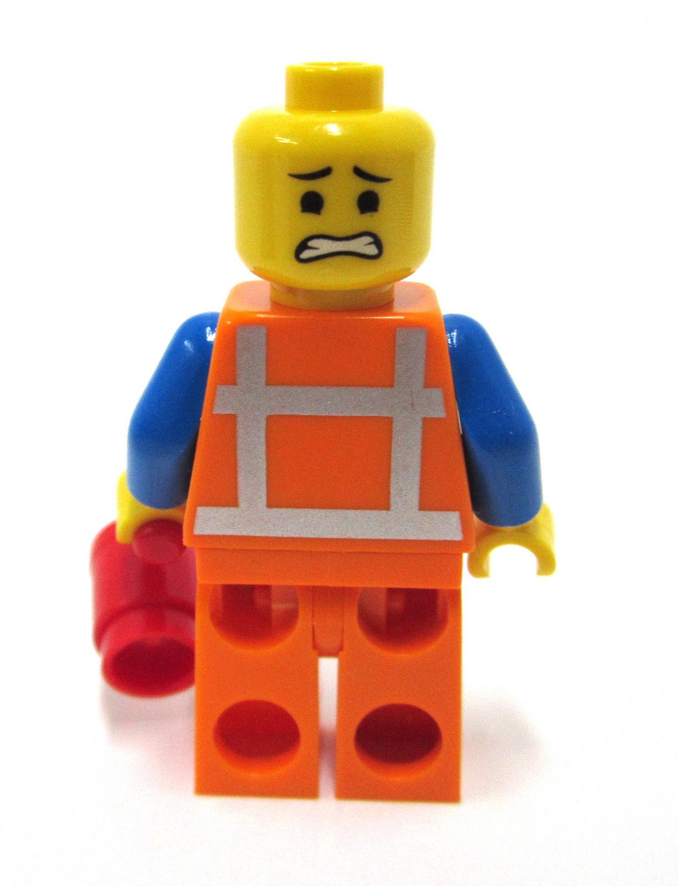
Results: Faculty feel overwhelmed
Notes:
Faculty members resented having the course requirement, were confused about the timeline, in many cases did not know exactly how to change materials, or felt overwhelmed. We saw resistance.

Slide 13
Initial Course Feedback--The Numbers
Question Text | Percentage of yes responses
Question #3: Do you have a better understanding of the fundamental principles and practices of accessibility? | 76.636
Question #4: Do you have a better understanding of applying fundamental accessibility principles and practices to evaluate and create accessible course materials? | 73.832
Notes:
With just over 100 people in this initial course, we have around 25 people that do not feel like they have an improved understanding of or ability to apply basic accessibility principles.

Slide 14
Initial Course Feedback: The Comments
“...too much information…section was confusing...was like learning a new language...time consuming...timed test difficult...I have never taken an online course before...I want to make my course accessible but do not know if I will remember how…”
Notes:
Some of the course did not seem practical.
There is a tremendous amount of information-too much to cover and too much to remember.
Simplify.
The real "human element" of working with students with disabilities was barely addressed.
I would surmise that the major problems that have resulted in law suits over inaccessibility boil down to a sensitivity/respect/responsibility issue.

Slide 15
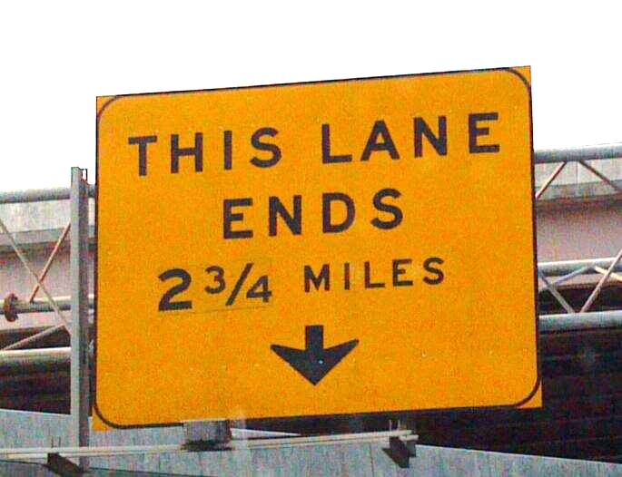
Change Process
Notes:
At the beginning of the 2013-14 school year, a significant change in personnel opened up new possibilities to redesign the course.

Slide 16
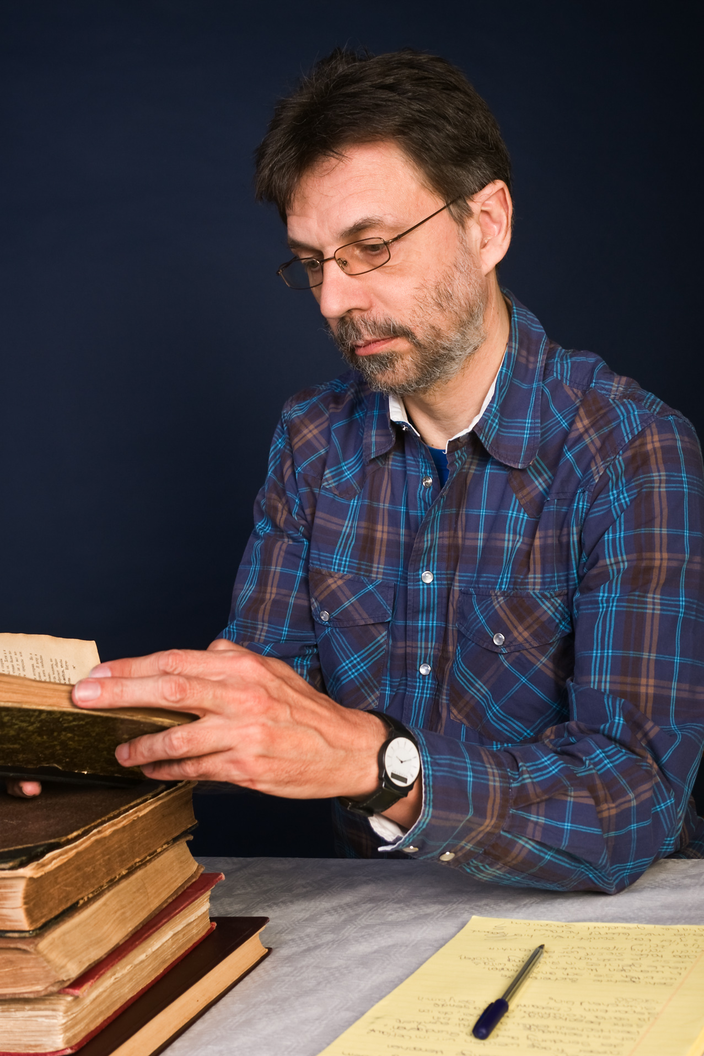


Adhering to Flow of Knowledge
Faculty
  SME
  Basic accessibility knowledge
  Aware of resources
Trainers
  Technical prowess
  Incrementally teach complex ideas
Specialists
  Keep abreast of changes in field
  Disseminates information
  Resource to faculty
Notes:
Culture shift, how to make this attainable for faculty
Faculty = SME, participate in conversations about UDL, accessibility
DSS staff can be trainers/specialists

Slide 17
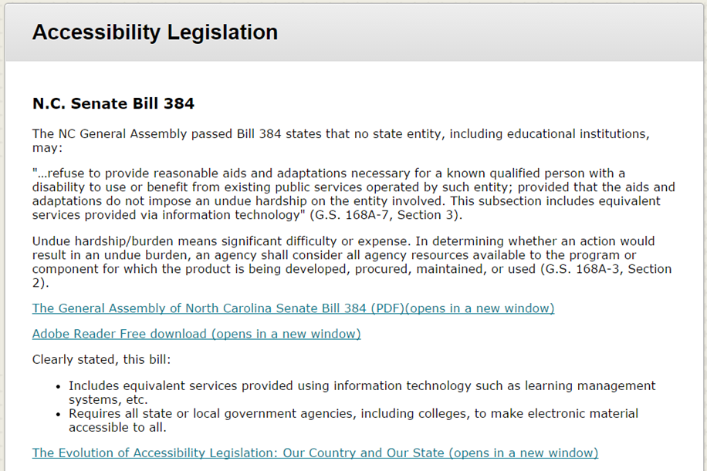
Change I: Eliminating the Legal Focus
Notes:
Focus should be on what’s best for students (human focus)
Original development based on fear of litigation
Research on stress reducing level of production (squashing creativity, etc.)
Including Bills/Legal evidence would reduce faculty pushback (unnecessary information)

Slide 18
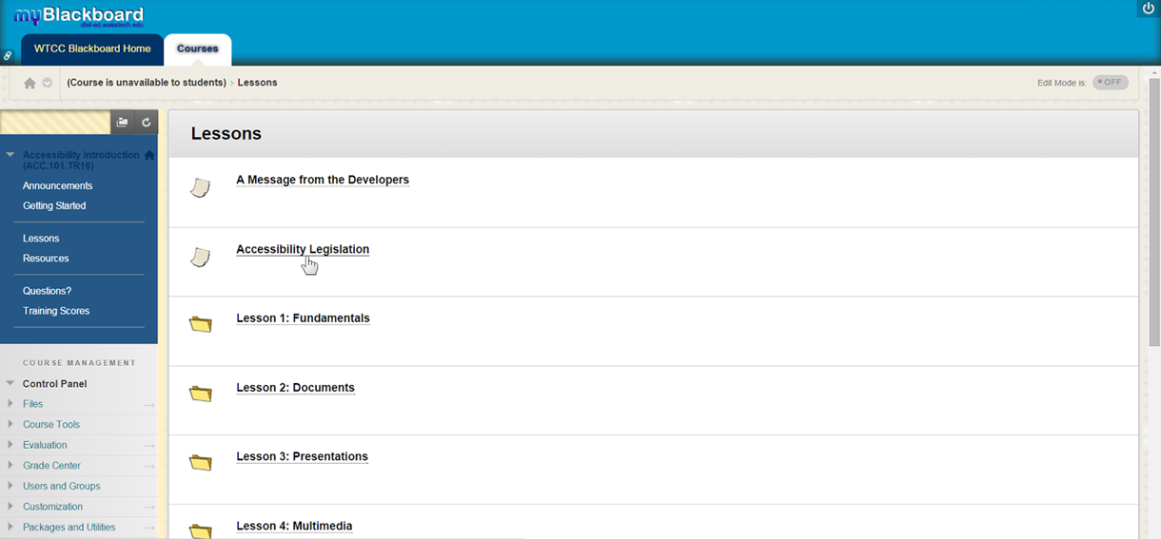
Change II: Reducing Information Overload

Slide 19
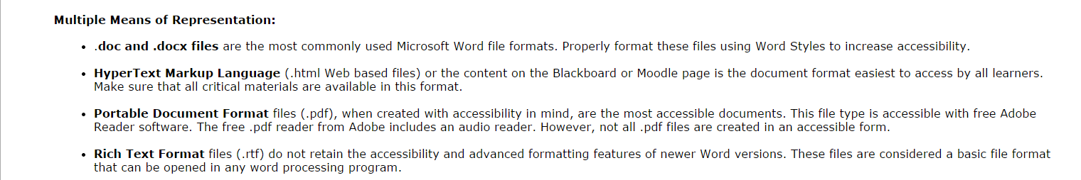
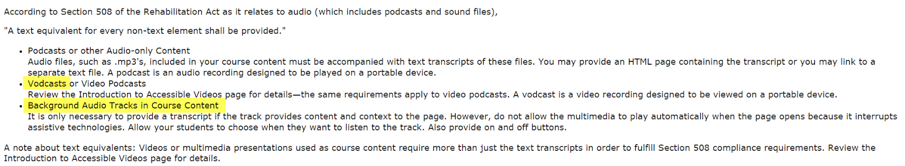
Reducing Overly Technical Language
Notes:
Reframing content by category (i.e., learn about headings and how to apply them to several content creation tools)

Slide 20
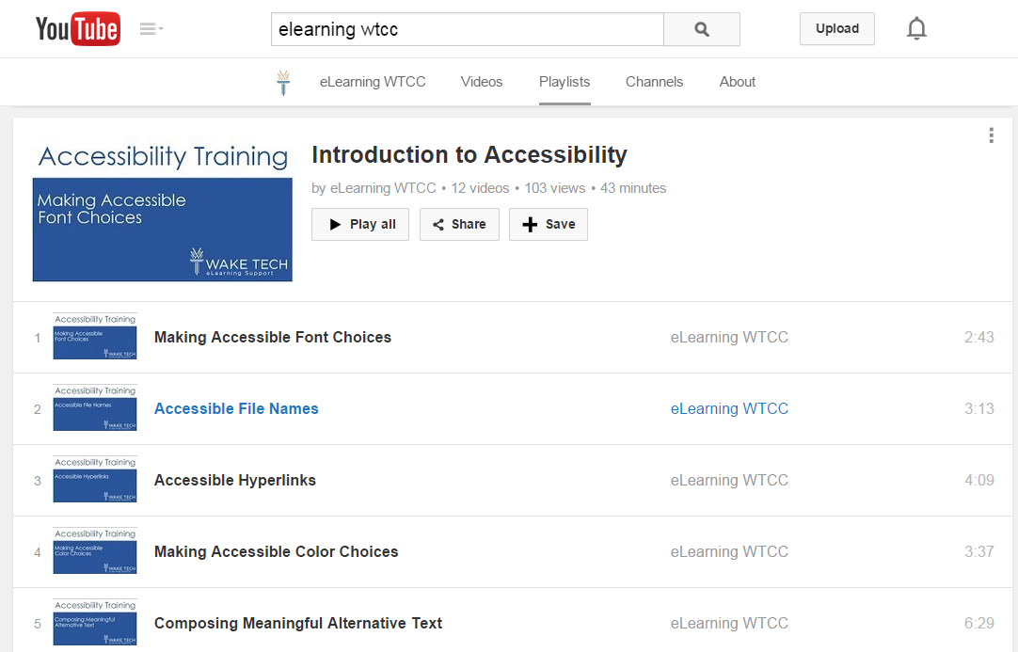
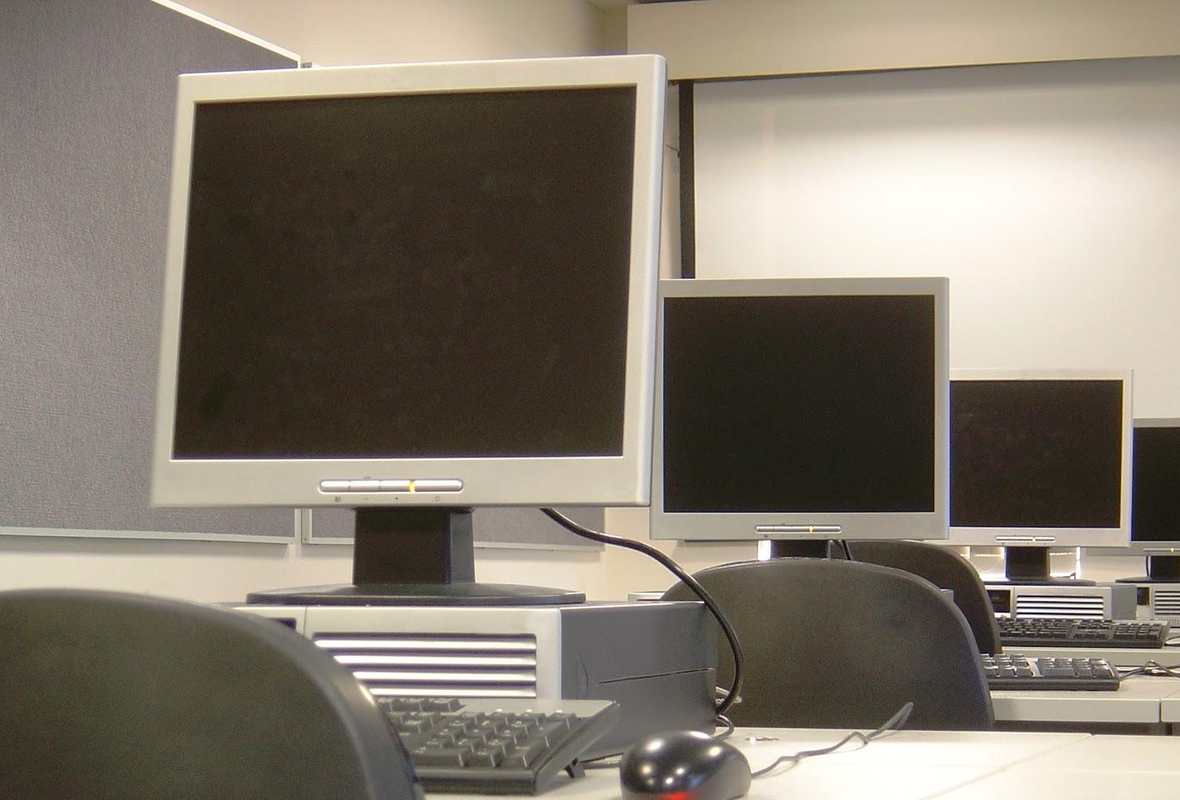
Change III: Incorporating UDL
Notes:
Included a series of screencasts in the course and held seated lab sessions to coincide with online training. These were ways to offer multiple means of representation through options for perception.
As a team, we discussed a couple of options that ultimately did not make it into the redesign (yet) due to limited staffing and the availability of other accessibility trainings.
These ideas included allowing faculty to take the assessment prior to starting the course to allow them the opportunity to test out (they would need to speak with the Accessibility Technologist to discuss incorrect answers). Problem: thought that the number of participants signing up for pretest would be too overwhelming for one or two people to monitor.
Second idea was to have participants complete brief assignments within each module. This was ultimately left out because there are other trainings available that go in depth and are beneficial as stand-alone sessions.
These two ideas would have incorporated additional means of engagement through options for sustaining effort and persistence. They remain a goal.

Slide 21
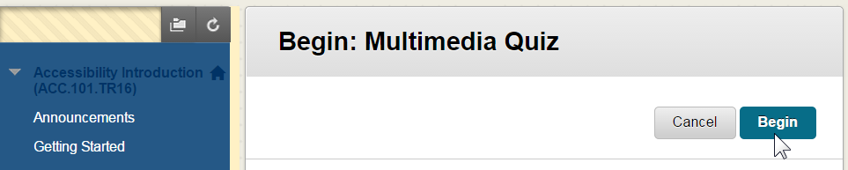
Change IV: Redesigning the Assessment
Notes:
Many of the test questions either referenced specific details buried deep in the instructional content or asked participants to choose the correct procedure for an accessibility “skill.”
Demonstration questions are from the final assessment. If faculty did not pass, they were going to be restricted from teaching online.

Slide 22
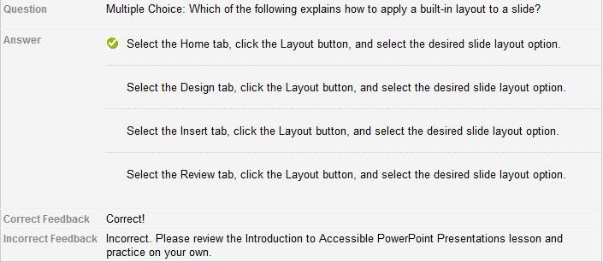
Sample I
Notes:
Redesign eliminated procedural questions (assesses rote memory, not ability to create structure in a presentation)

Slide 23
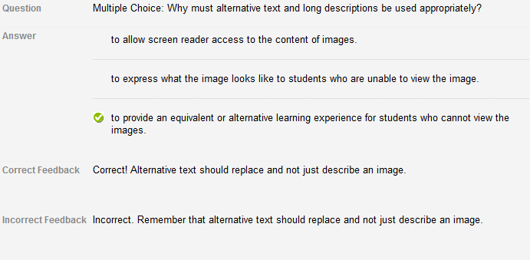
Sample II
Notes:
Audience: What do you think the question was assessing?
If goal of intro course was to give an overview of accessibility, question answers like these came across as a little tricky. Participants were asked to think about fine details of topic (seems like several choices were correct)

Slide 24
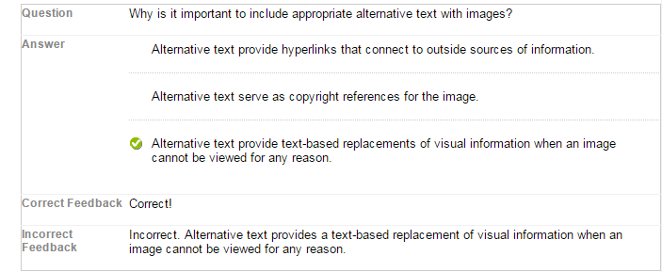
Revision II

Slide 25
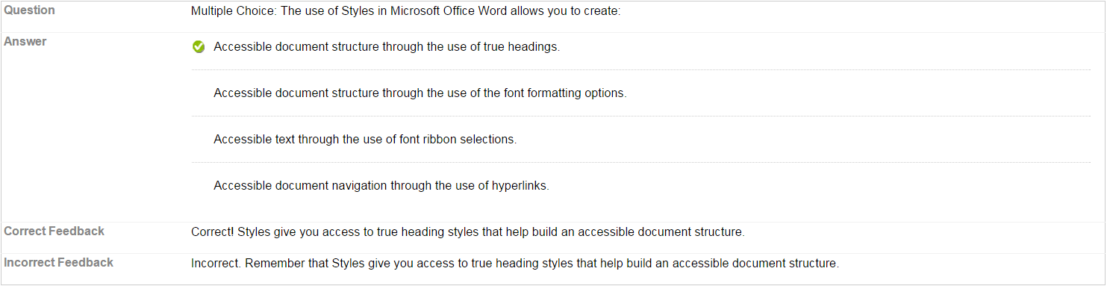
Sample III

Slide 26
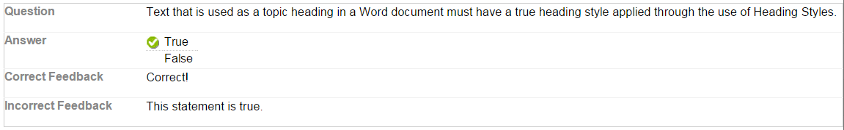
Revision III
Notes:
Through revision, questions assessed knowledge of basic accessibility. More (in-depth) training on specific procedures and how to create accessible content has been developed (i.e., Applying Headings in Word, Creating Accessible PowerPoint Presentations).

Slide 27
Post-revision Feedback--The Numbers
Question Text | Original Course | Redesigned Course
Question #3: Do you have a better understanding of the fundamental principles and practices of accessibility? | 76.636 | 100
Question #4: Do you have a better understanding of applying fundamental accessibility principles and practices to evaluate and create accessible course materials? | 73.832 | 100
Notes:
Confidence with material and concept of accessibility

Slide 28
Updated Course Feedback: The Comments
“Nothing... being a busy instructor, I truly appreciated the self paced nature of the course so that I could get the necessary information on accessibility and not fall behind in my own teaching.”
“When you take the quizzes or final exam and you get a question wrong, offer a different explanation of why the answer is the correct answer.”
“I think the training is fine. I liked how easy it was to follow.”
Notes:
Responses to “What would you want to change?”
Comparison to earlier comments (difference in what people were walking away from the course with - the overall experience)
Still a work in progress (assessment feedback, high level change)!

Slide 29
Quote
“Accessibility...is the ability of the learning environment to adjust to the needs of
all learners”
(Seale, 2014, pg. 9).
Notes:
UDL:

Slide 30
Who Holds the Responsibility for:
training faculty on accessibility?
captioning videos?
accessible digital content (Word, PPT, etc.)?
self-advocacy of disability?
classroom climate?
awareness of accessibility laws?

Slide 31

Discussion

Slide 32
Contact us
Serena Reavis
sreavis@ncsu.edu
Amy Netzel
abnetzel@waketech.edu

