Slide 1
Able Player:
A Fully Accessible Media Player
Terrill Thompson, University of Washington
Ken Petri, The Ohio State University
These slides: goo.gl/D9ZG9t

Slide 2
Media Players Then
<object id="mediaPlayer1" width="180" height="50" classid="CLSID:22d6f312-b0f6-11d0-94ab-0080c74c7e95" codebase=http://activex.microsoft.com/activex/controls/mplayer/en/nsmp2inf.cab#Version=5,1,52,701 type="application/x-oleobject" standby="Loading Microsoft Windows Media Player components..." > <param name="fileName" value="take5.wmv"> <param name="animationatStart" value="true"> <param name="transparentatStart" value="true"> <param name="autoStart" value="false"> <param name="showControls" value="true"> <param name ="ShowAudioControls"value="true"> <param name="ShowStatusBar" value="true"> <param name="loop" value="false"> <embed type="application/x-mplayer2" pluginspage="http://microsoft.com/windows/mediaplayer/en/download/" id="mediaPlayer" name="mediaPlayer" displaysize="4" autosize="-1" bgcolor="darkblue" showcontrols="true" showtracker="-1" showdisplay="0" showstatusbar="-1" videoborder3d="-1" width="420" height="380" src="take5.wmv" autostart="false" loop="false"> </embed> </object>

Slide 3
Media Players Now
<audio src="myaudio.mp3" controls>
</audio>

Slide 4
Your browser doesn't support MP3?
<audio controls>
<source src="myaudio.mp3">
<source src="myaudio.ogg">
</audio>

Slide 5
Your browser doesn't support HTML5 <audio>?
<audio controls>
<source src="myaudio.mp3">
<source src="myaudio.ogg">
<!-- fallback content goes here -->
</audio>

Slide 6
The Same Code Works for Video
<video controls>
<source src="myvideo.mp4">
<source src="myvideo.ogv">
<!-- fallback content goes here -->
</video>

Slide 7
Can't hear the audio?
<video controls>
<source src="myvideo.mp4">
<source src="myvideo.webm">
<track kind="captions" src="mycaps.vtt">
<!-- fallback content goes here -->
</video>

Slide 8
WebVTT Format
Stands for "Web Video Text Tracks"
http://dev.w3.org/html5/webvtt
WEBVTT
00:00:09.165 --> 00:00:10.792
You want these people.
00:00:10.792 --> 00:00:13.759
They order your products, sign up for your services,
00:00:13.759 --> 00:00:16.627
enroll in your classes, read your opinions,
00:00:16.627 --> 00:00:18.561
and watch your videos.

Slide 9
Can't see the visual content?
<video controls>
<source src="myvideo.mp4">
<source src="myvideo.webm">
<track kind="captions" src="mycaps.vtt">
<track kind="descriptions" src="mydesc.vtt">
<!-- fallback content goes here -->
</video>

Slide 10
HTML5 Media Rocks A11y!

Slide 11
But the players all look different

Slide 12
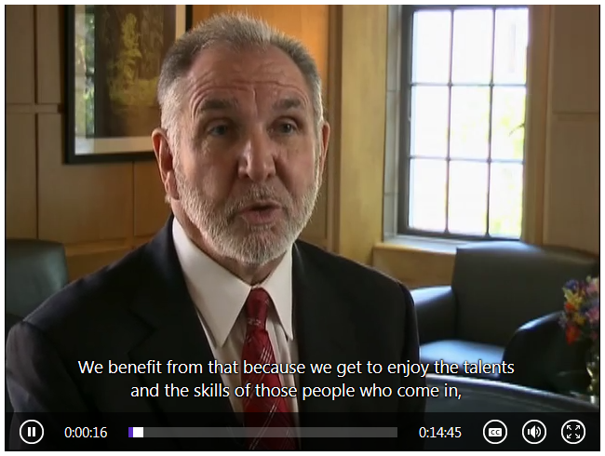
And some are more accessible than others

Slide 13
Comparing Player Accessibility
W3C Media Accessibility User Requirements
Media Player Accessibility Comparison Matrix

Slide 14
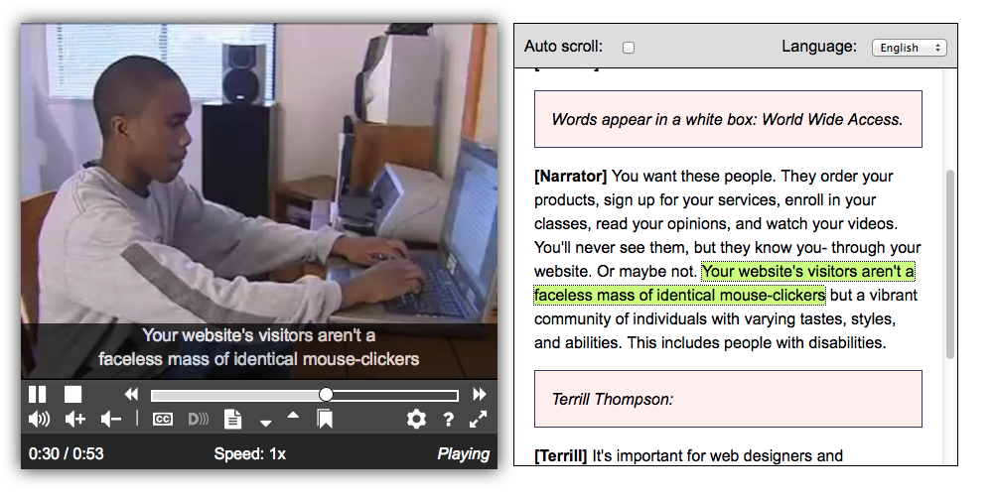
Introducing Able Player 2.0
http://ableplayer.github.io/ableplayer

